Slide 1
WEB COMPUTATIONAL BIOLOGY TRAINING

Slide 2
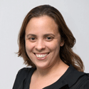
Today’s Instructor
Bioinformatics and Computational Biosciences Branch (BCBB), NIAID
National Institutes of Health, Bethesda, MD USA.
Contact our team via email:
Email: ace@icermali.org
Listserv: ACE-MALI-L@LIST.NIH.GOV
Instructor: mariam.quinones@nih.gov
Dr. Mariam Quiñones,
Ph.D. in Molecular Microbiology
Ongoing Computational Biology projects:
16S microbiome/WGS
Parasite strain evolution

Slide 3
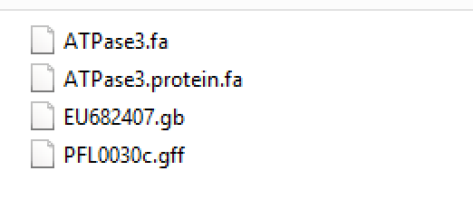
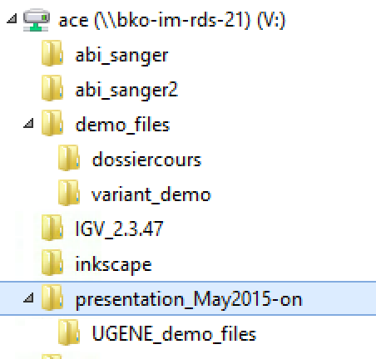
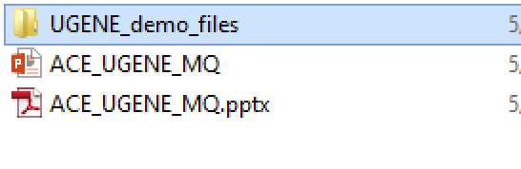
Class Materials
Temporary location:
File directory: \\bko-im-rds-21

