Slide 1
Introduction to the Unix shell
Jackie Milhans
NUIT Research Computing

Slide 2
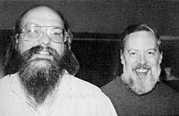


Unix Operating Systems
Developed in the 60’s at Bell Labs
Linux was first released in 1991
Ken Thompson & Dennis Ritchie
Linus Torvalds

Slide 3
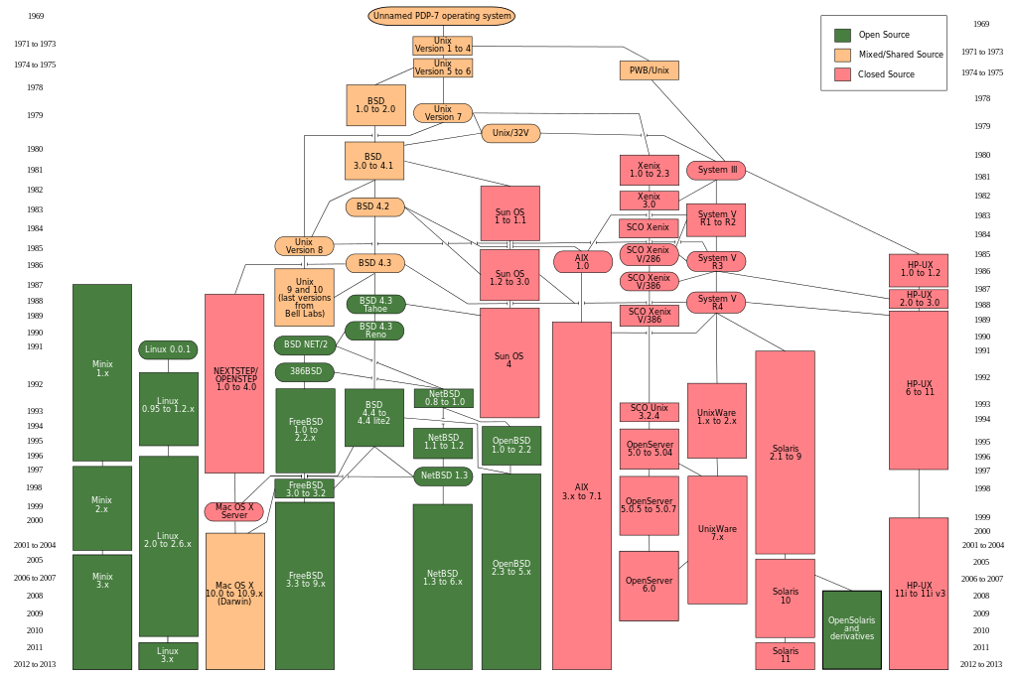
Unix OS
"Unix history-simple" by Eraserhead1, Infinity0, Sav_vas

Slide 4
Unix OS
Very stable (no “blue screen of death”)
In continuous development
Flexible
Multi-user & multi-tasking

Slide 5


Unix architecture
User
Operating System
Applications
Utilities
Operating System
Shell
Device Drivers
Kernel
System Software
Computer Hardware

Slide 6
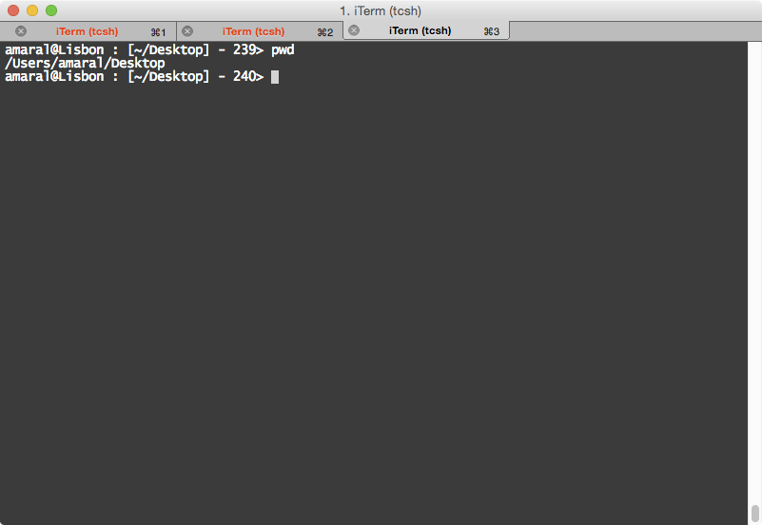
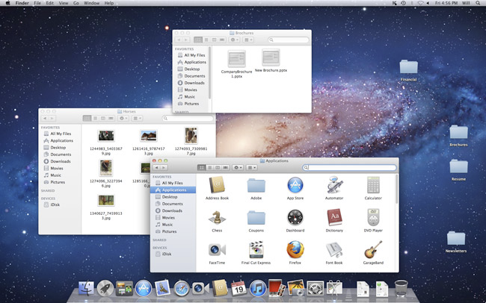
Command line interface (CLI)
To access the Unix shell:
Mac OS: open a terminal application
Linux: open a terminal
Windows: use Putty or X-Win32
GUI

Slide 7
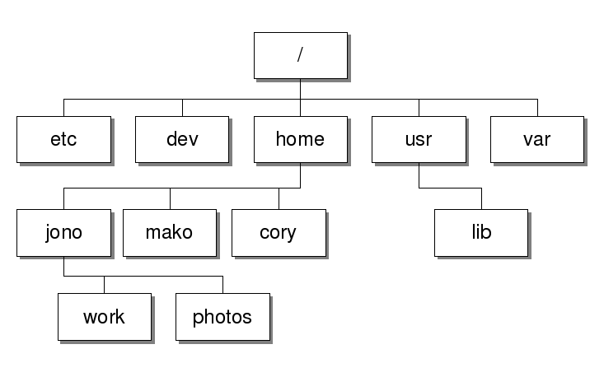
Understanding paths
Absolute Path:
/home/jono/
Relative Paths: Getting to jono from…
/usr/lib ~jono/
/home/jono/ ./
/home/cory/ ../jono/
/home/jono/work/ ../

Slide 8
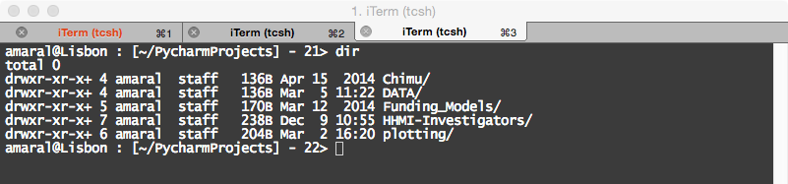
Understanding file systems
The file system specifies how data is stored and accessed in a computer storage device (such as a hard disk).
The file system has two classes of components:
inodes (which contain file attributes)
data blocks (where data is actually stored)
Different file systems store different file attributes.

Slide 9

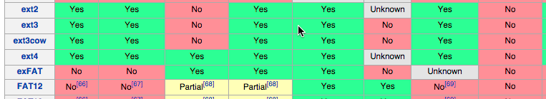
Understanding file systems
Earlier file systems had significant restrictions on:
length of file name,
length of path name,
allowable characters in names,
file size,
volume size.

Slide 10
Ownership and permissions
Ownership
owner group others
amaral staff
Permissions
read write execute
4 2 1

Slide 11
At the shell/command prompt
command –options arguments

Slide 12
Ownership and permissions
Goal | Command | Meaning
Change owner | chown owner file_name
Change group | chgrp group file_name
Change permissions | chmod ugo+rwx file_name | Change (access) mode
Create file Change file access time | touch file_name

Slide 13
Wildcards and other speedups
Key | Meaning
. or ./ | Current folder
.. or ../ | Parent folder
~ or ~/ | User’s home folder
* | Arbitrary symbols in any order and any length
? | Any single character
[0-3] | Single character in set [0, 1, 2, 3]
< | Direct input to command
> | Direct output to file and rewrite
>> | Direct output to file and append
| | Pipe output of one command into another
(tab) | Completes typing of command or path

Slide 14
Navigating and editing the tree
Goal | Command | Comments
Check where you are | pwd | ‘Print working directory’
List contents of folder | ls –alt… path | ‘List’ -a all -l long list format -F classify -G no-group info -h human-readable -t sort by modification date
Change location | cd path | ‘Change directory’
Create folder | mkdir folder_name | ‘Make directory’
Remove empty folder | rmdir folder_name | ‘Remove directory’

Slide 15
Navigating and editing the tree
Goal | Command | Comments
View the beginning of a text file | head file_name | Add -n3 (change number as desired) to alter number of lines
View the end of a text file | tail file_name
Print the entire text file | cat file_name
View part of a text file | less file_name | q – quit (space) – move forward b – move backward g – go to end of file /string – search for string n – repeat search

Slide 16
Navigating and editing the tree
Goal | Command | Meaning
Delete stuff | rm –ifr… name | Remove -i interactive -f force action -r recursively
Move stuff | mv –ifR… name_origin name_dest | Move
Copy stuff | cp –ifR… name_origin name_dest | Copy
Find file | find directory –name file_name | Find all files in directory matching file_name (wildcards can be used)
Make symbolic links | ln –s name_origin name_dest | Link names

Slide 17
Getting help
Goal | Command
Check file type | file file_name
Check for command | which name
Check command type | type command_name
Get info on command (in bash) | help -m command_name command --help command -h
Access manual pages | man command_name

Slide 18
Built-in editors
Goal | Command
Edit file | nano file_name
Edit file | vim file_name
Edit file | emacs (or) xemacs file_name

Slide 19
Variables
How to: | Answer
Declare a variable Export the variable value to the system level | var=value export var=value # bash shell
Print the variable value Reference the variable value | echo $var $var
When are:
The variables are not referenced by their values: | Variable is declared, unset or exported
 | In an arithmetic expression ((..)) The ((..)) construct allows for a C-style variable manipulation For example: var=$((5+3)) at prompt returns 8

Slide 20
System defined variables
Name of built-in variable | Refers to:
$BASH, $BASH_VERSION | The location and version of the bash shell in your system
$EDITOR | the default editor
$HOME | The home directory of the user
$IFS | Internal field separator. It determines how the shell recognizes fields. Default is whitespace
$PATH | Path to binaries (executables). System level binaries in /usr/bin, /bin and /usr/local/bin are accessible by the user by default. The path can be modified in a script or command prompt as: export PATH=<path>:$PATH, which prepends <path> to the PATH variable
$PWD | The working directory
$UID | The user ID number
$LD_LIBRARY_PATH | The path to libraries needed for application to link to. System libraries are /lib(64), /usr/lib(64) and /usr/local/lib(64) are available to the user by default. Add additional libraries in <path> as: export LD_LIBRARY_PATH=<path>:$LD_LIBRARY_PATH

Slide 21
Command Substitution
The output of a command – or multiple commands can be assigned to a variable in two different ways:
Backquotes ` l` : a=`ls –l`. $a now contains the listing of the directory as entries
$(..): a=$(ls –l)

Slide 22
Contact Us
Jackie Milhans
milhans@northwestern.edu
it.northwestern.edu/research

