Slide 1
Functions
Don’t Repeat Yourself
Nick Timkovich

Slide 2
Why write functions?
Write less code
Copy-paste is a warning sign.
Try to keep DRY
x = []
for line in open('file1.txt'):
x.append(int(line))
y = []
for line in open('file2.txt'):
y.append(int(line))
z = []
for line in open('file3.txt'):
z.append(int(line))
def load_file(filename):
"""Load numbers from a file"""
data = []
for line in open(filename):
data.append(int(line))
return data
x = load_file('file1.txt')
y = load_file('file2.txt')
z = load_file('file3.txt')

Slide 3
Why write functions?
Write more comprehensible code
Decomposing one large task into smaller tasks makes them easier to understand
data = load_file('measurements_inches.txt')
data = convert_to_centimeters(data)
plot_histogram(data)

Slide 4
Why write functions?
Write more maintainable code
Changes, bug-fixes, and other improvements are easier with less code to modify
x = []
for line in open('file1.txt'):
x.append(int(line))
y = []
for line in open('file2.txt'):
y.append(int(line))
z = []
for line in open('file3.txt'):
z.append(int(line))
def load_file(filename):
"""Load numbers from a file"""
data = []
for line in open(filename):
data.append(int(line))
return data
x = load_file('file1.txt')
y = load_file('file2.txt')
z = load_file('file3.txt')

Slide 5
Why write functions?
Write more maintainable code
Changes, bug-fixes, and other improvements are easier with less code to modify
x = []
for line in open('file1.txt'):
x.append(float(line))
y = []
for line in open('file2.txt'):
y.append(float(line))
z = []
for line in open('file3.txt'):
z.append(float(line))
def load_file(filename):
"""Load numbers from a file"""
data = []
for line in open(filename):
data.append(float(line))
return data
x = load_file('file1.txt')
y = load_file('file2.txt')
z = load_file('file3.txt')

Slide 6
What’s a good function?
Short (sometimes even one line)
Does one simple thing
…and is usable in more than one specific case
You can describe it in a phrase
“Reads the data from a file”
“Converts inches into centimeters”

Slide 7
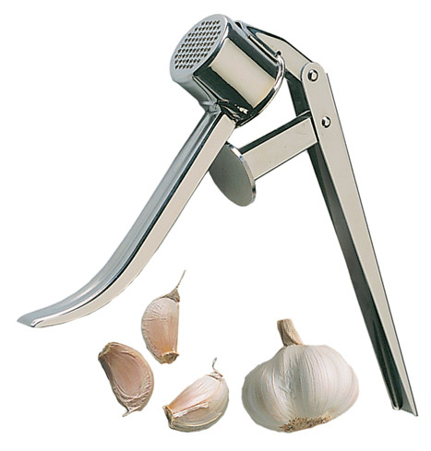
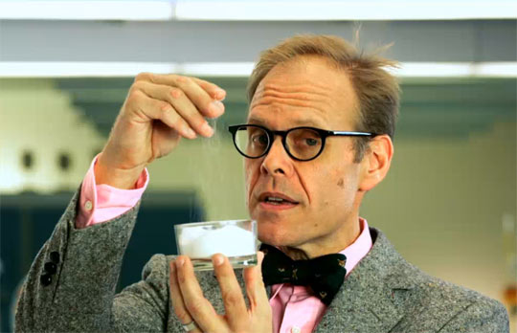
Why is short good?
Doing too much means it’s difficult to use anywhere else: “Unitaskers”
Waste space
Hard to clean (fix, debug…)
Alton Brown
Host of Good Eats

Slide 8
Why is short good?
The magical number 7 ± 2:
Some limits on our capacity for processing information
Computers don’t care how many variables are around (in scope) at any one time
Humans (i.e. future-you) do
By confining what’s going on in the program to sections, it’s easier to read

Slide 9
How do I make a function?
Syntax:
Arguments: Inputs
Return values: Outputs
def name([arguments]):
'''Description of function'''
# code here
[return [value]]

Slide 10
Top-down Design
“Sketch” out the program in pseudo-code (comments work well)
Start from high-level language, talking about meaning, not types
Break the task down into conceptual steps
If the steps are still abstract or difficult to implement, break those down into sub-steps

Slide 11
Interactive
IPython Notebook

