Slide 1

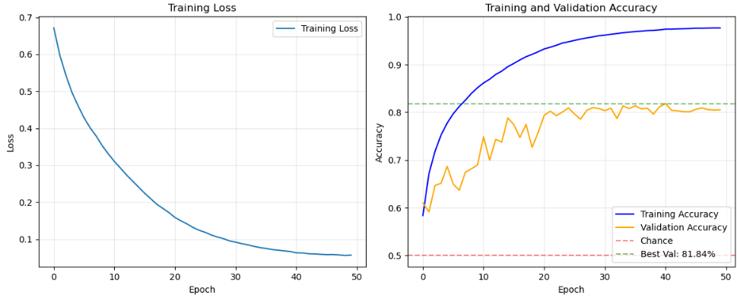
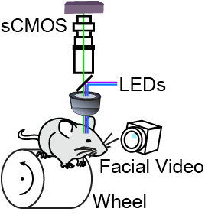
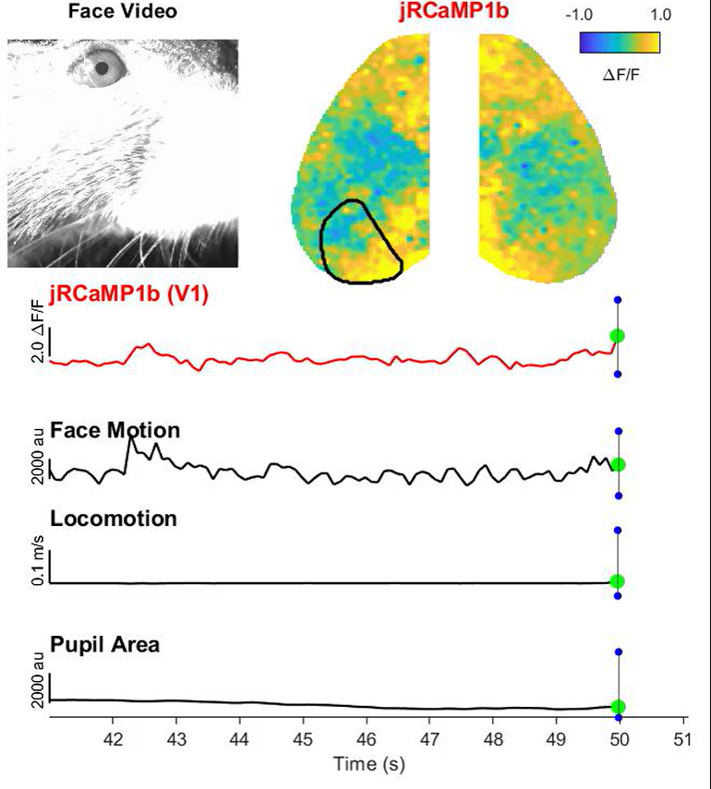
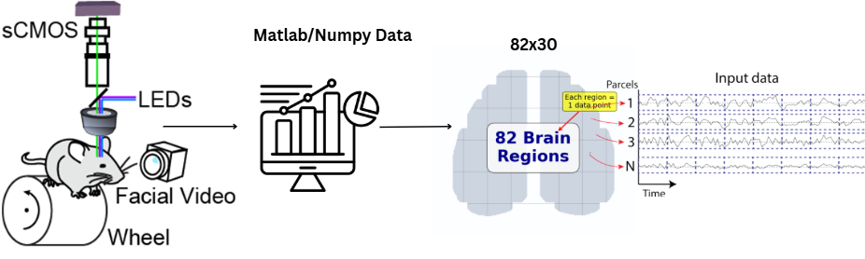
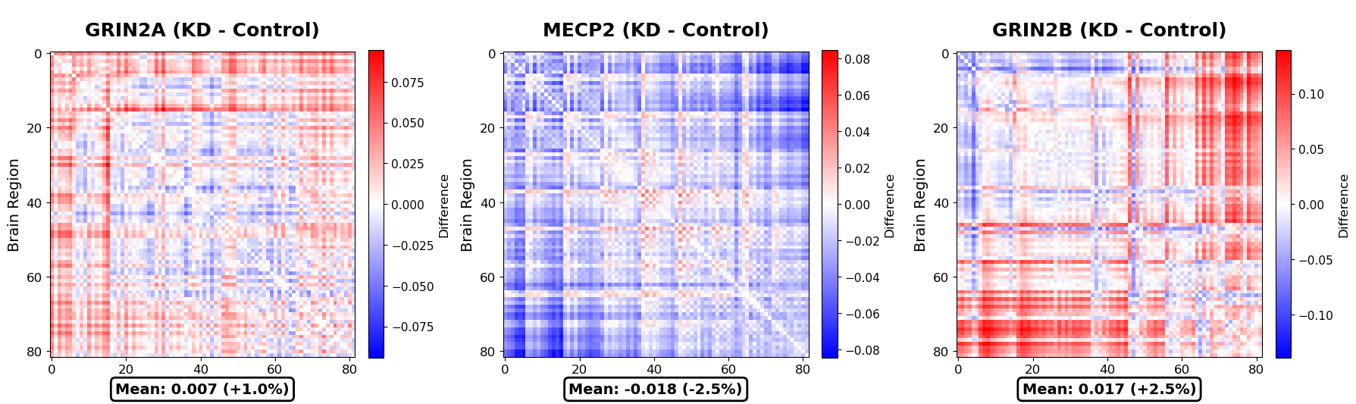
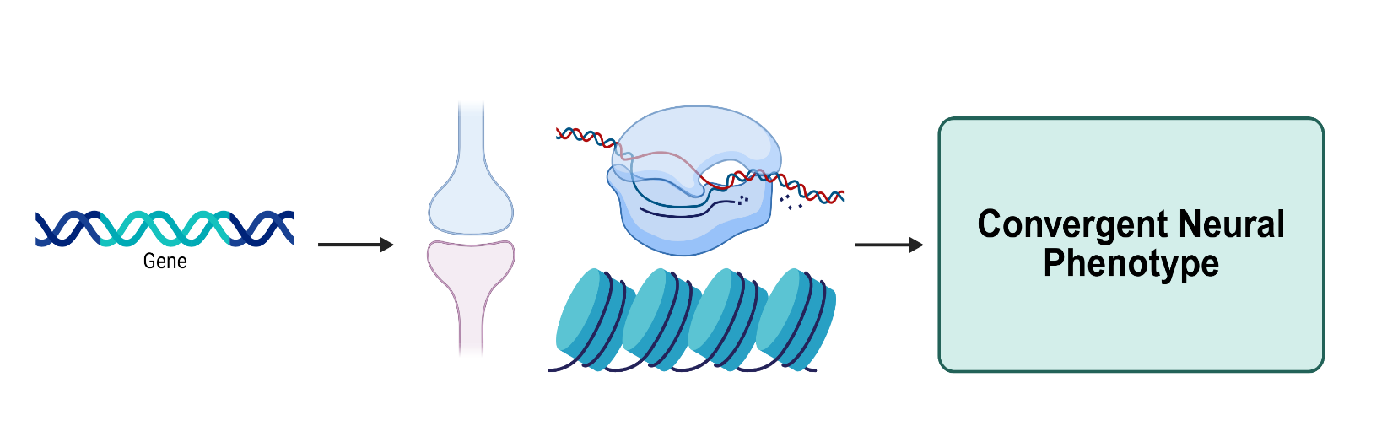
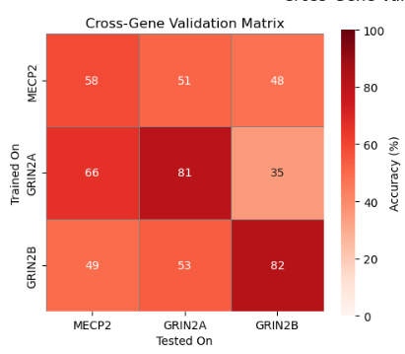
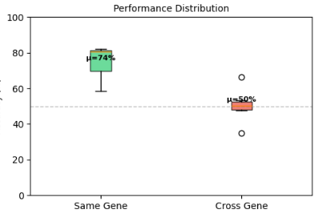
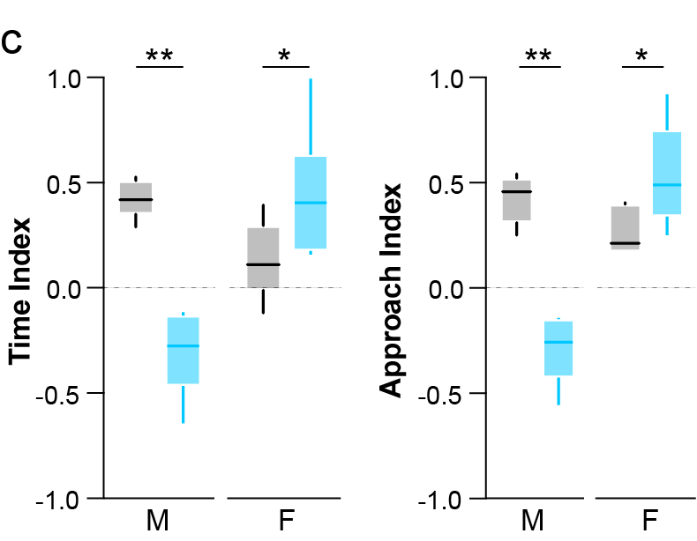
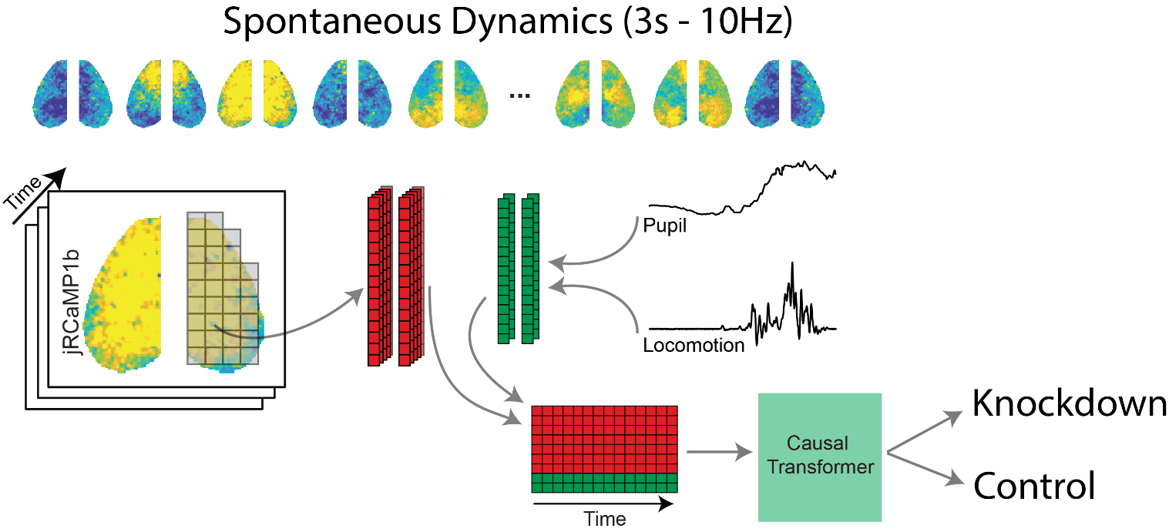
Discrimination of Autism Mouse Models via Machine Learning Methods
Alfredo F. Frontera Del Valle¹, Josué Ortega Caro, Ph.D.², Rachel Oren², Shreya Saxena, Ph.D.², Jessica Cardin, Ph.D.²
¹University of Puerto Rico, Río Piedras, ²Wu Tsai Institute, Yale University
Background
Vision Transformer Architecture
Results
Autism Spectrum Disorder (ASD) affects 1 in 31 children, with diagnosis typically delayed until age 4-5 when behavioral symptoms become apparent. This delay misses the critical window when interventions are most effective. Current diagnosis relies on subjective behavioral assessments with no objective biomarkers available.
The Convergent Phenotype Hypothesis: Multiple autism-associated genes affecting different cellular processes converge on similar behavioral and neural phenotypes. We investigate three high-confidence autism genes:
GRIN2A: NMDA receptor subunit (synaptic transmission, plasticity)
GRIN2B: NMDA receptor subunit (developmental synaptic transmission)
MECP2: Transcriptional regulator (gene expression)
Research Question: Can artificial intelligence detect convergent neural signatures across distinct genetic autism models?
Pupil Diameter
Facial Movements
Grooming
Locomotion
Figure 5. Model Performance - Training dynamics show convergence without overfitting. Test accuracy: 81.97%, Sensitivity: 84.53%, Specificity: 78.64%.
Figure 3. Mice run freely on a wheel while widefield calcium imaging captures neural activity across the dorsal cortex. Data is parcellated into 82 brain regions across 3 seconds
Figure 6. Correlation matrices showing changes in functional connectivity across cortical areas (knockdown minus control). Red indicates increased connectivity in knockdown; blue indicates decreased connectivity.
We developed a Vision Transformer adapted for neural time series:
Input: 82 regions × 30 timepoints → 246 patches
Architecture: 6 transformer layers, single-head attention, 128-dim embeddings
Training: 244,205 windows with session-level train/validation split
Key Innovation: Treats brain activity as spatiotemporal "image" for AI analysis
1
Figure 1. Different autism genes affecting distinct cellular processes may lead to convergent neural phenotypes and shared behavioral outcomes including social deficits and repetitive behaviors.
Figure 7. (left) Cross-gene validation matrix showing how models trained on one gene can detect autism in other genes, supporting convergent pathways. (right) Performance distribution in same gene vs cross gene.
Conclusions
Figure 2. Three-chamber social preference test shows reduced social interaction in MeCP2 knockdown mice, with sex-specific effects. Females exhibit stronger behavioral deficits despite mosaic expression.
AI Detects Invisible Patterns: Vision Transformers successfully identify autism-related neural signatures with 82% accuracy, detecting subtle 1-3% connectivity changes invisible to traditional analysis.
Convergent Neural Phenotypes: Different autism genes converge on detectable brain activity patterns, supporting the hypothesis of shared neural mechanisms despite distinct genetic causes.
Binary Classification
Methods
Experimental Design
We recorded spontaneous cortical activity from 129 mouse sessions:
Subjects: 57 control, 72 knockdown mice across three genes
Age: P60-90 (adult mice)
Recording: 20-30 minutes per session, awake and head-fixed
Widefield Calcium Imaging
Using GCaMP6f calcium indicator, we captured whole-cortex dynamics:
Coverage: 82 cortical regions
Sampling: 10Hz (100ms resolution)
Processing: ΔF/F normalization, z-scoring, 3-second windows
Figure 4. Vision Transformer processes 3-second brain activity windows by dividing them into patches (82 regions × 3 time segments). Self-attention mechanisms learn which brain patterns distinguish autism models from controls.
Future Directions
Technical Optimization: Reduce train-validation gap through architectural improvements and regularization strategies
Analyze brain state-dependent effects: Analyze Quiescence and Arousal data in respect to locomotion of wheel to find new answers in correlation to the convergent neural phenotypes.
Clinical Relevance: Demonstrates feasibility of objective biomarkers for early autism screening.
Our Brain Vision Transformer achieved 82% test accuracy in distinguishing autism models from controls across all three genes combined, demonstrating that different genetic mutations cause detectable, unique patterns of altered cortical activity.
References
1. Vaswani A, Shazeer N, Parmar N, et al. (2017). Attention is all you need. Advances in Neural Information Processing Systems, 30, 5998-6008.
2. Ortega Caro J, Badea A, Marks S, et al. (2024). BrainLM: A foundation model for brain activity recordings. International Conference on Learning Representations (ICLR).
3. Dosovitskiy A, Beyer L, Kolesnikov A, et al. (2021). An image is worth 16x16 words: Transformers for image recognition at scale. International Conference on Learning Representations (ICLR).
4. Sanders SJ, Murtha MT, Gupta AR, et al. (2012). De novo mutations revealed by whole-exome sequencing are strongly associated with autism. Nature, 485(7397), 237-241.
Poster Session
alfredo.frontera2@upr.edu

