Slide 1
The Battle of Neighborhoods
Alfredo Montero Fernández

Slide 2
Questions:
If I were a traveller in Tokyo and want to eat a specific type of food, in which ward should I search so Iit will be easier to find what I exactly want?
Which wards are similar between them when comparing the food they serve?

Slide 3
Answer:
No one knows until someone studies it, and who can do that? A data scientist!

Slide 4
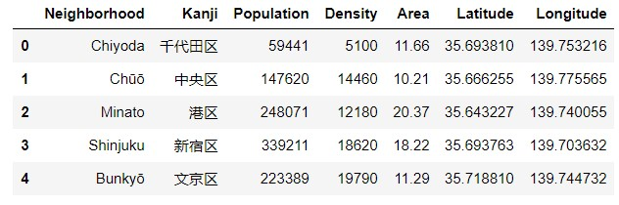
First someone has to obtain the data and process it

Slide 5
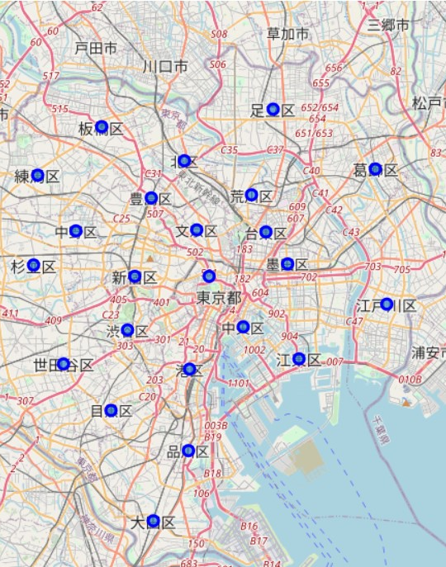
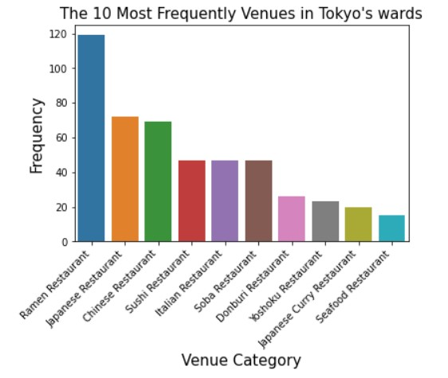
Then the data has to be managed

Slide 6

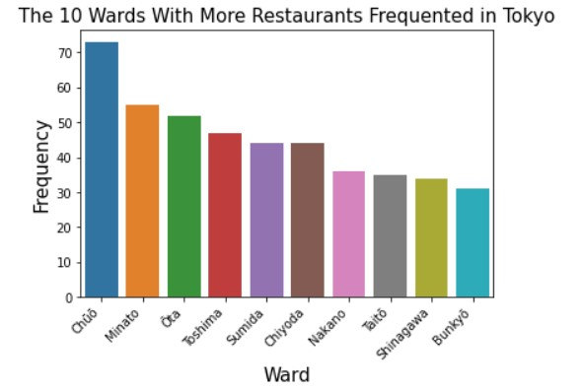
Obtaining this way more and more information!

Slide 7
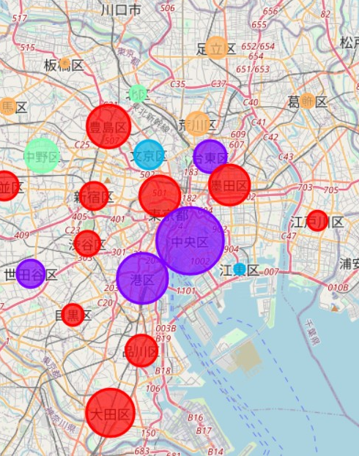
And using techniques like machine learning we obtain what we want

Slide 8
Now you know which wards are similar in what restaurant types refers!

