Slide 1

Brian Remmington
Alfresco Product Architect
Notes:
01:00 01:00

Slide 2

What we’ll cover
A demonstration
The Web Quick Start model
Overview of the features in the repository tier
Overview of the sample web application
Primary goal:
  To show you how Web Quick Start works so you can start to use it and extend it
Notes:
02:00 03:00

Slide 3

Notes:
Create new site and import WQS data
Walk around doc lib, pointing out things of interest: website metadata, folder structure, collections, section template config
Edit the port number for the editorial site, and remove the “isEditorial” flag
Walk around the website: into each section – blogs last
Take a look at the data list(s) that have been created (empty)
Post a comment to a blog post, show it appear in the data list
Back to site – show the comment on the blog page (including count)
Load a new image into the news section (Koala) – show the rendition definitions for the news section
Find a news article on the website and point out its image. In Share, edit the primary image of that article to be the Koala. Show the change on the website.
Into Share. Add a tag or two to some news articles
Onto site: show the tags appear on the articles and the tag roll-up on the news landing page
Send a “contact us” request
Show the contact us request in the data list and the workflow task in admin user’s task list.
Publish section structure some example articles (blogs?)
Show them appear in Share and on the “live” website.

Slide 4

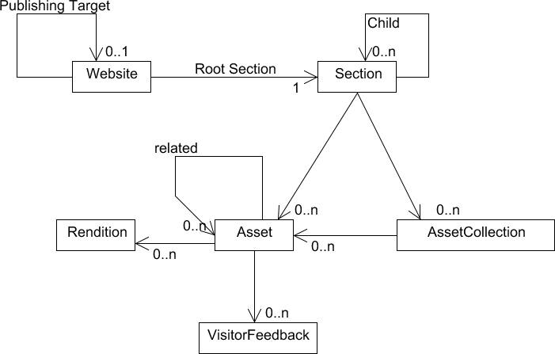
ws:website
ws:webroot
ws:section
ws:webasset
ws:webassetCollection
ws:visitorFeedback
Notes:
04:00 06:00

Slide 5

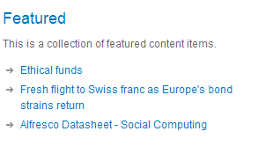
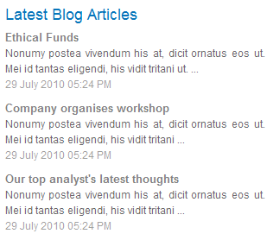
Groups of assets that are uniquely named within the scope of a particular section
Static asset collections
  Editor control over which assets are included
Dynamic asset collections
  Configured with a search query, maximum number of results, and a refresh period in minutes
  The query is executed periodically (as configured), and the results are placed in the asset collection
  CMIS and Lucene supported

Slide 6

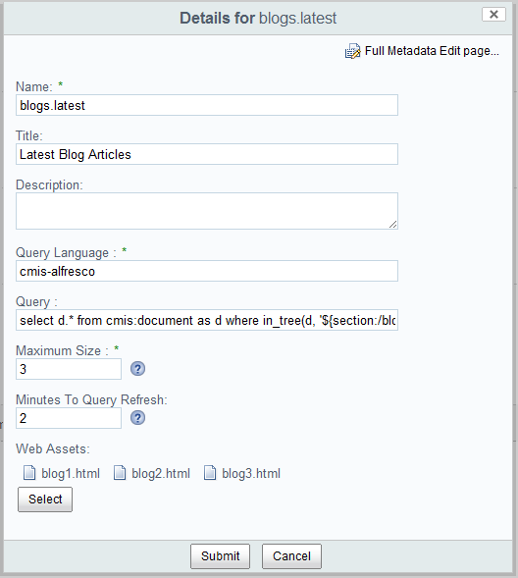
Queries can contain references to sections using the “section” placeholder:
${section:.} is the section that owns the asset collection
${section:/} is the root section of the website
${section:..} is the parent of this collection’s section
${section:/news/global} is the section at the path “news/global” from the root
You can plug in your own placeholders too

Slide 7
Queries can contain references to sections using the “section” placeholder:
${section:.} is the section that owns the asset collection
${section:/} is the root section of the website
${section:..} is the parent of this collection’s section
${section:/news/global} is the section at the path “news/global” from the root
You can plug in your own placeholders too

Slide 8


Each section may define what renditions should be created when an asset is added or updated
The configuration allows rendition definitions to be related to asset types (both by content type and MIME type)
Rendition definitions are defined in a Spring bean named “wqsmodule_renditionDefinitions” (defaults are in the file “rendition-context.xml”)
Each section may either inherit the rendition configuration from its parent section or not

Slide 9
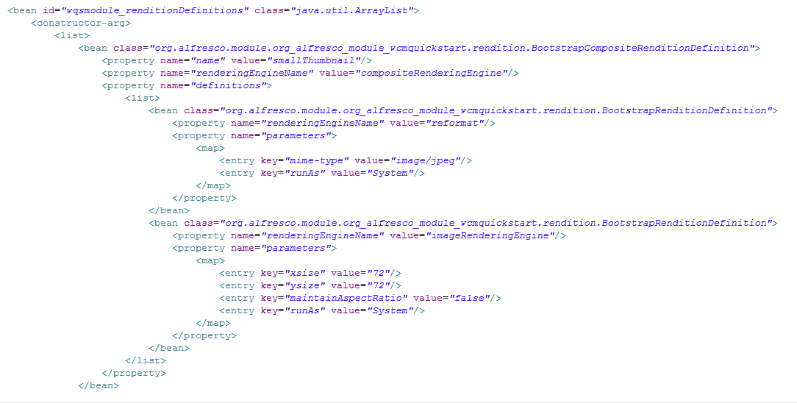
Each section may define what renditions should be created when an asset is added or updated
The configuration allows rendition definitions to be related to asset types (both by content type and MIME type)
Rendition definitions are defined in a Spring bean named “wqsmodule_renditionDefinitions” (defaults are in the file “rendition-context.xml”)
Each section may either inherit the rendition configuration from its parent section or not

Slide 10

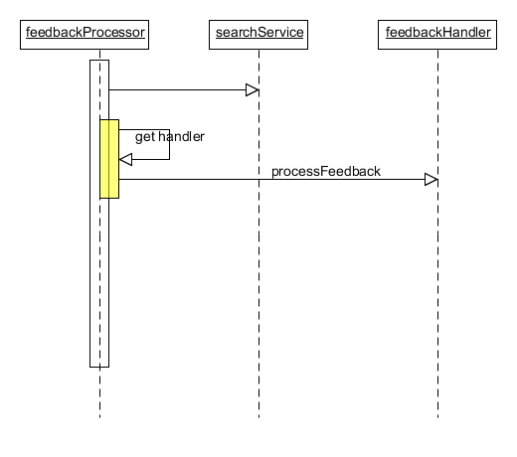
Each website has a corresponding data list for feedback (auto-created)
New entries are periodically processed – each type of feedback can have its own handler defined
  CommentFeedbackProcessorHandler
    feedbackType = “Comment”
  ContactFeedbackProcessorHandler
    feedbackType = “Contact Request”
<bean id="commentFeedbackProcessorHandler" parent="feedbackProcessorHandler"
class="org.alfresco.module.org_alfresco_module_wcmquickstart.jobs.feedback.CommentFeedbackProcessorHandler">
<property name="feedbackType" value="Comment" />
</bean>

Slide 11


Each website has a publishing queue
WQS has a PublishService that processes the queues
Two actions defined: “webqs_publishTree” and “webqs_publish”
Two workflows defined that use the actions
Queues are published periodically – every minute by default (override with property wcmqs.publishQueueProcessor.schedule)
Each website node may specify another website node that it publishes to

Slide 12


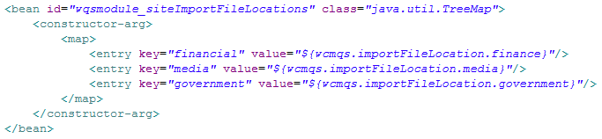
Override map of available ACP files using a bean named “wqsmodule_siteImportFileLocations”

Slide 13

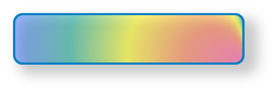


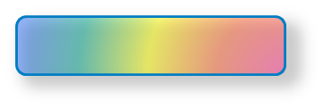
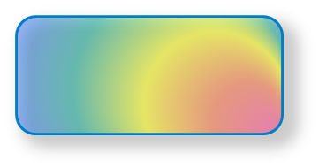

WQS API
Notes:
03:00 10:00

Slide 14

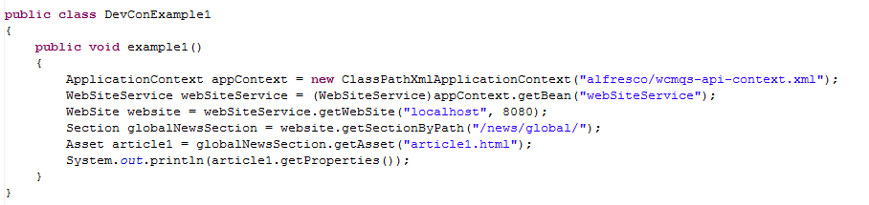
Bean “webSiteService” is a good starting point:
Notes:
04:00 19:00

Slide 15
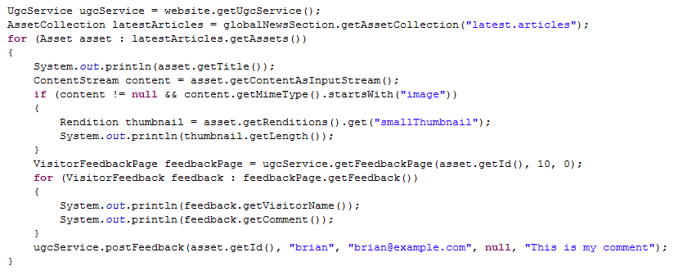
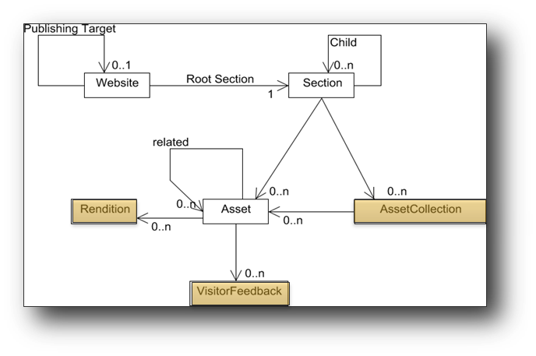
Notes:
04:00 23:00

Slide 16

“Friendly” URLs
The requested URL is parsed to find the website, section, and asset that are being addressed
www.example.com/news/global/financial_outlook_good
The resolved API objects are stored on the request context with the names “website”, “section”, and “asset” for use by page components.
website
asset
section
Notes:
03:00 26:00

Slide 17

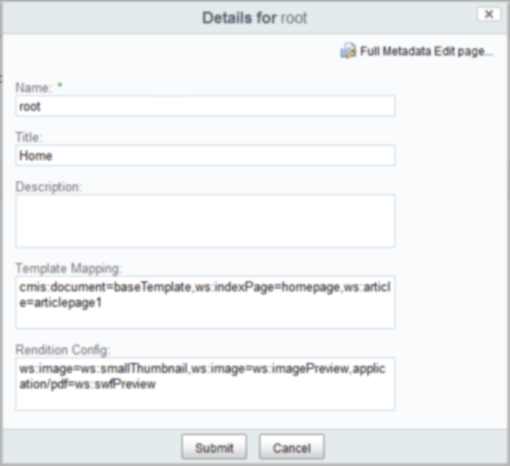

Wired in to respond whenever an asset has been resolved
Discovers the page name to be used to render the asset
Each section may define template mappings from asset type to view name
Searches up the type hierarchy first, then the section hierarchy
Notes:
03:00 29:00

Slide 18

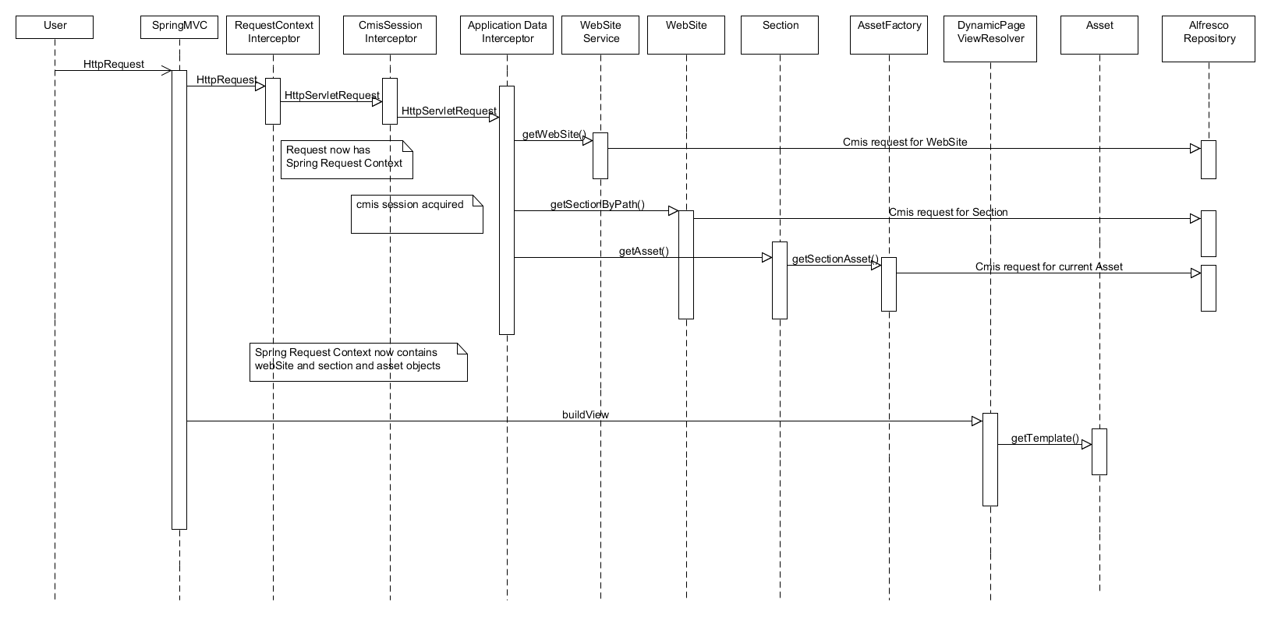
Notes:
04:00 38:00

Slide 19

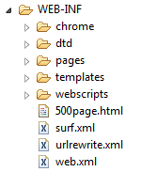
Notes:
04:00 42:00

Slide 20
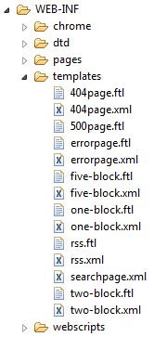

Think of “templates” as layouts:
HTML with holes cut out (“regions”)
Notes:
04:00 42:00

Slide 21
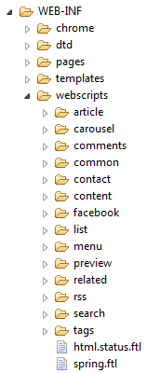
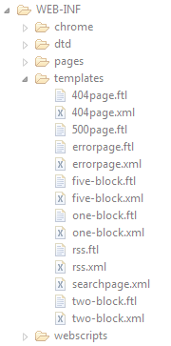
The webscripts folder
contains components:
HTML fragments that can
be used to fill in regions
Notes:
04:00 42:00

Slide 22
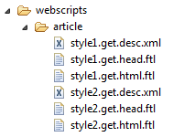
The webscripts folder
contains components:
HTML fragments that can
be used to fill in regions
For example, there are two
components that render
article details: “article/style1”
and “article/style2”
Notes:
04:00 42:00

Slide 23
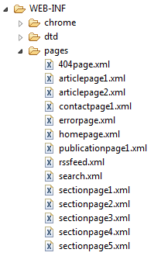

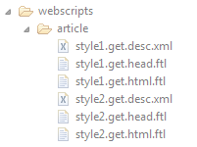
Finally, pages weave
templates and components
together: a page specifies
a template and which
components are to fill which
regions in that template
Notes:
04:00 42:00

Slide 24


Notes:
08:00 50:00

Slide 25
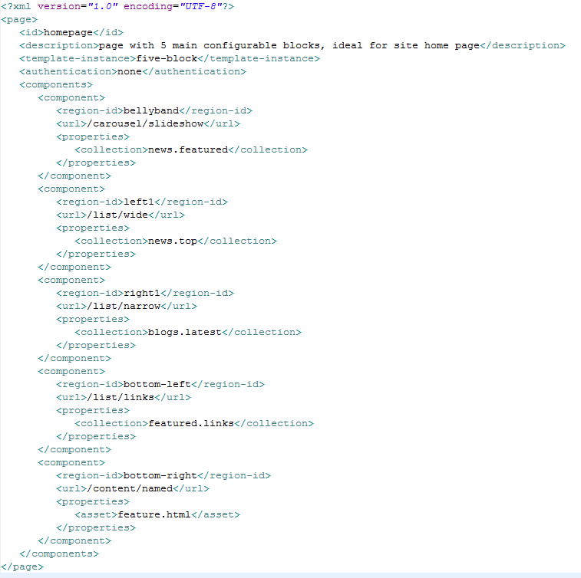
Notes:
08:00 50:00

Slide 26
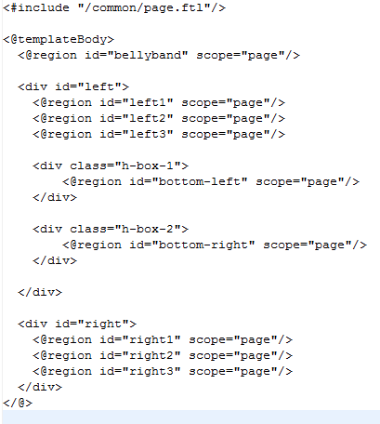
five-block.ftl
Notes:
08:00 50:00

Slide 27
bellyband
left1
right1
bottom-left
bottom-right
Notes:
08:00 50:00

Slide 28
For example, the region
“left1” is populated by
the component “list/wide”.
This component accepts
a property named
“collection” – in this case
the value of that property
is being set to “news.top”
Notes:
08:00 50:00

Slide 29
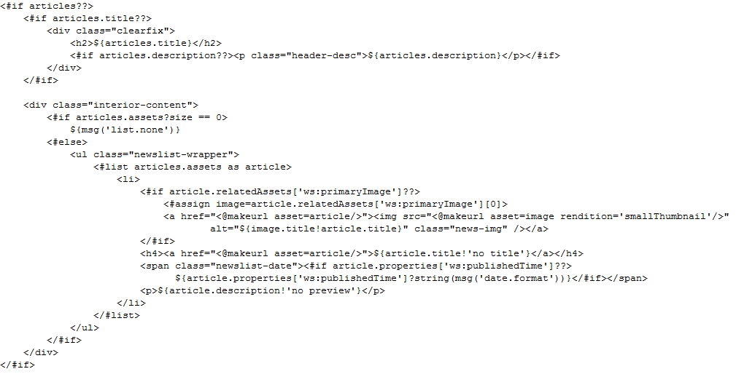
webscripts/list/wide.get.js
webscripts/list/wide.get.html.ftl
The “list/wide” component loads the named asset
collection (“news.top” in this example), and then
renders information about each asset in that
asset collection
bottom-left
bottom-right
Notes:
08:00 50:00

Slide 30
left1
Notes:
08:00 50:00

Slide 31


wiki.alfresco.com/wiki/Web_Quick_Start
forums.alfresco.com/en/viewforum.php?f=52
twitter: @Alfresco, @brianremmington

