Slide 1
Grey Matter
Arthur, Justin, Alex

Slide 2
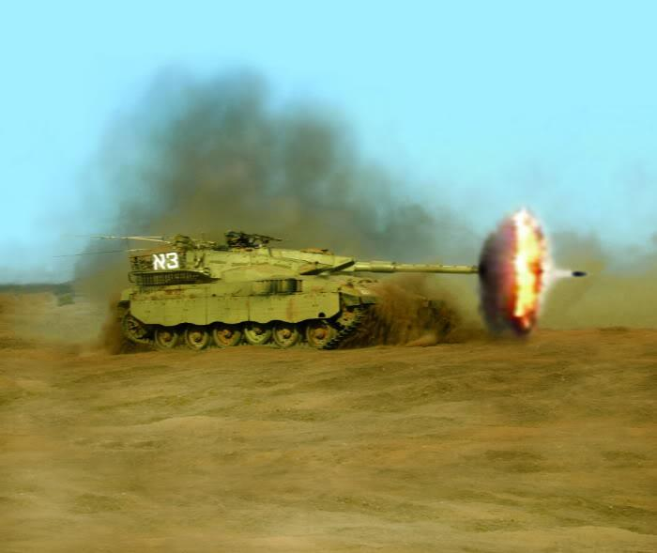

Game Idea
Driving Game
Shoot Stuff(agility challenge)
Timed challenge

Slide 3
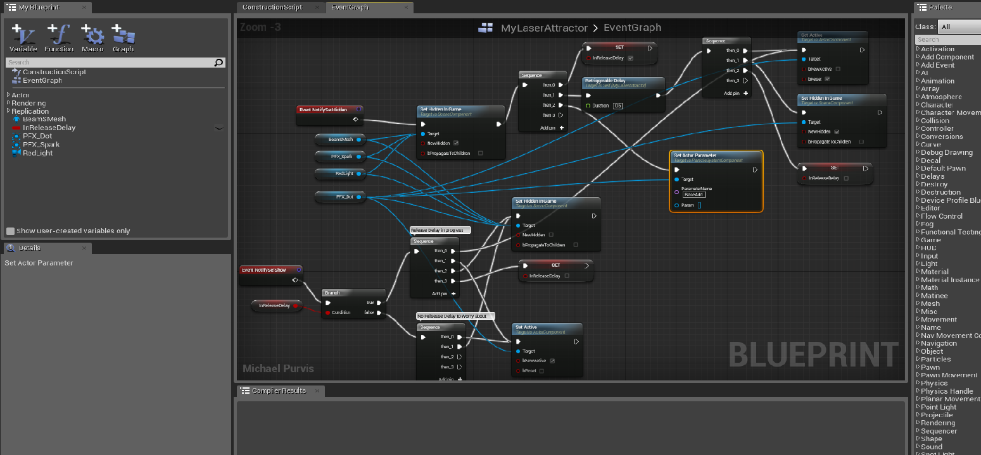


Challenges
Working with Unreal Engine
Blueprints everywhere
Using GIT as a source control solution
Combining binary .uasset files

Slide 4

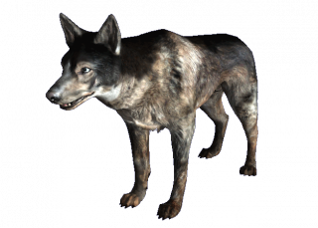
Challenge Resolution
Research research and more research
Keep on searching for C++ examples
Get better with the Unreal documentation
Branchs
We created feature branches
Later merged into master through a pull request
Only one person per .uasset
Prevents unmergeable changes

Slide 5

What did we learn?
Unreal wants everyone to use blueprints
Game development is hard

Slide 6
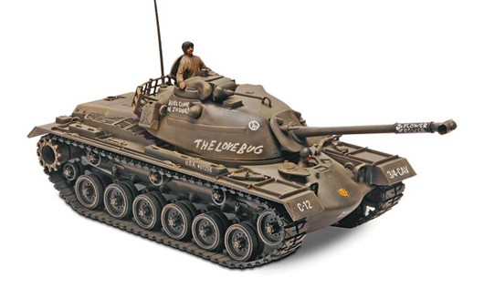
Legacy
Tank asset
More maps
Targets that actually explode(break apart)
Leaderboard

Slide 7
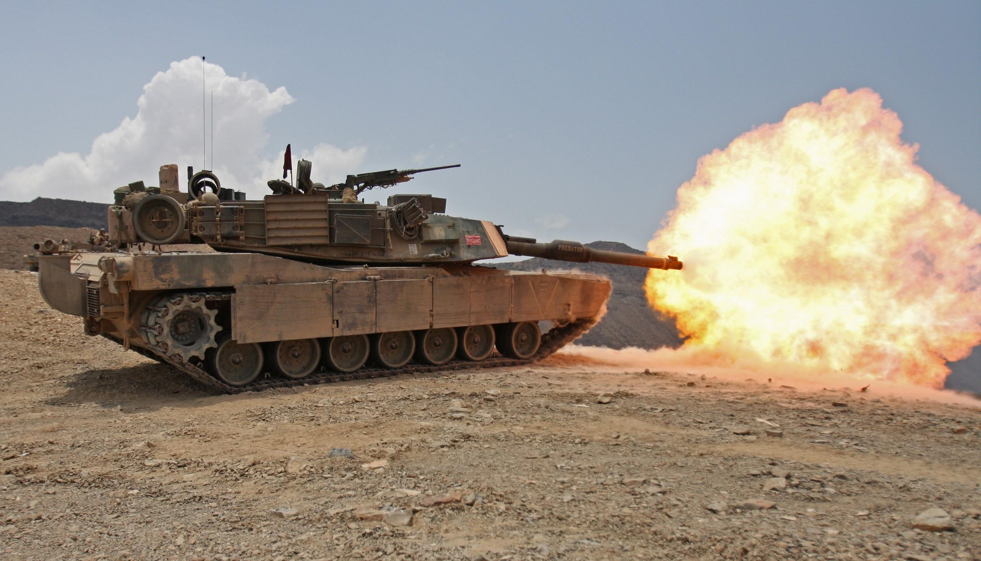
Thanks!

