Slide 1
Noise Cancellation
Luis Arturo Dan Fong
A01650672
José Rubén Villacaña Ibargüengoytia A01654347
Frida Berenice Rangel García
A01651385
Alfredo Zhu Chen
A01651980
Notes:
Rubén

Slide 2
—Arthur Schopenhauer
“Noise is the most impertinent of all forms of interruption. It is not only an interruption, but also a disruption of thought.”
Notes:
Rubén

Slide 3

TABLE OF CONTENTS
01.
02.
03.
04.
05.
Background and Problem
Objectives
Materials and Methods
Results
Demo
Notes:
Arturo

Slide 4
01.
Background and Problem
Notes:
Arturo

Slide 5
PROBLEM
The problem
Examples
Noise is one of the most significant problems in the process of sending, analyzing, and processing signals.
Acoustic noise of industrial equipment(engines,fans, transformers)
60 Hz power line
Electromagnetic interference
White noise
K. Sen. and M. Deniss. 1999. Active Noise Control: A tutorial Review. IEEE.
Notes:
Arturo

Slide 6
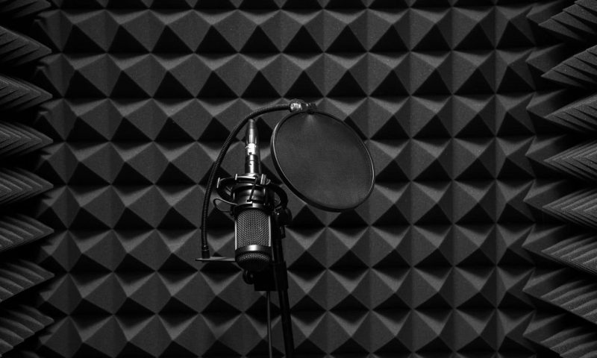
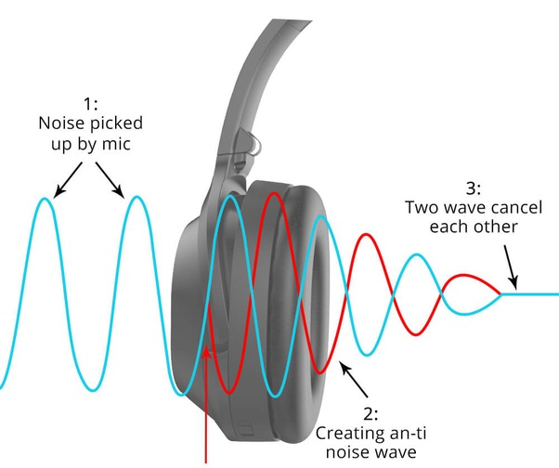
BACKGROUND
PNC (Passive Noise Control)
Relies on absorption and isolation of materials.
ANC (Active Noise Control)
Generates signals with a phase shift from the noise signal, resulting in cancellation of the noise when summed up. It depends on adaptive adjustment capability.
Y. Sun et al. 2020. Research on Optimal Control Method of Active Noise reduction of Active Noise Cancelling Headphones Combined with Noise Reduction of Phonon Materials in High Voltage Converter Station IJOMAM
Notes:
Arturo

Slide 7
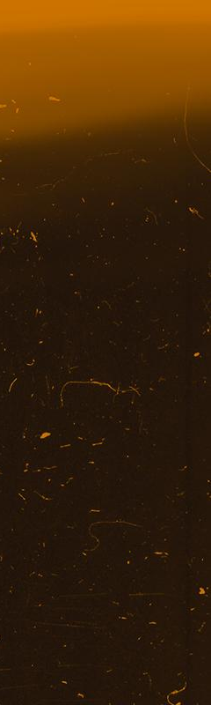
02.
Aim and Objectives
Notes:
Frida

Slide 8
AIM
The main purpose of the project is to develop a useful noise cancelling algorithm that can be implemented onto hearable signals.
Notes:
Frida

Slide 9
OBJECTIVES
OBJECTIVE 1
OBJECTIVE 2
OBJECTIVE 3
OBJECTIVE 4
Put into practice the knowledge acquired during the semester about signal processing
Offline noise cancelling algorithm
Showing plots as aids to visualize and filter the signal
Noise cancelling algorithm in MATLAB along with a graphical interface (GUI)
Notes:
Frida

Slide 10
03.
Materials and Methods
Notes:
Frida

Slide 11
MATERIALS
MATLAB version R2019 or later
1 Computer with at least 8GB of RAM
1 External condenser microphone
1 Digital audio interface with ADC of 16 bits resolution and 44.1kHz sampling rate
Notes:
Frida

Slide 12
APPROACHES
Filters
Windowing with Short-Time Fourier Transform(STFT)
APPROACH I
APPROACH II
Notes:
Alfredo

Slide 13
Approach I (FILTERS)
Read noise and input signal
Apply FFT to both signals
Find noise in frequency domain above a threshold value
Start
Amplify and attenuate components of input signal in frequency with gain/loss threshold
Select gain/loss threshold with gain and loss factors
Apply notch filters to input signal
Select bandwidth and attenuation factor of filter
Does not Satisfy
Plot in time, frequency domain and spectrogram of results
Check filtered signal result
IFFT of the signal
End
Satisfies
Notes:
Alfredo

Slide 14
Approach II (Windowing with STFT)
Start
Read noise and input signal
Select window functions
Apply a STFT algorithm to the input signal
Select gain and attenuation factor
Comparison of values between threshold and STFT matrix
Create threshold from the noise
Select multiplication factor of noise threshold
Does not Satisfy
Plot in time, frequency domain and spectrogram of results
Check filtered signal result
Apply ISTFT
End
Satisfies
Notes:
Rubén

Slide 15
04.
Results

Slide 16
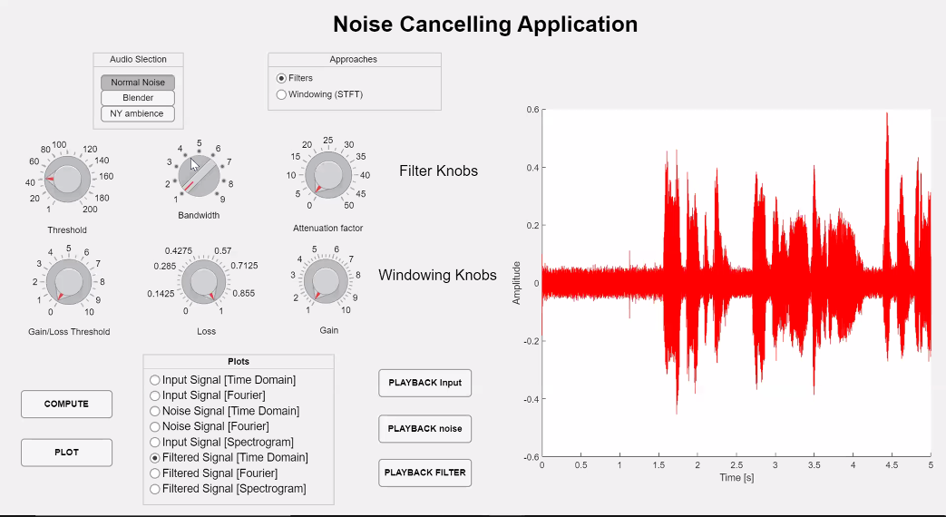
Graphical User Interface (GUI)
Notes:
Alfredo

Slide 17
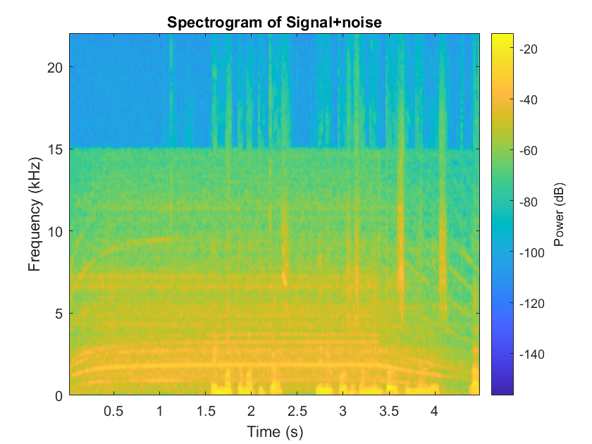
Spectrogram of Signal+noise APPROACH II
Notes:
Alfredo

Slide 18
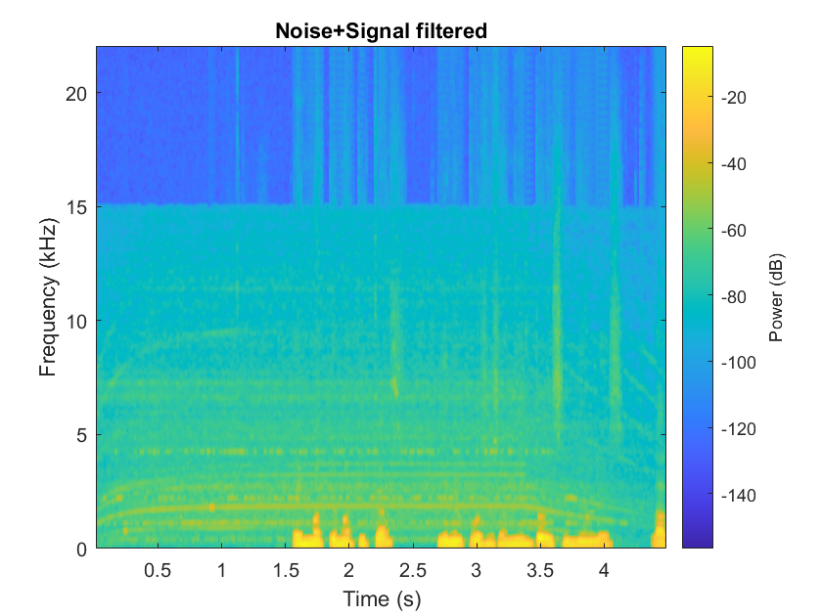
Spectrogram of filtered signal APPROACH II
Notes:
Alfredo

Slide 19

05. A DEMO IS WORTH A THOUSAND WORDS...
Notes:
Rubén

Slide 20
THANKS

