Slide 1



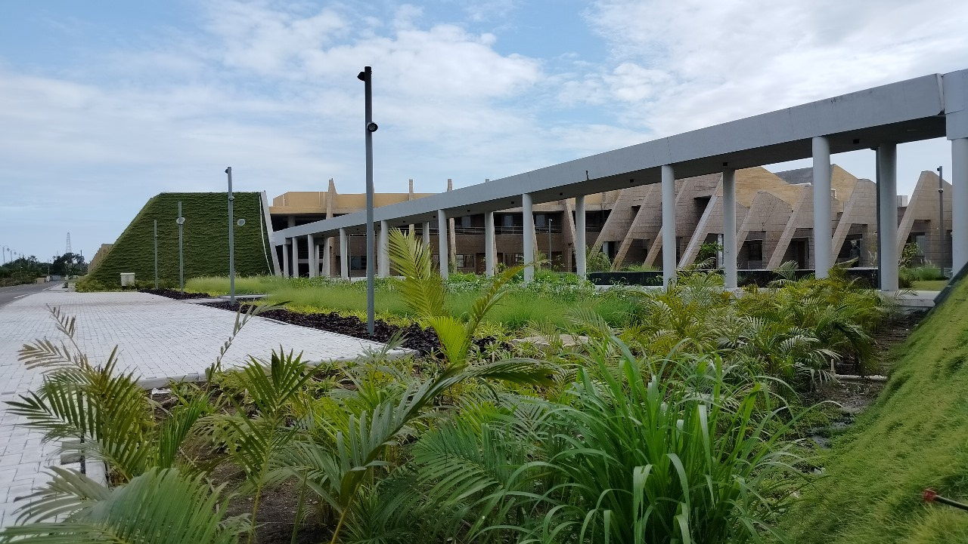

Indian Institute of Information Technology Vadodara
Smart Hostel Room Allocation &
Waiting List Management System
CS-162 Project
Under the supervision of Dr. Venkata Phanikrishna
Department of Computer Science
& Engineering
IIITV & IIITV-ICD

Slide 2
Our Team
Pranav Borole – 20252501015
Parth Chavan – 20252501049
Rahul Kumawat - 20252501061

Slide 3
Objective / Use of the Project
The Smart Hostel Management System is a terminal-based C application that automates the entire lifecycle of hostel room allocation in a college campus. Managing hundreds of student applications manually is error-prone and slow; this system replaces that process with a data-structure-driven engine.
Core objectives:
Automated Priority-Based Allocation: Rank students by GPA and home distance so the most deserving applicants receive rooms first.
Branch-Specific Room Assignment: Each room is tagged to a department (CSE, ECE, AI, MCA, MTech, PhD, or ANY) so students are placed in appropriate accommodation.
Waiting List Management: Students who cannot be immediately housed join a circular waiting list and are promoted automatically when a vacancy arises.
CRUD Operations: Register, edit, search, and delete student records from anywhere in the system.

Slide 4
Real-World Applications:
College and university hostel management portals
Hospital patient ward allocation systems
Hotel / resort room booking and overflow queuing
Any resource-constrained reservation system requiring fairness-based queuing

Slide 5
Input and Output
Input Field | Description | Constraints
Enrollment ID | Unique student identifier | Numeric only; no duplicates allowed
Full Name | Student's full name | Non-empty string, up to 64 characters
Branch | Student's department | CSE / ECE / AI / MCA / MTECH / PHD / ANY (case-insensitive)
GPA | Grade Point Average | Float, 0.0 – 10.0
Distance (km) | Distance from home to college | Integer, 0 – 99,999 km
Room Number | Room to vacate or operate on | Integer matching an existing room
Menu Choice | Navigation input | Integer matching a listed option

Slide 6
Expected Output:
Room Allocation: Student is extracted from the max-heap and assigned to a branch-matching room; confirmation with room number and occupancy ratio is displayed.
Waitlist Notice: If no matching room is available, student is enqueued with a WAITLISTED message.
Auto-Promotion: When a room becomes available (vacate or new room added), a matching waitlisted student is promoted automatically.
Reports: Room status table, pending-applications heap listing, waiting-list queue, and branch-wise summary table.

Slide 7
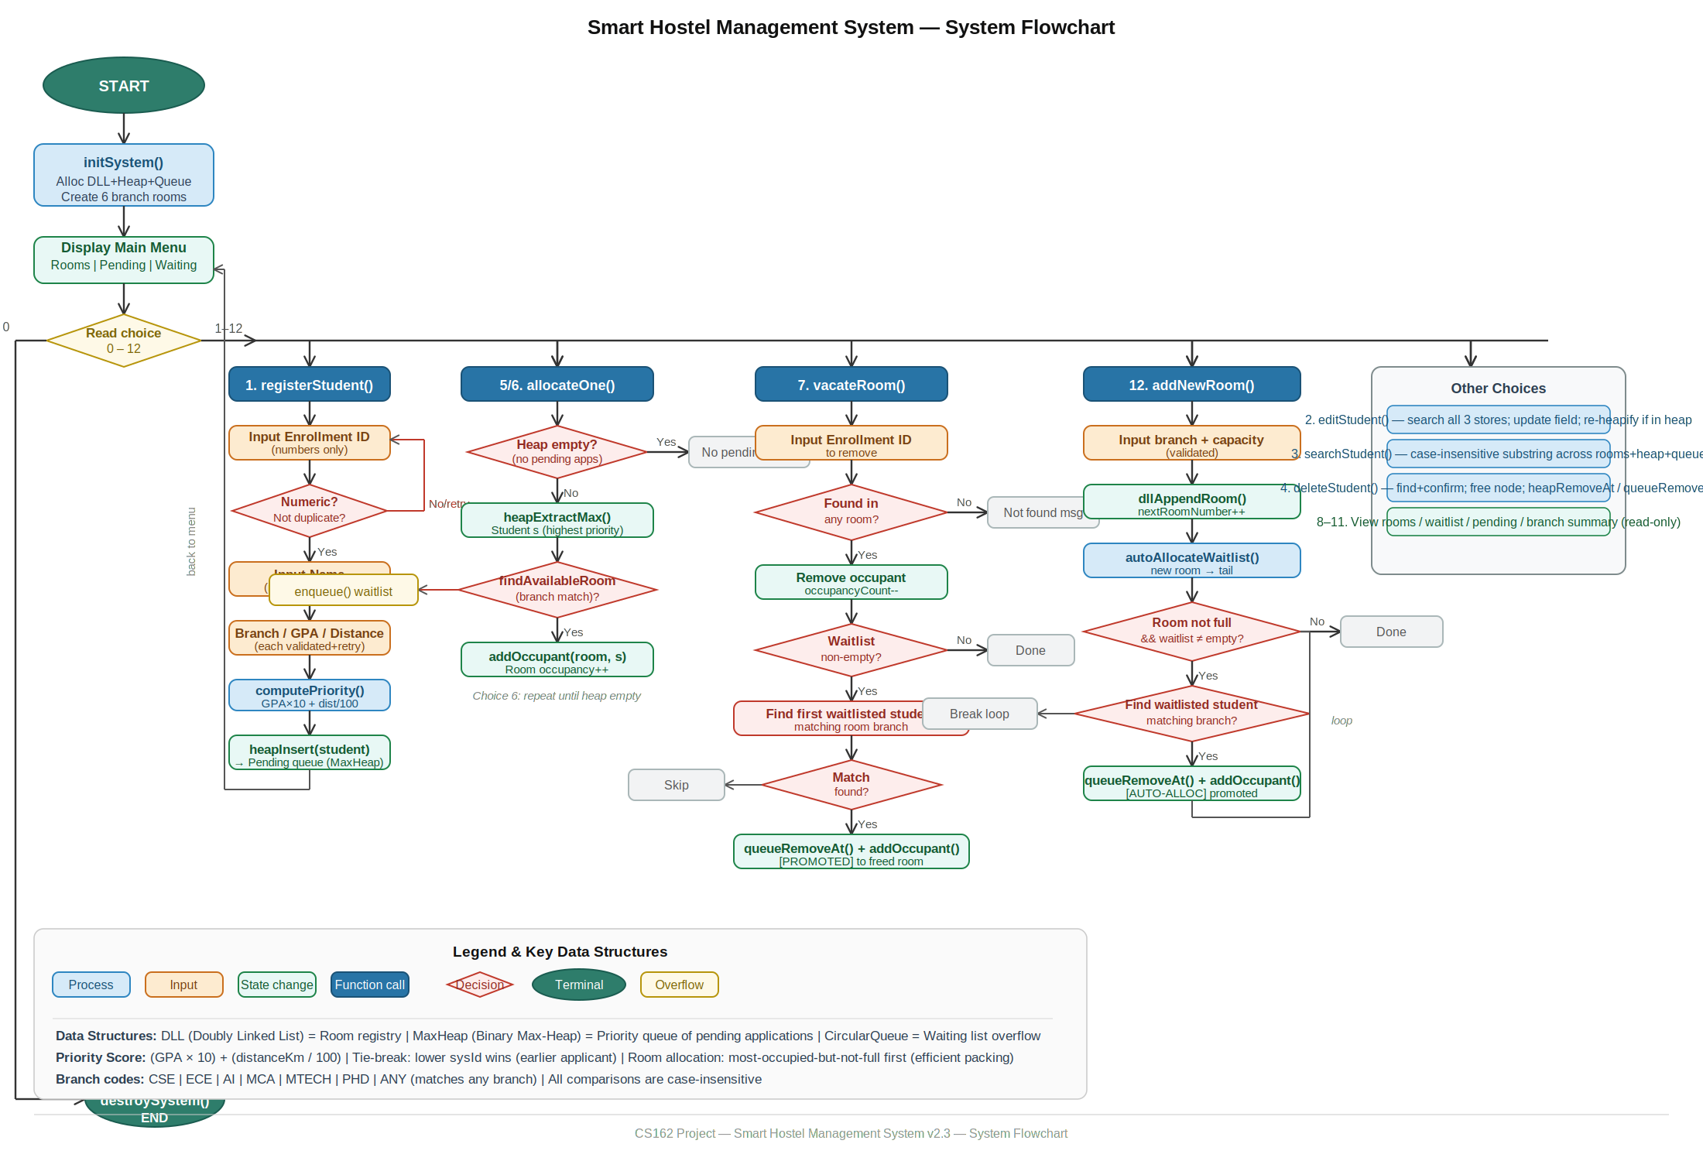
Process Flow Diagram

Slide 8
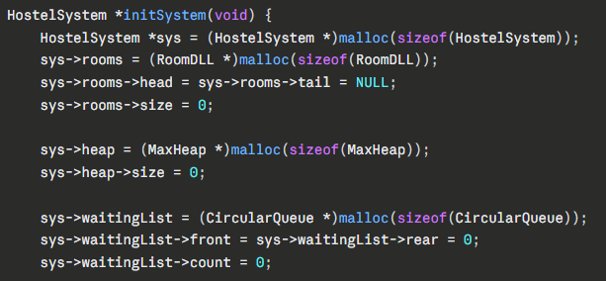
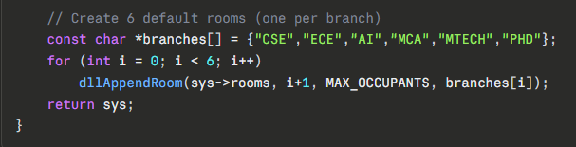
Step-by-Step Explanation
Step 1 — System Initialisation (initSystem)
When the program starts, initSystem() allocates memory for the three core data structures using malloc(). Six default rooms are created (one per branch), each appended to the doubly linked list. The max-heap and circular queue begin empty. If any malloc() call fails, the program exits gracefully with an error message.
Data structure used: Doubly Linked List for room registry.
Concept: Dynamic memory allocation with full validation.

Slide 9
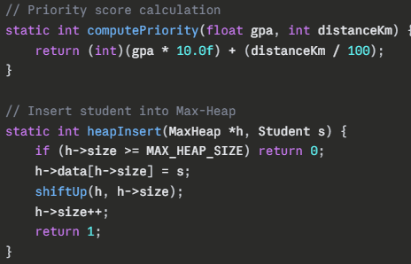
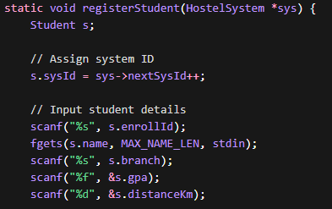
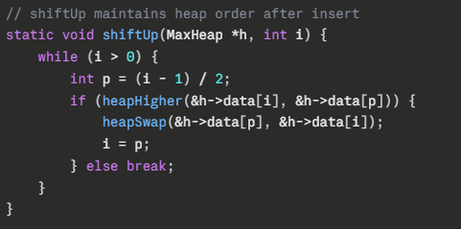
Step 2 — Student Registration
Admin enters student details (ID, name, branch, GPA, distance).
System validates each input; invalid entries are re-entered without returning to menu.
Enrollment ID is checked for uniqueness across all records.
Priority score is calculated:
Priority = (GPA × 10) + (Distance ÷ 100)
Student is inserted into a max-heap using heapInsert(), maintaining order via shiftUp().
Concepts used: Binary Max-Heap, priority-based ordering

Slide 10
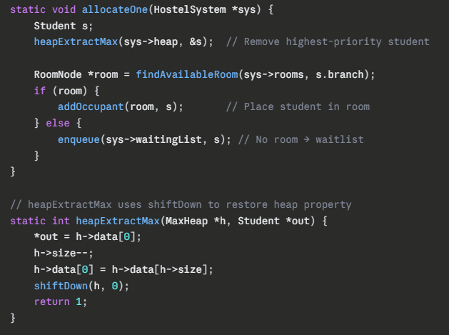
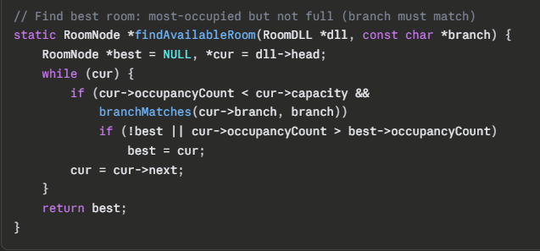
Step 3 — Room Allocation
On allocation, the highest-priority student is removed from the heap using heapExtractMax() and heap is fixed using shiftDown().
findAvailableRoom() scans rooms (doubly linked list) to find a suitable match:
  Branch must match (or be ANY).
  Room with the most occupants (but not full) is preferred.
If a room is found → student is added to its occupant list.
If no room is available → student is added to the waiting list (circular queue).
Concepts used: Heap extraction, shiftDown, room optimization, enqueue.

Slide 11
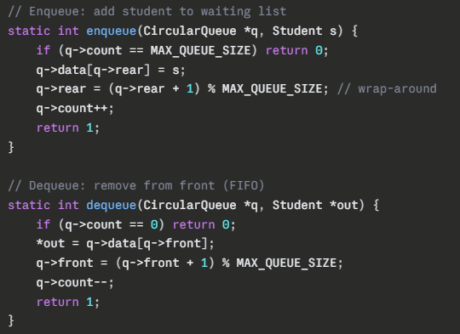
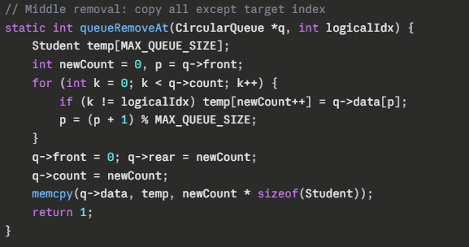
Step 4 — Waiting List Management(Circular Queue)
Waiting list is a fixed-size circular queue (50 students) using front/rear pointers with modulo wrap-around and a count variable.
Maintains FIFO order.
Used in two cases:
When a room is vacated → first matching student in queue is promoted.
When a new room is added → queue students are auto-allocated to fill available seats.
Middle removal (queueRemoveAt) is done by copying elements (except target) to maintain order.
Concepts used: Circular queue, FIFO, modulo indexing, in-place removal.

Slide 12
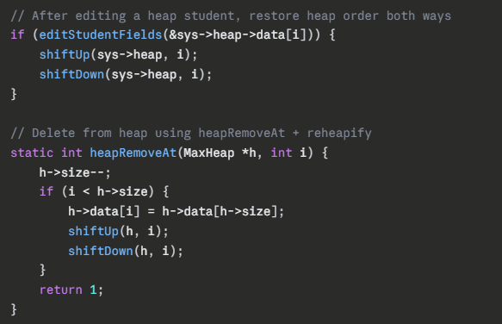
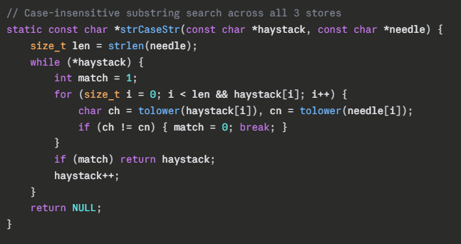
Step 5 — Edit, Search, and Delete (Utility Operations)
All operations search across rooms, heap, and waiting list using enrollment ID.
editStudent: Updates details, recalculates priority, and restores heap using shiftUp & shiftDown (if in heap).
searchStudent: Uses case-insensitive partial matching (strCaseStr()) on name and ID across all stores.
deleteStudent: Confirms deletion, removes from the respective structure; heap uses heapRemoveAt() with reheapification.
Concepts used: Traversal, heap reordering, circular queue indexing.

Slide 13
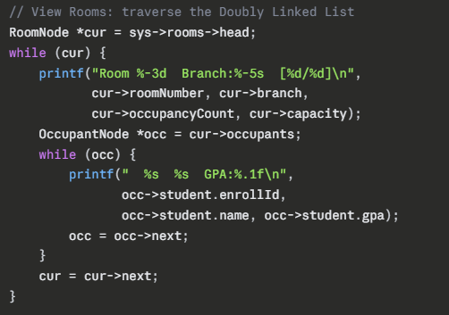
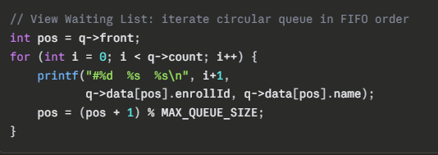
Step 6 — Reporting Operations
viewRooms: Traverses rooms (DLL) and shows room details + occupants.
viewWaitingList: Displays students in FIFO order from the circular queue.
viewPending: Shows heap array (not sorted), with top-priority student at index 0 highlighted.
branchSummary: Aggregates and displays total rooms, capacity, and occupancy per branch.
Concepts used: Traversal, aggregation, queue order, heap representation.

Slide 14
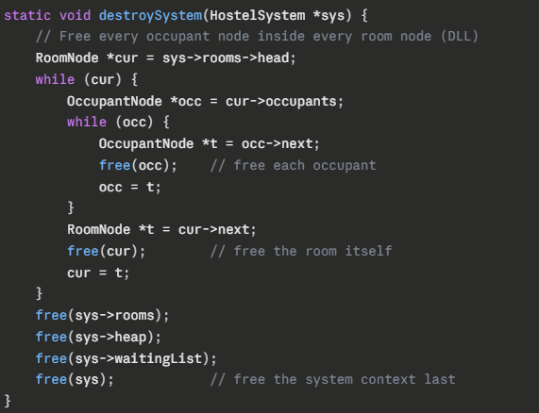
Step 7 — Clean Exit (destroySystem)
Choosing option 0 calls destroySystem(), which walks the doubly linked list and frees every OccupantNode and every RoomNode. The heap and circular queue structures are then freed as well, leaving no memory leaks. This deliberate cleanup is enforced as a project constraint.
Concept used: Recursive/iterative memory deallocation, preventing memory leaks.

Slide 15
Data Structures Used
Data Structure | Implementation | Used For | Key Complexity
Doubly Linked List | RoomNode with prev + next pointers | Room registry; O(1) append via tail pointer; O(n) branch search | Insert: O(1) Search: O(n) Delete: O(n)
Singly Linked List | OccupantNode with next pointer, nested inside each RoomNode | Occupant list per room; O(1) append via tail scan; O(n) removal | Insert: O(n) Delete: O(n)
Binary Max-Heap | Array of Student[100]; manual shiftUp/shiftDown | Priority queue for pending applications; highest-score student always at index 0 | Insert: O(log n) Extract: O(log n) Peek: O(1)
Circular Queue | Array of Student[50] with front, rear, count | Waiting list; FIFO with branch-specific promotion; wrap-around with modulo | Enqueue: O(1) Dequeue: O(1) Scan: O(n)

Slide 16
What you learned from this project and Course
1. Data Structures I learned how to use Linked List, Priority Queue (Max-Heap), and Circular Queue in one real project. Each structure has its own purpose and works best in the right situation.
2. Memory Management I learned how to use malloc() and free() properly in C so the program does not crash or waste memory.
3. Problem Solving I learned how to break a big real-world problem (hostel management) into small parts and solve each part using the right data structure.
4. Input Validation I learned to handle wrong inputs from the user without crashing the program.
5. Teamwork with Structures I learned how multiple data structures can work together in one system to give a complete solution.
Overall, this project helped me understand how the concepts taught in CS162 are used to build real, working software.

