Slide 1


Optimal Dynamic Subset Sampling: Theory and Applications
Lu Yi, Hanzhi Wang, Zhewei Wei
Contact: zhewei@ruc.edu.cn
Notes:
Hello, everyone. I’m Lu Yi, and today I'll be presenting my work, "Optimal Dynamic 'Subset Sampling: Theory and Applications.”This work is collaborated with Hanzhi Wang and my supervisor, zhewei Wei from Renmin University of China. @@

Slide 2








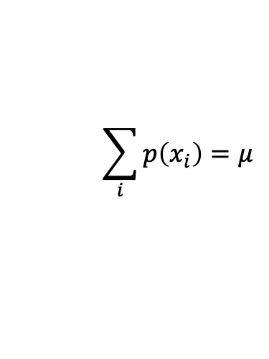




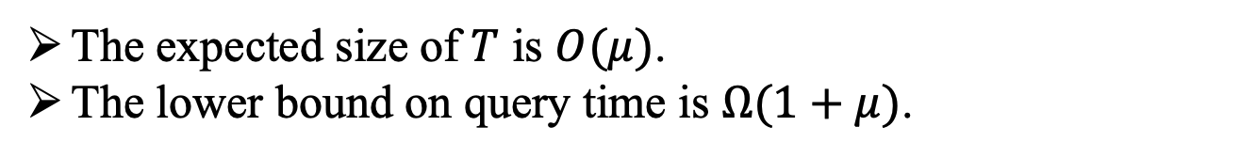


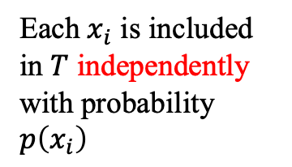
Subset Sampling
domain set S
sample result $T⊆S$
$${ x}_{1}$$
$${ x}_{2}$$
$${ x}_{3}$$
$${ x}_{4}$$
$$…$$
$${ x}_{n}$$
query
$${ x}_{1}$$
$$p(x_{1})$$
$$p(x_{2})$$
$$p(x_{3})$$
$$p(x_{4})$$
$$p(x_{n})$$
Each $x_{i}$ is included in $T$ independently with probability $p\left(x_{i}\right)$
$$x_{4}$$
$$\sum_{i}{p\left(x_{i}\right)=μ}$$
The expected size of $T$ is $O(μ)$.
The lower bound on query time is $Ω(1+μ)$.
Notes:
Subset sampling is such a problem: given a domain set S@@, which includes n distinct events from x one to x n, the subset sampling problem return@@ a subset T for a query. Each event x i@@ is included in T independently with probability p(x i). We denote the sum@@ of probabilities as \mu. The expected@@ size of T is O(\mu) and thus the lower bound of the query time is @@\Omega one plus \mu since any algorithm needs Omega \mu time to output the result T. @@

Slide 3















Dynamic Subset Sampling
The events and the probabilities change over time
Insert an event
Delete an event
Modify the probability of an event
$${ x}_{n+1}$$
$$p(x_{n+1})$$
domain set S
$${ x}_{1}$$
$${ x}_{2}$$
$${ x}_{3}$$
$${ x}_{4}$$
$$…$$
$${ x}_{n}$$
$$p(x_{1})$$
$$p(x_{2})$$
$$p(x_{3})$$
$$p(x_{4})$$
$$p(x_{n})$$
$$p(x_{n+1})$$
$$p′(x_{2})$$
Notes:
In a dynamic subset sampling problem, the events@@ in the domain set will change over time and the probabilities of the events will change too. There are three kinds of update operations: insert@@ elements, delete@@ elements, and modify the probabilities of elements.

Slide 4
















Applications of Dynamic Subset Sampling
Dynamic Influence Maximization
$0.4$
$0.3$
$0.1$
$0.4$
$0.1$
$0.1$
$0.6$
$0.1$
$0.1$
$0.4$
$0.3$
$0.5$
$0.1$
$0.1$
$0.3$
$0.1$
Influence spreading under the IC (Independent Cascade) model
Notes:
Various applications are in dire need of efficient 'subset sampling techniques, especially of .the implementations in a dynamic setting. One of the most concerned applications is the dynamic@@ influence maximization problem. Given a social network and propagation probabilities between users, a selected user spreads@@ its influence under .the Independent cascade model as follows: At timestep zero, the selected user@@ is active@@. In the following timesteps, each active user that is activated at the last timestep can activate its outgoing neighbors. For example, at timestep one, the user activates@@ its neighbors@@ according to@@ the propagation@@ probabilities@@ independently. At timestep two, .the active neighbors@@ activate@@ their neighbors@@ in the@@ same way@@. @@At timestep three, no more users can be activated and the spread process terminates. Note that each time an active user activating its neighbors independently is solving a 'subset sampling problem. When users join in the social @@network or leave@@ the social network, .the associated 'subset sampling problems are modified accordingly.

Slide 5


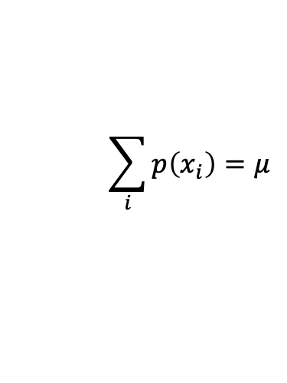



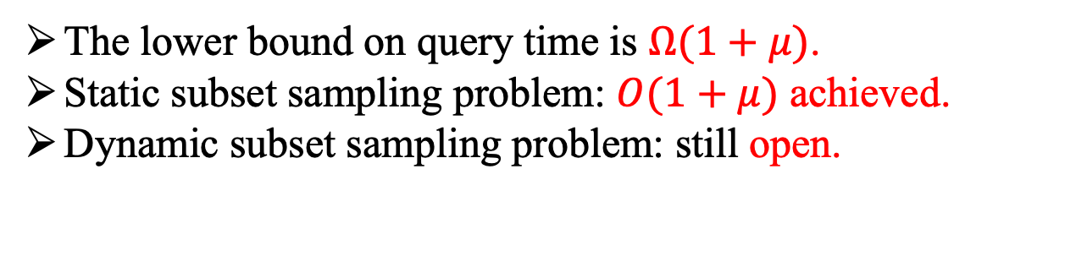
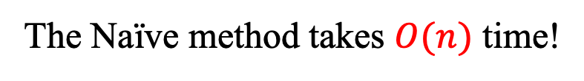
Naïve Method for Subset Sampling
The Naïve method takes $O(n)$ time!
$rand(0,1)<p\left(x_{2}\right)?$
$rand(0,1)<p\left(x_{1}\right)?$
YES!
NO!
domain set S
sample result T
$${ x}_{1}$$
$${ x}_{2}$$
$${ x}_{3}$$
$${ x}_{4}$$
$$…$$
$${ x}_{n}$$
subset sampling
$${ x}_{1}$$
$$p(x_{1})$$
$$p(x_{2})$$
$$p(x_{3})$$
$$p(x_{4})$$
$$p(x_{n})$$
$$x_{4}$$
$$\sum_{i}{p\left(x_{i}\right)=μ}$$
The lower bound on query time is $Ω(1+μ)$.
Static subset sampling problem: $O(1+μ)$ achieved.
Dynamic subset sampling problem: still open.
Notes:
How to solve the subset sampling problem? The naive way is to generate@@ a uniform random number for each x_i, and check whether the number is less than p(x_i). If yes,@@ sample the event@@, else@@, do not sample it. It takes O(n) time@@.
.The existing work has achieved@@ O(one plus \mu) time in the static ‘subset sampling problem. However, when it comes to a dynamic setting, the problem is still open.

Slide 6

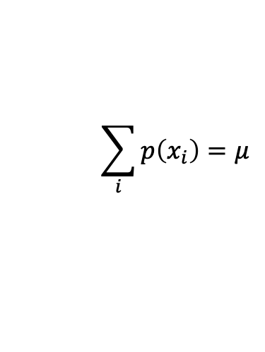




Optimal Dynamic Subset Sampling(ODSS)
domain set S
sample result $T⊆S$
$${ x}_{1}$$
$${ x}_{2}$$
$${ x}_{3}$$
$${ x}_{4}$$
$$…$$
$${ x}_{n}$$
$${ x}_{1}$$
$$p(x_{1})$$
$$p(x_{2})$$
$$p(x_{3})$$
$$p(x_{4})$$
$$p(x_{n})$$
$O\left(1+μ\right)$ per query
$$x_{4}$$
$$\sum_{i}{p\left(x_{i}\right)=μ}$$
Insert an element
Delete an element
Modify the probability of an element
$O\left(1\right)$ per update
Our contribution: achieve both optimality in query and update.
Notes:
In our work, we propose an optimal dynamic subset sampling algorithm, called ODSS, achieving@@ O(one plus \mu) query time and@@ O one update time for the dynamic subset sampling problems. That is, we achieve@@ both optimality in query and update. In the following, we will present the details of our proposed algorithm ODSS.

Slide 7












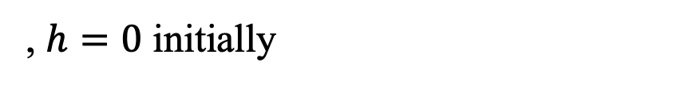


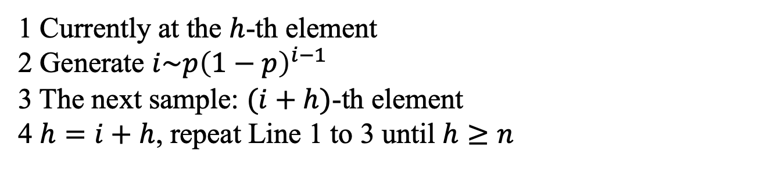
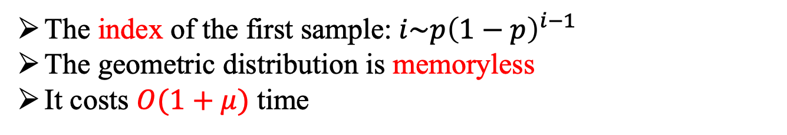

A Simple Case
domain set S
$$p$$
$$p$$
$$p$$
$$p$$
$$p$$
$$p$$
$$p$$
$${ x}_{1}$$
$${ x}_{2}$$
$${ x}_{3}$$
$${ x}_{4}$$
$${ x}_{5}$$
$${ x}_{6}$$
$${ x}_{7}$$
$$h=2$$
$$i=3$$
Sample $h+i=5$
$$h=5$$
The index of the first sample: $i\sim p{\left(1−p\right)}^{i−1}$
The geometric distribution is memoryless
It costs $O(1+μ)$ time
1 Currently at the $h$-th element
2 Generate $i\sim p{\left(1−p\right)}^{i−1}$
3 The next sample: $(i+h)$-th element
4 $h=i+h$, repeat Line 1 to 3 until $h≥n$
, $h=0$ initially
Notes:
A simple case of subset sampling is that each element has the same@@ probability. The index of the first sample@@ follows the geometric distribution. Since the geometric@@ distribution is memoryless, we can obtain the index of the second sample by generating geometric random number in the remainder of the group. Suppose that we are at@@ .the h-th element currently, h equals two, we generate a @@geometric random number i with parameter p, and obtain i as three, Thus, the index of the next@@ sample is I plus h, that is，@@ x five. And we set h as i plus h@@, that is, h equals five, and repeat .the above process until h is greater than n. Initially,@@ we set h equals 0. This finishes the sample. The algorithm costs@@ O one plus \mu time.

Slide 8


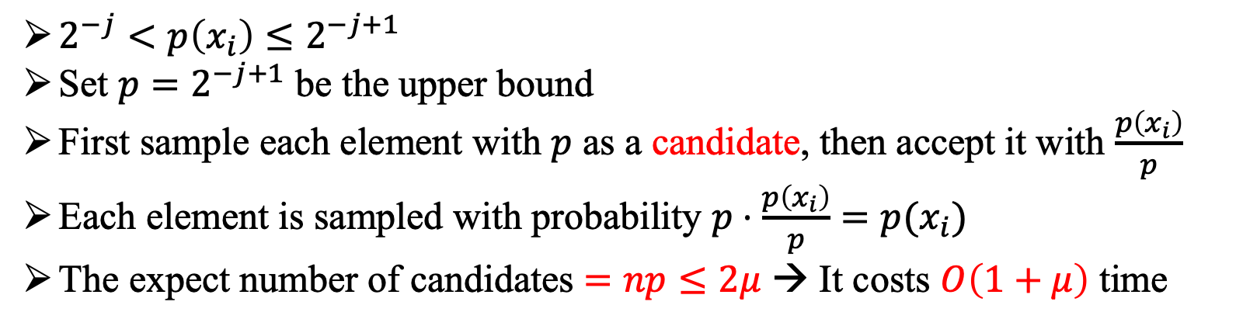



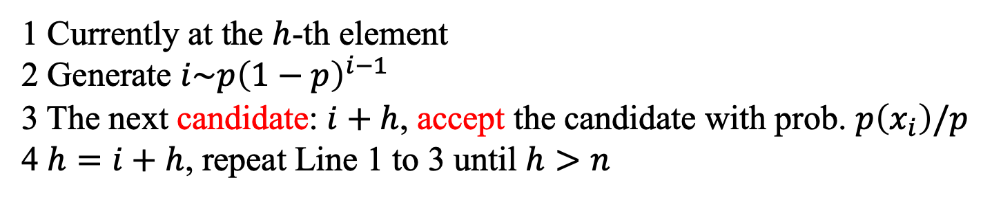






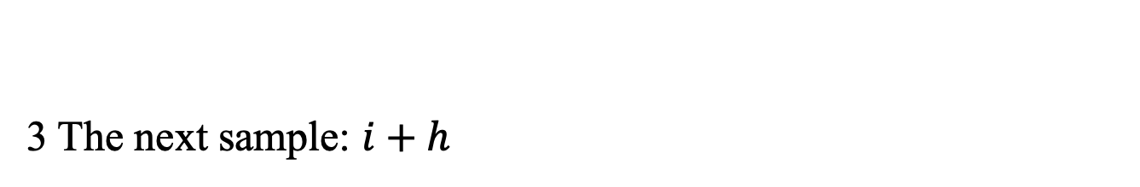



A More Complicated Case
domain set S
$$p(x_{1})$$
$$p(x_{2})$$
$$p(x_{3})$$
$$p(x_{4})$$
$$p(x_{5})$$
$$p(x_{6})$$
$$p(x_{7})$$
$${ x}_{1}$$
$${ x}_{2}$$
$${ x}_{3}$$
$${ x}_{4}$$
$${ x}_{5}$$
$${ x}_{6}$$
$${ x}_{7}$$
GeoSS
$2^{−j}<p\left(x_{i}\right)≤2^{−j+1}$
Set $p=2^{−j+1}$ be the upper bound
First sample each element with $p$ as a candidate, then accept it with $\frac{p\left(x_{i}\right)}{p}$
Each element is sampled with probability $p⋅\frac{p\left(x_{i}\right)}{p}=p(x_{i})$
The expect number of candidates $=np≤2μ$ → It costs $O\left(1+μ\right)$ time
1 Currently at the $h$-th element
2 Generate $i\sim p{\left(1−p\right)}^{i−1}$
3 The next candidate: $i+h$, accept the candidate with prob. $p\left(x_{i}\right)/p$
4 $h=i+h$, repeat Line 1 to 3 until $h>n$
3 The next sample: $i+h$
Notes:
Next, we consider a more complicated case. In this case, all probabilities @@is greater than two to the power of negative j and no greater than two to the power of negative j plus one. Let p be two to the power of negative j plus one, the upper @@bound of the probabilities. We first sample each element@@ with probability p as a candidate, then accept the candidate with probability p x i divided by p. Thus, each element is correctly sampled with probability p x i. Note that the expected number of candidates equals np, which is less than twice \mu@@ since p is no greater than twice the probabilities of all elements, thus it only costs one plus \mu time to obtain a sample. Only Line 3@@ of the algorithm need to be revised. We call the method as geometric subset sampling@@. This inspires us that we can partition the elements into some groups according to their probabilities and then sample within the groups.

Slide 9


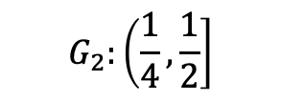


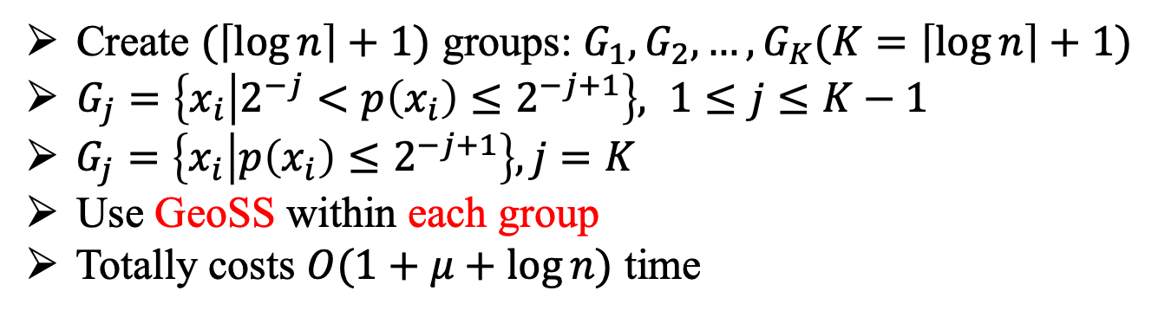
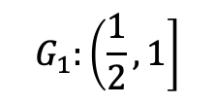




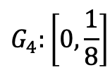




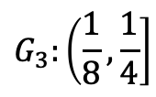
Group Partition
domain set S
$$p(x_{1})$$
$$p(x_{2})$$
$$p(x_{3})$$
$$p(x_{4})$$
$$p(x_{5})$$
$$p(x_{6})$$
$$p(x_{7})$$
$${ x}_{1}$$
$${ x}_{2}$$
$${ x}_{3}$$
$${ x}_{4}$$
$${ x}_{5}$$
$${ x}_{6}$$
$${ x}_{7}$$
$${ x}_{1}$$
$${ x}_{4}$$
$${ x}_{6}$$
$${ x}_{7}$$
$${ x}_{2}$$
$${ x}_{3}$$
$${ x}_{5}$$
$$G_{1}:\left(\frac{1}{2},1\right]$$
$$G_{2}:\left(\frac{1}{4},\frac{1}{2}\right]$$
$$G_{3}:\left(\frac{1}{8},\frac{1}{4}\right]$$
$$G_{4}:\left[0,\frac{1}{8}\right]$$
Create $(\left\lceil \log{n}\right\rceil +1)$ groups: $G_{1}, G_{2},…,G_{K}(K=\left\lceil \log{n}\right\rceil +1)$
$G_{j}=\left\{x_{i} | 2^{−j}<p\left(x_{i}\right)≤2^{−j+1}\right\}, 1≤j≤K−1$
$G_{j}=\left\{x_{i} | p\left(x_{i}\right)≤2^{−j+1}\right\}, j=K$
Use GeoSS within each group
Totally costs $O(1+μ+\log{n})$ time
Notes:
In our algorithm, we will first partition the n elements into@@ the ceiling of log n plus one groups, from group one to group K. For the first@@ K minus one groups, the j-th group contains the elements with probability greater than two to the power of negative j and less than two to the power of negative j plus one. And the last group@@ G K contains the elements with probability less than two to the power of negative K plus one. Let’s work it out in detail in the example here. There are seven elements in the domain set S. Thus, we@@ create four groups, and put the elements into the groups@@ according to their probabilities. In doing so, we can use the geometric@@ subset sampling method within each group. It costs@@ one plus \mu plus log n time since there are log n groups. The time complexity is not optimal due to the log n term. How to get rid of it?

Slide 10













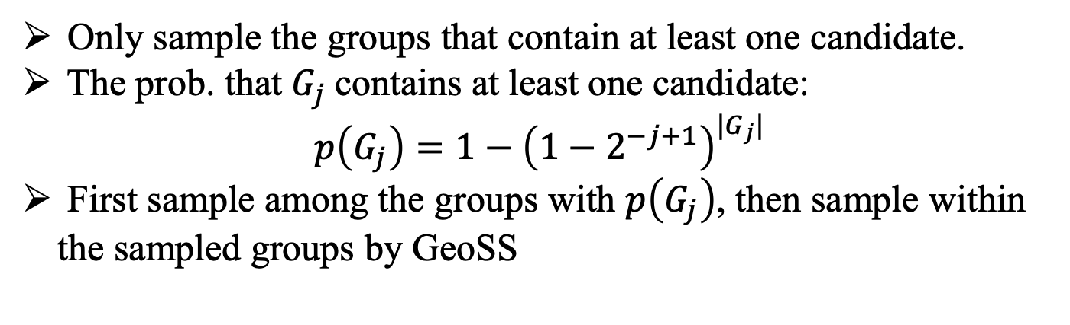





















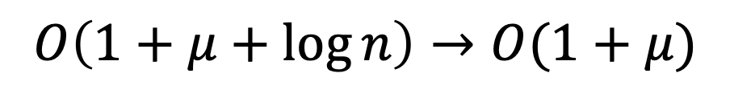
$$O\left(1+μ+\log{n}\right)→O(1+μ)$$
domain set S
$$p(x_{1})$$
$$p(x_{2})$$
$$p(x_{3})$$
$$p(x_{4})$$
$$p(x_{5})$$
$$p(x_{6})$$
$$p(x_{7})$$
$${ x}_{1}$$
$${ x}_{2}$$
$${ x}_{3}$$
$${ x}_{4}$$
$${ x}_{5}$$
$${ x}_{6}$$
$${ x}_{7}$$
$${ x}_{1}$$
$${ x}_{4}$$
$${ x}_{6}$$
$${ x}_{7}$$
$${ x}_{2}$$
$${ x}_{3}$$
$${ x}_{5}$$
$$G_{1}$$
$$G_{2}$$
$$G_{3}$$
$$G_{4}$$
$${ G}_{1}$$
$${ G}_{2}$$
$${ G}_{3}$$
$${ G}_{4}$$
$$p(G_{1})$$
$$p(G_{2})$$
$$p(G_{3})$$
$$p(G_{4})$$
Only sample the groups that contain at least one candidate.
The prob. that $G_{j}$contains at least one candidate: $p\left(G_{j}\right)=1−{\left(1−2^{−j+1}\right)}^{|G_{j}|}$
First sample among the groups with $p\left(G_{j}\right)$, then sample within the sampled groups by GeoSS
Notes:
To get rid of the log n term, we must not sample within each group. Instead, we only@@ sample the group when the group has at least one candidate. The probability that the group G j contains at least one candidate can be calculated as p G j. We@@ first sample among the groups with p G j, then only sample within the sampled groups by geometric subset sampling. In our example, we get four @@new group elements, G one to G four. After we sample these four groups according to their probabilities p G j, we get the sample result containing @@G one and G three. Then we sample within G one and G three, and we obtain @@x one and x six in G one and obtain @@x two in G three.

Slide 11








































Sample Among the Groups
domain set S
$$p(x_{1})$$
$$p(x_{2})$$
$$p(x_{3})$$
$$p(x_{4})$$
$$p(x_{5})$$
$$p(x_{6})$$
$$p(x_{7})$$
$$p(x_{1}^{\left(0\right)})$$
$$p(x_{2}^{\left(0\right)})$$
$$p(x_{3}^{\left(0\right)})$$
$$p(x_{4}^{\left(0\right)})$$
$$p(x_{5}^{\left(0\right)})$$
$$p(x_{6}^{\left(0\right)})$$
$$p(x_{7}^{\left(0\right)})$$
$${ x}_{1}$$
$${ x}_{2}$$
$${ x}_{3}$$
$${ x}_{4}$$
$${ x}_{5}$$
$${ x}_{6}$$
$${ x}_{7}$$
$$x_{1}^{\left(0\right)}$$
$$x_{2}^{\left(0\right)}$$
$$x_{3}^{\left(0\right)}$$
$$x_{4}^{\left(0\right)}$$
$$x_{5}^{\left(0\right)}$$
$$x_{6}^{\left(0\right)}$$
$$x_{7}^{\left(0\right)}$$
Level 0
$${ x}_{2}$$
$${ x}_{5}$$
$${ x}_{1}$$
$${ x}_{4}$$
$${ x}_{6}$$
$${ x}_{7}$$
$$x_{2}^{\left(0\right)}$$
$${ x}_{3}$$
$$x_{5}^{\left(0\right)}$$
$$x_{1}^{\left(0\right)}$$
$$x_{4}^{\left(0\right)}$$
$$x_{6}^{\left(0\right)}$$
$$x_{7}^{\left(0\right)}$$
$$x_{3}^{\left(0\right)}$$
$$G_{1}$$
$$G_{2}$$
$$G_{3}$$
$$G_{4}$$
$$G_{1}^{\left(0\right)}$$
$$G_{2}^{\left(0\right)}$$
$$G_{3}^{\left(0\right)}$$
$$G_{4}^{\left(0\right)}$$
$$x_{1}^{\left(1\right)}$$
$$x_{2}^{\left(1\right)}$$
$$x_{3}^{\left(1\right)}$$
$$x_{4}^{\left(1\right)}$$
$${ G}_{1}$$
$${ G}_{2}$$
$${ G}_{3}$$
$${ G}_{4}$$
$$p(x_{1}^{\left(1\right)})$$
$$p(x_{2}^{\left(1\right)})$$
$$p(x_{3}^{\left(1\right)})$$
$$p(x_{4}^{\left(1\right)})$$
$$p(G_{1})$$
$$p(G_{2})$$
$$p(G_{3})$$
$$p(G_{4})$$
Level 1
$$x_{3}^{\left(1\right)}$$
$$x_{4}^{\left(1\right)}$$
$$x_{1}^{\left(1\right)}$$
$$x_{2}^{\left(1\right)}$$
$$G_{3}^{\left(1\right)}$$
$$G_{1}^{\left(1\right)}$$
$$G_{2}^{\left(1\right)}$$
Partition again.
How to sample the groups at level 1?
Notes:
Now we are left with the problem that how to sample among the groups. We note that it is a subset sampling problem too. Our choice is to @@partition the groups again and thus breaking down the problem into a new but smaller subset sampling problem. To distinguish various subset sampling problems, we denote the subset sampling problem with level index. Level zero@@ is the original subset sampling problem with n elements@@. At level one@@, the elements are the groups from level zero@@. After partitioning again, we obtain three@@ groups at level one. So @@how to sample among the groups at level one? @@

Slide 12



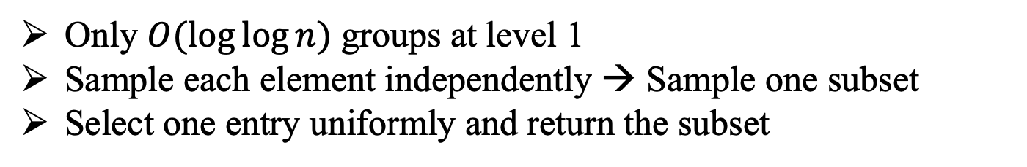
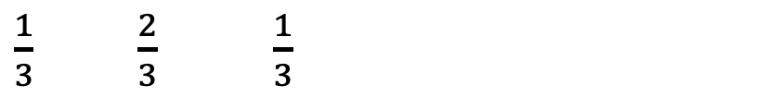













Table Lookup Method
Only $O(\log{\log{n}})$ groups at level 1
Sample each element independently → Sample one subset
Select one entry uniformly and return the subset
$${ x}_{1}$$
$${ x}_{2}$$
$${ x}_{3}$$
$\frac{1}{3}$ $\frac{2}{3}$ $\frac{1}{3}$
$${ x}_{1}$$
$${ x}_{2}$$
$${ x}_{3}$$
$\frac{1}{3}⋅\frac{2}{3}⋅\frac{1}{3}=\frac{2}{27}$
111
111
110
110
110
110
…
…
…
…
$${ x}_{1}$$
$${ x}_{2}$$
$${ x}_{3}$$
$\frac{1}{3}⋅\frac{2}{3}⋅\frac{2}{3}=\frac{4}{27}$
$$=1$$
27 entries
……
$${ x}_{1}$$
$${ x}_{2}$$
$${ x}_{3}$$
$\frac{2}{3}⋅\frac{1}{3}⋅\frac{2}{3}=\frac{4}{27}$
Notes:
Note that there are @@only O log log n groups at level one. To deal with the subset sampling problem with so few elements, we introduce a table lookup method. Suppose that we have @@three elements, x one, x two, and x three, with probability one third, two third, and one third, respectively. We can calculate the probability that each subset is selected as the sample result, for example, the subset containing all the three elements@@ is selected as the result with probability two over twenty-seven. And the subset@@ containing x one x two is selected with probability four over twenty-seven. We can calculate the probabilities of all the subsets@@. And All the probabilities sum up to one. Instead of @@sampling each element with its probability independently, we can select one subset from all the subsets according to the probability distribution of subsets. We create a row@@ to help with sample. There are twenty-seven entries. For the first subset@@ that contains all the elements, since its probability is two over twenty-seven, we fill two entries@@ with the subset, denoted as 111 in binary. The second subset@@, with probability four over twenty-seven, is thus filled in four entries@@. After we’ve done with all subsets@@, the row is full-filled. To get a sample, we simply @@select one entry uniformly from the row and return the subset indicated by the entry.

Slide 13
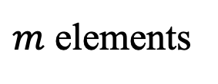
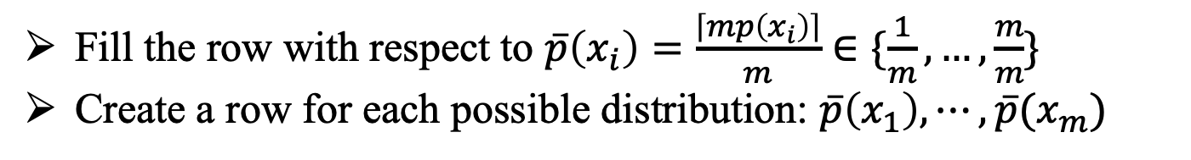
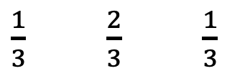
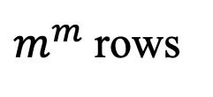

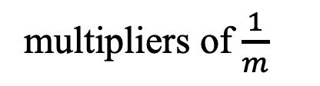
Table Lookup Method
Fill the row with respect to $\overline{p}\left(x_{i}\right)=\frac{\left\lceil mp\left(x_{i}\right)\right\rceil }{m}∈\{\frac{1}{m},…,\frac{m}{m}\}$
Create a row for each possible distribution: $\overline{p}\left(x_{1}\right),⋯,\overline{p}(x_{m})$
$${ x}_{1}$$
$${ x}_{2}$$
$${ x}_{3}$$
$m$ elements
$\frac{1}{3}$ $\frac{2}{3}$ $\frac{1}{3}$
multipliers of $\frac{1}{m}$
111
111
110
110
110
110
…
$m^{m}$ rows
$m^{m}$ entries
…
$m^{m}$ entries
Notes:
In a word, when there are@@ m elements@@, and all the probabilities@@ are the multipliers@@ of one over m, we can create a row with m to the power of m entries to sample.
To deal with the general case, we @@fill the row with respect to bar p x i instead of p x i.
Note that the probabilities of the elements will change over time. To accommodate the modification, we @@create a row for each possible distribution. Thus, a table@@ with m@@ to the power@@ of m rows and m@@ to the power of m columns is obtained@@.

Slide 14



















The Structure Overview
domain set S
$$x_{1}^{\left(0\right)}$$
$$x_{4}^{\left(0\right)}$$
$$x_{6}^{\left(0\right)}$$
$$x_{7}^{\left(0\right)}$$
$$x_{2}^{\left(0\right)}$$
$$x_{3}^{\left(0\right)}$$
$$x_{5}^{\left(0\right)}$$
Level 0
$$G_{1}^{\left(0\right)}$$
$$G_{2}^{\left(0\right)}$$
$$G_{3}^{\left(0\right)}$$
$$G_{4}^{\left(0\right)}$$
$$x_{3}^{\left(1\right)}$$
$$x_{4}^{\left(1\right)}$$
$$x_{1}^{\left(1\right)}$$
$$x_{2}^{\left(1\right)}$$
Level 1
$$G_{3}^{\left(1\right)}$$
$$G_{1}^{\left(1\right)}$$
$$G_{2}^{\left(1\right)}$$
$$p\left(G_{1}^{\left(1\right)}\right),p\left(G_{2}^{\left(1\right)}\right),p\left(G_{3}^{\left(1\right)}\right)$$
101
Level 2
…
Return $\{x_{2},x_{4}\}$ as the sample result.
Notes:
Now, it is time to look at the whole algorithm. After preprocessing, we have three levels: level zero has the original elements, which have been put@@ in the corresponding groups. The groups at level zero becomes the elements at level one@@, which have also been put@@ in the corresponding groups. Level two is a lookup table, which is used to sample the groups at level one. According to the probabilities of the groups at level one, that is, p G one, p G two, and p G three@@, we have indexed into a row that corresponds to the current distribution. When sampling, we first uniformly choose@@ an entry in the row. And it turns out@@ to be one zero one, that is, sampling the g one@@ and g three@@. Then, We sample within g one and g three at level one. In G three, we successfully sample @@x 3 and reject x 4. In G one, we successfully sample @@x 1. Then we comes to level zero. We sample within g three and g one, and finally it comes out that @@x four and @@x two is sampled@@. This finishes the sampling@@.

Slide 15
Update Operations
Insert an element
Delete an element
Modify the probability of an element
Notes:
Next, we consider the update operations, including insertions@@, deletions@@ and modifications@@. Take an element insertion@@ as an example. Suppose that x eight is to insert. According to p x eight, it is assigned to G two at level zero. Since the size of G two is enlarged to two elements, p G 2 becomes smaller, that is, the probability of x two at level one is modified and needs to move from G two to G one. Thus, G two becomes empty and G one contains two elements.

Slide 16

























Update Operations
$$x_{8}^{\left(0\right)}$$
$$p\left(x_{8}^{\left(0\right)}\right)=0.3$$
Insert an element
$$x_{1}^{\left(0\right)}$$
$$x_{4}^{\left(0\right)}$$
$$x_{6}^{\left(0\right)}$$
$$x_{7}^{\left(0\right)}$$
$$x_{7}^{\left(0\right)}$$
$$x_{8}^{\left(0\right)}$$
$$x_{2}^{\left(0\right)}$$
$$x_{3}^{\left(0\right)}$$
$$x_{5}^{\left(0\right)}$$
Level 0
$$G_{1}^{\left(0\right)}$$
$$G_{2}^{\left(0\right)}$$
$$G_{3}^{\left(0\right)}$$
$$G_{4}^{\left(0\right)}$$
$$x_{3}^{\left(1\right)}$$
$$x_{4}^{\left(1\right)}$$
$$x_{1}^{\left(1\right)}$$
$$x_{1}^{\left(1\right)}$$
$$x_{2}^{\left(1\right)}$$
$$x_{2}^{\left(1\right)}$$
Level 1
$$G_{3}^{\left(1\right)}$$
$$G_{1}^{\left(1\right)}$$
$$G_{2}^{\left(1\right)}$$
$$p\left(G_{1}^{\left(1\right)}\right),p\left(G_{2}^{\left(1\right)}\right),p\left(G_{3}^{\left(1\right)}\right)$$
Level 2
…
Notes:
Suppose that x eight@@ is to insert. According to p x eight, it is assigned to G two@@ at level zero@@. Since the size of G two is enlarged to two elements, p G 2@@ becomes smaller, that is, the probability of x two at level one is modified and needs to be moved@@ from G two@@ to G one@@. Thus, G two becomes empty and G one contains two elements. Since G one and G two is modified, the probabilities of them is modified accordingly. Thus, the current row index@@ needs to be revised@@@@ based on the new probabilities. Deletions and probability modifications can be done in a similar way.

Slide 17
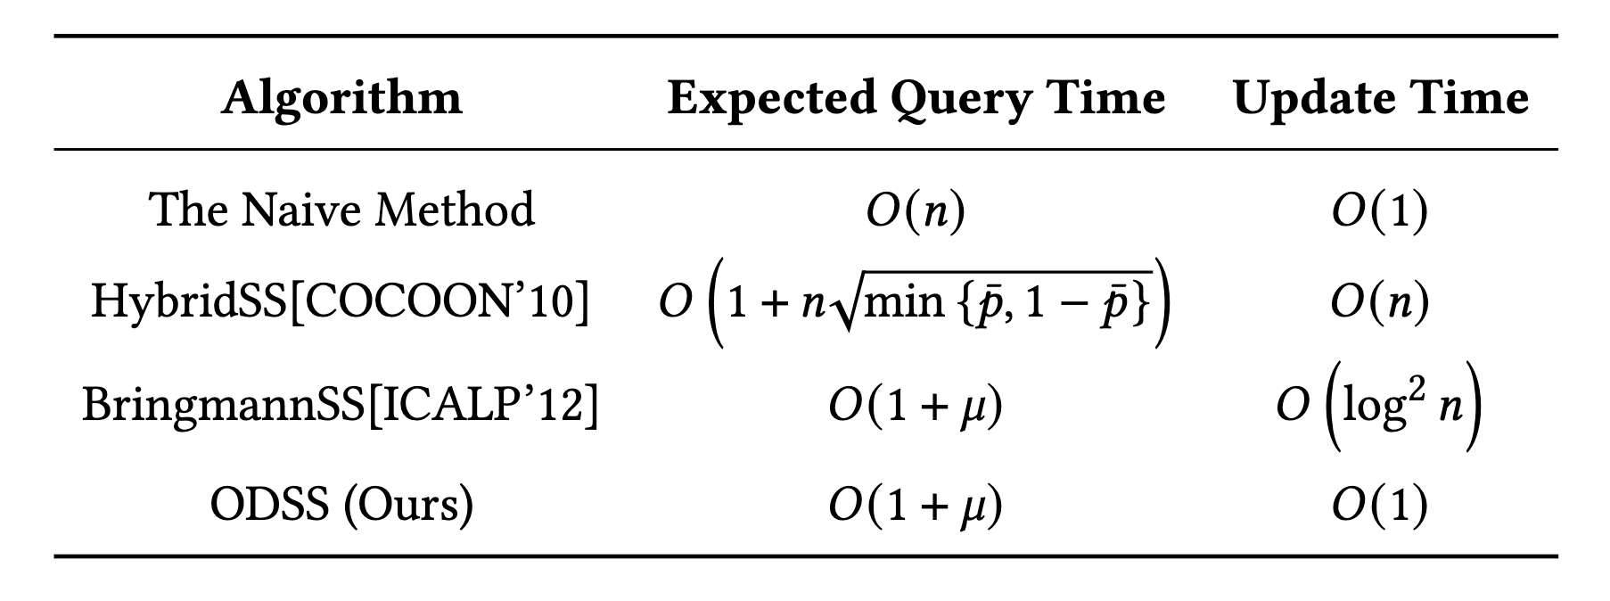

Experiments
Competitors
Distributions of probabilities
Normal distribution (skewness as 0)
Half-normal distribution (skewness below 1)
Exponential distribution (skewness as 2)
Log-normal distribution (skewness as 4 )
Re-scale the range of the random number into $[0,1]$
Notes:
We evaluate the performance of our algorithm ODSS @@against the existing works, including the naïve method, the hybrid subset sampling method, the bringmann subset sampling method. The expected query time of the naïve method is O n while the update time is O one. For the hybrid subset sampling method, the expected query time is one plus n times the square root of the minimum of bar p and one minus bar p, where \bar p is the average probability of the elements. And for the bringmann subset sampling method, the expected query time is the lower bound as our ODSS, O one plus mu. However, the update time is o the square of log n. To @@examine the effectiveness of our ODSS, we carefully set the probabilities of elements distributed with various skewnesses. We choose the normal distribution, which has skewness as zero, the half-normal distribution with skewness below one, exponential distribution with skewness as two and log-normal distribution with skewness as four. After generating random numbers, we @@rescale the range of them into the closed interval from zero to one.

Slide 18
Experiments
Trade-off between query time and update time. ($n={10}^{5},μ=1$)
Notes:
We first draw the trade-off plots between query time and update time of each method. Here we set the number of elements as one hundred thousand and the sum of probabilities as one. We observe that our ODSS outperforms other methods in terms of both query and update time. The Naive method performs efficient updates, while it requires a large query time, which is one thousand times slower than ODSS. The query time of the Bringmann subset sampling method and the Hybrid subset sampling method is significantly smaller than the Naive method, while the update time is one hundred times, ten thousand times larger than our ODSS, respectively.

Slide 19
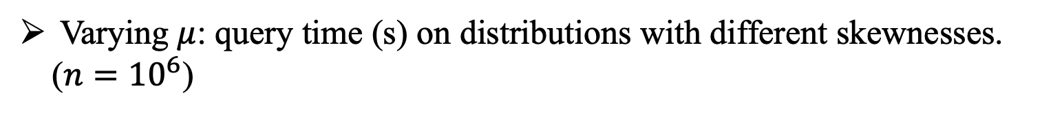
Experiments
Varying $μ$: query time (s) on distributions with different skewnesses. ($n={10}^{6}$)
Notes:
To further examine the query time of these algorithms, we vary 𝜇, the sum of the probabilities of elements, and show the query time. As shown in the figures, the query time of all algorithms except the naïve method increases linearly with \mu. These results concur with the theoretical time complexity of the query time of all algorithms.

Slide 20
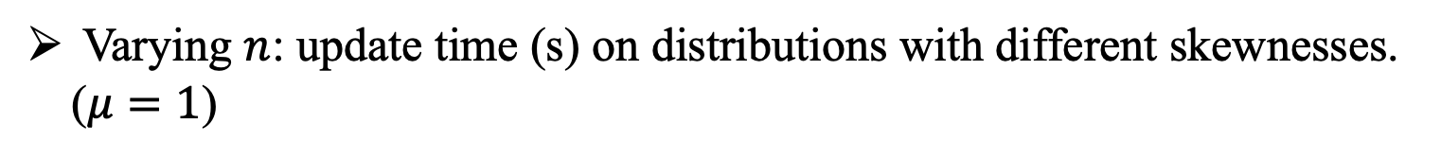
Experiments
Varying $n$: update time (s) on distributions with different skewnesses. ($μ=1$)
Notes:
To further examine the update time, we set \mu equals one and vary n from one million to one billion. The results shows that the naïve method and ODSS consistently outperform other algorithms on all distributions.

Slide 21
Thank you!
Notes:
Thank you for your listening and see you in Long Beach!

