Slide 1

Optimal Matrix Sketching over Sliding Windows
Hanyan Yin¹, Dongxie Wen¹, Jiajun Li¹, Zhewei Wei^{1*},
Xiao Zhang¹, Zengfeng Huang², Feifei Li³
¹ Renmin University of China
² Fudan University
³ Alibaba Group
Aug 2024
*Zhewei Wei is the corresponding author.

Slide 2
Streaming Scenario & Sliding Window Model
Streaming data scenario encounters vast volume of data streams with rapid throughput rate. (sensor data/network logs)
Computational/storage resources are still limited today.
Algorithms for streaming data provide approximate solutions with sublinear space or time complexity relative to the input size
Notes:
In many applications today, data are often input like a stream, which can be vast in volume and at a rapid rate, such as sensor data or network logs. However, our computational and storage resources are still limited today. Therefore, we need efficient algorithms with compact data structures, where a small margin of error is acceptable.

Slide 3









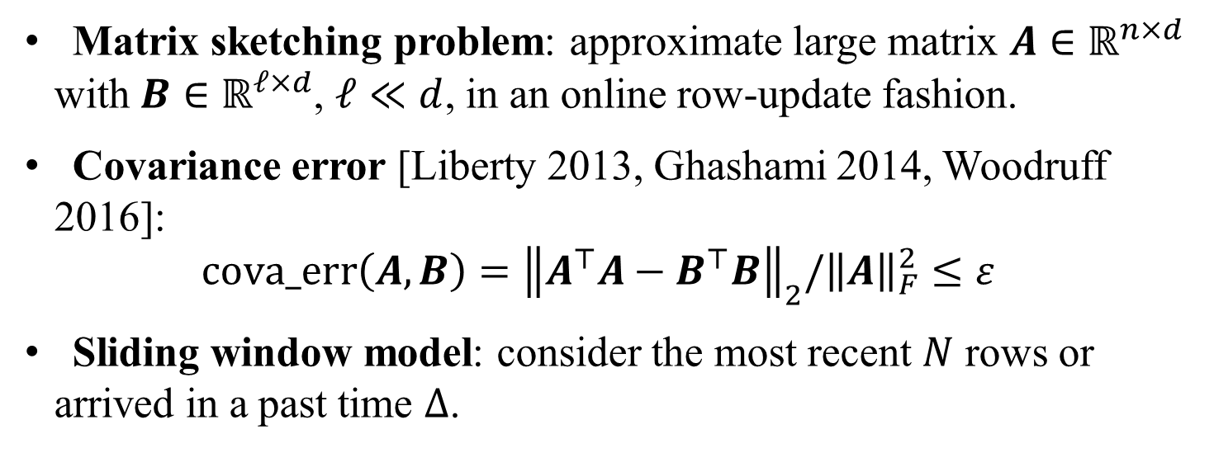
Matrix sketching over sliding windows
Matrix sketching problem: approximate large matrix $A∈ℝ^{n×d}$ with $B∈ℝ^{ℓ×d}$, $ℓ≪d$, in an online row-update fashion.
Covariance error [Liberty 2013, Ghashami 2014, Woodruff 2016]: $cova_err\left(A,B\right)={\left\|A^{⊤}A−B^{⊤}B\right\|}_{2}/{\left\|A\right\|}_{F}^{2}≤ε$
Sliding window model: consider the most recent $N$ rows or arrived in a past time $Δ$.
E.g. recent 1k posted tweets, network logs in last 24 hours
$$A$$
$$d$$
$$B$$
$$d$$
$$A$$
$$d$$
$$B$$
$$d$$
$$\frac{1}{ε}$$
$$\frac{1}{ε}$$
$$T$$
$$N$$
Streaming model
Sliding window model
Notes:
In this work, we focus on the matrix sketching problem within the sliding window model. The goal of the algorithm is to produce a smaller matrix B, that approximates a larger matrix A. The large matrix A is formed by stacking the N most recently arrived vectors from a vector stream. The quality of this approximation is evaluated by the covariance error.
While the streaming model considers all elements from the beginning of an epoch, the sliding window model narrows the focus to the most recent N elements or those that arrived within a recent time period, Δ. Our study addresses this latter model.

Slide 4
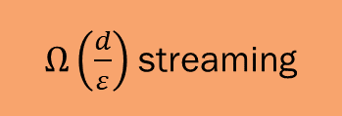

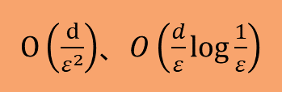
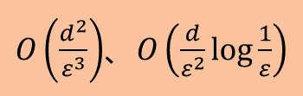
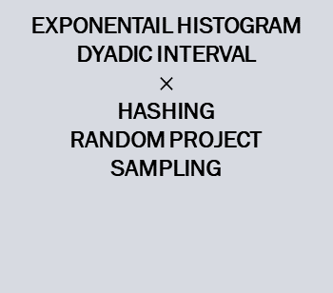
Motivations
Matrix sketching in sliding window model is not optimal.
Matrix sketching in streaming model is optimal. [Liberty 2013]
Matrix sketching in sliding window model was NOT optimal yet.
Lower bound.
The space complexity of our method aligns with the lower bound, thus is optimal.
$O\left(\frac{d^{2}}{ε^{3}}\right)$、$O\left(\frac{d}{ε^{2}}log\frac{1}{ε}\right)$
$O\left(\frac{d}{ε^{2}}\right)$、$O\left(\frac{d}{ε}\log{\frac{1}{ε}}\right)$
Exponentail histogram
Dyadic interval
$$×$$
HAShing
random project
Sampling
$$O\left(\frac{d}{ε}\right)$$
$Ω\left(\frac{d}{ε}\right)$ streaming
LM-FD
Di-FD
DS-FD
Sliding window LB
FD
Streaming LB
2016-
2016
This work
2013
Notes:
One of the motivations for studying the matrix sketching problem in sliding window model is that the space complexity of existing algorithms has not yet reached optimal, unlike in the streaming model. For example, given a covariance error bound epsilon, methods like hashing, random projection or sampling require quadratic level of space. In 2016, Wei introduced the LM-FD and DI-FD algorithms, which reduced the space complexity further.
In this work, we squeeze the space cost further to the optimal level by proposing the DS-FD algorithm. This result is consistent with the lower bound in the streaming model established by Liberty in 2013.

Slide 5
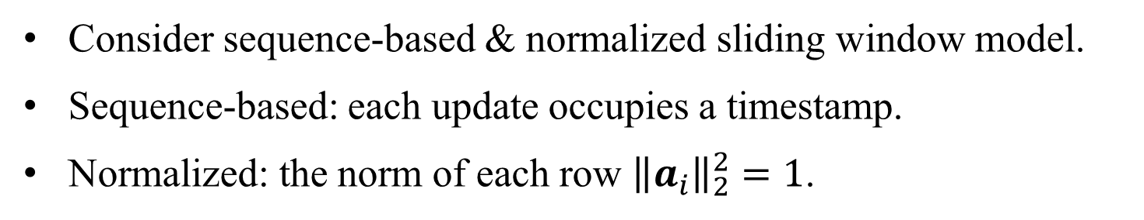


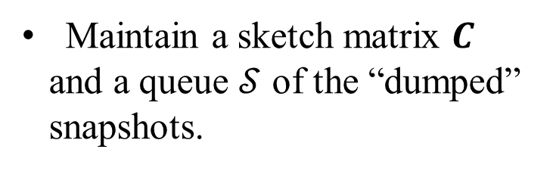
Dump snapshot
Consider sequence-based & normalized sliding window model.
Sequence-based: each update occupies a timestamp.
Normalized: the norm of each row ${\left\|a_{i}\right\|}_{2}^{2}=1$.
$$𝒮$$
Maintain a sketch matrix $C$ and a queue $𝒮$ of the “dumped” snapshots.
$$C$$
Time
Notes:
First, let's take a step back and consider a constrained scenario where the norm of each row is constantly 1, and each update occupies one timestamp. The window length is set to N. We refer to this as the sequence-based and normalized sliding window model.
Now, let me introduce how DS-FD works within this model. Initially, we maintain a sketch matrix C and a queue S.

Slide 6

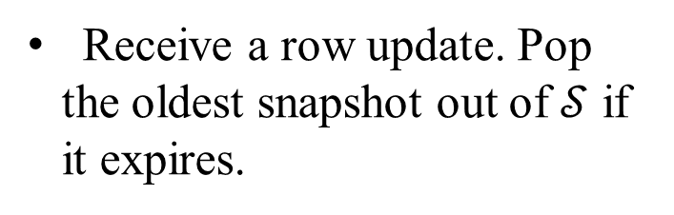
Dump snapshot
Consider sequence-based & normalized sliding window model.
Sequence-based: each update occupies a timestamp.
Normalized: the norm of each row ${\left\|a_{i}\right\|}_{2}^{2}=1$.
$$𝒮$$
Receive a row update. Pop the oldest snapshot out of $𝒮$ if it expires.
$$C$$
$$a_{T}$$
Time
Notes:
When a row vector a arrives, we first remove any outdated elements from the queue S. Next, we concatenate the matrix C with the new vector a.

Slide 7




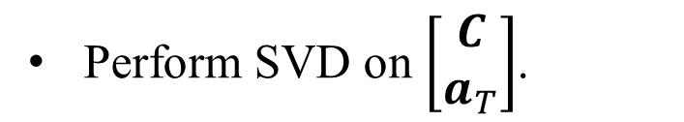

Dump snapshot
Consider sequence-based & normalized sliding window model.
Sequence-based: each update occupies a timestamp.
Normalized: the norm of each row ${\left\|a_{i}\right\|}_{2}^{2}=1$.
$$𝒮$$
Perform SVD on $\left[\begin{matrix}C \\ a_{T}\end{matrix}\right]$.
$$C$$
$$a_{T}$$
=
$$⋅$$
$$⋅$$
$$U$$
$$Σ$$
$$V^{⊤}$$
Time
Notes:
Next, we perform Singular Value Decomposition (SVD) on the concatenated matrix C.

Slide 8
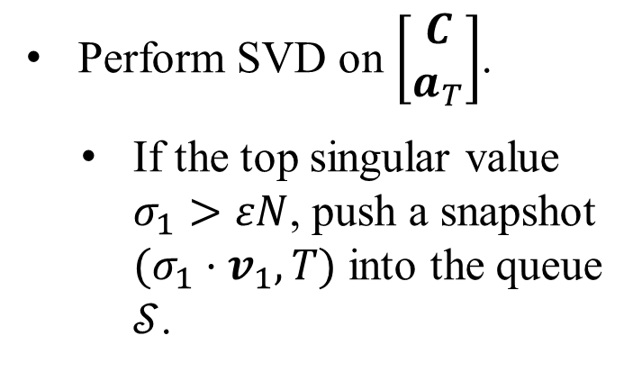
Dump snapshot
Consider sequence-based & normalized sliding window model.
Sequence-based: each update occupies a timestamp.
Normalized: the norm of each row ${\left\|a_{i}\right\|}_{2}^{2}=1$.
$$𝒮$$
Perform SVD on $\left[\begin{matrix}C \\ a_{T}\end{matrix}\right]$.
If the top singular value $σ_{1}>εN$, push a snapshot $(σ_{1}{⋅v}_{1}, T)$ into the queue $𝒮$.
$$C$$
$$a_{T}$$
=
$$⋅$$
$$⋅$$
$$U$$
$$Σ$$
$$V^{⊤}$$
Time
Notes:
We refer to this as the 'dump' operation.

Slide 9
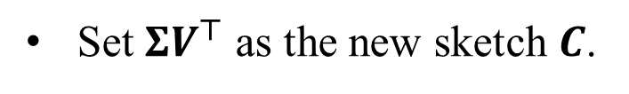
Dump snapshot
Consider sequence-based & normalized sliding window model.
Sequence-based: each update occupies a timestamp.
Normalized: the norm of each row ${\left\|a_{i}\right\|}_{2}^{2}=1$.
$$𝒮$$
Set $ΣV^{⊤}$ as the new sketch $C$.
$$C$$
Time

Slide 10
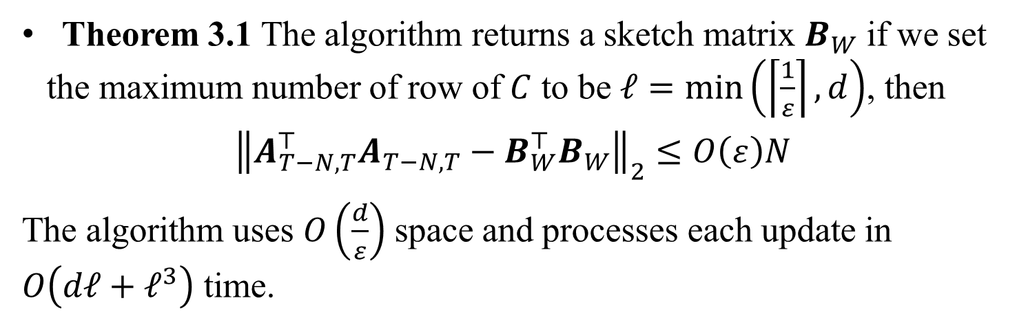
Analysis
Theorem 3.1 The algorithm returns a sketch matrix $B_{W}$ if we set the maximum number of row of $C$ to be $ℓ=\min\left(\left\lceil \frac{1}{ε}\right\rceil ,d\right)$, then
$${\left\|A_{T−N,T}^{⊤}A_{T−N, T}−B_{W}^{⊤}B_{W}\right\|}_{2}≤O\left(ε\right)N$$
The algorithm uses $O\left(\frac{d}{ε}\right)$ space and processes each update in $O\left(dℓ+ℓ^{3}\right)$ time.
Notes:
We have proven that in the sequence-based and normalized model, the algorithm can produce a sketch matrix B that satisfies the epsilon covariance error bound. The space complexity and time complexity are ......... and ........., respectively."

Slide 11

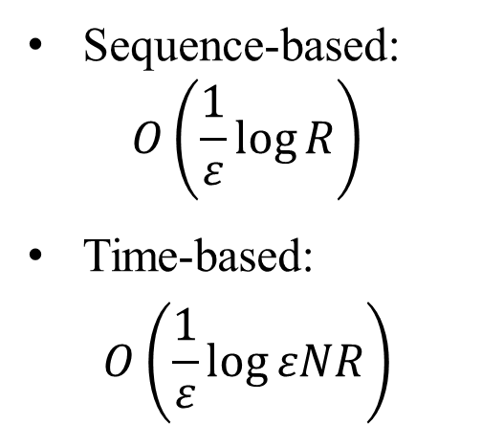
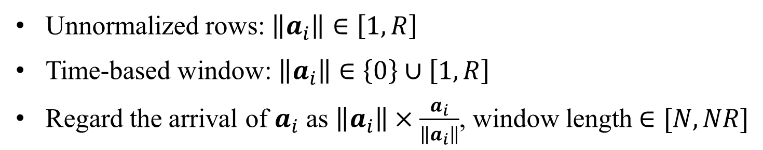






Unnormalized rows & time-based window
Unnormalized rows: $\left\|a_{i}\right\|∈\left[1,R\right]$
Time-based window: $\left\|a_{i}\right\|∈\left\{0\right\}∪\left[1, R\right]$
Regard the arrival of $a_{i}$ as $\left\|a_{i}\right\|×\frac{a_{i}}{\left\|a_{i}\right\|}$, window length $∈[N,NR]$
Current Window
Level $\log{R}$
$$θ=RεN$$
Sequence-based: $O\left(\frac{1}{ε}\log{R}\right)$
Time-based:
$$O\left(\frac{1}{ε}\log{εNR}\right)$$
.
.
.
.
.
.
.
.
.
Level 2
$$θ=4εN$$
Level 1
$$θ=2εN$$
Level 0
$$θ=εN$$
Time
$$T−N$$
$$T$$
Expired Snapshot
Dropped Snapshot
Saved Snapshot
Notes:
We then extend DS-FD to handle more general scenarios when the rows are unnormalized, where the norm of each row vector lies within the range of 1 to R, or in a time-based window model, where each timestamp may contain zero or multiple updates.
In these scenarios, we can first normalize the vector a and treat the one time update of a as multiple time updates of the normalized vector a. This converts the problem into the normalized sequence-based model aforementioned, but with a variable window length. The minimum window length is N, and the maximum is NR.
To manage this, we initialize logarithm R parallel DS-FD data structures, each with an exponentially increasing threshold to trigger the 'dump' operation. The queue at each level stores no more than O(1/ϵ) snapshots. As a result, there will always be one DS-FD level that returns a qualified sketch at any time, and the space complexity naturally increases by a logarithm factor.

Slide 12


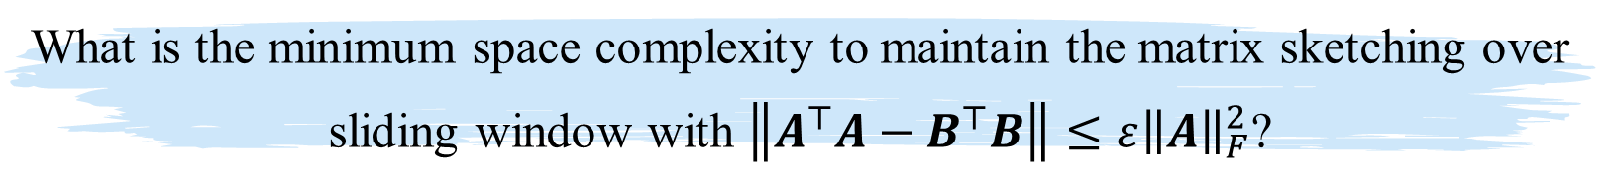



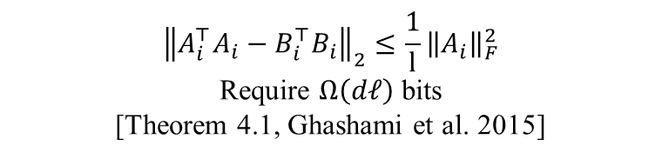
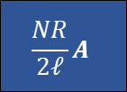
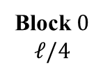



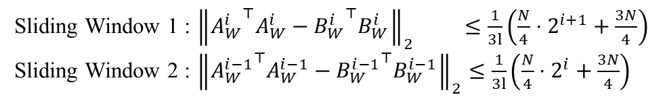
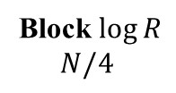



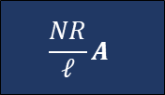
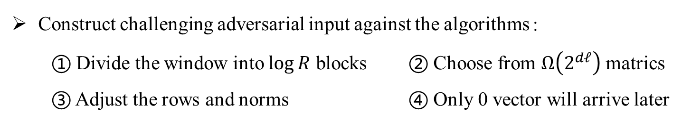

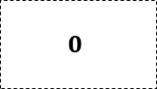




Space Lower bound
What is the minimum space complexity to maintain the matrix sketching over sliding window with $\left\|A^{⊤}A−B^{⊤}B\right\|≤ε{\left\|A\right\|}_{F}^{2}$?
Construct challenging adversarial input against the algorithms：
① Divide the window into $\log{R}$ blocks ② Choose from $Ω\left(2^{dℓ}\right)$ matrics
③ Adjust the rows and norms ④ Only 0 vector will arrive later
Block $\log{R}$
$N/4$
Block 0
$$ℓ/4$$
$$N/8$$
$$ℓ/2$$
$$ℓ/4$$
$$ℓ/4$$
$$ℓ/4$$
$N/4$
$d$-dim
$$\frac{NR}{ℓ}A$$
$$\frac{NR}{2ℓ}A$$
…
$$2RA$$
$$RA$$
$$\frac{R}{2}A$$
…
$$\frac{2N}{ℓ}A$$
$$\frac{N}{ℓ}A$$
$$0$$
$$0$$
$$1$$
$$1$$
$$1$$
$$1$$
$$1$$
$$1$$
$$1$$
$$1$$
$$1$$
$$t−N+1$$
$$t$$
$$t+N/4$$
Sliding Window 1
Sliding Window 2
Sliding Window 1 : ${\left\|{A_{W}^{i}}^{⊤}A_{W}^{i}−{B_{W}^{i}}^{⊤}B_{W}^{i}\right\|}_{2} ≤\frac{1}{3l}\left(\frac{N}{4}⋅2^{i+1}+\frac{3N}{4}\right)$
Sliding Window 2 : ${\left\|{A_{W}^{i−1}}^{⊤}A_{W}^{i−1}−{B_{W}^{i−1}}^{⊤}B_{W}^{i−1}\right\|}_{2}≤\frac{1}{3l}\left(\frac{N}{4}⋅2^{i}+\frac{3N}{4}\right)$
$${\left\|A_{i}^{⊤}A_{i}−B_{i}^{⊤}B_{i}\right\|}_{2}≤\frac{1}{l}{\left\|A_{i}\right\|}_{F}^{2}$$
Require $Ω\left(dℓ\right)$ bits
[Theorem 4.1, Ghashami et al. 2015]
Notes:
Furthermore, we were surprised to discover that the space lower bound for the matrix sketching problem in the sliding window model is of the same order as the space complexity of DS-FD. This indicates that our DS-FD algorithm is optimal in terms of space overhead for solving the problem.

Slide 13
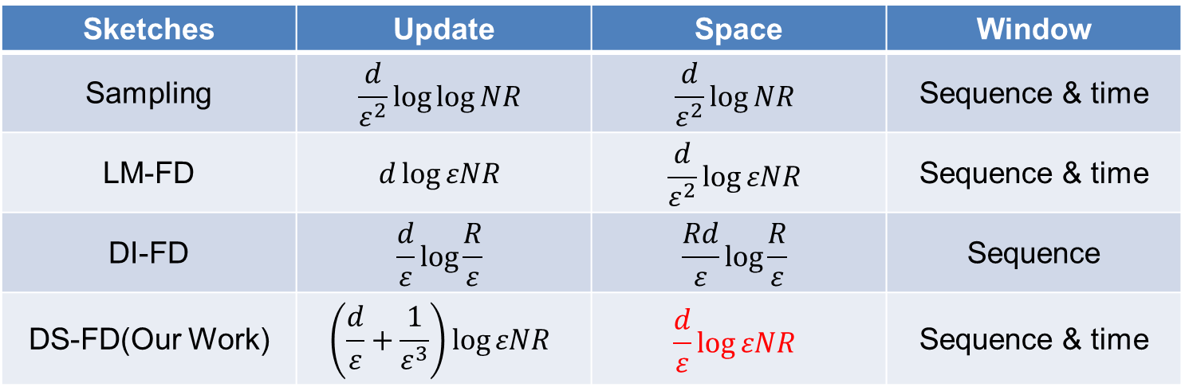
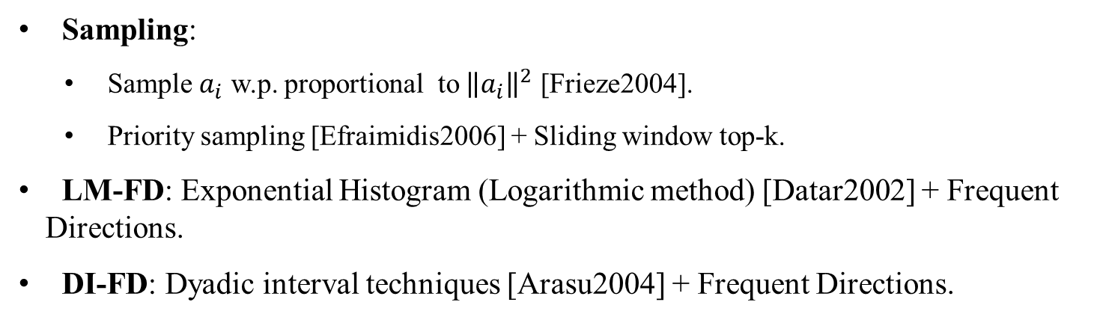
Experiments
Sampling:
Sample $a_{i}$ w.p. proportional to ${\left\|a_{i}\right\|}^{2}$ [Frieze2004].
Priority sampling [Efraimidis2006] + Sliding window top-k.
LM-FD: Exponential Histogram (Logarithmic method) [Datar2002] + Frequent Directions.
DI-FD: Dyadic interval techniques [Arasu2004] + Frequent Directions.
Sketches | Update | Space | Window
Sampling | $$\frac{d}{ε^{2}}\log{\log{NR}}$$ | $$\frac{d}{ε^{2}}\log{NR}$$ | Sequence & time
LM-FD | $$d\log{εNR}$$ | $$\frac{d}{ε^{2}}\log{εNR}$$ | Sequence & time
DI-FD | $$\frac{d}{ε}\log{\frac{R}{ε}}$$ | $$\frac{Rd}{ε}\log{\frac{R}{ε}}$$ | Sequence
DS-FD(Our Work) | $$\left(\frac{d}{ε}+\frac{1}{ε^{3}}\right)\log{εNR}$$ | $$\frac{d}{ε}\log{εNR}$$ | Sequence & time
Notes:
In addition to our theoretical analysis, we conducted comprehensive experiments to show the good performance of our DS-FD algorithm. We compared it with several state-of-the-art baselines, such as the Sampling algorithm.

Slide 14
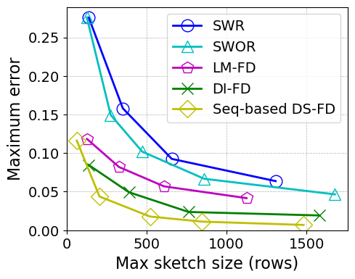
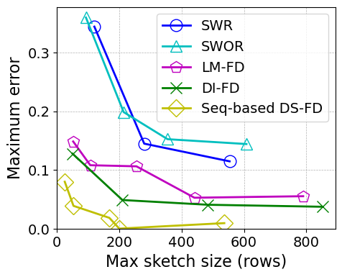
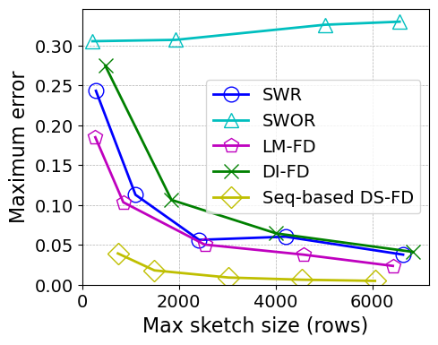
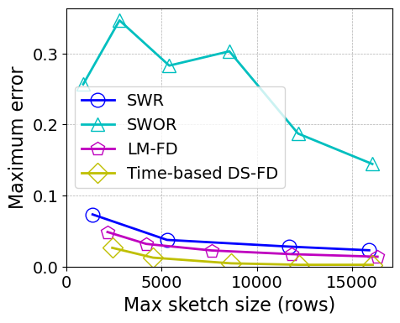
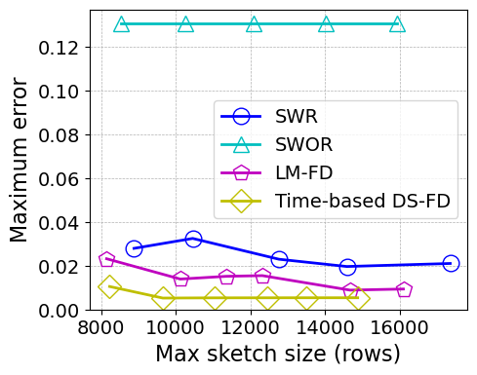
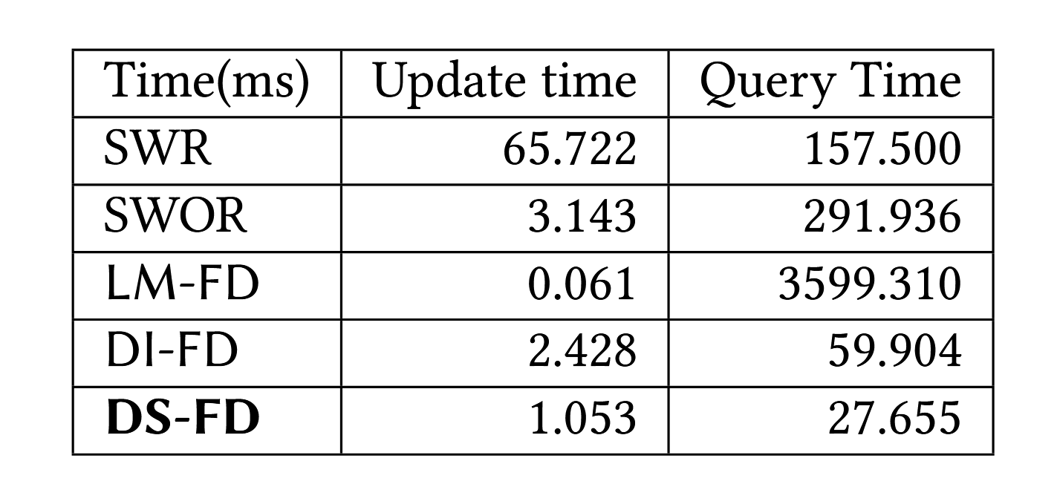
Experiments: space vs. error
(a) SYNTHETIC
(b) BIBD
(c) PAMAP
(d) RAIL
(d) YEAR
DS-FD achieves the best space-error trade-off.
DS-FD achieves the best update-query time cost trade-off.
Notes:
We implemented all the algorithms across various data streams, both synthetic and real-world. We recorded the maximum error, average error, and the corresponding maximum space cost under different parameter settings. Our observations show that DS-FD achieves the best trade-off between error and space cost, as well as between update time and query time. These results confirm the theoretical analysis and the efficiency of our algorithm.

Slide 15
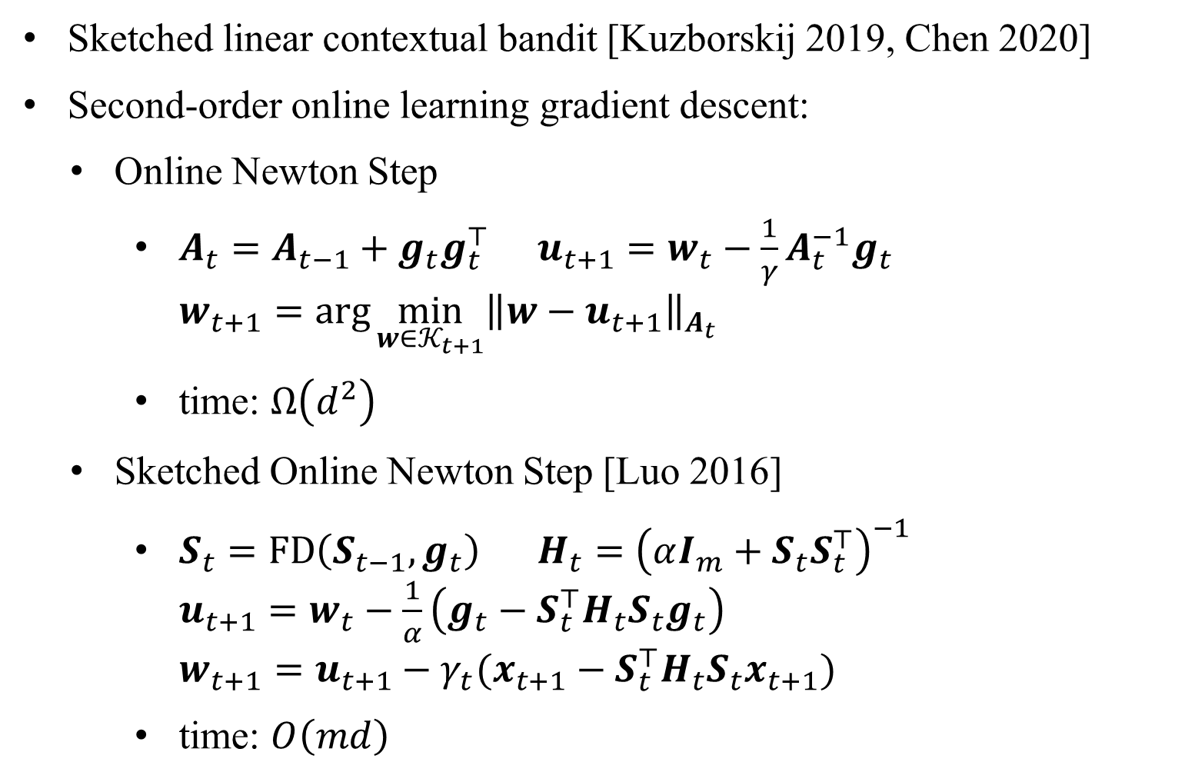
Applications of Matrix Sketching
Sketched linear contextual bandit [Kuzborskij 2019, Chen 2020]
Second-order online learning gradient descent:
Online Newton Step
$A_{t}=A_{t−1}+g_{t}g_{t}^{⊤}$ $u_{t+1}=w_{t}−\frac{1}{γ}A_{t}^{−1}g_{t}$ $w_{t+1}=\arg{\min_{w∈𝒦_{t+1}}{{\left\|w−u_{t+1}\right\|}_{A_{t}}}}$
time: $Ω\left(d^{2}\right)$
Sketched Online Newton Step [Luo 2016]
$S_{t}=FD\left(S_{t−1}, g_{t}\right)$ $H_{t}={\left(αI_{m}+S_{t}S_{t}^{⊤}\right)}^{−1}$ $u_{t+1}=w_{t}−\frac{1}{α}\left(g_{t}−S_{t}^{⊤}H_{t}S_{t}g_{t}\right)$ $w_{t+1}=u_{t+1}−γ_{t}(x_{t+1}−S_{t}^{⊤}H_{t}S_{t}x_{t+1})$
time: $O\left(md\right)$
Notes:
Matrix sketching has been applied to optimize online learning algorithms, like sketched linear contextual bandits and second-order online gradient descent. For example, in the online Newton step, the space and time complexity per step is typically quadratic d. By applying matrix sketching to approximate matrix \( A \), this complexity reduces to \( O(md) \), with only a slight increase in the regret upper bound, where setting of m depends on the spectrum distribution of \( A \).

Slide 16
Conclusion
We introduce DS-FD, a deterministic algorithm that achieves better space complexity for matrix sketching over sliding windows.
We solve the open question of the lower bounds for any deterministic matrix sketching algorithm over sliding windows.
The answer to the open problem confirms that our DS-FD algorithm is optimal in terms of space complexity.
Notes:
In conclusion, we introduced DS-FD, a deterministic algorithm that achieves improved space complexity for matrix sketching over sliding windows. Additionally, we addressed the open question regarding the lower bounds for any deterministic matrix sketching algorithm in this context. The resolution of this open problem confirms that our DS-FD algorithm is indeed optimal in terms of space complexity.

Slide 17
Thanks!
Notes:
Thank you for your attentive listening! And now if you have any questions, I'll be happy to answer them for you.

