Slide 1



Revisiting Local Computation of PageRank: Simple and Optimal
Hanzhi Wang, Zhewei Wei, Ji-Rong Wen, Mingji Yang
Renmin University of China
June 26, 2024
Notes:
Hello everyone. I am Hanzhi Wang from Renmin University of China. It’s my pleasure to present our paper, "Revisiting Local Computation of PageRank: Simple and Optimal." This is a joint work with my supervisor, Prof. Zhewei Wei, Prof. Ji-Rong Wen, and Mingji.

Slide 2
Outline
Random-Walk Probability Estimation
1
Problem Formulations
2
Our Results
3
Techniques
4
Conclusions
Notes:
In this paper, we consider the problem of efficiently estimating random-walk probabilities on large graphs.

Slide 3





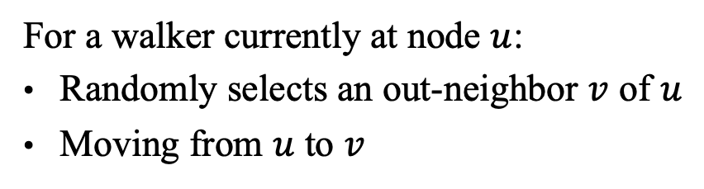


Random Walks on Graphs
10
9
12
2
1
8
3
11
$$1/3$$
$$1/3$$
4
$$1/4$$
$$1/3$$
$$1/4$$
For a walker currently at node $u$:
Randomly selects an out-neighbor $v$ of $u$
Moving from $u$ to $v$
6
5
$$1/4$$
$$1/4$$
7
Notes:
Briefly speaking, a random walk on a graph is a Markovian /mɑ:'kəuviən/ process. (click!) Intuitively, we can imagine that there is a walker on the given graph, continually moving from one node to one of its out-neighbors.

Slide 4




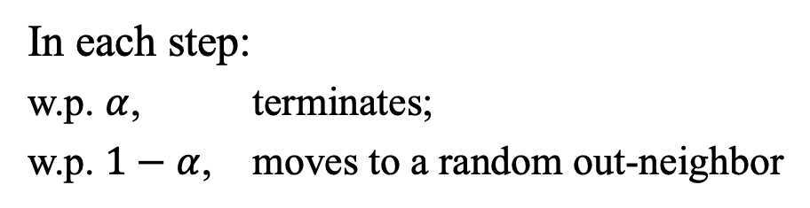
$α$-Discounted Random Walks ($α$-Walks)
10
9
12
2
1
8
3
11
$$α$$
4
$$1−α$$
Damping Factor $α∈(0,1)$, e.g., $α=0.2$
6
5
In each step:
w.p. $α$, terminates;
w.p. $1−α$, moves to a random out-neighbor
$$1−α$$
7
Notes:
Specifically, in our paper, we focus on a special type of random walk called an alpha-walk, （click!）which has a probability of alpha to terminate at each step. We refer to alpha as the damping factor, which is always considered a constant. Due to the presence of alpha, the length of an alpha-walk won’t be too long, and the walking probabilities can quickly converge. These desirable properties make alpha-walks one of the most significant types of short-distance random walks.

Slide 5
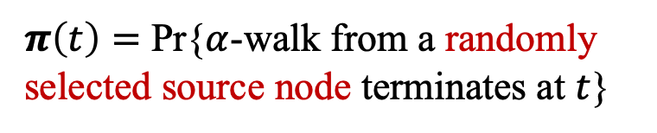




PageRank
Uniformly Sampling a Source Node …
10
10
9
9
12
12
2
2
$$α$$
8
1
8
1
11
3
11
3
4
4
Node $t$’s PageRank Score
$$1−α$$
$$1−α$$
6
6
5
5
Sampled!
$π\left(t\right)=$ Pr{$α$-walk from a randomly selected source node terminates at $t$}
7
7
Notes:
Another reasons alpha-walks are very famours is that the cofouders of Google used alpha-walks to define PageRank. Specifically, for any node t in the graph, (click!) the pagerank score of t equals the probability that an alpha-walk generated from a random source node terminates at node t.

Slide 6
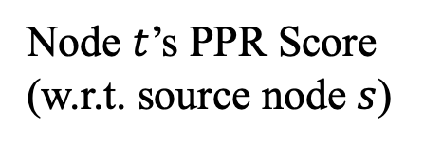

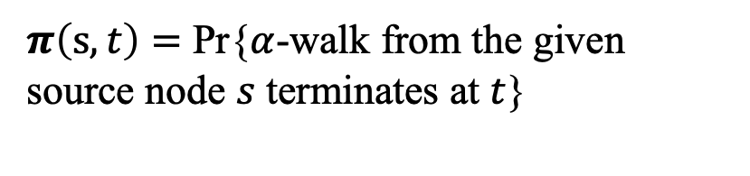



Personalized PageRank (PPR)
10
9
12
2
$$1−α$$
1
8
3
11
$$α$$
4
$$1−α$$
$$1−α$$
Node $t$’s PPR Score (w.r.t. source node $s$)
Given a
Source Node
6
5
$π\left(s,t\right)=$ Pr{$α$-walk from the given source node $s$ terminates at $t$}
7
Notes:
PageRank also has a well-known variant called personalized pagerank, or ppr for short, where for any nodes s and t, the PPR score pi(s,t) equals the probability (click!) that an alpha-walk generated from node s terminates at node t.

Slide 7

Applications
PageRank: Top 10 Data Mining Problems
Proposed by Google for ranking web pages
Local Graph Partitioning [Andersen, Chung, Lang, ’07]
Graph Sparsification [Spielman and Teng, ’04]
Property Testing [Kale and Seshadhri, ’11]
Graph Neural Networks [Klicpera et al., ’19]
Notes:
PageRank computation has been recognized as one of the top 10 data mining problems in the last decade, attracting significant attention and being widely adopted in various applications, such as local graph partitioning, graph sparsification, property testing, and graph neural networks. These applications highlight the importance of designing efficient algorithms for PageRank computation on large graphs.

Slide 8
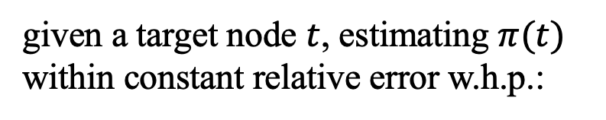


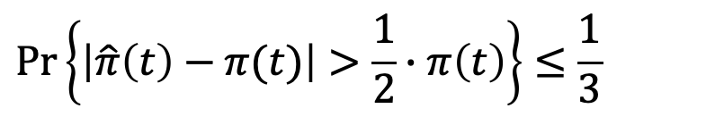
Problem Formulation
Single-Node PageRank Estimation
Given a
Target Node
Estimating $π(t)$
$$t$$
goal:
given a target node $t$, estimating $π(t)$ within constant relative error w.h.p.:
Uniformly Sampled Source Node
$$\operatorname{Pr}\left\{\left|\hat{π}\left(t\right)−π(t)\right|>\frac{1}{2}∙π\left(t\right)\right\}≤\frac{1}{3}$$
Notes:
Given the importance, in our paper, we focus on two fundamental problems related to PageRank and PPR estimation. The first one is single-node PageRank estimation, which asks for a single node’s PageRank on the graph. Specifically, given an arbitrary target node t in a general directed graph, we aim to estimate the PageRank score of node t while ensuring a constant relative error and a constant success probability.

Slide 9
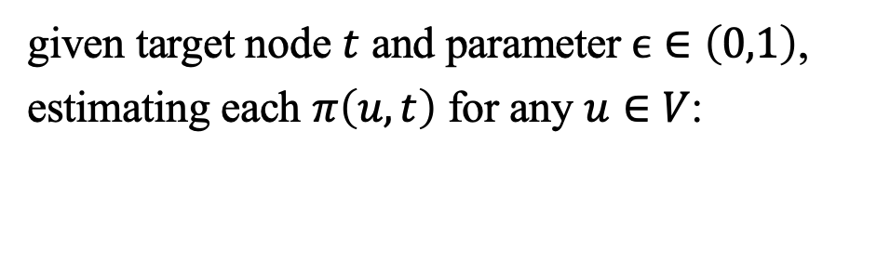


Problem Formulation
Single-Target PPR Estimation
Given a
Target Node
$$t$$
goal:
given target node $t$ and parameter $ϵ∈\left(0,1\right)$, estimating each $π\left(u,t\right)$ for any $u∈V$:
$$\left|\hat{π}\left(u,t\right)−π(u,t)\right|<ϵ$$
Notes:
Another problem we consider is single-target PPR estimation, which requires estimating the PPR score pi(u,t) (click!) for each node u in the graph with a given target node t. We require each estimate to be within an additive error of epsilon compared to the real score. As we shall discuss later, techniques for single-target PPR estimation always serve as a basis for single-node PageRank estimation.

Slide 10





Computational Model
Worst-case computational complexity: standard RAM model
Graph access oracle: arc-centric graph-access model
$$u$$
$$v$$
Indeg ($u$): return the in-degree of $u$
Uniformly
Sampled!
Outdeg ($u$): return the out-degree of $u$
InNbr ($u,i$): return the $i_{th}$ in-neighbor of $u$
OutNbr ($u,i$): return the $i_{th}$ out-neighbor of $u$
Jump (): return a uniformly sampled node
Notes:
It’s worth mentioning that throughout our paper, we consider the computational complexity of each algorithm under the standard RAM model, and focus on the standard arc-centric graph-access model, where the algorithm can only access the graph structure through a graph oracle using five types of query operations. That is, asking for a node’s in-degree, out-degree, the i-th in-neighbor, the i-th out-neighbor, and a random node uniformly sampled from the graph.

Slide 11
Outline
1
Problem Formulations
2
Our Results
3
Techniques
4
Conclusions
Notes:
Given the two problems and the computational model, in this paper, we achieve the following contributions.

Slide 12
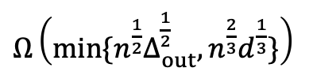

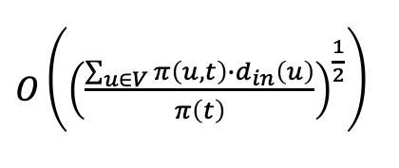
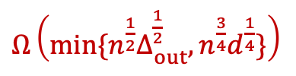

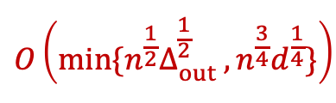

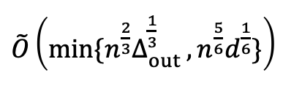
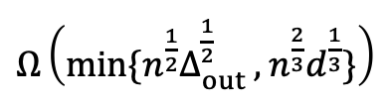
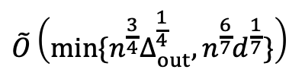

Our Contributions
Optimal Bounds for Single-Node PageRank Estimation
BiPPR, WSDM 2016
FOCS 2018
SICOMP 2023
STOC 2024 (Ours)
upper bound
$O\left({\left(\frac{\sum_{u∈V}{π\left(u,t\right)∙}d_{in}\left(u\right)}{π\left(t\right)}\right)}^{\frac{1}{2}}\right)$
upper bound
$$\tilde{O}\left(min⁡\{n^{\frac{3}{4}}Δ_{out}^{\frac{1}{4}}, n^{\frac{6}{7}}d^{\frac{1}{7}}\}\right)$$
upper bound
$\tilde{O}\left(min⁡\{n^{\frac{2}{3}}{Δ_{out}^{\frac{1}{3}}}_{ }^{ }, n^{\frac{5}{6}}d^{\frac{1}{6}}\}\right)$
upper bound
$$O\left(min⁡\{{n^{\frac{1}{2}}Δ_{out}^{\frac{1}{2}}}_{ }^{ }, {n^{\frac{3}{4}}d}^{\frac{1}{4}}\}\right)$$
$Ω\left(min⁡\{{n^{\frac{1}{2}}Δ}_{out}^{\frac{1}{2}},{n^{\frac{3}{4}}d}^{\frac{1}{4}}\}\right)$
$Ω\left(min⁡\{n^{\frac{1}{2}}{Δ_{out}^{\frac{1}{2}}}^{ },{n^{\frac{2}{3}}d}^{\frac{1}{3}}\}\right)$
$Ω\left(min⁡\{n^{\frac{1}{2}}Δ_{out}^{\frac{1}{2}},{n^{\frac{2}{3}}d}^{\frac{1}{3}}\}\right)$
lower bound
$Ω\left(n^{\frac{1}{2}}\right)$
lower bound
lower bound
lower bound
$n$: the number of nodes in the graph
${Δ_{out}}_{ }$: maximum out-degree
$d_{ }$: average degree
Notes:
First, for the single-node pagerank estimation problem, we establish matching upper and lower bounds, closing the longstanding theoretical gap for this problem. Our bound is the minimum of n to the power of 1 half, Delta_out to the 1 half, and n to the three fourth, d to the 1 fourth. Here n is the number of nodes in the graph, Delta_out is the maximum out-degree of the graph, and d is the average degree of the graph. Before our result, the best-known complexity bound was established in SICOMP 2023 (click!). Their bound is the minimum of n to the power of 2 third, Delta to the 1 third, and n to the power of five sixth, d to the 1 sixth. We note that in the SICOMP paper's bound and our bound, the sum of the exponents /ɪkˈspoʊnənt/ of n and Delta or n and d are consistently one, but the exponent of n in our bound is smaller than the previous result. Since n is larger than Delta and d, our bound is asymptotically smaller than previous results. An interesting point is that we do not propose new algorithm in our paper. We derive our upper bound simple (click!) by revisiting an existing algorithm, called BiPPR, which was proposed in a WSDM 2016 paper.

Slide 13
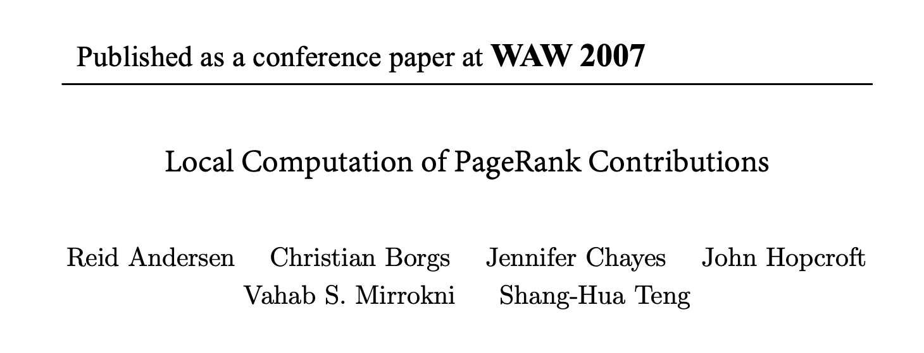
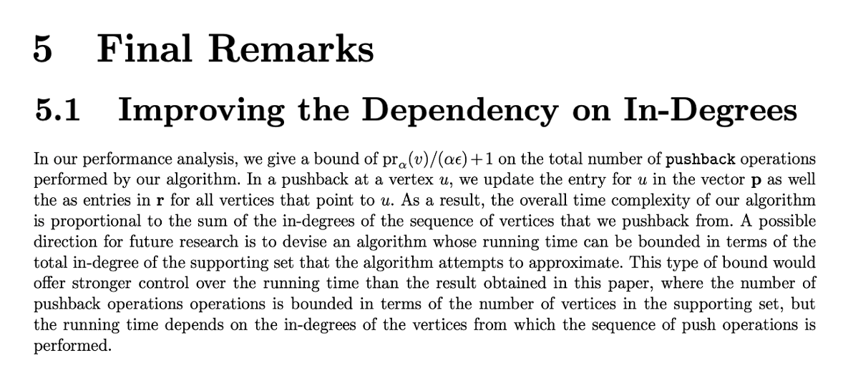

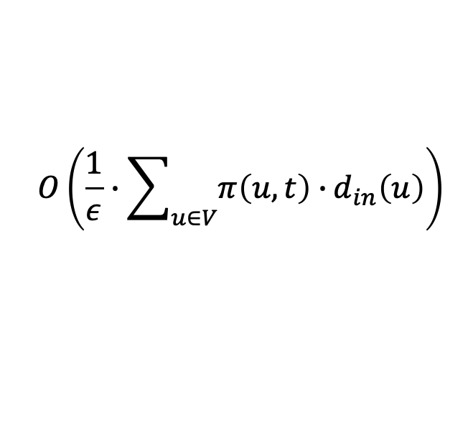
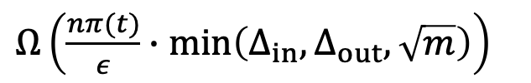

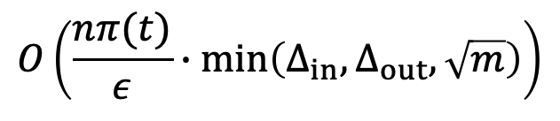

Our Contributions
Optimal Bounds for Single-Target PPR Estimation
The Push Method,WAW’07:
Ours:
$$O\left(\frac{1}{ε}∙\sum_{u∈V}{π\left(u,t\right)∙}d_{in}\left(u\right)\right)$$
$$O\left(\frac{nπ(t)}{ε}∙\min\left(Δ_{in},Δ_{out},\sqrt{m}\right)\right)$$
match
$Ω\left(\frac{nπ(t)}{ε}∙\min\left(Δ_{in},Δ_{out},\sqrt{m}\right)\right)$
negative answer
$π(t)$: PageRank of $t$
$ε_{ }$: additive error
$m_{ }$: number of edges in the graph
Notes:
Furthermore, for the single-target PPR estimation problem, we improve the computational complexity for this problem to npi(t) over epsilon times the minimum of Delta_in, Delta_out, and the square root of m, where pi(t) denotes the pagerank of t, epsilon is the additive error parameter, and m is the number of edges in the graph. (click!) And we also provide a matching lower bound, demonstrating that our upper bound is optimal. Remarkably, we derive our upper bound also by revisiting a previous method called the Push method which was proposed by Andersen, Borgs, Chayes (chess), Hopcroft, Mirrokni (mi ro k ni), and Teng in WAW 2007. The push method has been an algorithmic building block for random-walk probability estimation. Numerous attempts have been devoted to optimize the push method for better time complexity. But our work shows that actually the good old push algorithm is optimal. We only need to revisit its theoretical analysis to derive the optimal bounds. Moreover, our lower bound also provides a negative answer to the open problem established in the WAW 2007 paper regarding whether the time dependency /dɪˈpendənsi/ on in-degrees can be improved.

Slide 14
Outline
1
Problem Formulations
2
Our Results
3
Techniques
4
Conclusions
Notes:
It’s worth mentioning that our analysis to achieve these optimal bounds is remarkably simple. Next, I would like to briefly illustrate our analysis.

Slide 15









The Monte-Carlo Method [InternetMath ’05]
# of $α$-walks terminates at $t$
$≈$
$$π\left(t\right)$$
# of $α$-walks generated in total
$Ω(n)$ time to touch $t$ at least once
$$u$$
$$t$$
$n$ nodes
$$…$$
$$…$$
Notes:
First, let’s consider the single-node pagerank estimation problem. A canonical method for this problem is the monte-carlo method. That is, if we want to estimate node t’s PageRank, (click!) we can generate multiple alpha-walks in the graph, each starting from a uniformly random source node. We can use the proportion of alpha-walks that terminate at node t to the total number of alpha-walks generated in the graph serves as an unbiased estimate for \pi(t). The monte-carlo method is very straightforward, but it's has a major challenge that it requires significant time fpr a monte-carlo method to estimate a small pagerank score in the graph. For example, if we estimate the pagerank score of node t in this toy graph, we must generate n alpha-walks to ensure that at least one of these alpha-walk can reach node t. In other words, the monte-carlo method costs O(n) time in the worst-case scenario to estimate pi(t).

Slide 16



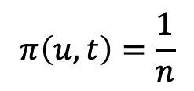

Monte Carlo + Push
$O(1)$ time to touch $u$ !!!
$$π\left(u,t\right)=\frac{1}{n}$$
Monte Carlo
Push
$$u$$
$$t$$
$n$ nodes
$$…$$
$$…$$
Notes:
In order to improve the complexity bound of the Monte Carlo method, a well-adopted algorithm structure is to combine the Monte Carlo method with the push method. (click!) Here, the push method was proposed in the WAW 2007 paper initially for single-target PPR estimation as we mentioned before. To see the power of combining mc and push, let‘s revisit this example. We know that an alpha-walk from a random source node is very hard to reach node t due to the presence of node u. In other words, since node u has n out-neighbors, the probability of a random walk moving from node u to t is only 1/n. However, we note that node t only has one in-neighbor, that is node u. So if we start from the given target node t, (click!) deterministically check each in-neighbor of t, calculate the probability of walking from the in-neighbor to node t, and push the probability mass to the in-neighbor, then in this case, we can accurately obtain that the probability pi(u,t) of walking from u to t (click!) is 1/n using only O(1) time since node t has only one in-neighbor, u. The method of deteministically pushing the probability mass from the target node t to other nodes in the graph along in-edges step by step is called the push method. By adopting the push method, we can accurately derive pi(u,t) in O(1) time. Then we adopt the monte-carlo method to estimate pi(u). Since node u has many in-neighbors, pi(u) can be accurately estimated by the monte-carlo method in O(1) time. Finally, by multiplying pi(u) by pi(u,t), we can accurately derive the estimate for pi(t) using only O(1) time. This is the power of combining the push method and the monte-carlo method together.

Slide 17

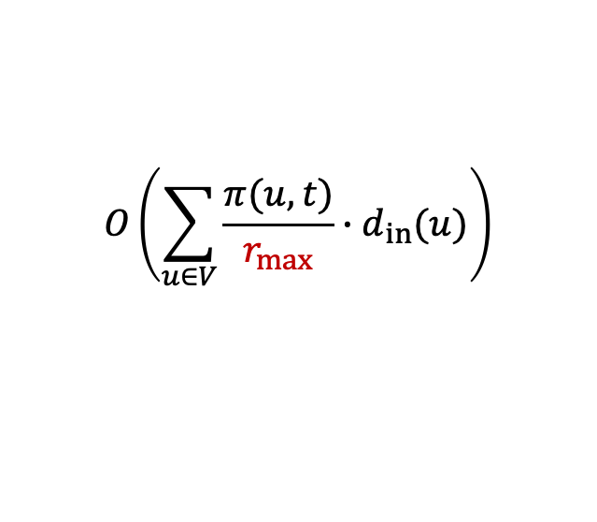
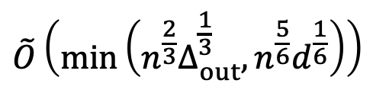
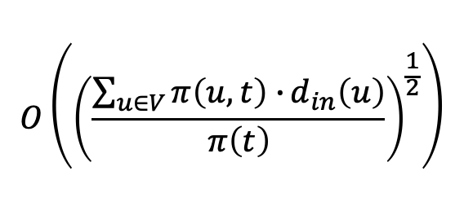
Single-Node PageRank Estimation
BiPPR, WSDM’16
SICOMP’23
$$O\left({\left(\frac{\sum_{u∈V}{π\left(u,t\right)∙}d_{in}\left(u\right)}{π\left(t\right)}\right)}^{\frac{1}{2}}\right)$$
$$\tilde{O}\left(\min\left(n^{\frac{2}{3}}Δ_{out}^{\frac{1}{3}}, n^{\frac{5}{6}}d^{\frac{1}{6}}\right)\right)$$
Monte Carlo
Push
$$u$$
$$t$$
$$O\left(\frac{r_{max}}{π(t)}\right)$$
$$O\left(\sum_{u∈V}{\frac{π(u,t)}{r_{max}}∙d_{in}(u)}\right)$$
$$…$$
$$…$$
Notes:
This structure of combining MC and push was proposed by the BiPPR algorithm in WSDM 2016. It introduces a threshold rmax​ to balance the time cost of the MC and push phases, and makes the time cost of the two phases equal to achieve the minimum of the total time cost. However, since the worst-case time complexity of the push method has been unclear for several years, the WSDM paper does not provide a meaningful worst-case complexity bound for single-node PageRank estimation. (click!) A recent SICOMP paper improves the complexity of BiPPR by modifying the push and MC methods.

Slide 18
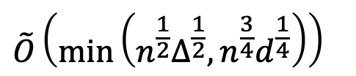
Single-Node PageRank Estimation
SICOMP’23
Ours
$$\tilde{O}\left(\min\left(n^{\frac{2}{3}}Δ_{out}^{\frac{1}{3}}, n^{\frac{5}{6}}d^{\frac{1}{6}}\right)\right)$$
$$\tilde{O}\left(\min\left(n^{\frac{1}{2}}Δ^{\frac{1}{2}}, n^{\frac{3}{4}}d^{\frac{1}{4}}\right)\right)$$
Blacklistin
Blacklisting nodes
Weighted Sum of Many Subgraph Estimators
Blacklistin
Sample Outside Subgraphs
Push in Subgraphs
Monte Carlo
Push
$$u$$
$$t$$
$$…$$
$$…$$
Notes:
Specifically, the SICOMP paper (click!) constructs a subgraph around the given target node t and restricts the push operations to the subgraph. Moreover, (click!) it restricts alpha-walks to only touch the nodes outside the subgraph. Then it combines the MC results with the push results to derive a subgraph estimte. Finally, this SICOMP paper (click!) constructs multiple subgraph estimates and returns the weighted sum of these estimates as the final result. This algorithm is very complicated, but in our paper, we show that all these modifications are unnecessary. Using the basic Monte Carlo method and the push method suffices to achieve the optimal results.

Slide 19

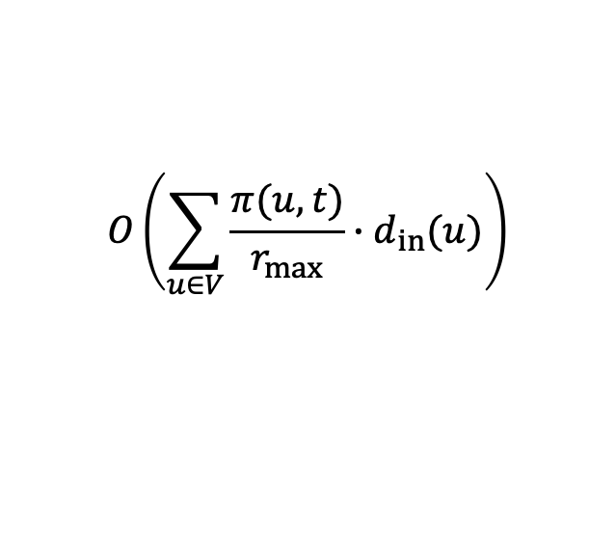

Single-Node PageRank Estimation
BiPPR, WSDM’16
Ours
$$O\left({\left(\frac{\sum_{u∈V}{π\left(u,t\right)∙}d_{in}\left(u\right)}{π\left(t\right)}\right)}^{\frac{1}{2}}\right)$$
$$\tilde{O}\left(\min\left(n^{\frac{1}{2}}Δ^{\frac{1}{2}}, n^{\frac{3}{4}}d^{\frac{1}{4}}\right)\right)$$
Our Push Cost:
$$O\left(\frac{nπ(t)}{r_{max}}∙\min\left(∆_{ }, n^{\frac{1}{2}}d^{\frac{1}{2}}\right)\right)$$
Monte Carlo
Push
$$u$$
$$t$$
$$O\left(\frac{r_{max}}{π(t)}\right)$$
$$O\left(\sum_{u∈V}{\frac{π(u,t)}{r_{max}}∙d_{in}(u)}\right)$$
$$…$$
$$…$$
Notes:
In other words, we show that the BiPPR method is optimal. What we only need to do is revisiting the theoretical analysis of the push method. (click!) We improve the time cost of the push phase to npi(t) over rmax times the minimum of Delta and the square root nd, and make the new push time cost equal to the time cost of the monte-carlo phase. Then we can achieve the optimal bound.

Slide 20
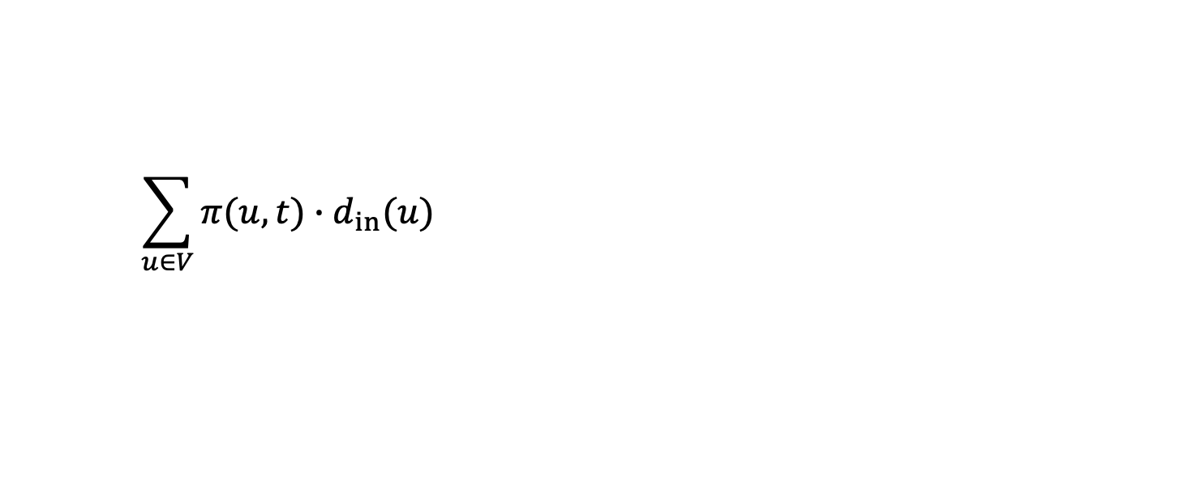
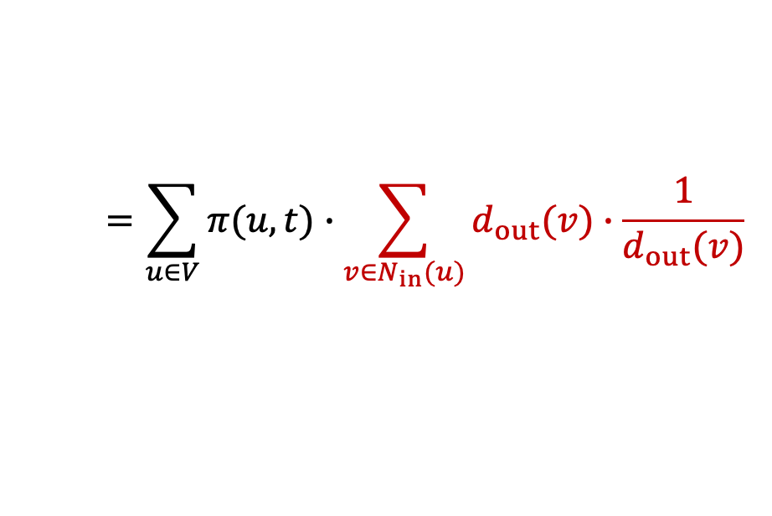
Our Contributions: Revisiting Push Cost
$$\sum_{u∈V}{π(u,t)∙d_{in}(u)}$$
$$=\sum_{u∈V}{π(u,t)∙\sum_{v∈N_{in}(u)}{d_{out}(v)∙\frac{1}{d_{out}(v)}}}$$
Notes:
To take a quick look at our analysis for the push cost. This is the original complexity bound for the push cost. The core of our analysis is to rewrite the in-degree of node u, (click!) din(u), as （click!） the summation of dout(v) times 1 over dout(v) over all the in-neighbor v of node u. Although this seems very simple, it is very powerful. Based on this step,

Slide 21


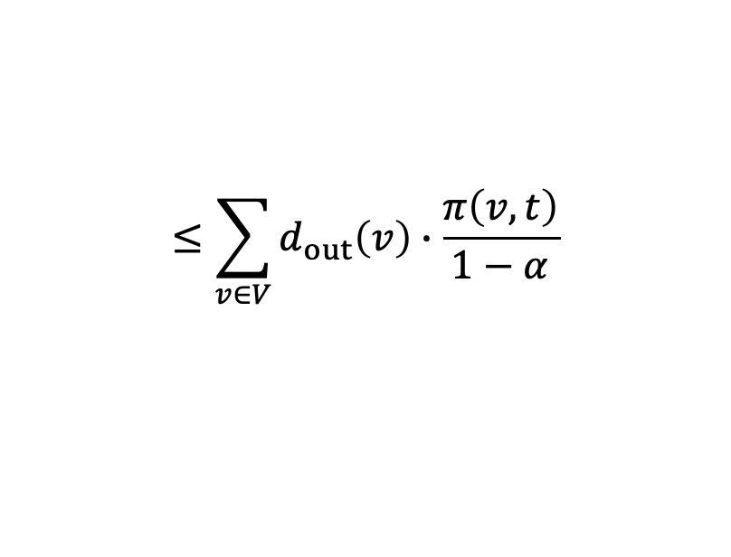




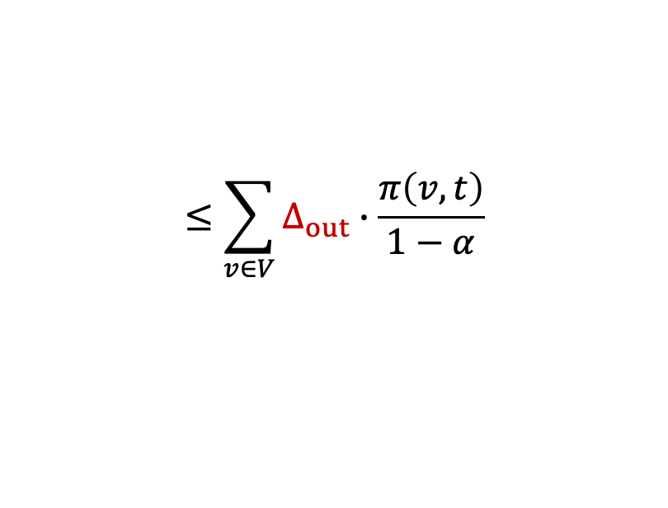







Our Contributions: Revisiting Push Cost
$$\sum_{u∈V}{π(u,t)∙d_{in}(u)}$$
$$=\sum_{u∈V}{π(u,t)∙\sum_{v∈N_{in}(u)}{d_{out}(v)∙\frac{1}{d_{out}(v)}}}$$
$$=\sum_{v∈V}{d_{out}(v)∙\sum_{u∈N_{out}(v)}{\frac{π(u,t)}{d_{out}(v)}}}$$
$$≤\sum_{v∈V}{d_{out}\left(v\right)∙\frac{π\left(v,t\right)}{1−α}}$$
$$π(u_{1},t)$$
$\frac{1−α}{d_{out}(v)}$
$$u_{1}$$
$\frac{1−α}{d_{out}(v)}$
$$π(u_{2},t)$$
$$≤\sum_{v∈V}{∆_{out}∙\frac{π\left(v,t\right)}{1−α}}$$
$$v$$
$$u_{2}$$
$$t$$
$$π(u_{3},t)$$
$\frac{1−α}{d_{out}(v)}$
$$u_{3}$$
$$=O\left(nπ(t)∙∆_{out}\right)$$
Notes:
We then reorder the summation, (click!) utilize the property of one-step of random walks that (click!) this summation can be upper bounded by pi(v,t) over 1-alpha. (click!) Then we upper bound dout(v) by Deltaout, (click!) and derive the complexity bound involving Delta_out.

Slide 22
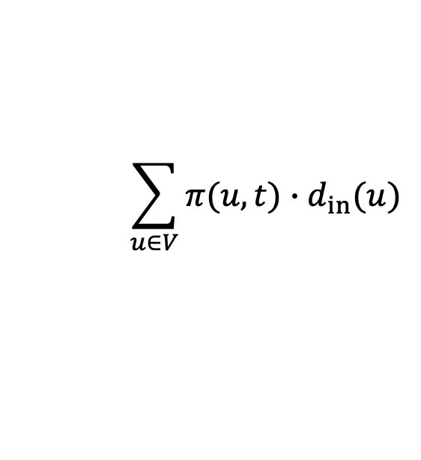
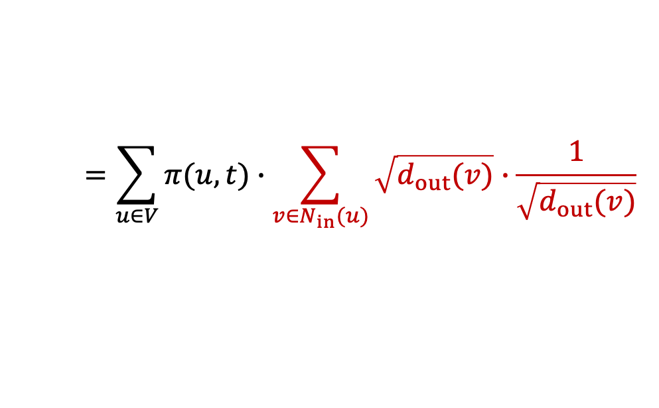
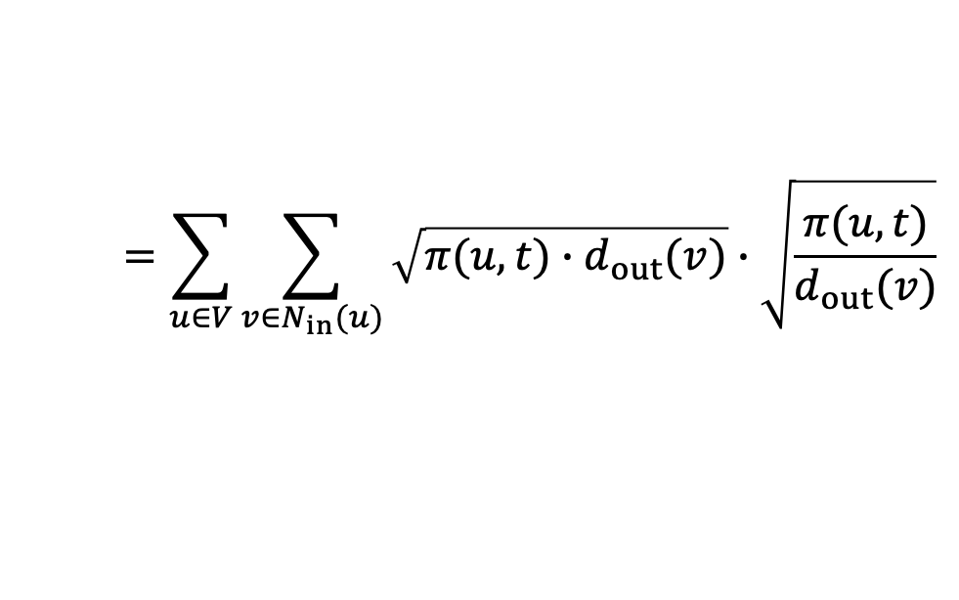
Our Contributions: Revisiting Push Cost
$$\sum_{u∈V}{π(u,t)∙d_{in}(u)}$$
$$=\sum_{u∈V}{π(u,t)∙\sum_{v∈N_{in}(u)}{\sqrt{d_{out}(v)}∙\frac{1}{\sqrt{d_{out}(v)}} }}$$
$$=\sum_{u∈V}{\sum_{v∈N_{in}(u)}{\sqrt{π(u,t)∙d_{out}(v)}∙\sqrt{\frac{π(u,t)}{d_{out}(v)}}}}$$
Notes:
Similarly, we rewrite din(u) as the summation of the square root of dout(v) times 1 over the square root of dout(v), and distrbiute pi(u,t) into the two square-root sign,

Slide 23

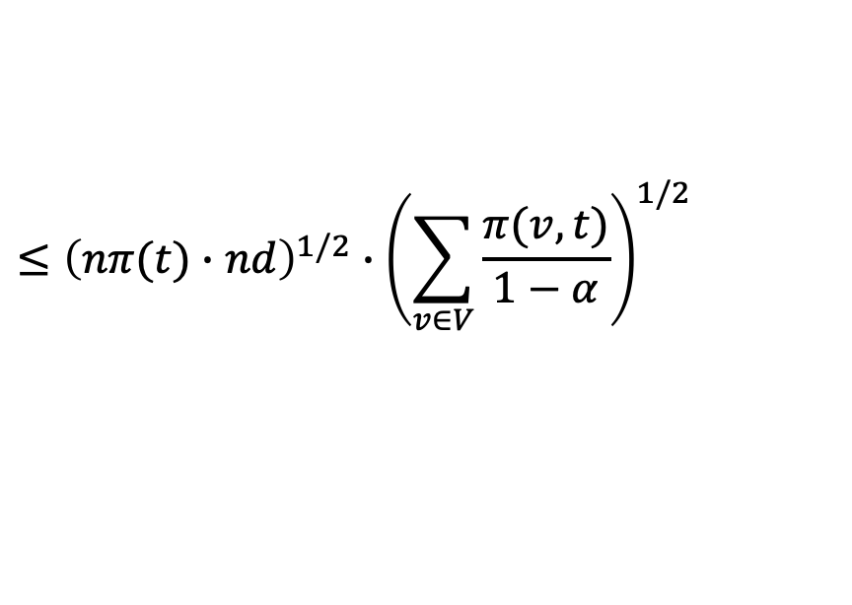
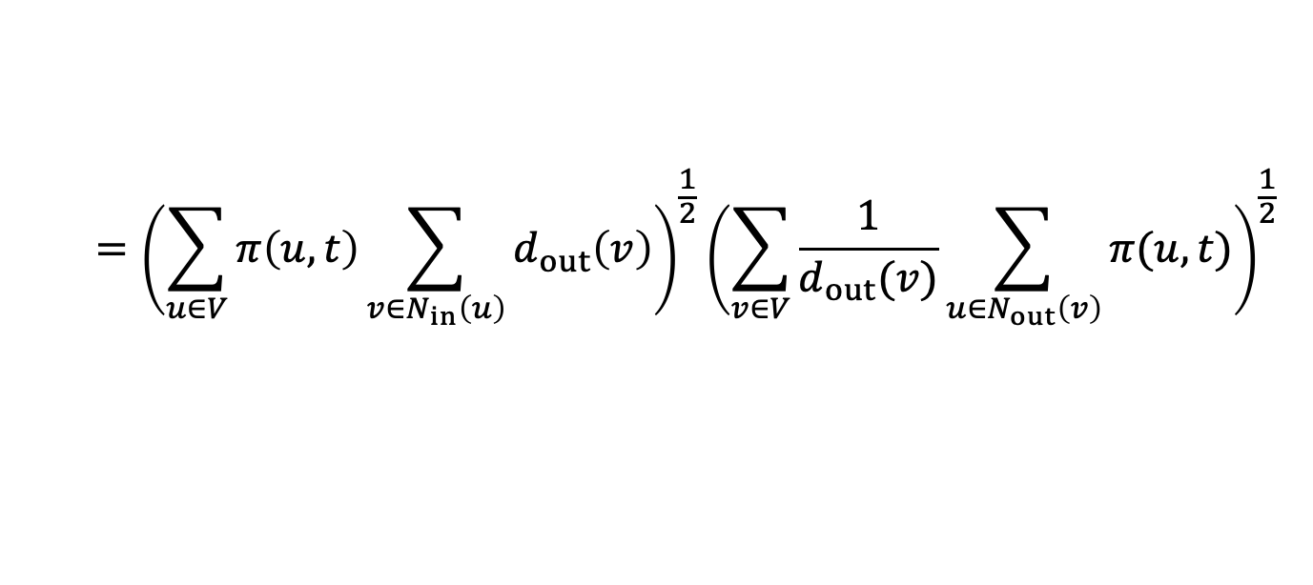
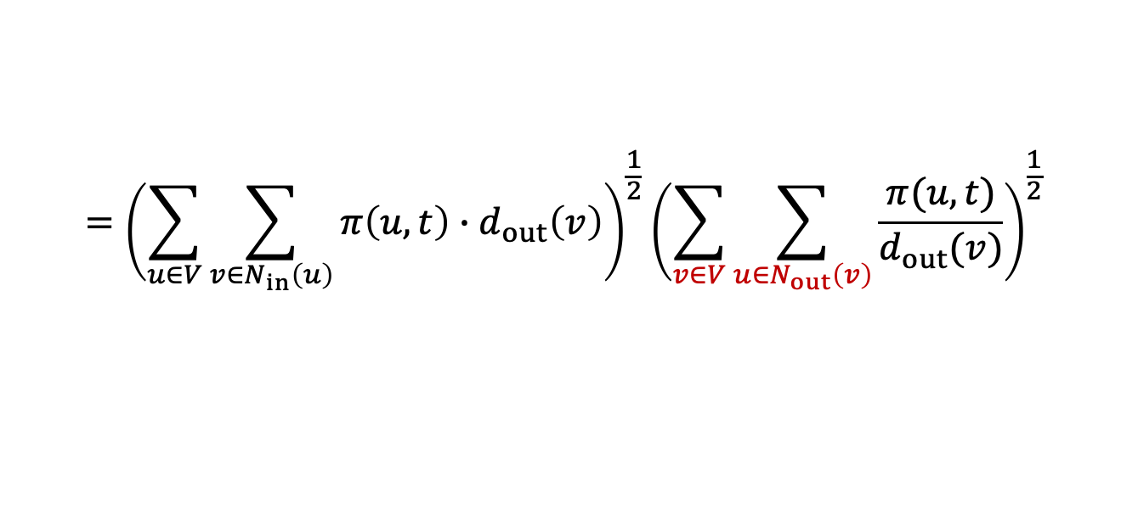
Our Contributions: Revisiting Push Cost
$$\sum_{u∈V}{π(u,t)∙d_{in}(u)}$$
$$=\sum_{u∈V}{π(u,t)∙\sum_{v∈N_{in}(u)}{\sqrt{d_{out}(v)}∙\frac{1}{\sqrt{d_{out}(v)}} }}$$
$$=\sum_{u∈V}{\sum_{v∈N_{in}(u)}{\sqrt{π(u,t)∙d_{out}(v)}∙\sqrt{\frac{π(u,t)}{d_{out}(v)}}}}$$
Cauchy-Schwarz inequality
$$={\left(\sum_{u∈V}{\sum_{v∈N_{in}\left(u\right)}{π\left(u,t\right)∙d_{out}\left(v\right)}}\right)}^{\frac{1}{2}}{\left(\sum_{v∈V}{\sum_{u∈N_{out}\left(v\right)}{\frac{π(u,t)}{d_{out}(v)}}}\right)}^{\frac{1}{2}}$$
$$={\left(\sum_{u∈V}{π\left(u,t\right)\sum_{v∈N_{in}\left(u\right)}{d_{out}\left(v\right)}}\right)}^{\frac{1}{2}}{\left(\sum_{v∈V}{\frac{1}{d_{out}(v)}\sum_{u∈N_{out}\left(v\right)}{π(u,t)}}\right)}^{\frac{1}{2}}$$
$$≤{\left(nπ(t)∙nd\right)}^{1/2}∙{\left(\sum_{v∈V}{\frac{π(v,t)}{1−α}}\right)}^{1/2}$$
= $O\left(nπ(t)∙{(nd)}^{1/2}\right)$
Notes:
Then we can derive the complexity bound involving d by using the cauchy schwarz inequality.

Slide 24



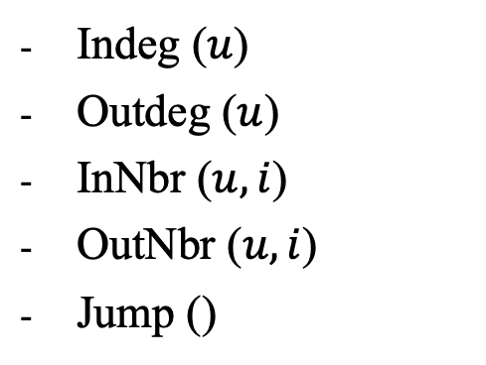
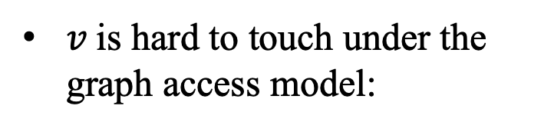



Overview: Lower Bound
large out-degree
$v$ contributes significantly to $π(t)$
$$u_{1}^{ }$$
$v$ is hard to touch under the graph access model:
Indeg ($u$)
Outdeg ($u$)
InNbr ($u,i$)
OutNbr ($u,i$)
Jump ()
$$t$$
$$u_{2}^{ }$$
$$u_{3}^{ }$$
$$v$$
small out-degree
Notes:
Finally, we would like to give an overview of our lower bound, we construct a hard instance, where (click!) all blue nodes have large out-degrees, while (click!) only the red node. node v has an out-degree of 1. Therefore, node v contributes significantly to node t’s pagerank, but it is very difficult for an algorithm to detect node v under the graph access model. For example, if we use the push operation to estimate pi(v,t), then in the worst-case scenario, (click!) we must scan all the blue edges before we find node v. In this way, we establish the lower bound for this problem.

Slide 25
Outline
1
Problem Formulations
2
Our Results
3
Techniques
4
Conclusions
Notes:
Finally, to conclude,

Slide 26
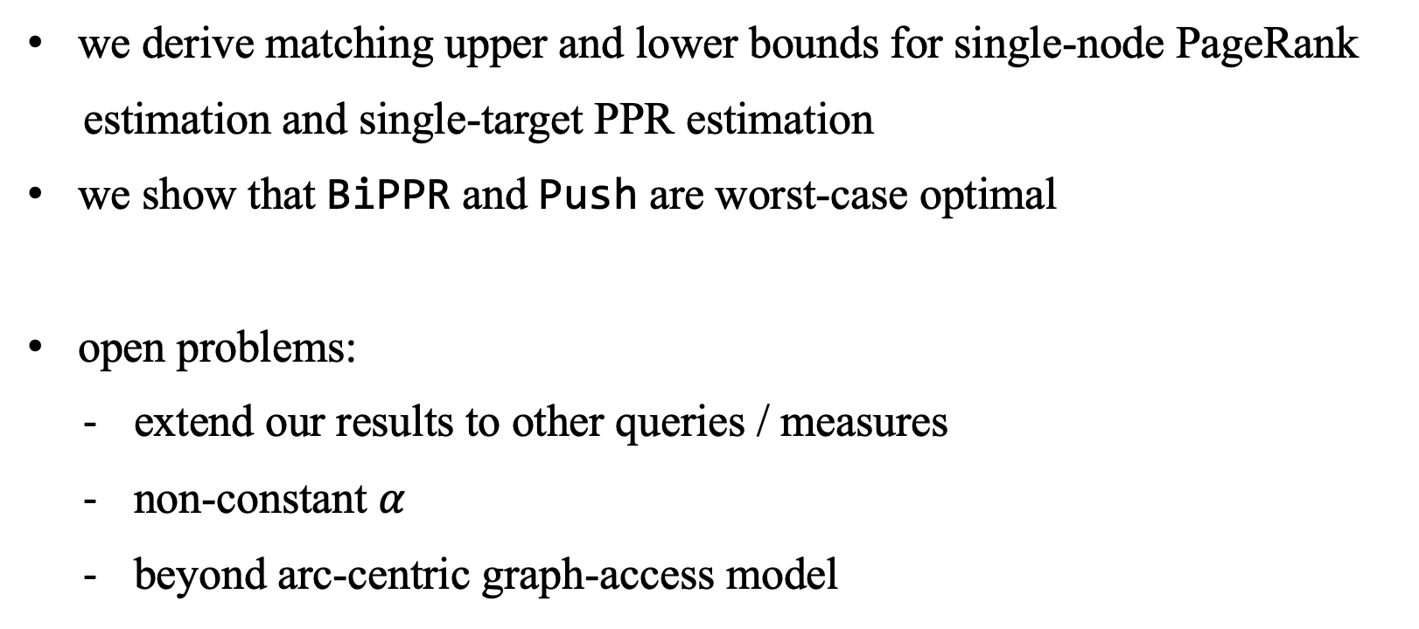
Conclusions
we derive matching upper and lower bounds for single-node PageRank
estimation and single-target PPR estimation
we show that BiPPR and Push are worst-case optimal
open problems:
extend our results to other queries / measures
non-constant $α$
beyond arc-centric graph-access model
Notes:
In this paper, we derive matching upper and lower bounds for single-node PageRank estimation and single-target PPR estimation, surprisingly by only revisiting previous algorithms, BiPPR and push. We prove that the good old push method is worst-case optimal for single-target PPR estimation. Simply combining the push method and the MC method, as bippr does, is optimal for single-node PageRank estimation. In the future, we hope to extend our results and analysis to other query types, such as single-pair PPR queries, and other random-walk types, such as long-distance random walks. Moreover, we are also interested in random-walk probability estimation under alternative computational models. We aim to go beyond the canonical arc-centric graph-access model to better align with practical scenarios.

Slide 27
Thanks and QA!
Notes:
That’s all of my presentation. Thank you very much. Any questions?

Slide 28
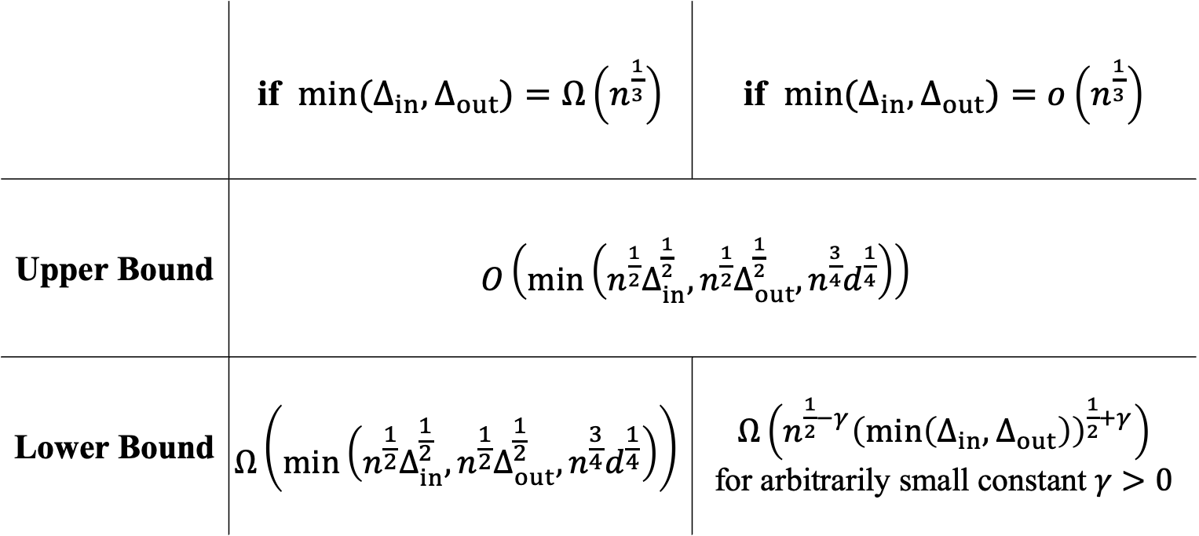



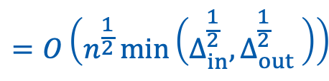
Our Contributions
 | if $\min{(Δ_{in},Δ_{out})}=Ω\left(n^{\frac{1}{3}}\right)$ | if $\min{(Δ_{in},Δ_{out})}=o\left(n^{\frac{1}{3}}\right)$
Upper Bound | $O\left(\min\left({n^{\frac{1}{2}}Δ}_{in}^{\frac{1}{2}},{n^{\frac{1}{2}}Δ}_{out}^{\frac{1}{2}},{n^{\frac{3}{4}}d}^{\frac{1}{4}}\right)\right)$
Lower Bound | $$Ω\left(min\left({n^{\frac{1}{2}}Δ}_{in}^{\frac{1}{2}},{n^{\frac{1}{2}}Δ}_{out}^{\frac{1}{2}},{n^{\frac{3}{4}}d}^{\frac{1}{4}}\right)\right)$$ | $Ω\left(n^{\frac{1}{2}−γ}{\left(\min\left(Δ_{in},Δ_{out}\right)\right)}^{\frac{1}{2}+γ}\right)$ for arbitrarily small constant $γ>0$
$$=O\left(n^{\frac{1}{2}}\min\left(Δ_{in}^{\frac{1}{2}},Δ_{out}^{\frac{1}{2}} \right)\right)$$
match
$n$: number of nodes in the graph
${Δ_{in}/Δ_{out}}_{ }$: maximum in-/out-degree
$d_{ }$: average degree
Notes:
Specifically, we show that the upper bound for single-node pagerank estimation is the minimum of the previously mentioned two terms and n to the power of 1 half times Delta_in to the power of 1 half. When the maximum in-degree Delta_in and out-degree Delta_out are relatively large, we derive a (click!) completely matching lower bound, demonstrating the optimality of our upper bound. When Delta_in and Delta_out are small, the first two terms dominate our upper bound. Thus our upper bound becomes n to 1 half times the minimum of Delta_in to 1 half and Delta_out to 1 half. (click!) The lower bound in this case is almost the same as the upper bound (click!), with only a gamma difference in the exponent, where gamma is an arbitrarily /ˌɑːrbɪˈtrerəli/ small constant.

