Slide 1

Hassen Allegue
IOF/Biodiv Informatics Study Group

Slide 2
Create a GitHub account
https://github.com
Install GitHub Desktop
https://desktop.github.com

Slide 3

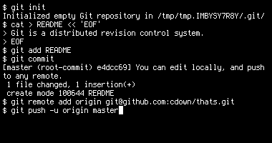



Remote (online!!!)
Repository
Version control software
Code hosting platform
(web site)
Local Repository
Local Repository
Local Repository
Notes:
Git:
On command line
GitHub:
upload git repo --> access online
have a user-interface rather the command line
other people can access to your repo
and collaboration is easier

Slide 4
Tasks
Create a repository
Create a Branch
Make and commit changes
Revert a commit
Open a Pull Request
Merge your Pull Request
Fork
Resolve conflicts

Slide 5
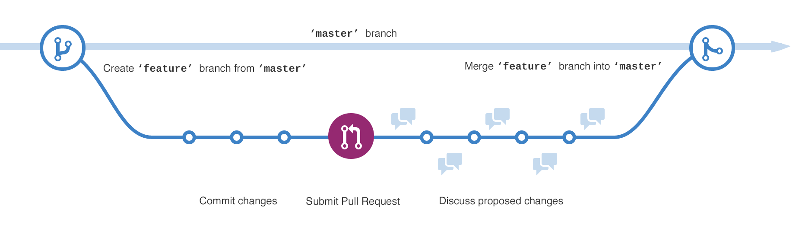
Branching

Slide 6
