Slide 1


Slide 2

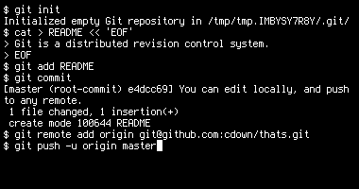



Remote (online!!!)
Repository
Local Repository
Local Repository
Local Repository
Notes:
Git:
On command line
GitHub:
upload git repo --> access online
have a user-interface rather the command line
other people can access to your repo
and collaboration is easier

Slide 3
Tasks
Create a repository
Create a Branch
Make and commit changes
Revert a commit
Open a Pull Request
Merge your Pull Request
Fork
Resolve conflicts

Slide 4
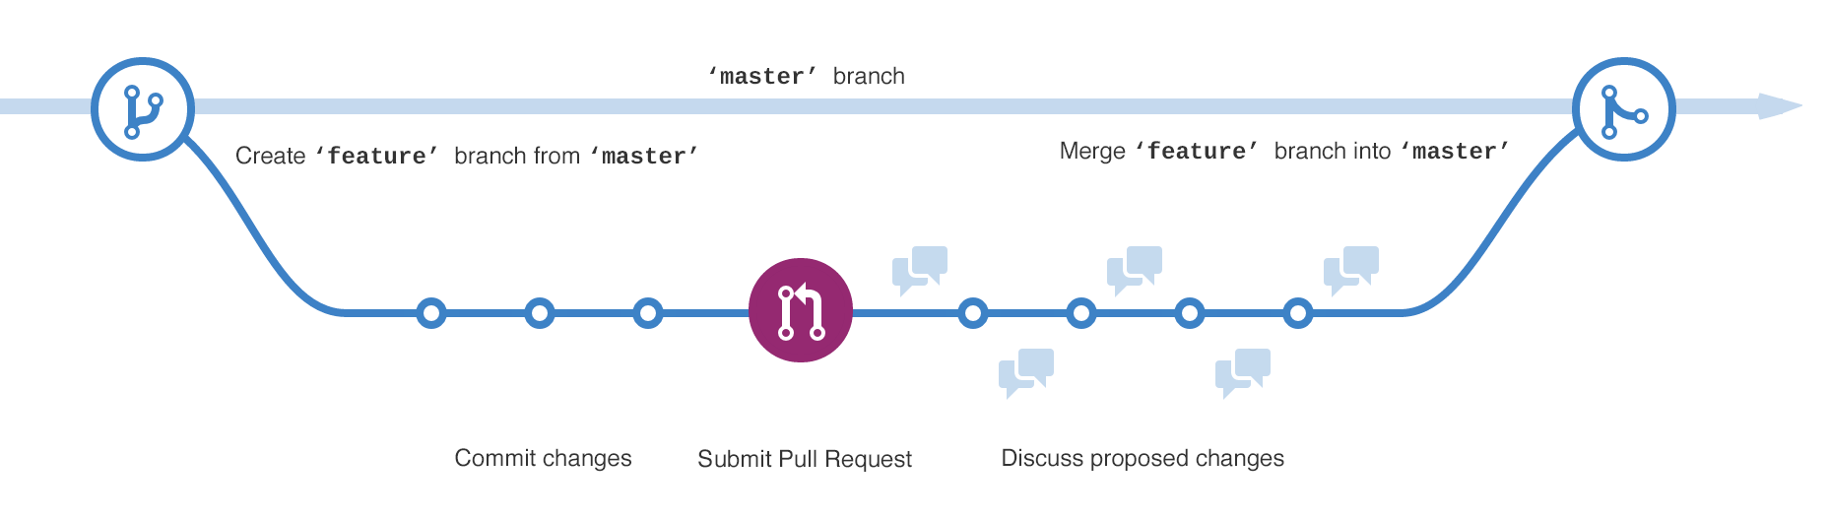
Branching

Slide 5
