Slide 1

Advancements in Robust Time Series Forecasting and Anomaly Detection
Presented by Aleksandr Algazinov

Slide 2
Topics We Will Cover
Paper Title | Topic | Publication Venue | Link | Key Contributions
ROBUSTTSF: TOWARDS THEORY AND DESIGN OF ROBUST TIME SERIES FORECASTING WITH ANOMALIES | Robust Time Series Forecasting in the Presence of Anomalies | ICLR 2024 | https://arxiv.org/pdf/2402.02032 | Define three types of time-series anomalies, provide analyses of loss robustness (for target anomalies) and sample robustness (for covariate anomalies), and introduce RobustTSF
SARAD: Spatial Association-Aware Anomaly Detection and Diagnosis for Multivariate Time Series | Spatial Association-Aware Anomaly Detection and Diagnosis in Multivariate Time Series | NeurIPS 2024 | https://proceedings.neurips.cc/paper_files/paper/2024/file/56ad264ac7448239145606cf4106042f-Paper-Conference.pdf | Uncover a Spatial Association Reduction phenomenon in multivariate series, propose SARAD, and combine data-space and association-space reconstruction errors into a joint criterion

Slide 3

1
Robust Time Series Forecasting in the Presence of Anomalies

Slide 4
Paper 1: ROBUSTTSF: TOWARDS THEORY AND DESIGN OF ROBUST TIME SERIES FORECASTING WITH ANOMALIES
Problem:
The majority of current time series forecasting techniques operate under the assumption that the training data is clean and devoid of anomalies. This is not always true in real-world applications. In practice, collected time series data is frequently contaminated with various types of anomalies, which can arise from sensor malfunctions, transmission errors, or even intentional manipulation. Examples of such anomalies include constant values replacing actual readings, missing data points, and observations corrupted by noise
Training forecasting models directly on such anomaly-ridden data can have detrimental effects on their performance. The accuracy of the resulting models can be significantly reduced, leading to unreliable predictions. This is particularly problematic in critical applications where decisions are heavily reliant on the accuracy of these forecasts
Motivation:
The need to develop methodologies that can automatically learn robust forecasting models even when the time series data used for training is contaminated with anomalies. The paper effectively highlights the discrepancy between the idealized assumptions of many forecasting methods and the often-imperfect nature of real-world data. Addressing this gap is crucial for enhancing the practical utility of time series forecasting
Anomalies can significantly mislead forecasting models, underscoring the importance of robustness for achieving reliable predictions, especially in sensitive domains like intelligence analysis where accuracy is of utmost importance

Slide 5
Paper Contributions
Authors analyze the impact of three formally defined anomalies on model performance, exploring loss robustness with target anomalies and sample robustness with covariate anomalies
Authors propose RobustTSF, an efficient algorithm for time series forecasting with anomalies (TSFA), which is both theoretically grounded and empirically superior to existing TSFA approaches
Authors conduct extensive experiments, including single-step and multi-step time series forecasting with different model structures, to validate our method’s performance
To the best of their knowledge, this is the first study to extend the theory of learning with noisy labels (LNL) to time series forecasting, which builds a bridge between LNL and TSFA tasks

Slide 6
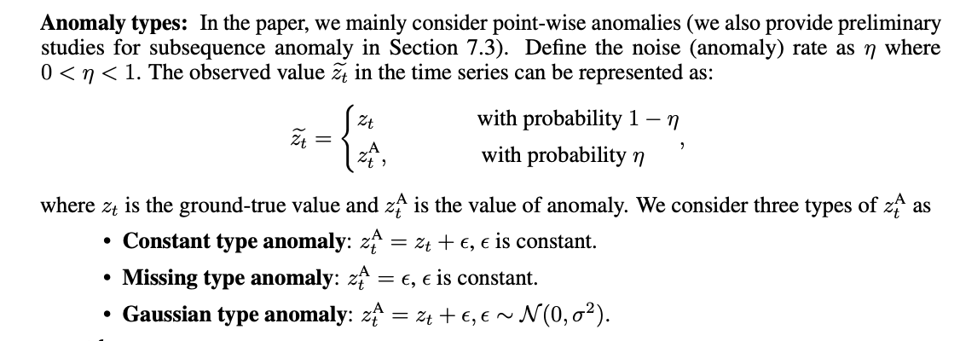
Anomalies

Slide 7
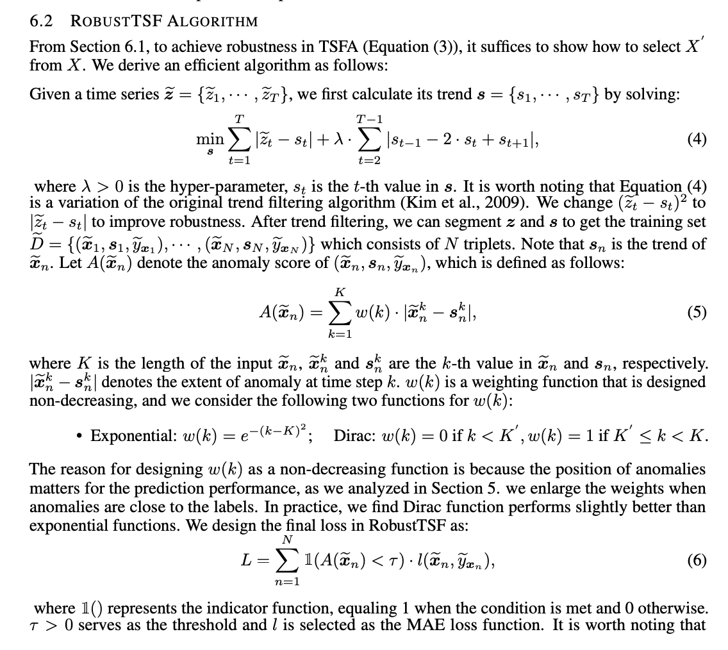
RobustTSF Algorithm

Slide 8
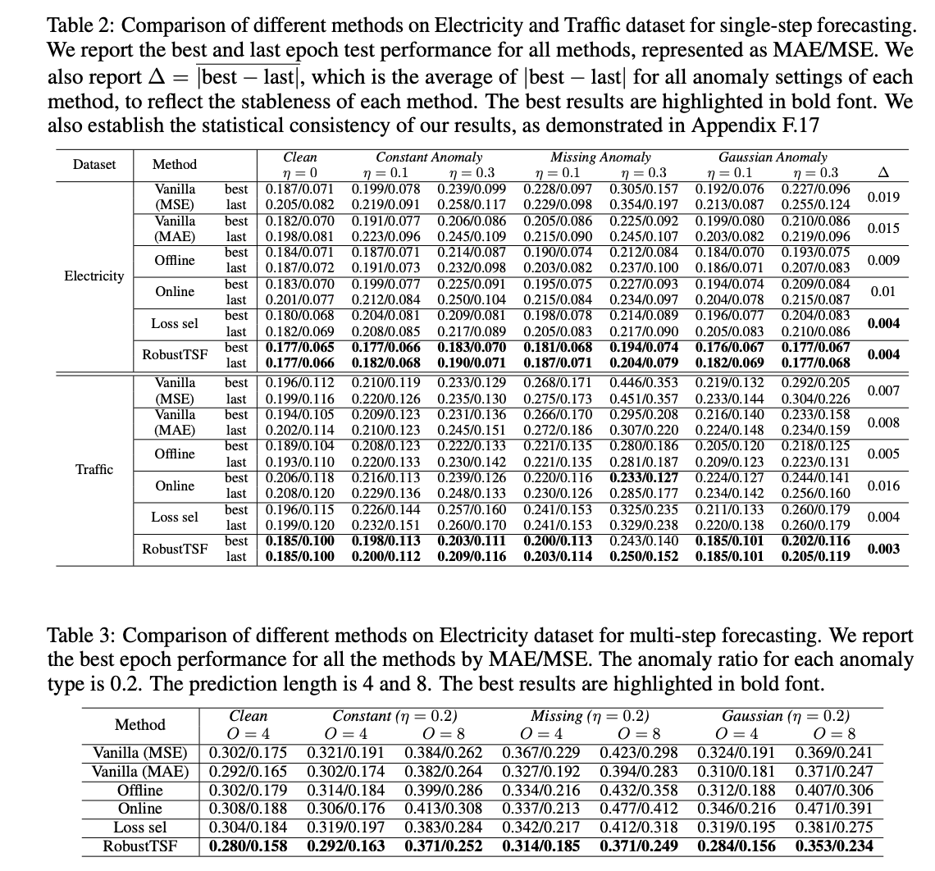
Results

Slide 9
Conclusion and My Criticism
Conclusion:
The research paper addresses the critical challenge of robust time series forecasting in the presence of anomalies
Authors make several key contributions, including the statistical definition of three common anomaly types, a theoretical analysis of their impact on loss and sample robustness, the proposal of the efficient RobustTSF algorithm, extensive experimental validation of its superior performance, and the establishment of a connection between TSFA and LNL
This research has significant implications for improving the reliability of time series forecasting in real-world applications where data is often contaminated
Criticism:
No SOTA clean-data baselines: The paper reports (in the appendix) performance of SOTA architectures (Autoformer, Informer, FedFormer) only under various noisy settings, but omits results for these models retrained on fully cleaned (anomaly-free) data, preventing direct comparison of anomaly impact on SOTA forecasters
Synthetic-only anomalies: All experiments inject anomalies manually (constant/missing/Gaussian) into “clean” real-world series; there is no evaluation on naturally occurring anomalies, which may exhibit more complex patterns
Limited anomaly types: The method and theory focus on point-wise anomalies; sequence-wise anomalies receive only preliminary empirical study and lack formal theoretical guarantees
Oversimplification: anomaly scores and the loss function are trivially defined
However, the architecture is flexible, and multiple adjustments can be easily made. Given that the method has theoretical justifications, solves the relevant problem, and is recently published at a top conference, it seems like researches can easily establish multiple relevant research questions by analyzing this paper

Slide 10

Any questions so far?

Slide 11

Spatial Association-Aware Anomaly Detection and Diagnosis in Multivariate Time Series
2

Slide 12
Paper 2: SARAD: Spatial Association-Aware Anomaly Detection and Diagnosis for Multivariate Time Series
Problem:
The primary problem addressed by the paper is that existing anomaly detection methods for time series data have largely focused on temporal modeling, which involves learning the dependencies between consecutive time steps
While temporal modeling is effective in many scenarios, it has limitations when applied to multivariate time series data. Specifically, a focus solely on temporal patterns can obscure or dilute the valuable spatial information, represented by the inter-feature relationships, that is inherent in multivariate data Consequently, temporal methods might struggle to identify anomalies that primarily manifest as changes in the associations between different variables
Motivation:
Leverage spatial information to enhance both the detection and diagnosis of anomalies in multivariate time series, particularly in complex systems like industrial control systems where intricate interdependencies between various sensors and actuators are common
The paper challenges the traditional focus on temporal modeling, asserting that spatial relationships contain vital information for detecting anomalies. The "association descending pattern" provides a novel way to identify anomalies by observing the breakdown of inter-feature dependencies. The emphasis on industrial control systems underscores the practical importance of this research

Slide 13
Paper Contributions
Authors reveal and extract spatial association descending patterns of time series anomalies with a bespoke Transformer and subseries division. The former learns the pairwise inter-feature associations via autoencoding in the data space and the latter enables shuffled autoencoding training and memory-less progression aggregation
Authors propose progression autoencoding to quantify anomalous descent in the association space and a joint detection criterion in both data and association spaces, which complement each other
Experimentally, SARAD performs SOTA anomaly detection and diagnosis on multivariate time series and ablation studies support authors’ design choices

Slide 14
Terminology
Spatial Associations are the pairwise dependencies between features in a multivariate time series
During anomalous events, there is a noticeable "association descending pattern”, also known as Spatial Association Reduction (SAR), where the features that are behaving anomalously tend to become detached from other features, leading to a reduction in their spatial associations. This observation forms the foundation of the proposed SARAD methodology
Anomaly Detection vs Anomaly Diagnosis. The goal of the anomaly detection is to decide whether something unusual is happening, while the goal of the anomaly diagnosis is to pinpoint what and where the root cause of the detected anomaly lies. In this case, the goal is to to predict the diagnosis label
Anomaly detection in SARAD is defined per timestamp (per observation), not per feature. Anomaly detection identifies the observations having anomalies, while the anomaly diagnosis identifies, which features experience abnormal behavior in a particular observation

Slide 15
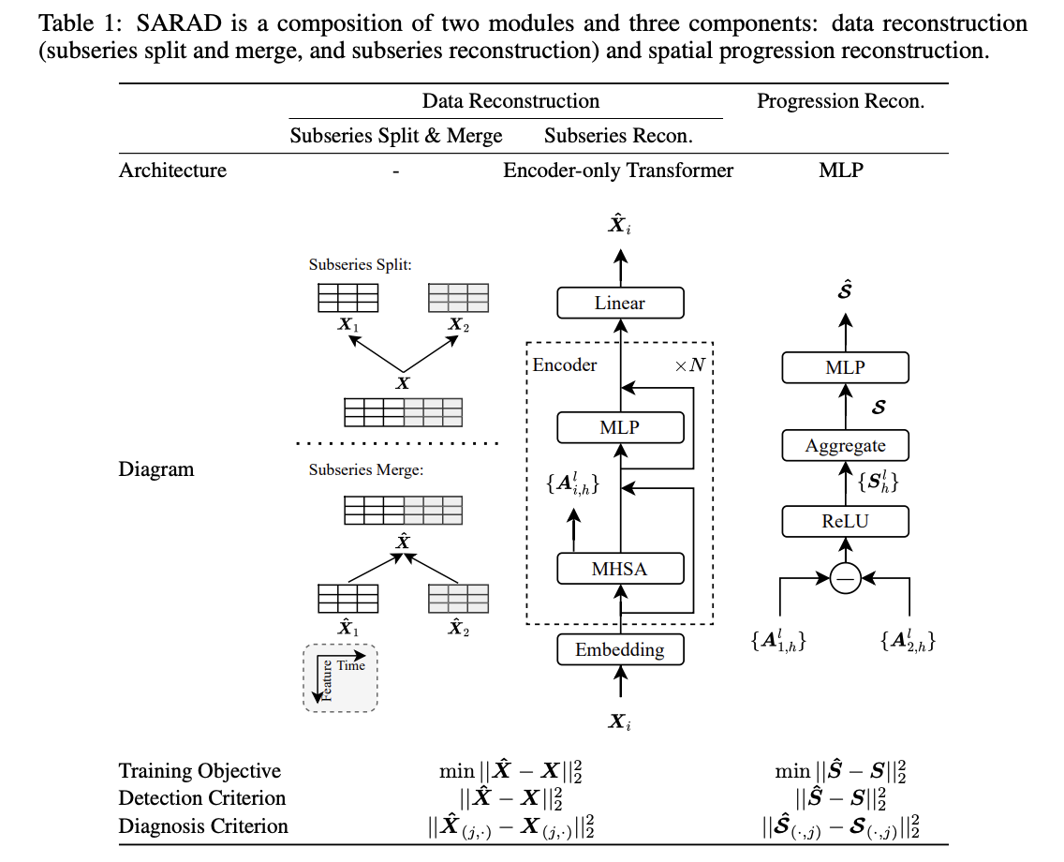
SARAD architecture

Slide 16
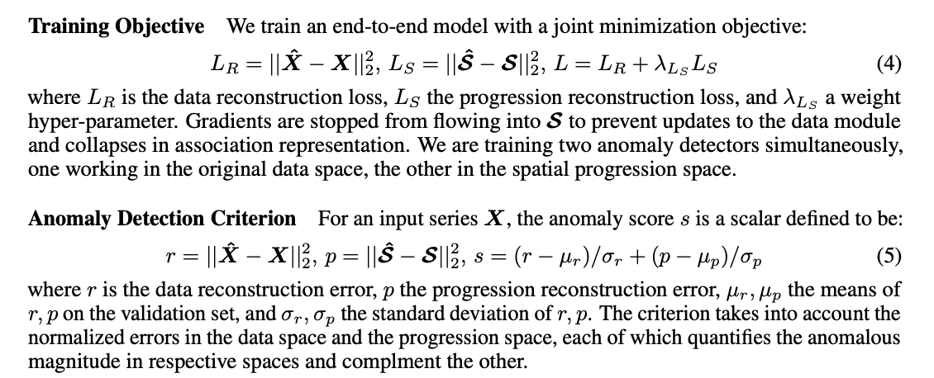
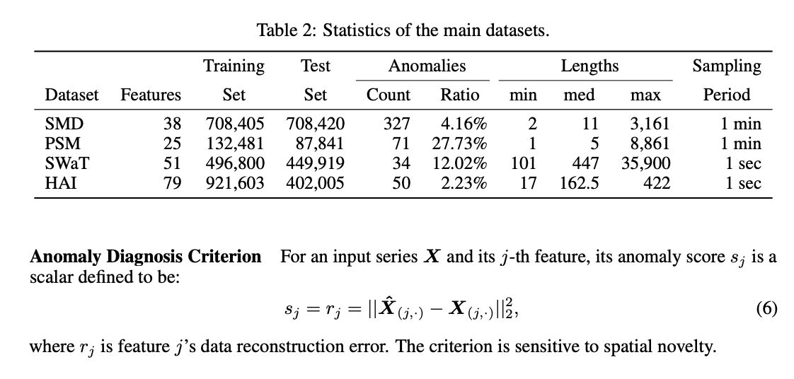
Loss function and anomaly score definitions

Slide 17
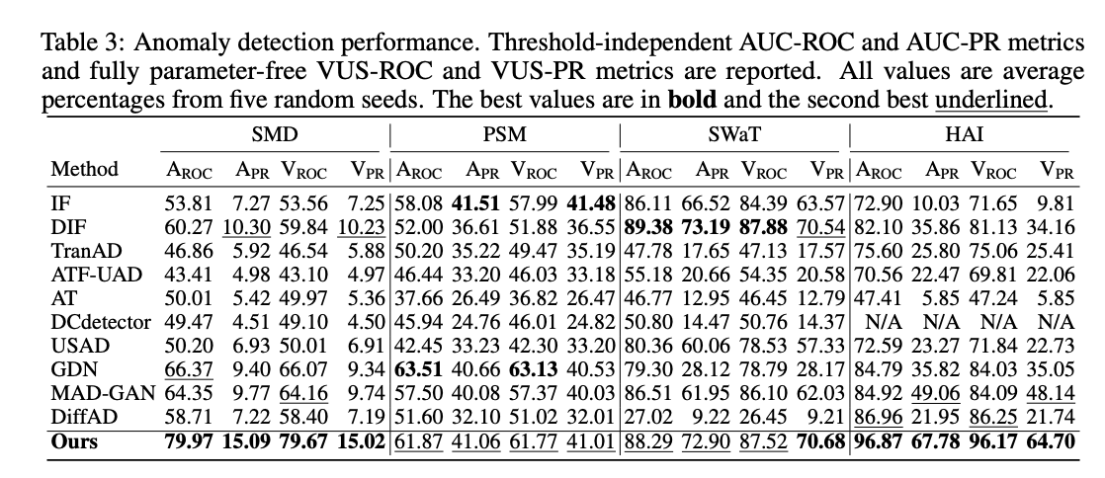
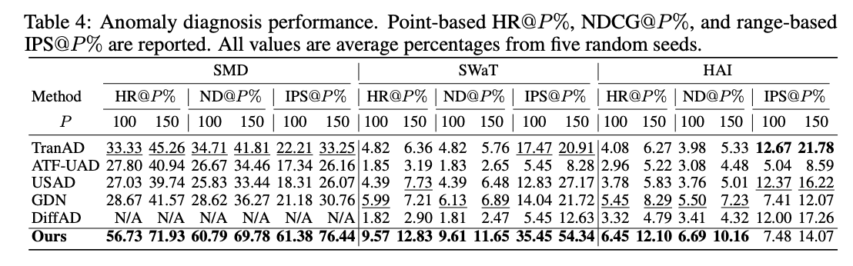
Results

Slide 18
Conclusion and The Future Research Directions
Conclusion:
SARAD is a novel and effective approach for anomaly detection and diagnosis in multivariate time series data. SARAD effectively exploits the spatial association descending patterns that occur during anomalies. The methodology involves using a Transformer for data reconstruction to learn spatial associations and capture their progression, followed by progression reconstruction to quantify the anomalous reduction in these associations
Results demonstrate that SARAD achieves SOTA performance in both detection and diagnosis on real-world datasets. The success of SARAD highlights the potential of spatial modeling for advancing the field of time series anomaly detection and for related time series analysis tasks beyond anomaly detection
Limitations (defined by me):
Evaluation Scope and Generalization: Experiments are limited to SMD, PSM, SWaT, HAI, which are mainly for industrial control systems; performance on other domains (e.g., financial, medical) remains untested
Too focused on spatial features: It would be interesting to see if the proposed architecture maintains strong ability of capturing temporal dependencies. If not, then future work can focus on combining temporal mechanisms with spatial
Lack of unsupervised anomaly detection metrics definition: it is very simple to evaluate the model when there are true labels. However, how to do it when there are none of them, like in real-time industrial control systems monitoring

Slide 19

Thanks!
Do you have any questions?

