Slide 1
Genomics
Visualizing the Genomics of Drug Sensitivity in Cancer (GDSC)

Slide 2
Introduction and Background
The Genomics of Drug Sensitivity in Cancer (GDSC) dataset links drug response data with genomic profiles of cancer cell lines.
It helps study how genetic differences influence how cancer cells respond to various drugs.
Includes data such as IC50 (drug sensitivity measure), gene expression, mutations, and cancer type information.
Our project uses data visualization to uncover patterns between drugs, genes, and cancer types.
The goal is to make complex genomic data easier to interpret and highlight insights that support personalized cancer treatment.

Slide 3
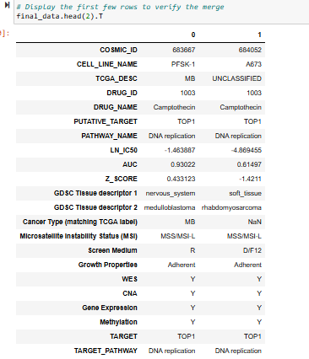
Dataset overview
Dataset Source: GDSC – available on Kaggle.
Main Files Used:
GDSC2-dataset.csv – contains drug sensitivity data (IC50, AUC, etc.) for drugs tested on different cancer cell lines.
Cell_Lines_Details.xlsx – provides genomic and biological information about each cell line (like mutation, expression, and methylation).
Compounds-annotation.csv – includes details about drugs and their biological targets.
Merged Dataset Shape: After merging → 242,035 rows × 19 columns

Slide 4
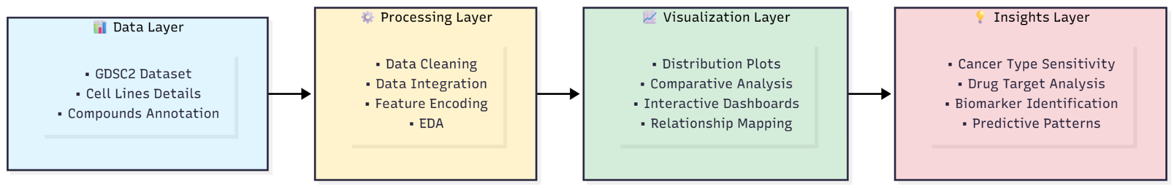
Project Architecture

Slide 5
Visualization Plan
We designed a visualization plan to explore the dataset from multiple angles:
Distribution of Numeric Features
GDSC Tissue Distribution
Pairplot of Numeric Features
Drug Sensitivity Across Cancer Types
Drug Efficacy Across Tissue Types
Top Drug Targets
Pathway Distributions
Impact of Microsatellite Instability
Treemap / Sunburst / Sankey Diagrams for interactive exploration

Slide 6
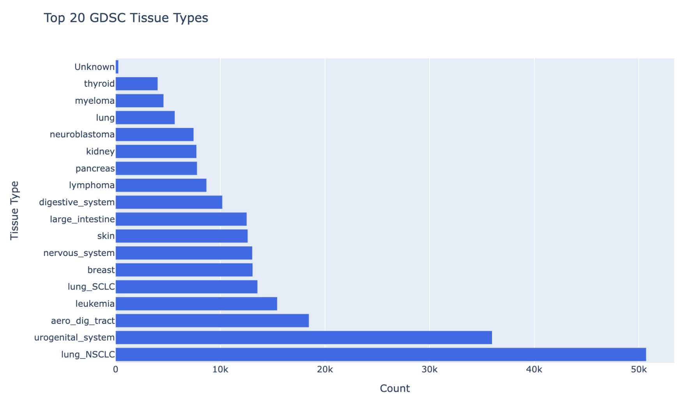
GDSC Tissue Distribution
The dataset covers a variety of cancer tissue types, with lung (NSCLC) and urogenital system cancers having the highest representation.
Cancers like thyroid and myeloma have fewer samples, showing limited data for those types.
This distribution highlights which cancers are more studied and where data gaps exist.

Slide 7
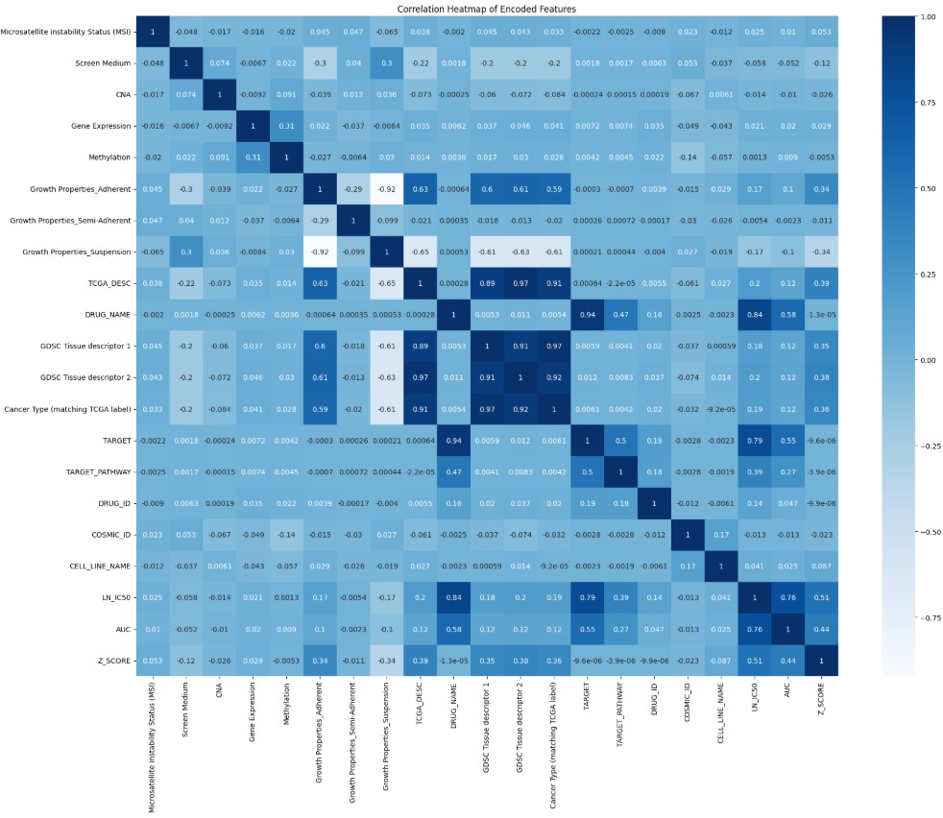
Correlation Heatmap of Encoded Features
The heatmap shows relationships between all encoded features in the drug sensitivity dataset.
Strong positive correlations appear between TCGA_DESC, DRUG_NAME, and GDSC tissue descriptors, while growth properties are negatively correlated due to exclusivity. LN(IC50), AUC, and Z_SCORE are positively correlated, confirming consistent drug response metrics.
Most genomic features show weak correlations, indicating independent biological contributions.

Slide 8
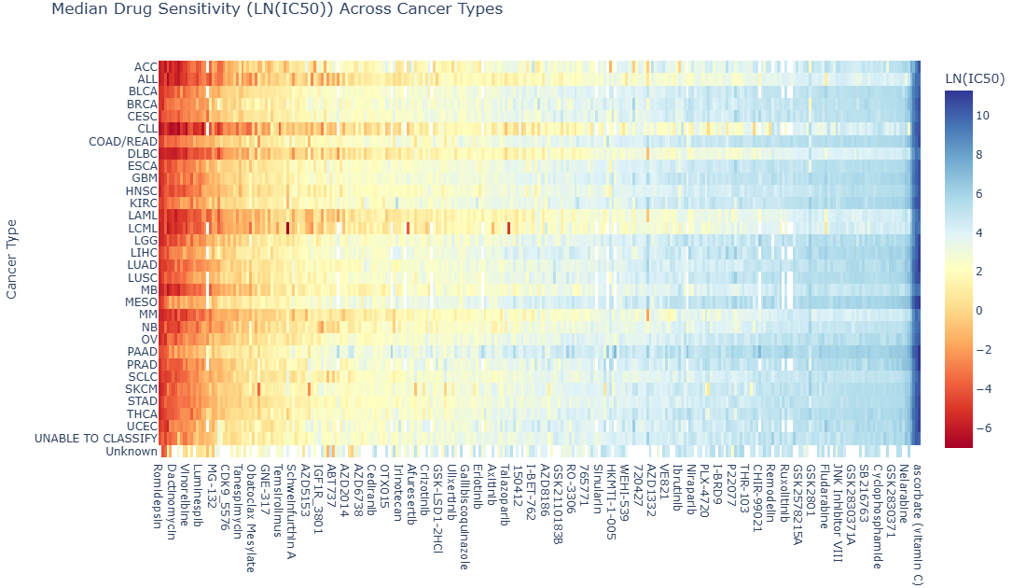
Drug Sensitivity Across Cancer Types (Heatmap)
This heatmap shows how different cancer types (rows) respond to various drugs (columns) based on LN(IC50) values
The color scale represents drug sensitivity — red areas indicate higher sensitivity (lower IC50, meaning the drug is more effective), while blue areas show lower sensitivity (higher IC50, meaning the drug is less effective).
From the pattern, we can see that drug response varies widely across cancer types, suggesting that certain drugs are more effective for specific cancers, highlighting the importance of personalized treatment strategies

Slide 9
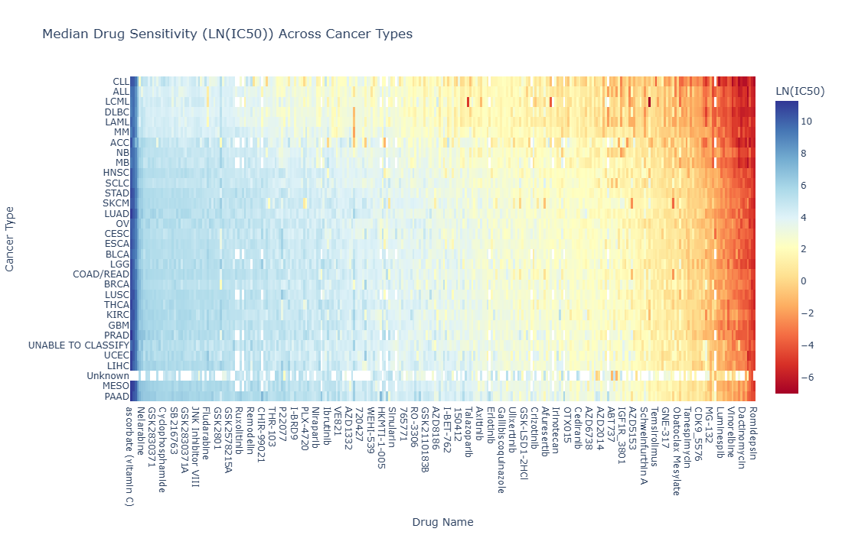
Drug Sensitivity Across Cancer Types (Heatmap)
Median Drug Sensitivity (LN(IC50)) Across Cancer Types – Sorted by Drug and Cancer Sensitivity. This heatmap is sorted by both drug efficacy and cancer type sensitivity.
The orientation is reversed so that lower efficacy drugs appear on the left and higher efficacy drugs (red) are on the right.
This dual sorting highlights how both drug potency and cancer-specific responses contribute to the overall sensitivity landscape.

Slide 10
Next Steps
Complete and refine all the planned visualizations
Build interactive dashboards (using Plotly/Dash or Tableau) for dynamic exploration.
Analyze relationships between drugs, pathways, and cancer types to extract insights.
Key Learnings
Learned to process and visualize large, complex biomedical datasets.
Improved skills in data cleaning, feature analysis and exploratory visualization.
Understood how visualization can reveal hidden genomic patterns and relationships.

Slide 11
THANK YOU!

