Slide 1

GATAS Lab Presentation
Structured Decompositions
Andersen Wall

Slide 2
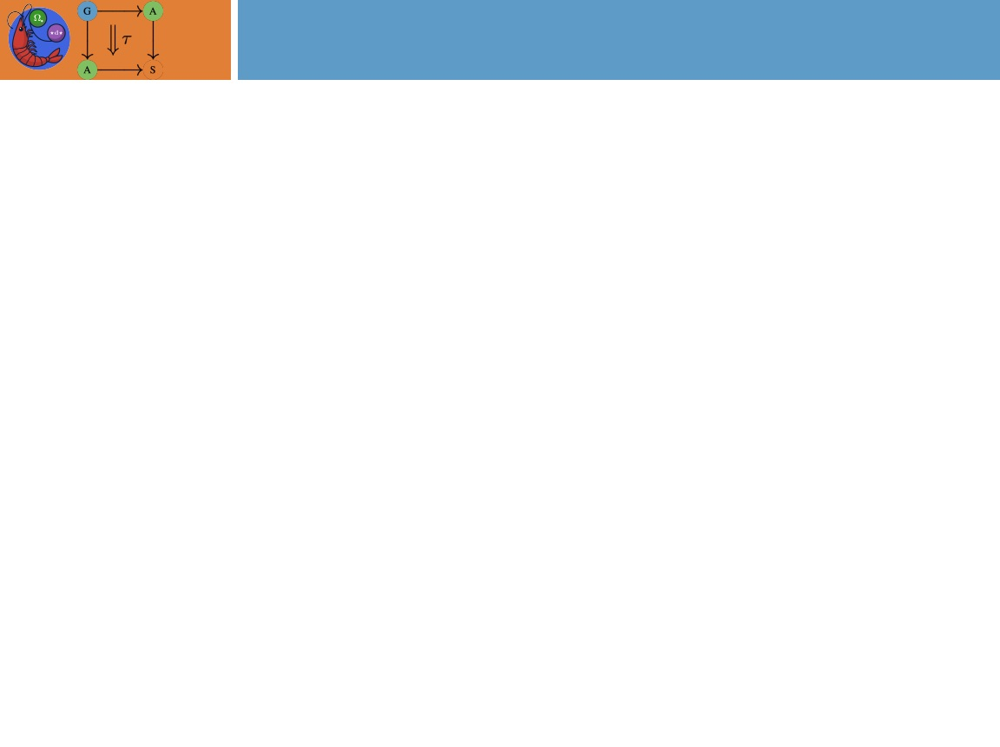

Overview
Structured Decompositions
Current Algorithm for graph coloring
Complexity Expectation
First attempt benchmarking and code improvement
Test cases and results
Future work

Slide 3




















Structured Decompositions
A structured decomposition is a method to break down complex mathematical objects into simpler components.
It’s like taking a big graph or structure and dividing it into smaller, easier-to-understand parts.
Consider the following example using the tree, t.
$$d: \int{t →Grph}$$
$$DF$$
$$DGrph →D({Set}^{op})$$
$$t$$
$$\int{t}$$
$$d$$
$$DFd$$
$$a$$
$$da$$
$$\left(DFd\right)a$$
$$a$$
$$e$$
$$e$$
$$de$$
$$(DFd)e$$
$$c$$
$$b$$
$$db$$
($DFd)b$
$$b$$
$$c=\left\{\left(a,b\right)∈\left(DFd\right)a ×\left(DFd\right)b \right| fa=gb\}$$

Slide 4
Structured Decompositions
a
b
a
b
Recognize that the colimit of subgraphs a and b returns to the original graph
This property will hold as more bags are added

Slide 5

















Structured Decompositions
$$d: \int{t →Grph}$$
$$DF$$
$$DGrph →D({Set}^{op})$$
$$d$$
$$DFd$$
$$da$$
$$f$$
$$\left(DFd\right)a$$
$$de$$
$$(DFd)e$$
$$c$$
$$db$$
$$g$$
($DFd)b$
$$da$$
$$c=\left\{\left(a,b\right)∈\left(DFd\right)a ×\left(DFd\right)b \right| fa=gb\}$$
$$de$$
$$db$$

Slide 6
Current Algorithm
Currently we require the graph to be input as a decomposition
Two main parts
adhesion_filter()
decide_sheaf_tree_shape()
adhesion_filter()
Takes inputs of a CoDecomposition and a tuple of cospans
Unpacks the tuple
Forms the pullback cone from the decompositions cospans
Note – If the cone is empty then there will no solution to the problem
Computes the image of each pullback leg
Gets the domain of the structured decomposition from the diagram
Creates the new decomposition from a new object and morphism map
decide_sheaf_tree_shape()
Computes adhesion_filter() on each bag, computes edges and projects to bags

Slide 7

Complexity Expectation
Graph coloring complexity
For a c-coloring with tree-width w, total vertices n, and adhesions a
Brute Force - $O(c^{w−a})$
Dynamic Solution - $O\left(c^{2w}\right)n$
Consider when brute force would be better
Depending on brute force objective there are some edge cases
In a yes instance, if brute force is looking for only 1 solution, a yes instance could get lucky, especially if there are many possible c-colorings
In a yes instance, if brute force is looking for all solution, the dynamic solution is slower in the 2-bag case
In a no instance, the dynamic solution is slower in the 2-bag case

Slide 8
Benchmarking and Improvement
adhesion_filter() and decide_sheaf_tree_shape() were running relatively slow at first
I made the following changes

Slide 9
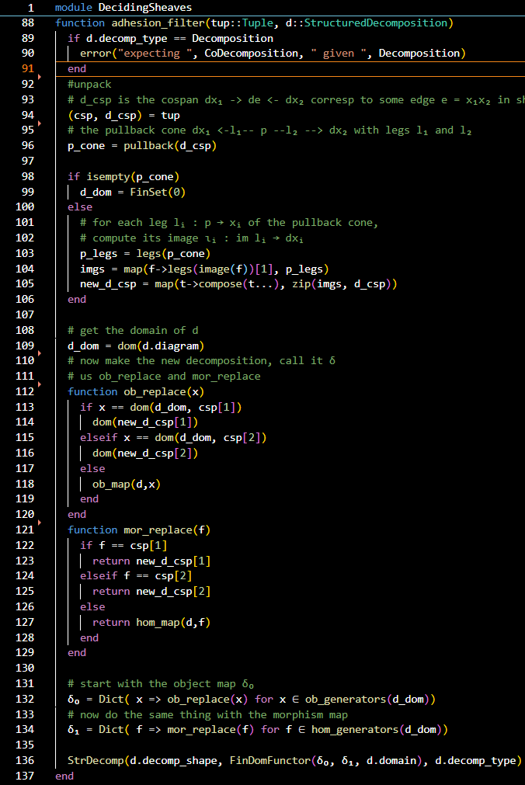
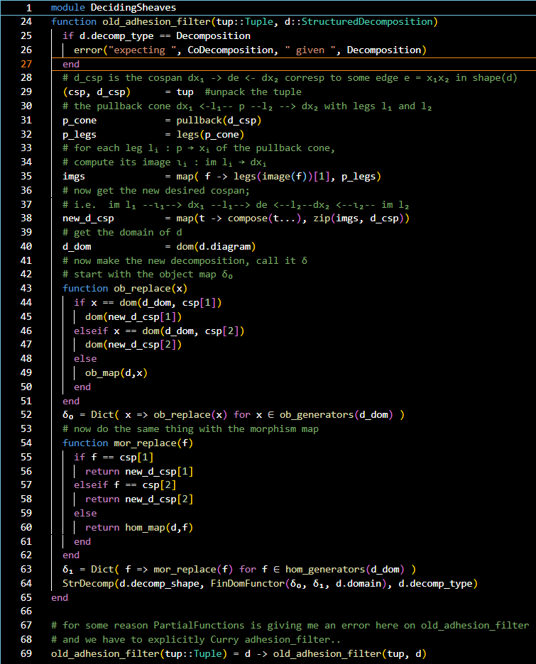
Benchmarking and Improvement
adhesion_filter()

Slide 10
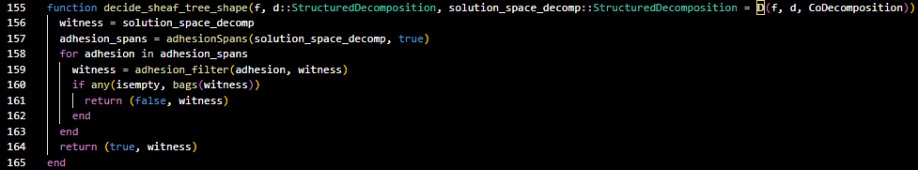
Benchmarking and Improvement
decide_sheaf_tree_shape()

Slide 11
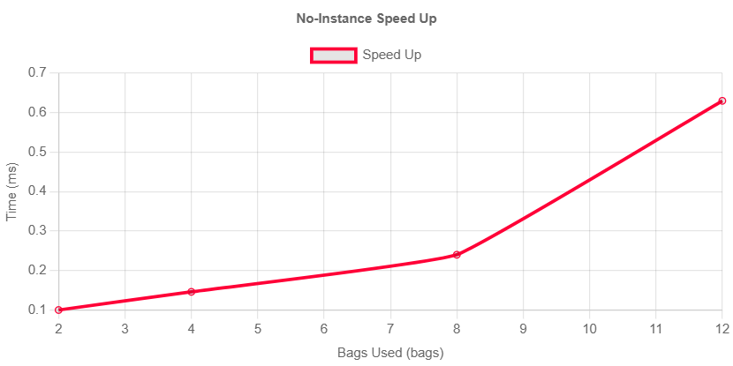
Benchmarking and Improvement
Note that the Yes-Instance
Speed up is negligible ( > |0.01ms|)

Slide 12
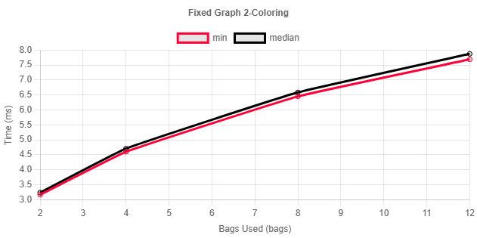
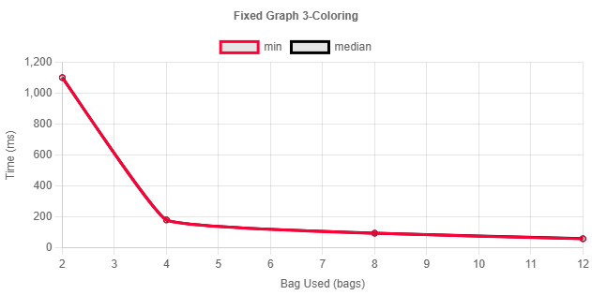
Test Cases and Results

Slide 13
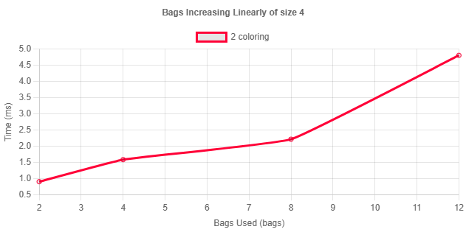
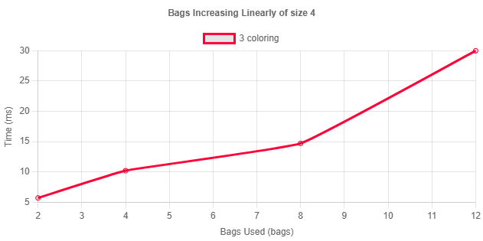
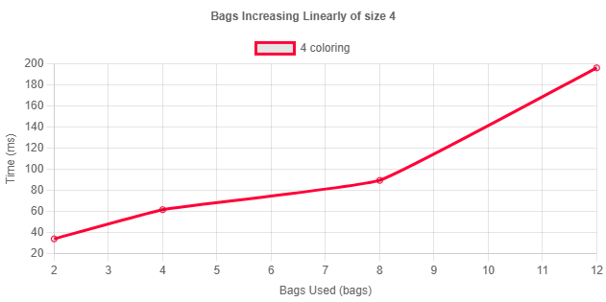
Test Cases and Results
In this case we expect a linear increase
in run time as the bags are all of the same
size and have the same number of adhesions

Slide 14
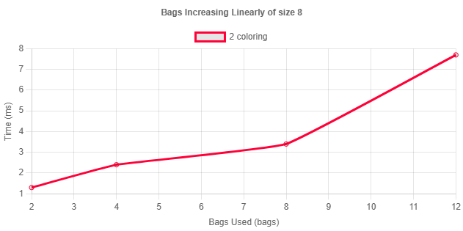
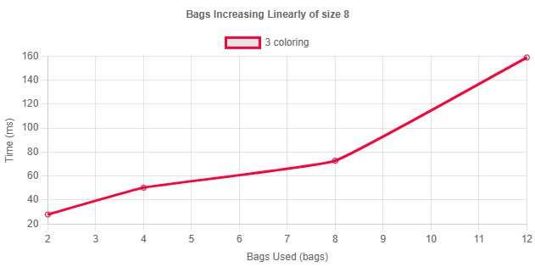

Test Cases and Results
In this case we expect a linear increase
in run time as the bags are all of the same
size and have the same number of adhesions

Slide 15
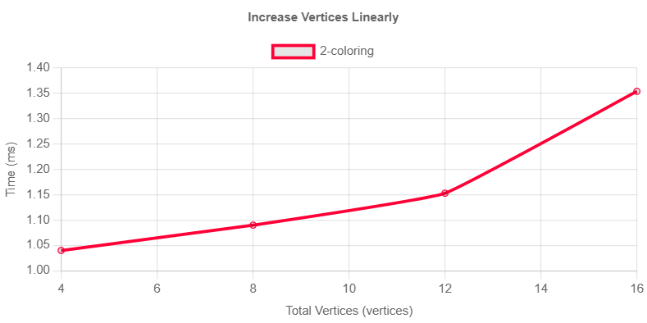
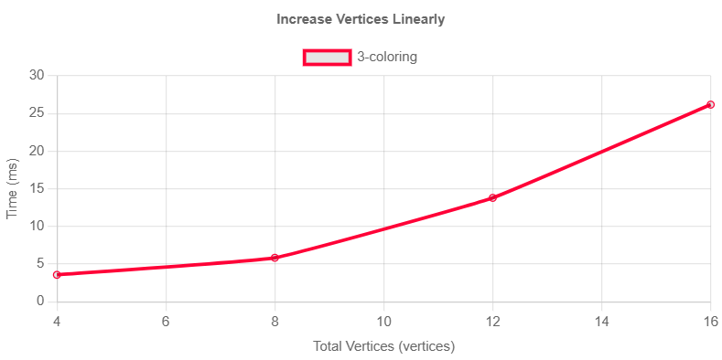
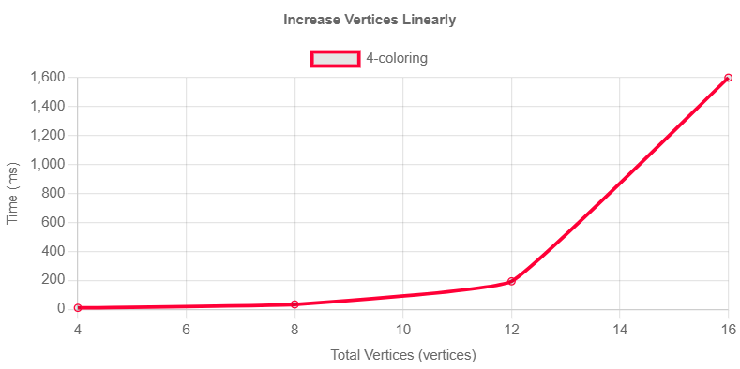
Test Cases and Results
In this case we expect an exponential
increase in run time as the bags are all
increasing linearly and have the same
number of adhesions. The number of
bags is also constant.

Slide 16
Future Work
Need to get accurate benchmarks against brute force method
Against homomorphisms and hom-search
Ben and I have discussed how to generalize away from requiring the graph to need to be representable as a tree
Adding benchmarks to show that as the number of adhesions increases, the efficiency of the algorithm decreases
Adding documentation

