Slide 1
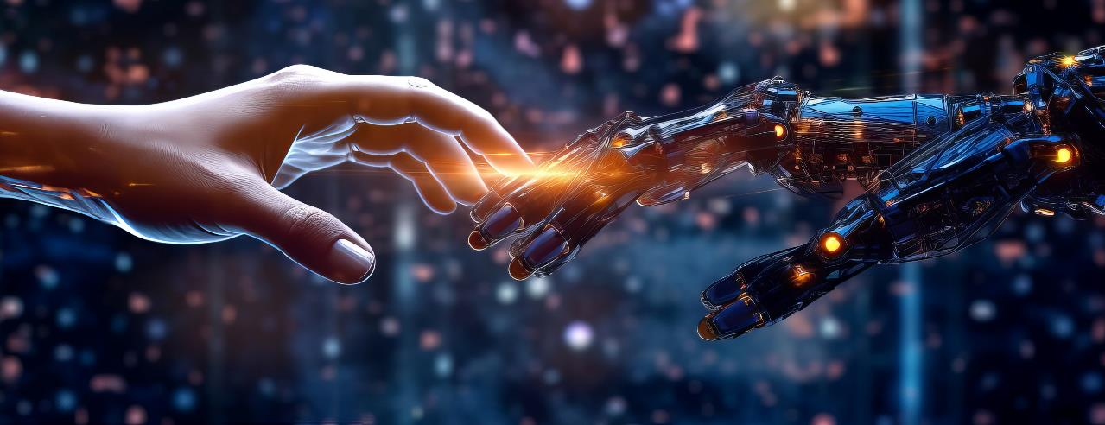
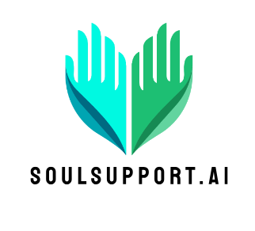
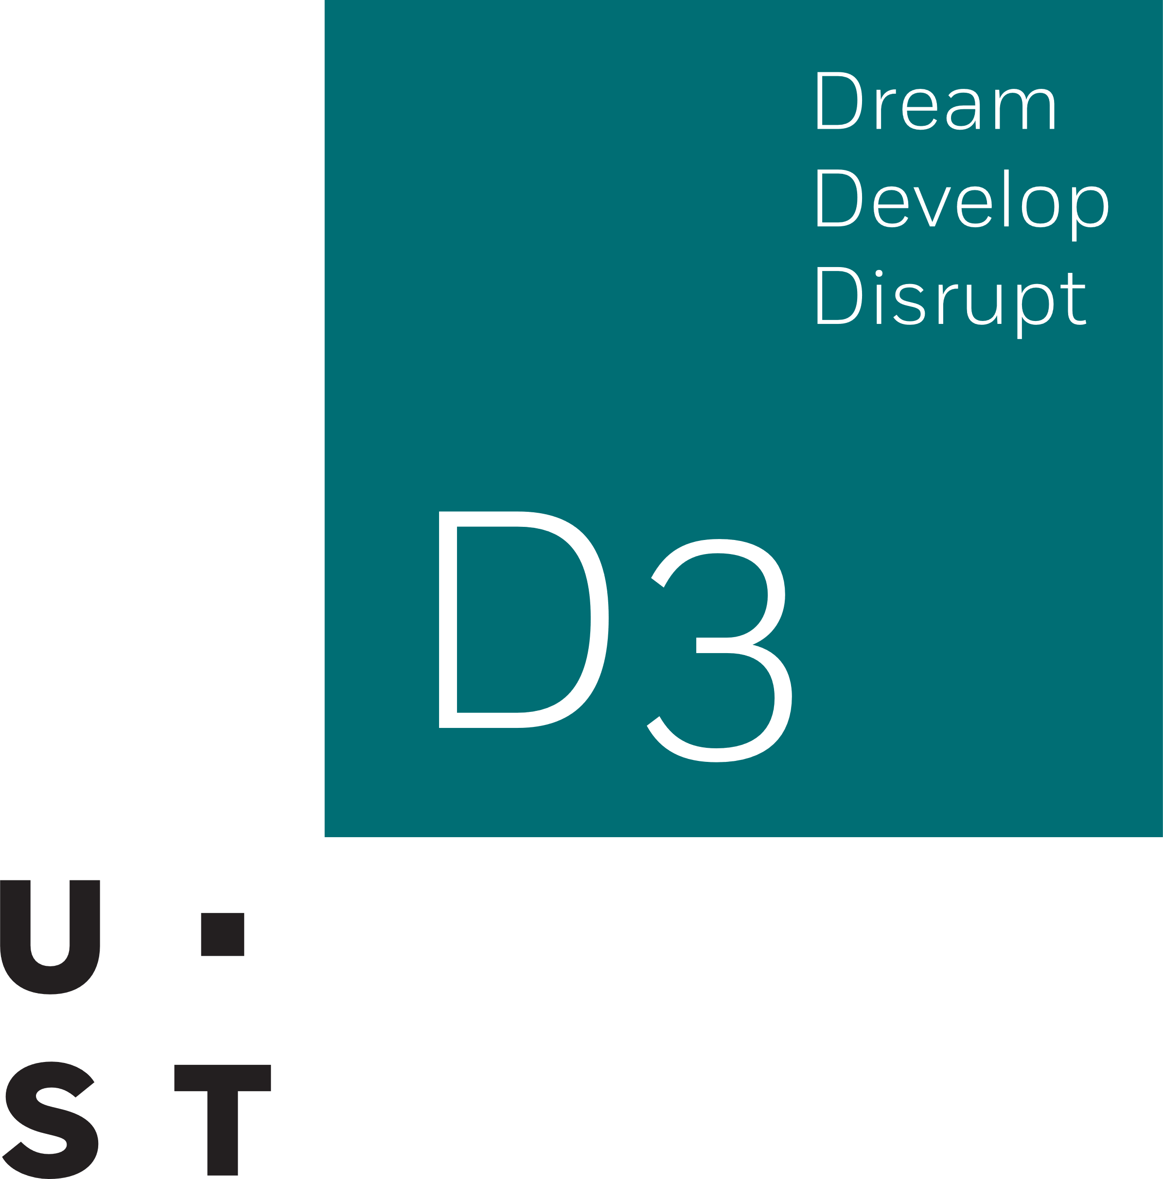
SoulSupport.AI
Dream. Develop. Disrupt
October 01,2023
Team Masala Papad
SoulSupport.AI

Slide 2
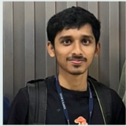
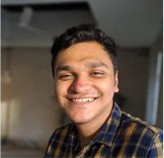
MASALA PAPAD
Manan Shah
L.Y. Btech
Fullstack Developer
Harsh Shah
L.Y. BTech
Backend Developer

Slide 3
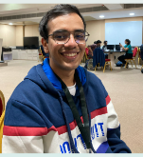

MASALA PAPAD
Mihir Shinde
L.Y. BTech
Frontend Developer
Alan George
T.Y. BTech
Flask Developer

Slide 4
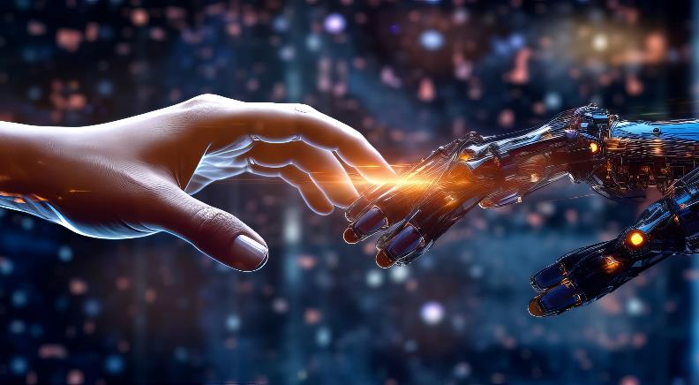
Agenda
The Need Arises
The Solution Offered
Architecture
Business Model & USP
Salient Features
Tech Stacks
Prototype Demo

Slide 5

WHY EVEN BUILD IT ?
Places like Kota are hotspots for students in India.
India has one of the most toxic corporate culture worldwide & burdening Societal system
Research has shown that 46% of people who die by suicide had a known mental health condition.
280 million worldwide and 56 million in India

Slide 6
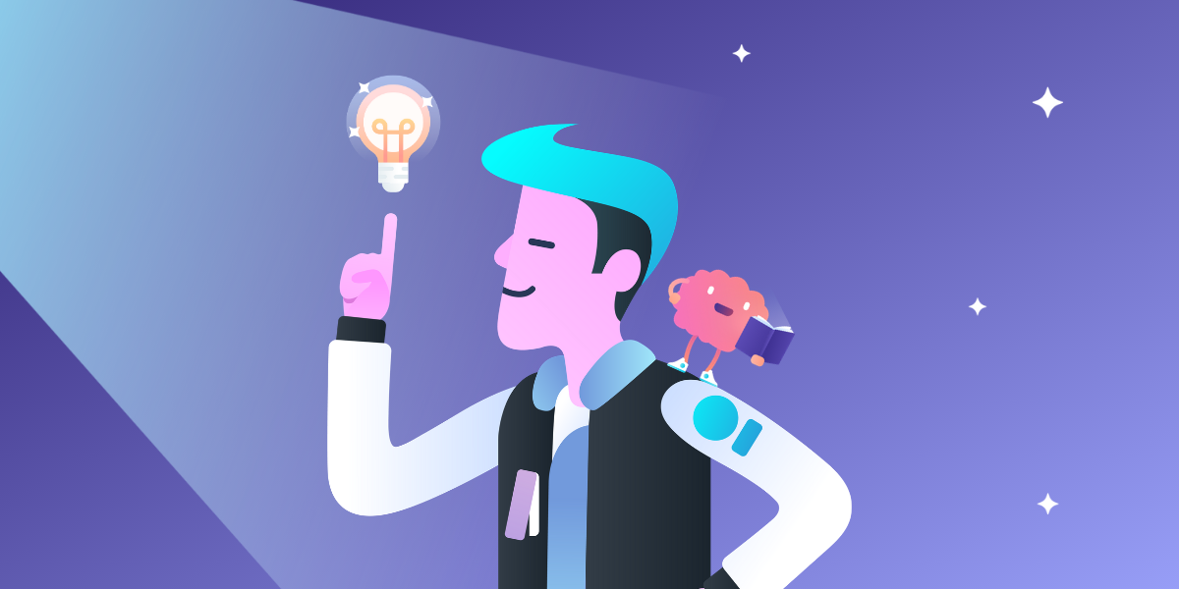
Probable Solution to this disaster
A probable Solution to this disaster
The Idea was to provide a Personal mental support system
Introducing a Web based solution using generative AI
Try to Prevent the user becoming degenerate while still curable
The Idea was to provide a Personal mental support system
Introducing a Web based solution using generative AI
Try to Prevent the user becoming degenerate while still curable

Slide 7
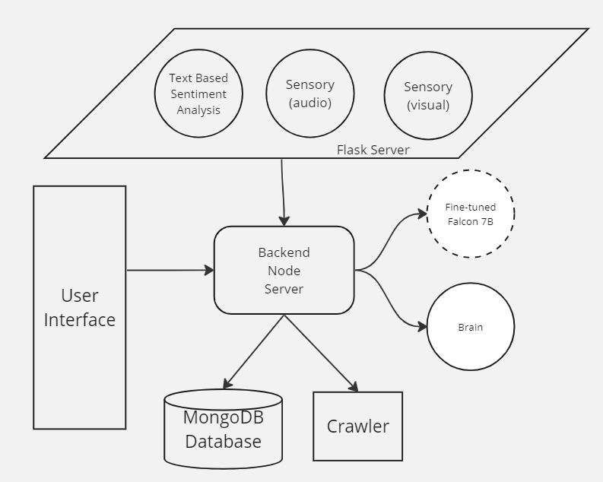
Conceptual Architecture

Slide 8

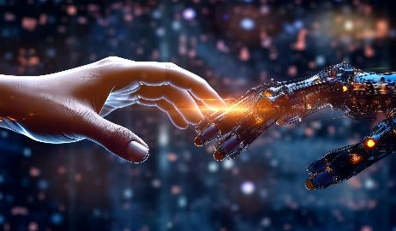
Business Model & Unique Selling Point
Business Model
Subscription Based Features
Customizing the application for private sectors for employee welfare
Unique Selling Point
. Not just limited to mental health problems
3D companion to keep you entertained
Funding
Setup Large GPU supply to run a bigger and better model
Advance R&D on better versions of model
Requirements
Trained personnel for expert insights to continuously improve the application
8

Slide 9
Salient Features
Doctor Search
Smart Recommender system that can suggest relevant doctors to the user
Personalized Healthcare AI at your service
Mikasa : A 24/7 available health care bot there to answer all of your questions in the most precise and accurate way through voice & chat.
Weekly Reports (CBT Analyzer)
Generates weekly CBT questionnaire that evaluates the user’s condition , improvements and well-being
Diet Plan
Intelligent Diet Recommendation based on user needs and situation

Slide 10




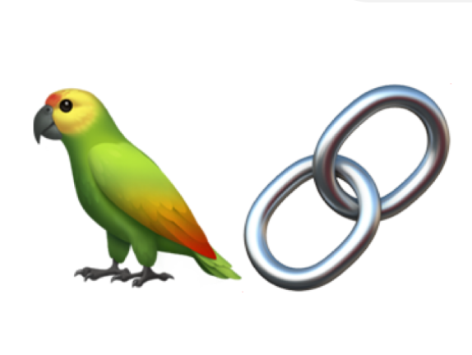
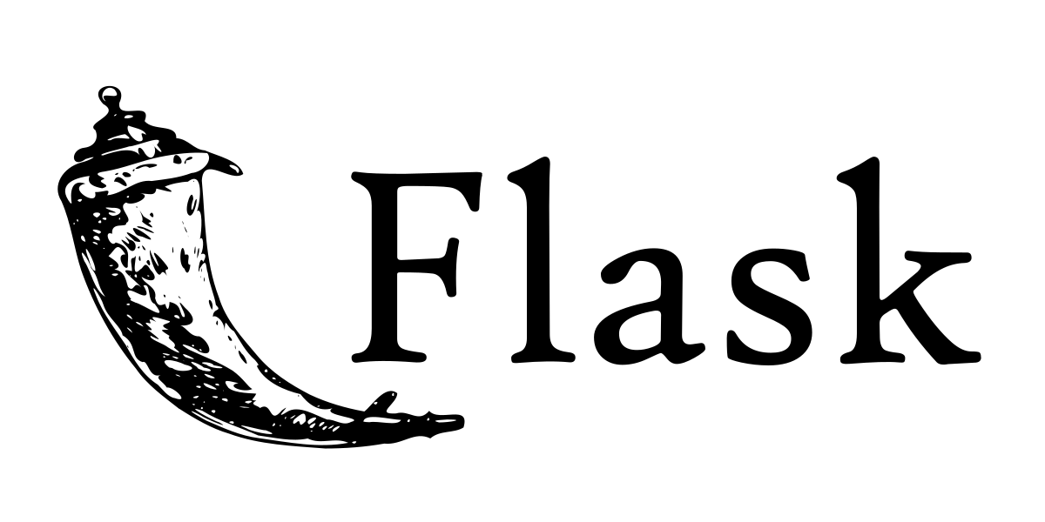

Tech Stacks
Nodejs
React
Python
Flask
LangChain
PyTorch
Azure

