Slide 1
Innovative Product Development
Group Members:
RISHABH SHAH (60018210033)
ALAN GEORGE (60018210093)
YUKTA SARAF
(60018210028)
RUJUTA JARIWALA (60018210015)
Title:
JARVIS: VOICE ASSISTANT WITH SMART HOME AUTOMATION

Slide 2
ABSTRACT
This paper explores the integration of virtual assistant technology with home automation systems. The voice assistant JARVIS leverages natural language processing to understand user requests and perform tasks such as information retrieval from Wikipedia, video playback on YouTube, and managing reminders and alarms. By simplifying daily routines and enhancing accessibility, JARVIS has the potential to revolutionize how we interact with technology in our homes. We use artificial intelligence (AI) and natural language processing (NLP) methods like Hidden Markov Models (HMM) and Mel-Frequency Cepstral Coefficients (MFCC) for speech recognition. Our setup involves using Raspberry Pi 3B+ to link with IoT devices and sending signals over Bluetooth and Wi Fi. We have prioritized the security of the user by ensuring that the data does not get stored in the cache memory. To maintain functionality when disconnected from the internet, the system will explore alternative communication methods for signals between system components. This research takes a thorough look at how we can blend virtual assistant tech into home automation systems to make living spaces intelligent.
Keywords: Virtual Assistant, Smart Home Automation, Artificial Intelligence, Natural Language Processing, Raspberry Pi 3B+, Speech Recognition, Hidden Markov Model (HMM), Mel-Frequency Cepstral Coefficients (MFCC), Natural Language Understanding, Accessibility, Scalability, User Privacy.

Slide 3
IDEA/APPROACH DETAILS
Problem Statement:
Due to the limitations of current smart home interfaces, which are complex and lack natural interaction, there is a necessity for the development of an AI voice assistant-integrated home automation system that seamlessly integrates with the home environment of user and allows them to control their appliances through voice commands.
Objectives:
1) The voice assistant recognizes and responds to natural language voice commands. 2) The voice assistant performs standard voice assistant functions such as answering questions, setting reminders, alarms, timers, and providing personalized recommendations based on user preferences. 3) Enables users to control and monitor various aspects of their home environment, including lighting, temperature, etc. 4) The system is easily adaptable to different types of homes and devices. 5) Interactions with the IoT devices are confined within the boundaries of the private network of the home. 6) Only trusted users have access to the voice assistant
:

Slide 4
Novelty of the proposed work
1) Integration of the assistant with IoT Novelty - Integration of voice assistants with IoT enhances the functionalities and efficiency of home automation systems.
2) Contextual Continuity Novelty - Our voice assistant maintains context from previous dialogues, ensuring coherent responses to follow-up questions.
3) Data Security/Privacy Novelty - Interactions with the IoT devices are confined within the boundaries of the private network of the home.
4) The extension of the voice assistant's capabilities to various tasks such as communication, AI cooking recommendations, timetable management, and product recommendations widens its area of work Novelty: The multifunctional nature of the AI assistant goes beyond traditional home automation, offering users a holistic solution that simplifies daily life and improves productivity.

Slide 5
IDEA (Layout of the idea)
This innovative project addresses a Smart Home Assistant System that merges advanced voice control with Internet of Things (IoT) technology. It aims to revolutionize smart home interactions by offering a comprehensive and intuitive control system that sets a new standard for user experience.
JARVIS leverages sophisticated Natural Language Processing (NLP) and machine learning algorithms to enable natural language understanding. Users can effortlessly command and monitor their smart home through voice commands, eliminating the need for complex apps or button presses.
This goes beyond standard automation by catering to diverse user needs. Accessibility features, and personalized recommendations based on usage patterns can be implemented. Security, scalability, and adaptability across various devices are also central to the design, promising a truly enhanced smart living experience.
This project involves integrating voice control with home automation systems. The core idea is to create a user-friendly system that empowers users with natural language interactions. By simplifying daily routines and offering intuitive voice control, JARVIS has the potential to transform the way we interact with technology in our homes.

Slide 6
IDEA (Layout of the idea)
The Intelligent Home Assistant System (IHAS) revolutionizes smart home interactions by seamlessly merging an AI-powered voice assistant with IoT technology. This innovative project addresses the limitations of current home automation interfaces, providing users with a comprehensive and intuitive control system.
IHAS employs sophisticated Natural Language Processing (NLP) and machine learning algorithms to enable natural language understanding, allowing users to effortlessly command and monitor various aspects of their smart homes.
Beyond standard automation functions, IHAS caters to diverse user needs, including accessibility features, voice-activated navigation, and personalized AI-assisted recommendations. The system ensures scalability, adaptability to different devices, robust security, and user privacy, promising an enhanced smart living experience. Key components include wake word detection, Hidden Markov Models for speech recognition, and a focus on comprehensive natural language understanding. IHAS emerges as a sophisticated yet user-friendly solution, combining advanced technologies for efficient voice recognition with multifunctional capabilities, ultimately simplifying and enriching daily life through intelligent home management.

Slide 7
Literature Review/Existing Systems
Sr. No: | Reference Paper Title/ Existing Applications | Key Findings | Scope for improvement/Gap Identification
1 | Intelligent Voice Assistant using Android Platform Author: Vinay Sagar , Kusuma S International Research Journal of Engineering and Technology (IRJET), Volume: 02 Issue: 03 | Jan-2015 | Development of an intelligent voice assistant, enabling hands-free smartphone operations. Interaction between user and assistant is intuitive and user friendly User can make calls, send messages, or search for information conveniently Saves time and effort compared to manual input methods | Gaps: Voice assistants often require initial training to recognize and adapt to a user's voice patterns and preferences accurately Recognizing specific individuals' voices within a household and personalization features are challenging to implement Voice assistant struggles in understanding complex and context specific instructions. Future Scope: Enhance prediction accuracy, integrate more smart functionalities, optimize for diverse user needs, improve compatibility with various devices, and refine the user interface for broader accessibility.

Slide 8
Literature Review/Existing Systems
Sr. No: | Reference Paper Title/ Existing Applications | Key Findings | Scope for improvement/Gap Identification
2 | Home Automation Using Internet of Things Author: Darpan Raut, Sumedh Salvi, Shrikrishna Salvi, Prof. S. R. Rangari International Journal of Computer Trends and Technology (IJCTT), Volume 34 Number 3 - April 2016 | Key Findings: Successful remote appliance control, cloud-based data analysis, and cost-effective scalability. Hands free operation along with multitasking ability leads to increased accessibility User friendly interface Multiple device integration provides a centralised controlled hub for home automation | Gaps: Scope of improving the accuracy of voice recognition Functionality of voice assistance is compromised due to dependency on internet connectivity Potential security risks like accidental recordings or unauthorized access to sensitive information Future Scope: Strengthen Security, Expand Compatibility by Integrating with diverse appliances for broader use, Optimize Energy Usage, Enhance User Interface, Integrate AI for predictive maintenance, Address scalability challenges

Slide 9
Literature Review/Existing Systems
Sr. No: | Reference Paper Title/ Existing Applications | Key Findings | Scope for improvement/Gap Identification
3 | Artificial Intelligence-Based Voice Assistant Authors: Vigneswaran A, Dr. Gowri J, Aakash B | Key Findings: Development of an AI-powered voice assistant for various tasks, including opening applications and sentiment analysis based on user voice input. | Gaps: Sentiment Analysis Scope: Limited focus on sentiment analysis restricted to user voice inputs IoT Integration: The depth of integration with IoT devices needs elaboration Application Integration: The paper discusses opening applications but lacks insight into the complexity and compatibility issues that might arise when integrating various applications. User Interaction Personalization Performance Evaluation: There's a lack of detailed performance metrics or evaluation methodologies for the voice assistant's effectiveness and accuracy. Future Scope: Enhance IoT integration for voice assistants, broaden home appliance control, improve sentiment analysis with larger voice datasets, integrate diverse applications, and personalize interactions for heightened user engagement.

Slide 10
Literature Review/Existing Systems
Sr. No: | Reference Paper Title/ Existing Applications | Key Findings | Scope for improvement/Gap Identification
4 | Google assistant, Alexa, Microsoft Cortana, Siri Existing applications | Key Findings: Makes proactive suggestions Integrated to various home appliances Dataset has already been trained | Gaps: Certain apps or services are not be supported, preventing users from accomplishing certain tasks via voice commands Potential misuse of personal information collected by these assistants Difficulty in understanding few accents, dialects, and non-native speakers results in misinterpretations and less accurate responses Handling multistep queries or commands

Slide 11
Literature Review/Existing Systems
Sr. No: | Reference Paper Title/ Existing Applications | Key Findings | Scope for improvement/Gap Identification
5 | Development of Voice Control and Home Security for Smart Home Automation | Key Findings: Successful integration of voice control adds a new level of convenience for smart home users. Users can control various devices and security features using natural language commands. Integration of home security systems enhances the overall safety of smart homes. Real-time monitoring and alerts contribute to quick responses to potential security threats. Positive user experiences with voice control and enhanced security features lead to higher user satisfaction. | Potential Gaps: Issues may arise if devices from different manufacturers have interoperability challenges. Standardization efforts are crucial to ensuring seamless integration. The scalability of the system needs careful consideration, especially as the number of connected devices increases. Continuous monitoring for potential security vulnerabilities is critical. Regular software updates and patches are necessary to address emerging threats. Providing adequate education and resources for users is essential for maximizing the benefits of the smart home automation system.

Slide 12
Literature Review/Existing Systems
Sr. No: | Reference Paper Title/ Existing Applications | Key Findings | Scope for improvement/Gap Identification
6 | Home Automation System with Raspberry Pi Authors: Nikolay Valov, Irena Valova | Key Findings: 1. Home Automation Framework: Introduced a comprehensive system using Raspberry Pi as the central microcomputer for managing home appliances. 2. Sensor Integration: Incorporated BH1750 for light sensing and BME280 for temperature, pressure, and humidity readings. 3. Software Modules: Developed Python and PHP-based modules for data collection, administration, visualization, and control. 4. Web-Based System: Implemented a three-tiered web-based system for user interaction and device control. | Gaps: 1. Real Device Testing: Limited testing done with LED lights; actual appliance validation pending. 2. Security Testing: Needs thorough testing and refinement for system security. 3. Mobile Interface: Lacks a dedicated mobile app for user interface and notifications. 4. Data Utilization: Opportunity to utilize accumulated data for system improvement and prediction.

Slide 13
Literature Review/Existing Systems
Sr. No: | Reference Paper Title/ Existing Applications | Key Findings | Scope for improvement/Gap Identification
7 | Voice Controlled Home Automation Authors: Dusi Durga Prasad, Golla Jyothi Mallika, Shaik Umer Fasooq, S. Pramod | Key Findings: Enhanced Accessibility by empowering disabled individuals with the ability to control appliances through voice commands. Focused on providing a low-cost solution for voice-controlled home automation. Automatic mode adjusts fan speed based on temperature and controls light intensity according to room lighting. Android control mode enables users to switch appliances on/off using both buttons and voice commands. | Gaps: Limited Android Control Functionality: In Android control mode, fan speed adjustment is not achievable through the app. Future improvements may explore enhancing the app's capabilities for comprehensive appliance control. Dependency on MIT Inventor Application: The system relies on the MIT inventor application for Android control. Investigating alternative app solutions or developing a dedicated app could increase versatility. Scope for Appliance Expansion: The current system focuses on controlling fans, lights, and sockets. Expanding the range of controllable appliances may further benefit users with diverse needs.

Slide 14
Literature Review/Existing Systems
Sr. No: | Reference Paper Title/ Existing Applications | Key Findings | Scope for improvement/Gap Identification
8 | Development of GUI for Text-to-Speech Recognition using Natural Language Processing Authors: Partha Mukherjee, Soumen Santra, Subhajit Bhowmick, Ananya Paul, Pubali Chatterjee, and Arpan Deyasi | Key Findings: The paper presents the successful development of a Text-to-Speech (TTS) synthesizer using Natural Language Processing (NLP) and Digital Signal Processing (DSP) technologies. It offers a user-friendly application that converts text inputs into synthesized speech, aiding visually impaired individuals and enabling various applications. | Gaps: The paper could expand on the specific algorithms and models used in NLP and DSP for a deeper technical understanding. It lacks details on potential limitations or challenges faced during the development process. Future Scope: Language Expansion: Extend language capabilities beyond American English to increase accessibility. Enhanced Accuracy: Continuously improve accuracy for real-life environment application. Web-based Real-time System: Transition the system into a web-based platform to widen its reach and accessibility.

Slide 15
Literature Review/Existing Systems
Sr. No: | Reference Paper Title/ Existing Applications | Key Findings | Scope for improvement/Gap Identification
9 | Cross Modal Audio Search and Retrieval with Joint Embeddings Based on Text and Audio Authors: Elizalde, B., Zarar, S., & Raj, B. (2019) IEEE International Conference on Acoustics, Speech and Signal Processing (ICASSP 2019) | Key Findings: Framework that learns a shared space for both text and audio, enabling the direct comparison and retrieval of audio clips using either text or audio queries. Results demonstrate improved performance using joint embeddings (JEs) compared to baseline features. Robustness against noise and allowed retrieval using out-of-vocabulary (OOV) queries, enhancing its practical utility. | Gaps: Noise or ambiguous labels in real-world applications could affect retrieval accuracy. Challenges in scaling to larger datasets or diverse domains due to limitations in embedding generalization. Future Scope: Enhanced Noise Handling, Scalability Improvements, refining the retrieval evaluation metrics and methodologies to enhance the accuracy, domain diversification.

Slide 16
Literature Review/Existing Systems
Sr. No: | Reference Paper Title/ Existing Applications | Key Findings | Scope for improvement/Gap Identification
10 | Use of Transforms for Indexing in Audio Databases Authors: S.R. Subramanya1 , Abdou Youssef 2 , Bhagirath Narahari 2 , Rahul Simha3 | Key Findings: Transform Selection: Discrete Cosine Transform (DCT) consistently outperformed other transforms, threshold coefficient selection demonstrated superior results over zonal selection Transform-based indexing offered energy compaction, robustness to noise, and faster computations. Segmentation resulted in significantly faster search speeds (6-10 times faster) but retrieval precision of segmentation was slightly lower compared to blocking. | Potential Gaps: Lacked a direct comparison with existing audio data indexing techniques, limiting insights into the approach's uniqueness. Insufficient discussion on scalability, particularly with larger datasets, and limited exploration of real-world applicability. Did not extensively discuss user-centric evaluations, such as user satisfaction and usability, leaving a gap in understanding user impact. Lack of exploration of Advanced Techniques in audio data indexing, particularly those involving machine learning techniques.

Slide 17
Study Design and Methodology
Input Processing:
Audio input using user's microphone
Pre-processing:
Removing background noise that can interfere with speech recognition
Automatic Speech Recognition:
Machine algorithm converts audio to text
Wake Word Detection:
Voice assistant system gets activated when wake word 'JARVIS' is detected
Dialogue Management & Dialogue State Tracking:
Determines the apt response and keeps track of current context and state of conversation
Intent Recognition:
Determines intent of user's command based on results of previous sub-components
Dependency parsing:
Identifies grammatical relationships between words
Natural Language Processing:
Extract meaning and context of the text output from ASR component
Database creation:
Database for storing queries and mapping queries to their respective outputs/results
Action selection:
Selects actions based on user's intent
Output Generation:
Generates response (audio) for user using text-to-speech(TTS) component
Response generation: Creates actual response based on selected action
GUI:
User interface to access application
Integration with External Services/API:
Provides additional functionality of smart home automation
Machine Learning:
Training the ASR/NLP components on additional data or using reinforcement learning to optimize dialogue management/action selection to enhance performance

Slide 18
Study Design and Methodology
Hardware:
Raspberry Pi connected to a breadboard with components for home automation
Automatic Speech Recognition:
Machine algorithm converts audio to text
Input Processing:
Audio input using user's microphone
Pre-processing:
Removing background noise that can interfere with speech recognition
Dialogue Management & Dialogue State Tracking:
Determines the apt response and keeps track of current context and state of conversation
Intent Recognition:
Determines intent of user's command based on results of previous sub-components
Natural Language Processing:
Extract meaning and context of the text output from ASR component
Wake Word Detection:
Voice assistant system gets activated when wake word 'JARVIS' is detected
Action selection:
Selects actions based on user's intent
Output Generation:
Generates response (audio) for user using text-to-speech(TTS) component
Response Generation:
Creates actual response based on selected action
Integration with External Services/API:
Provides additional functionality of smart home automation

Slide 19
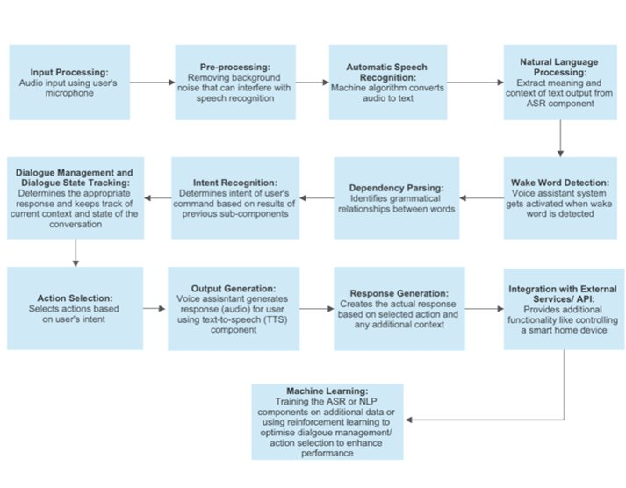

Slide 20
TECHNOLOGY STACK
Software Stack:
Speech Recognition:
Google Cloud Speech-to-Text
Natural Language Processing (NLP):
Hidden Markov Model
Mel- frequency cepstral coefficient
Text-to-Speech (TTS):
Python Text-to-Speech
Programming Language:
Python (selected for its extensive libraries and programming ease)
Operating System:
Raspbian (for Raspberry Pi)
Debian-based Linux distribution (for BeagleBone)
Web Services/APIs:
Hub API Endpoints
Custom APIs for specific functionalities
Hardware Stack:
Single Board Computer:
Raspberry Pi 3 B+
BeagleBone Black or BeagleBone AI
Microphones and Speakers:
USB or I2S microphones
USB or I2S speakers
Hardware components:
Resistor 1kΩ
Connector wires for breadboard
LED bulb
Breadboard
Connectivity:
Wi-Fi or Ethernet for internet connectivity
Storage:
MicroSD card for the operating system and data

Slide 21
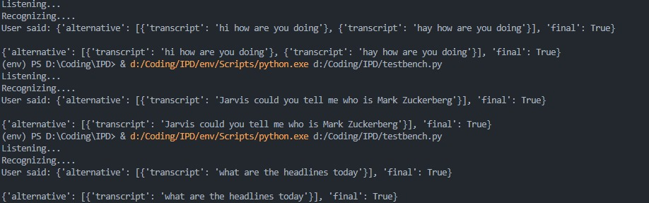

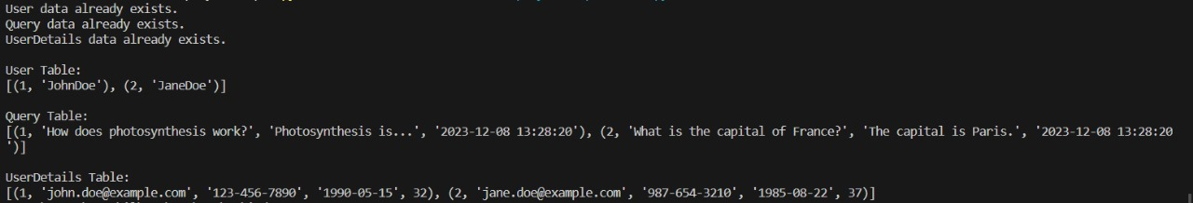
Results & Discussion
Voice assistant JARVIS performs standard voice assistant functions such as answering questions, opens Wikipedia, Google, YouTube, generates audio and text output for user queries
Voice assistant recognizes and responds to natural language voice commands

Slide 22
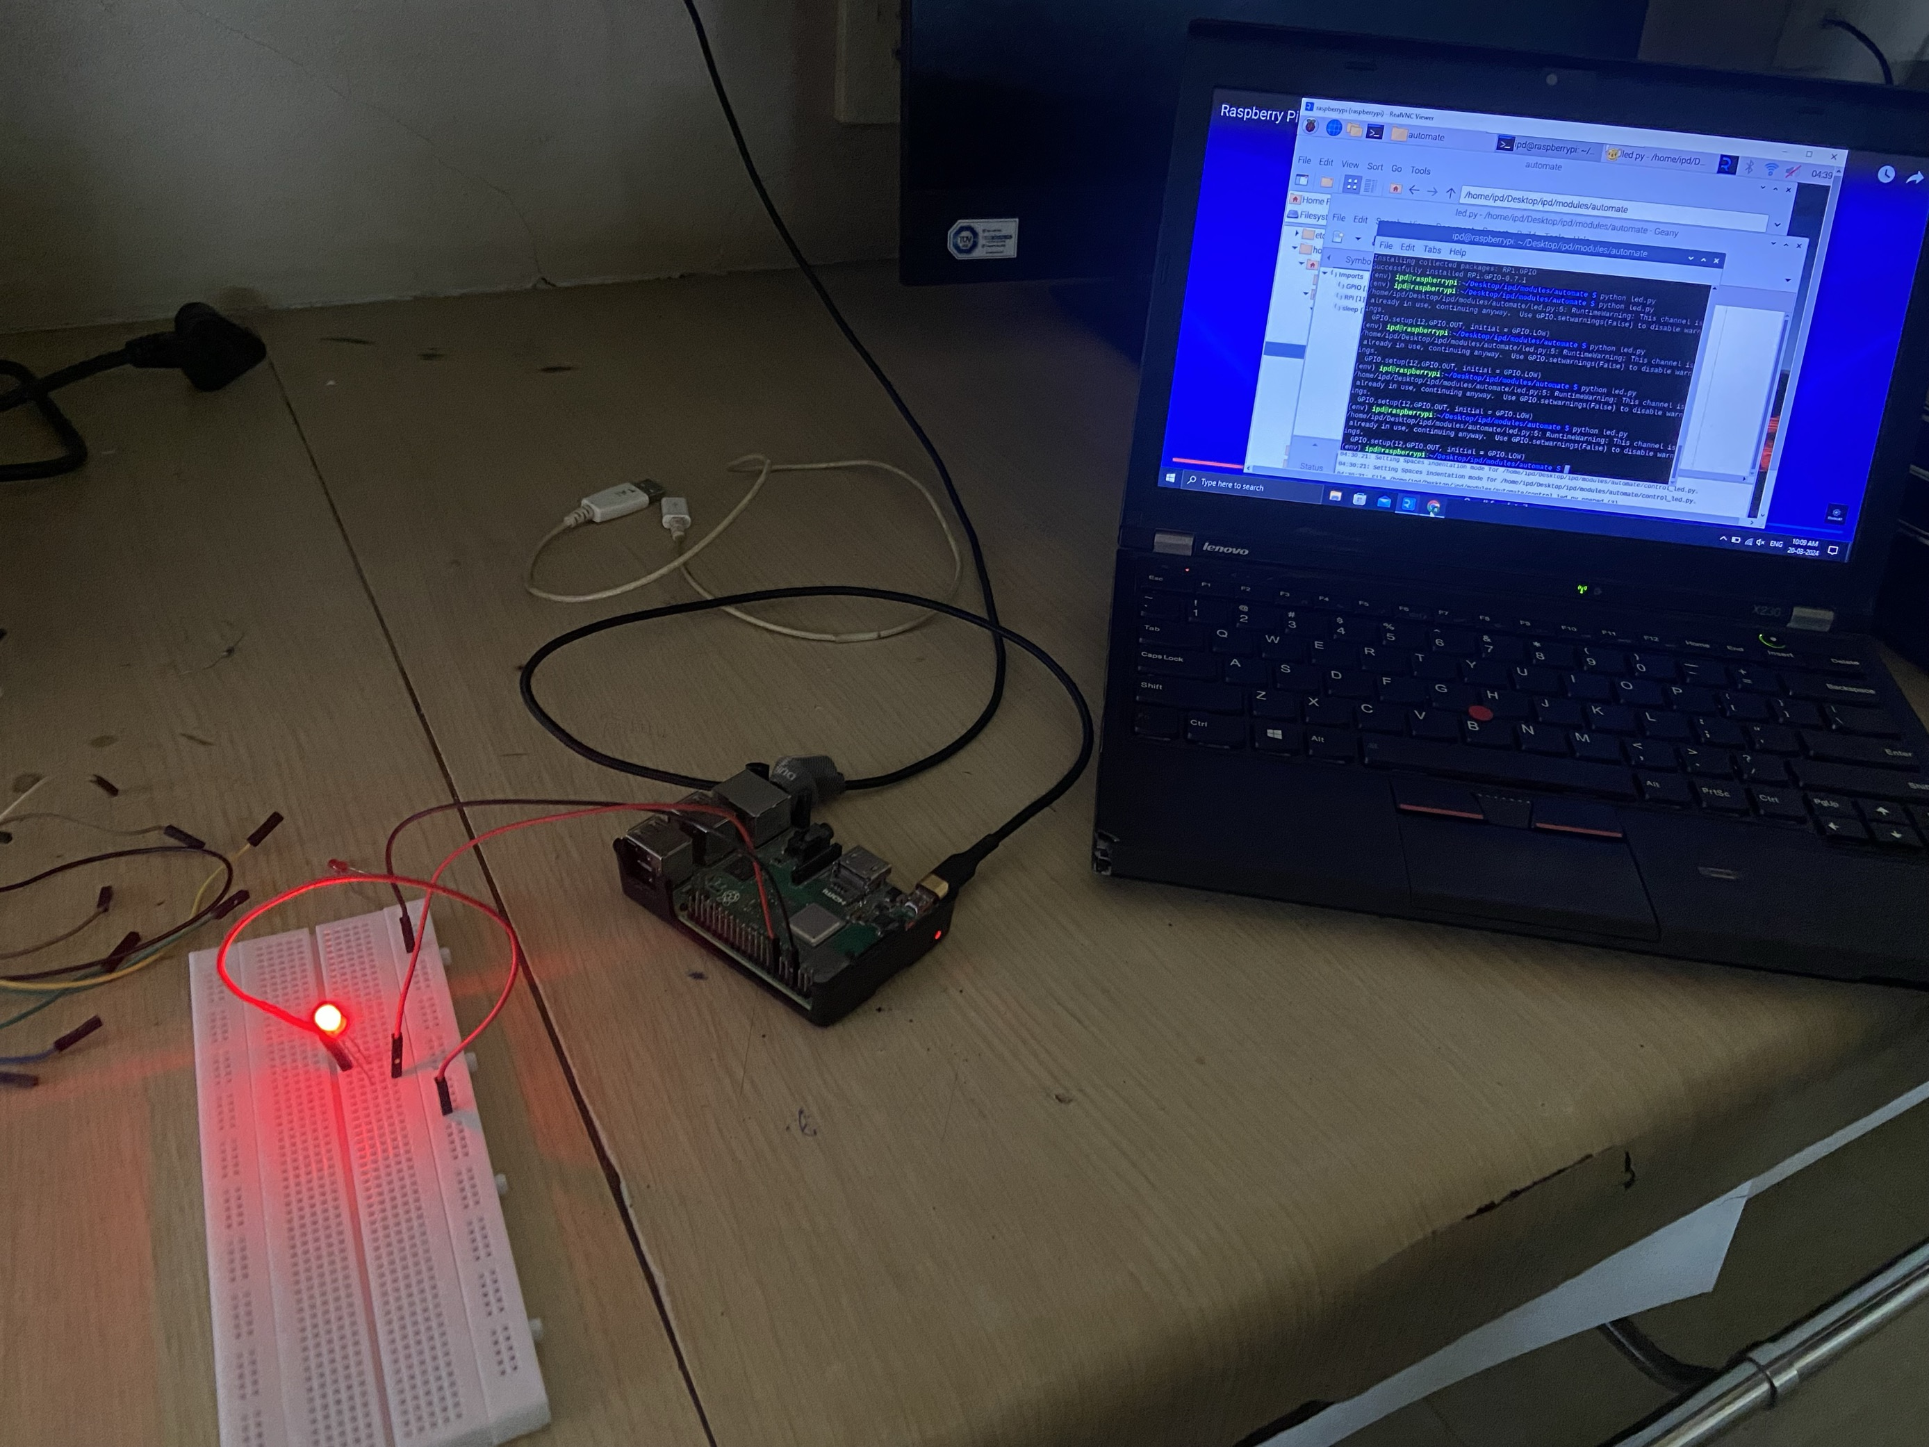
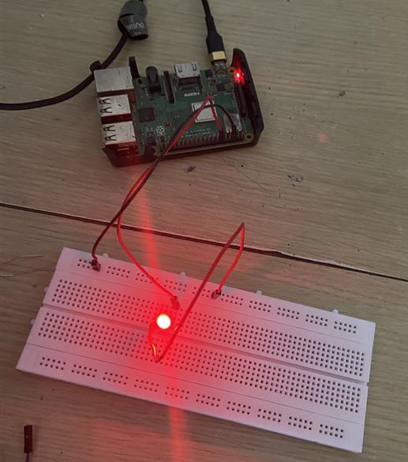
Smart Home Automation Output:
Switched ON/OFF LED light via internet

Slide 23
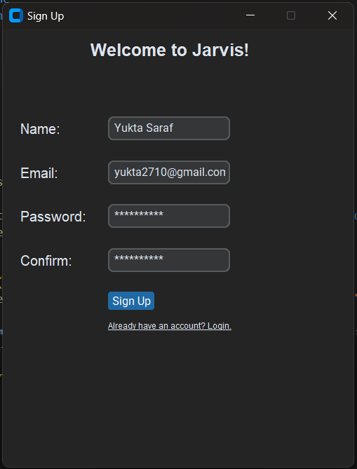
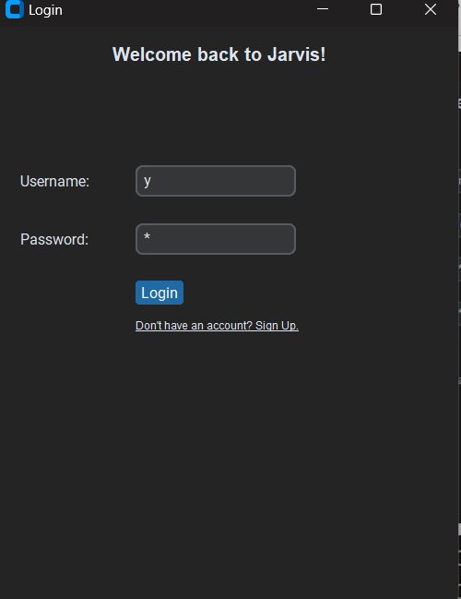
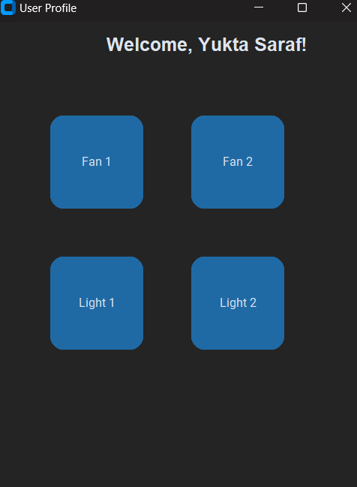
User Interface to access desktop application:

Slide 24
USE CASES:
Voice activated search
Personalised route recommendations based on user history
Assist people with disabilities to access digital content like articles, documents and messages.
Communication and Social Interaction (send WhatsApp messages and emails through voice) only for desktop.
Provides updates on train schedules according to user’s travel history (provide alternatives in case of emergencies and unexpected weather conditions, also provides alternative trains/buses in case the usual one is missed)
AI enabled cooking: Based on ingredients provided by user (in any language) suggests recipes and nutritional information based on user’s preference/mood.
Timetable management for university students based on assignments, break schedule and work load.
Product recommendations based on user conversation history.
Home automation (control of lights, fans, AC and other electronic devices using voice)

Slide 25
Conclusion:
This project presents the development of a voice assistant JARVIS for home automation and everyday tasks. The system integrates advanced NLP and machine learning algorithms to recognize and respond to natural language voice commands, enhancing user experience. It offers voice control for home automation functions, standard voice assistant features, scalability, and security.
Additionally, the system caters to various use cases, accessibility for people with disabilities, communication, AI-assisted cooking, timetable management, and product recommendations.
The system simplifies daily life and improves home management by seamlessly combining AI-driven voice assistance with IoT-based home automation, offering convenience and productivity.

Slide 26
Objectives for Next Semester(Sem–VI):
To write a research paper on said project.
Start working on hardware side of the project.
Improving accuracy of NLP Model [Natural Language Processing].
App development and deployment in addition to current CLI [Command Line Interface].

Slide 27
References:
Ref. Papers:
IPD LITERATURE REVIEW
References Web resources:
https://ieeexplore-ieee-org.svkm.mapmyaccess.com/Xplore/home.jsp

