Slide 1
About me !
Eden Kisniexsky

Slide 2
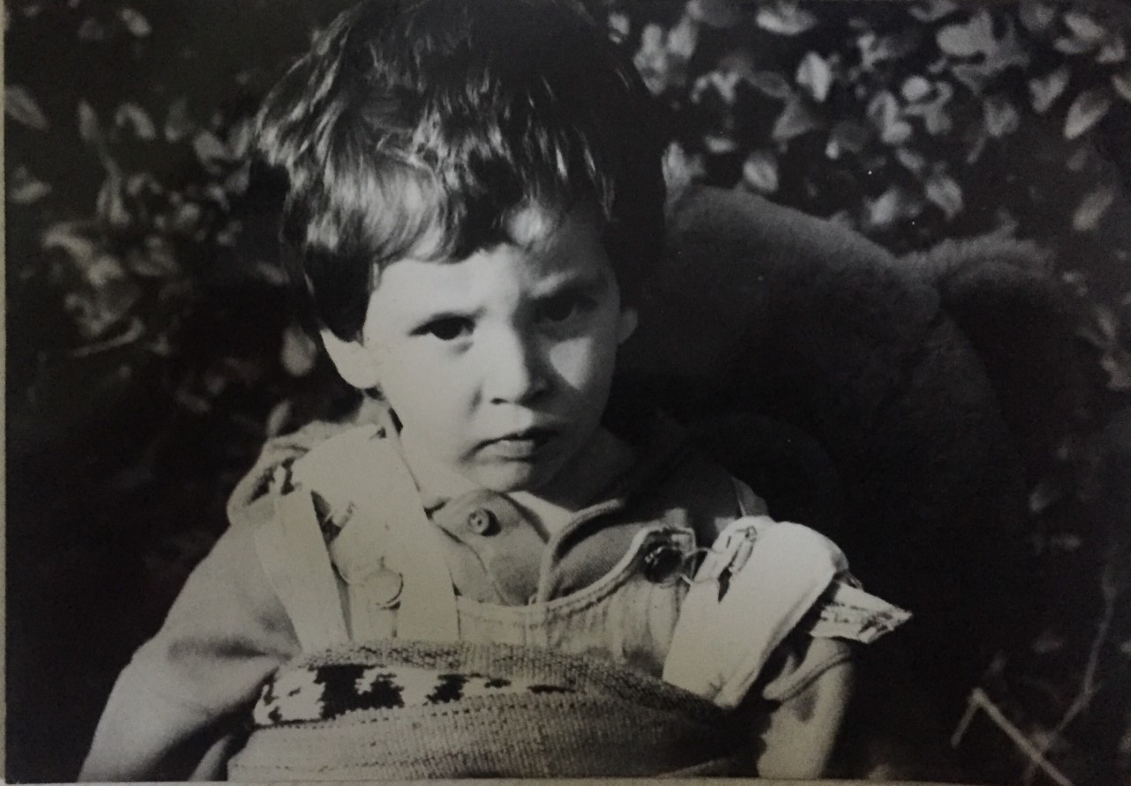




How do i come to you …
Young you don’t know what you want to do …
At 20 you know what you don’t want to do…
At 30 it’s time to find your way…
Hopefully, I’ve found my thing !

Slide 3
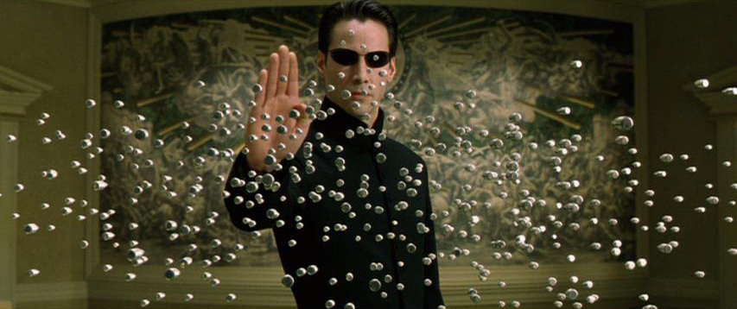

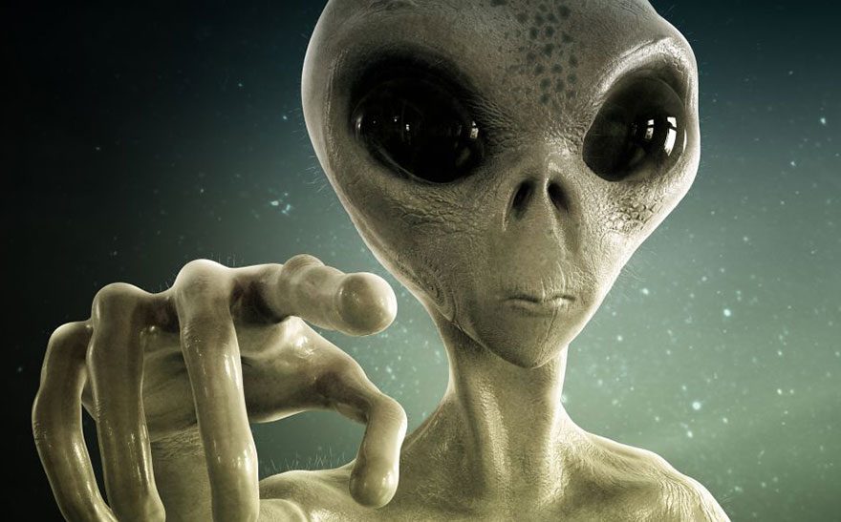




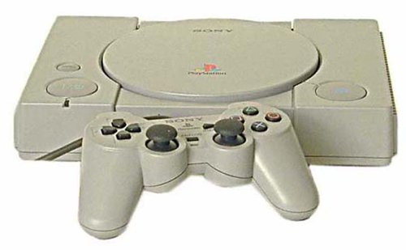
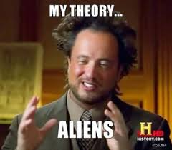



Who I am !
My father, was a computer technician workingfrom home, I grew up, in the middle of computer towers !
Passion Video Game
Science Fiction and Alien Loveur

Slide 4










We have learn a lot of languages and Framwork :

