Slide 1
Undirected graph

Slide 2
Introduction
A graph is an abstract notation used to represent the connection between pairs of objects.
A graph consists of −
Vertex (nodes)
Edges

Slide 3
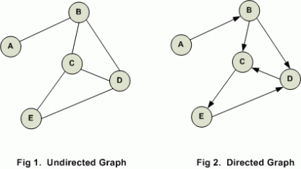
Graphs
Directed graph (di-graph) − have a pair of ordered vertices (u, v).
Undirected graph − have pair of unordered vertices (u, v) and (v, u) are the same.

Slide 4
How To Create A Graph?
Java does not provide a full-fledged implementation of the graph data structure. However, we can represent the graph programmatically using Collections in Java. We can also implement a graph using dynamic arrays like vectors.
Usually, we implement graphs in Java using HashMap collection. HashMap elements are in the form of key-value pairs. We can represent the graph adjacency list in a HashMap.
A most common way to create a graph is by using one of the representations of graphs like adjacency matrix or adjacency list. We will discuss these representations next and then implement the graph in Java using the adjacency list for which we will use ArrayList.

Slide 5
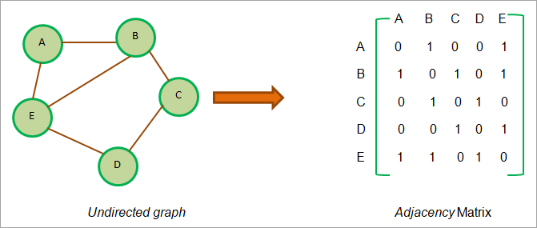
Adjacency Matrix
Adjacency Matrix is a linear representation of graphs. This matrix stores the mapping of vertices and edges of the graph. In the adjacency matrix, vertices of the graph represent rows and columns. This means if the graph has N vertices, then the adjacency matrix will have size NxN.
If V is a set of vertices of the graph then intersection M_{ij} in the adjacency list = 1 means there is an edge existing between vertices i and j.
To better understand this concept clearly, let us prepare an adjacency Matrix for an undirected graph.

Slide 6
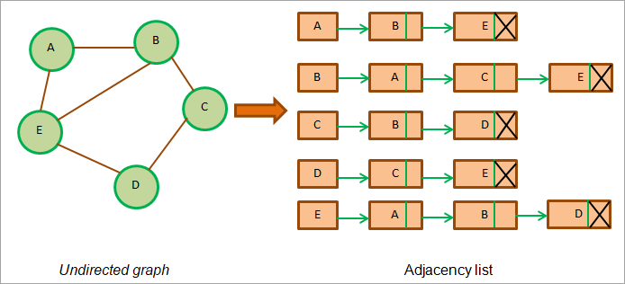
Adjacency List
Instead of representing a graph as an adjacency matrix which is sequential in nature, we can also use linked representation. This linked representation is known as the adjacency list. An adjacency list is nothing but a linked list and each node in the list represents a vertex.
The presence of an edge between two vertices is denoted by a pointer from the first vertex to the second. This adjacency list is maintained for each vertex in the graph.
When we have traversed all the adjacent nodes for a particular node, we store NULL in the next pointer field of the last node of the adjacency list.
Now we will use the above graphs that we used to represent the adjacency matrix to demonstrate the adjacency list.

Slide 7
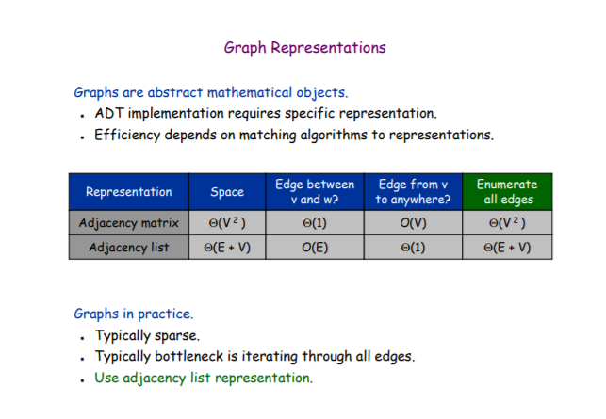

Slide 8
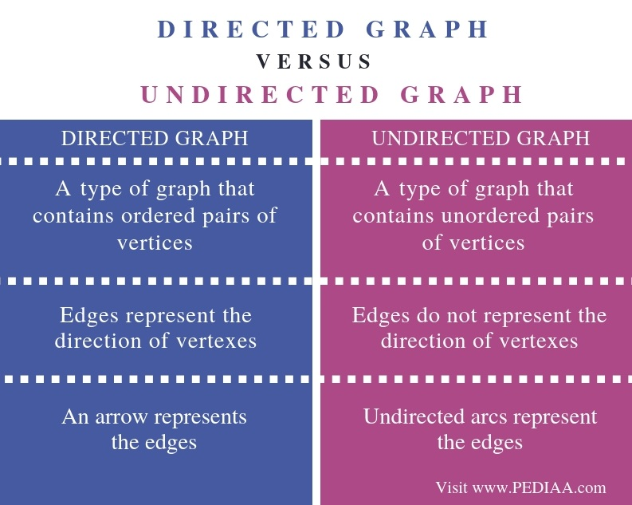

Slide 9
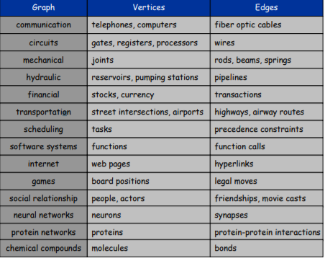
The very first example that comes to mind is a social network. The vertices of the graph are people, and the edges are relationships (friendship). The graph can be undirected, that is, I can only be friends with those who are friends with me.

