Slide 1
Automatic “Negotiable Price” Predictor for Lalafo E ANPPLE
Erlan Bazarov
Abbosjon Madiev
Shakhansho Sabzaliev

Slide 2
Outline
01
Background
04
Evaluation
Problem & Target variable
02
Data
05
Type of data
Assumptions and Limitations
03
Model
06
Next Steps
Why this model?

Slide 3
Background
Why we need price prediction?
Save your time, resources & nerves
No need to call the owner
Knowing approximate price before making a deal is important
Notes:
Looking for a laptop on advertising websites can be quite a tedious activity and things get even worse went suddenly you come across a perfect match. Butttt the price is set to “Negotiable”. So, what do you do?

Slide 4
Sample Usage
anpple.com

Slide 5
Web Scraping
DATA
Main Page + Individual Ad
Web Scraping
Pre-Processing
Cleaning Feature Engineering

Slide 6
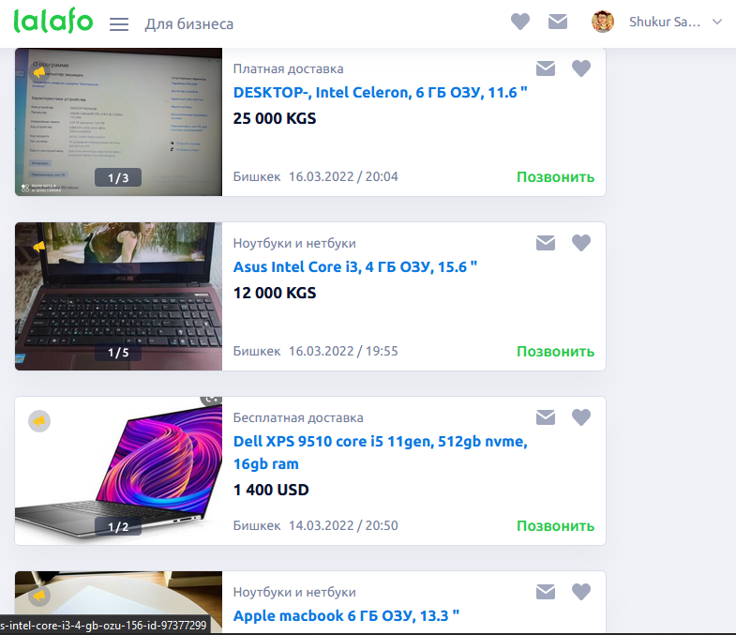
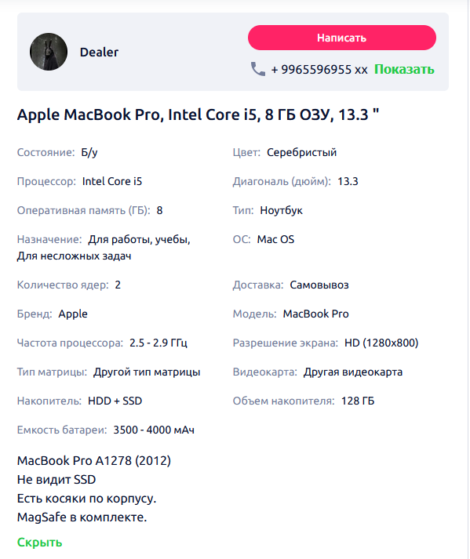
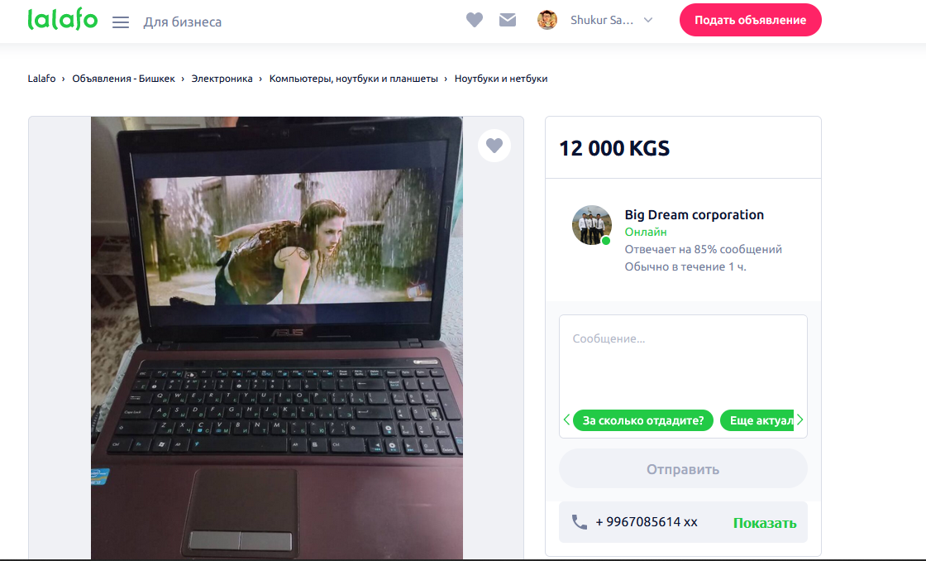
Web Scraping

Slide 7
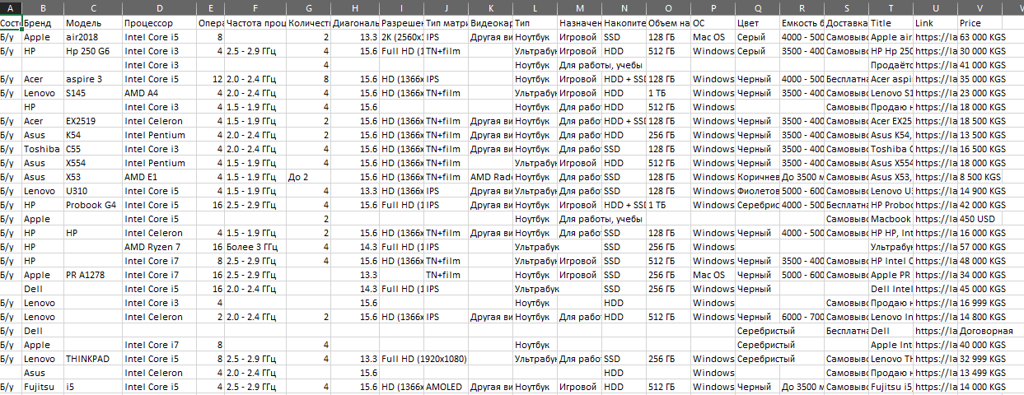
Result of Scraping

Slide 8
Pre-Processing steps
01
Choose most important features
02
Remove redundant features
03
Deal with missing values
04
Convert features to format acceptable by model

Slide 9
Most important features
01 | Condition
 | Categories: Used(1260), New(112)
02 | Brand
 | Categories: Apple(151), Not Apple (1230)
03 | Memory
 | Numerical: 8, 4, 16, 2, 6, 12. Mode is 4 with frequency 757
04 | CPU hertz
 | Numerical: 2.4-2.8, below 3.4, above 3.8 …
05 | CPU cores
 | Numerical: 4, 2, 8 …. Mode is 4 with frequency 757
06 | Graphic card
 | Textual: NVIDIA GeForce GTX 1070, Unspecified ….
07 | Type
 | Categories: Laptop (1185), Ultrabook(162), Netbook(20)
08 | Disk type
 | Categories: HDD(557), HDD + SSD(145), SSD(653)
09 | Disk Size
 | Numerical: 512 GB, 1 TB, More than 256GB, Less than 128GB

Slide 10
Remove redundant features
Processor name
correlates
CPU hertz CPU cores
OS
Brand
correlates

Slide 11
Dealing with missing values
Missing Feature | Solution
Brend | Fill out using OS
Processor | Remove row
Memory | Remove row
CPU hertz, CPU cores | Fill out using Processor
Graphic card | Assume that it is integrated if not provided.
Type | Remove row
Disk type, Disk size | Remove row

Slide 12
Converting features to format acceptable by model
Condition, Brand, Type, Disk type
Graphic card
01
Just tell model that they are categorical
04
Find score of graphic card using another dataset which contains scores for many GPUs. NVIDIA GeForce GTX 1070 -> 80.5. Highest score is 236. Score for integrated is 4.7
CPU hertz
02
Find average. 2.2 – 2.6 -> 2.4. Below 2.8 -> 2.4. Above 2.6 -> 2.8
CPU cores, Memory, Disk size
03
Remove all non-numeric symbols

Slide 13
Machine Learning Model
01
02
Less hyperparameter tuning
Fast
Reduces time spent on hyperparameter tuning
LightGBM
Fastest Gradient Boosting Model
03
04
High Accuracy
It is allways considered in kaggle competition because of its best accuracy
Handle Cat Data
No need to transform the categorical data to numerical.

Slide 14
Machine Learning Model Building
Machine learning
Model Inference
04
Saturn is the gas giant that has rings
Saving model inference for deploymnt.
Tuning & training
03
Best hyperparameters & Interpretation of model
EDA and Preprocess
02
Explore data insight & prepare for model
Import data and Library
01
Loaded data and installed needed libraries

Slide 15
Machine Learning Model Limitations
Transform data to numeric
01
Trying out numeric data may have resulted better accuracy
Transform skewed data
02
We should have tried out log/power transforms
Data Leakages
03
Duplicate data should have been deleted
Train longer
04
Training model using parameters longer gives better results.

Slide 16
Model Summary
01 | Supervised learning Regression
02 | LightGBM Regressor
03 | RandomizedSearchCV
04 | Pandas data mining
05 | Matplotlib visualization

Slide 17
Next Steps
More Testing
Browser Extension
Further Developements

Slide 18
Thank you for your attention!
Any Questions?

