Slide 1
Text Mining Music Lyrics
Advaith J & Amit J
Information Retrieval and Text Mining

Slide 2
Dataset
Chart topping (100) songs from Billboard for the years 2006-2021
Lyrics and Genres from Genius

Slide 3
Preprocessing
What we did:
Cleaning - Regex
Language Detection
Tokenization
POS tagging
Lemmatization
What we did not do:
Stemming

Slide 4
Song Repetitiveness
Used the Lempel-Ziv-Markov algorithm to see which songs were the most repetitive.
Artists | Songs | Doc Size after compression
Daft Punk Featuring Pharrell Williams | Get Lucky | 7,9
CJ | Whoopty | 9,4
Pharrell Williams | Happy | 11,7
Kiiara | Gold | 12,1
OneRepublic | Counting Stars | 12,3

Slide 5
Artists | Songs | Ratio
Daft Punk Featuring Pharrell Williams | Get Lucky | 7,9
CJ | Whoopty | 9,4
Pharrell Williams | Happy | 11,7
Kiiara | Gold | 12,1
OneRepublic | Counting Stars | 12,3
Desiigner | Tiimmy Turner | 12,5
The Weeknd | Can't Feel My Face | 12,6
XXXTENTACION | Changes | 13,2
Kent Jones | Don't Mind | 14,2
Calvin Harris & Disciples | How Deep Is Your Love | 14,4

Slide 6
Named Entity Recognition
Libraries used:
NLTK default NER tagger (ne_chunk)
Stanford NER tagger
Validation of results:
Picked a random sample of 10 songs
Computed Precision, Recall, Accuracy and F1 scores

Slide 7
Named Entity Recognition
Validation Results
Stanford NER |  | NLTK Ne_chunk
Precision | 0,85 | Precision | 0,32
Recall | 0,29 | Recall | 0,44
Accuracy | 0,975 | Accuracy | 0,950
F1 | 0,430 | F1 | 0,369

Slide 8
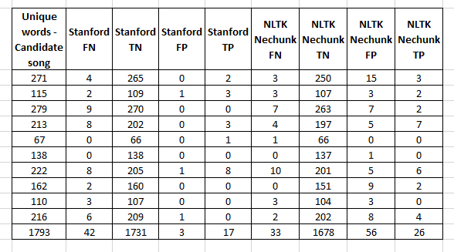
Named Entity Recognition - Validation Process

Slide 9
Emotion Quantification
Curated a self labelled dictionary of 7 emotions (Joy, Sadness, Love, Anger, Fear, Surprise, Neutral) from 196 Empath Lexicon Categories
Step 1: word to lexicon mapping
Step 2: Lexicon to emotion quantification

Slide 10
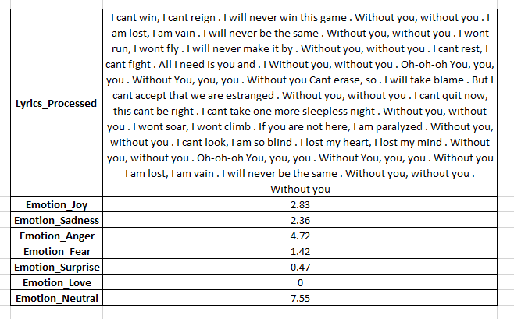
Emotion Quantification - One sample result

Slide 11
Emotion Quantification
Validation?
Hard to label. Randomly picked few sample songs
Emotion Quantification highly dependent on word frequencies and context insensitive

Slide 12
Sentiment Analysis
Used the Vader module from NLTK
Used the Textblob package
Used the quantified emotions to assess the sentiments (J + L - A - F - S)

Slide 13
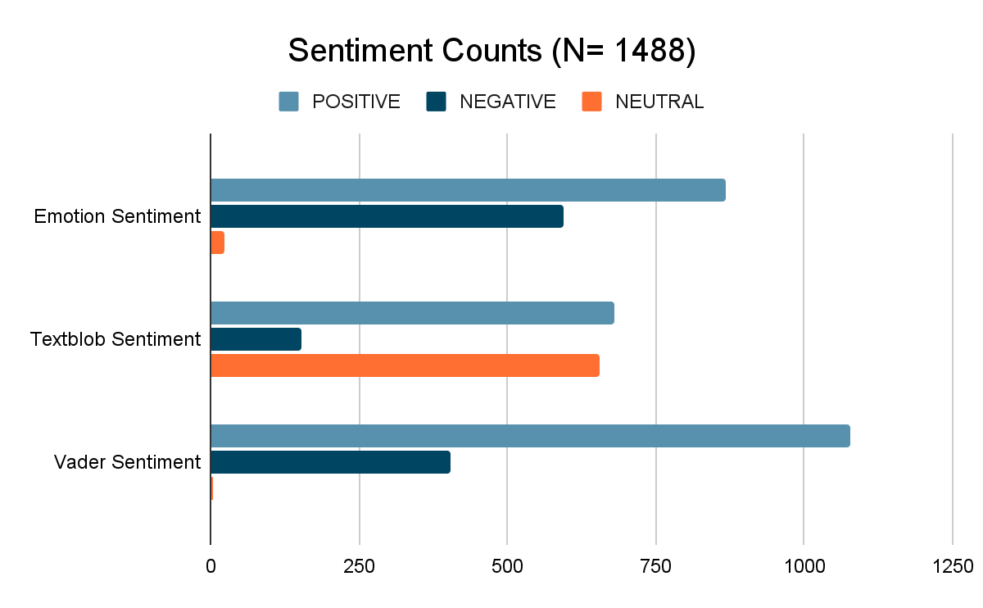
Sentiment Analysis

Slide 14
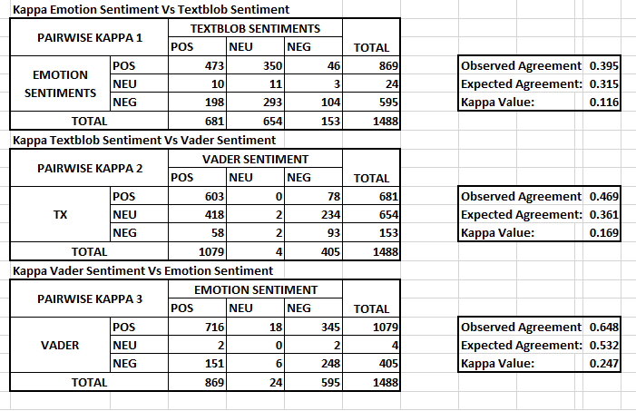
Sentiment Analysis - Validation
OVERALL KAPPA VALUE = AVERAGE OF 3 PAIRWISE VALUES = 0.177

Slide 15
Word Importance Clusters
TFIDF
TF-IDF weighing of lemmatized lyric words (Gensim)
Frequent 100 words considered
PCA on TF-IDF
100 Dims / Doc to 2 Dims / Doc
Kmeans
Visualized TF-IDF Weighted Docs using k=10 Clusters annotating Primary Song Genres

Slide 16
Word Vectorization
Word2Vec
Skip-gram based Word2Vec model (Gensim)
Examined cosine similar words to manually entered words
Experimented finding associations between words, nearest words to a given word

Slide 17
Entity Linking
Named Entities were linked to artists - https://rpubs.com/advaithjai/903328
Artists were linked to other artists that they collaborated with - https://rpubs.com/advaithjai/903330

Slide 18
Topic Modelling Visuals
50 Topics - Made of Bigrams / Trigrams / Bigrams of Bigrams / Trigrams of Trigrams
λ = 0.6 as per Sievert and Shirley, 2014.
30 Most frequent words with a high concentration in the topic cluster

Slide 19
Most frequent entities over time
Bar Visuals

Slide 20
Questions?

Slide 21
Bibliography
Jenny Rose Finkel, Trond Grenager, and Christopher Manning. 2005. Incorporating Non-local Information into Information Extraction Systems by Gibbs Sampling. Proceedings of the 43nd Annual Meeting of the Association for Computational Linguistics (ACL 2005), pp. 363-370
Fast, E., Chen, B., & Bernstein, M. S. (2016). Empath: Understanding Topic Signals in Large-Scale Text. CoRR, abs/1602.06979. Ανακτήθηκε από http://arxiv.org/abs/1602.06979
Sievert, Carson & Shirley, Kenneth. (2014). LDAvis: A method for visualizing and interpreting topics. 10.13140/2.1.1394.3043.
Bird, S., Klein, E., & Loper, E. (2009). Natural language processing with Python: analyzing text with the natural language toolkit. " O&#x27;Reilly Media, Inc."
Rehurek, R., & Sojka, P. (2011). Gensim–python framework for vector space modelling. NLP Centre, Faculty of Informatics, Masaryk University, Brno, Czech Republic, 3(2).

