Slide 1
Deep Learning for Computer Vision, Speech, and Language
Fall 2018
Liangliang Cao, Xiaodong Cui, Kapil Thadani
https://columbia6894.github.io/
Notes:
how to help the computer to understand challenging questions;
how to benchmark the AI;
how to scale up the computational power for AI.

Slide 2
Outline
How to register?
Who we are
Grading
Homework
Projects
Course schedule and resource
Some demo of deep learning
Programming basics
2
Notes:
2

Slide 3
How to register this class?
Unfortunately instructors do NOT have access to the waiting list
What we can do is to welcome sit-ins or independent study with instructors
Each department selected 20 students
EE, CS and Data Science co-sponsored 60 students total
Please drop early if you cannot follow or finish HW#1
Talk to your department if you want to be listed in the waiting list

Slide 4
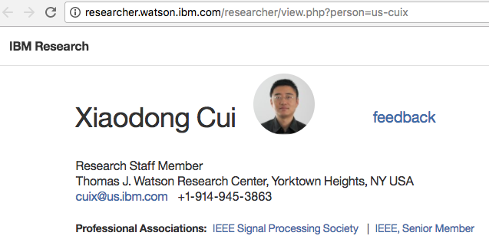
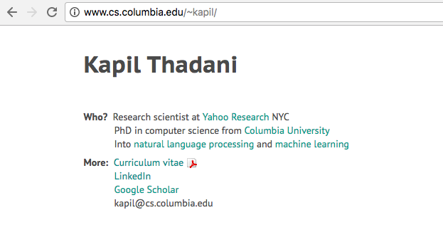
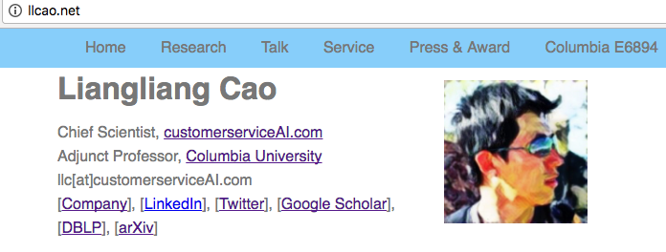
Lectures
A few guest lecturers announced soon

Slide 5
Teaching assistants
Rajath Kumar
rm3497@columbia.edu
Qiao Zhang
qz2301@columbia.edu

Slide 6
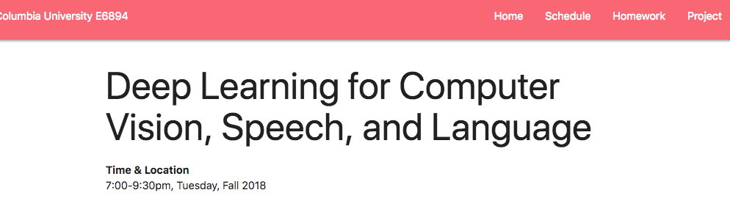
Website
Slides and materials will be available on the website https://columbia6894.github.io/

Slide 7
Purpose of This Class
For Columbia graduates, teach “what can we do with deep neural networks”
Why multi-modalities?
Speech, Vision, and NLP are most popular fields for deep learning
By comparing three fields, you may feel deep networks are no longer “black-box magic”
We hope you can generalize these success to multi-modal problem or a new domain
How?
Course, Homework and Projects

Slide 8
Grading
40% project
In previous class the best team published paper in top/premium conferences
40% homework
HW1 is important
Present one paper on the important research breakthough
20% paper presentation and course attendance

Slide 9
Examples of Successful Projects
Hassan Akbari and Himani Arora, Speech from Lip Videos, ICASSP 2018
Nikolai Yakovenko, Poker-CNN, AAAI 2016
Chris Cleveland, PIXM (startup) 2016
John Bowler and Mo Zhou, Axon Segmentation, WACV 2015
Yin Cui, Y. Xiang, and K. Rong, Galaxy Image Retrieval, WACV 2014

Slide 10
Course requirements
Knowledgeable about NLP and/or speech and/or vision and/or machine learning
Fluent in Python.
Know Tensorflow (or pyTorch) or you can learn it quickly
Willing to work with GPUs.

Slide 11
Why Python?
Free (not like Matlab!)
Much easier to use than CUDA C/C++
THE choice for scientific computing and cloud service
If you do not know python, please consider to drop coz it will be too hard to follow the class.

Slide 12
How to access GPU?
Build one
If you have a (relative new) desktop, you should add a GPU card with $1000 (eg. NVidia GTX1080Ti or Titan XP)
Use Google cloud
$300 free credit for ever email
Free credit via Columbia CRF (coming soon)

Slide 13
Course schedule
Overview (class 1-4)
Course overview and Tensorflow basic
Review of NN and Optimization
Review of NLP basic
Review of CNN
Deep learning for Speech, Language, and Vision Each class focuses one topic with
Lectures by the instructor/guest speaker
One homework per topic

Slide 14
Student presentation
Details to be announced in the next class
Reference: last year’s procedure:
Form a team with two students
Select one paper (from the list suggested by the instructors)
Prepare a 20 mins presentation, at least 15 pages slides
Demos/source code analysis are welcome

Slide 15
Final project
Team work: 2-3 students per group
Goal:
Develop the state-of-the-art deep learning techniques.
Try to solve real problems with the knowledge you learned
Format:
4 pages double column (e.g., in ICASSP format)
or 8 pages single column (e.g., in NIPS format)
Evaluation
Students’ vote: Idol Award
Instructor’s pick: AI conference quality
( I only write recommendation letters for students with conference-quality projects)

Slide 16
Which toolkit shall I use for project
Tensorflow (huge society, by Google)
Keras (high level interface)
Good for development and deployment
Other choices:
PyTorch (Good for sequential research)
MxNet

Slide 17
Mastering the tools
Use Python Notebook (Jupyter)
http://jupyter.org/try
colab.research.google.com
Submit homework with results in python notebook!
Use Git for team project
- Create a personal account on github.com
- Understand git commands

Slide 18
Power of Deep Networks
AlphaGo Zero by David Silver
Google Cloud Vision API
Visual Memory QA
Super SloMo
Watson Text to Speech and Watson Speech to Text

Slide 19
Short Break
https://columbia6894.github.io/

Slide 20
Programming: Tensorflow, Keras and Homework
Liangliang Cao
https://columbia6894.github.io/
Notes:
how to help the computer to understand challenging questions;
how to benchmark the AI;
how to scale up the computational power for AI.

Slide 21
Install Tensorflow
Documentation
https://www.tensorflow.org/
We suggest to use virtual env
Straightforward installation
On cloud, you need setup a project
On your local machine, type “pip install tensorflow” and install other related libraries
In this class, we’ll use Codelab to demonstrate some basic concept
https://colab.research.google.com/

Slide 22
Which is True for Tensorflow?
A python/C framework of computing math expression
Designed for large scale data
Designed for the specific purpose of deep learning

Slide 23
Which is True for Tensorflow?
A python/C framework of computing math expression
Similar with Theano
Designed for large scale data
Excellent engineering
Designed for the specific purpose of deep learning
Tensorflow’s low level APIs are for general purpose.

Slide 24
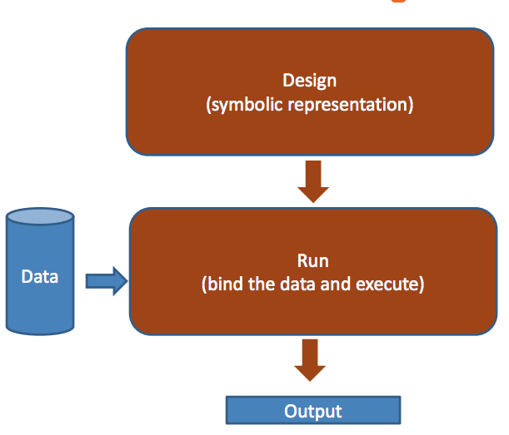
Tensorflow’s Design

Slide 25
Keras Design
Keras is a wrapper of Tensorflow
from tensorflow.python import keras
Keras.Model
Model.fit()
Model.predict()
Model.evaluate()
Reference: https://keras.io/

Slide 26
A Simple Tensorflow Example
import tensorflow as tf a = tf.add([2,1], [1,2]) print(a)
What is the output?

Slide 27
A Simple Tensorflow Example
import tensorflow as tf a = tf.add([1,2], [2,1]) print(a)
What is the output?
[3, 3]
Tensor("Add:0", shape=(2, 1), dtype=int32)
None of above

Slide 28
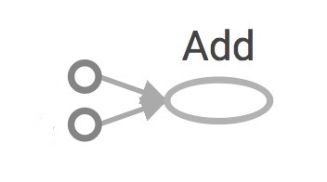
A Simple Tensorflow Example
import tensorflow as tf a = tf.add([1,2], [2,1]) print(a)
What is the output?
[1, 2]
A tf graph includes symbolic objects
A tf session allocates memory to evaluate symbolic objects
a
[2, 1]

Slide 29
A Simple Tensorflow Example
import tensorflow as tf a = tf.add([1,2], [2,1]) print(a)
with tf.Session() as sess:
print sess.run(a)
What is the new output?

Slide 30
Why Graph and Session?
Optimize computation. The graph model will be optimized before evaluating
Facilitate distributed computation, spread the work across multiple CPUs, GPUs, or TPUs.

Slide 31
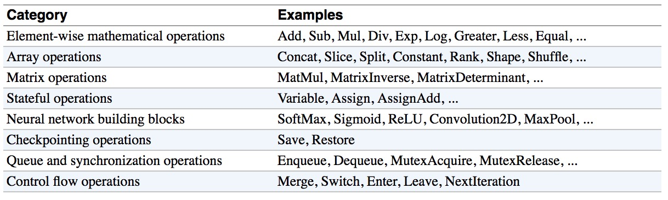
Tensorflow Low-level APIs
Refer to Chip Huyen’s course on Tensorflow

Slide 32
A Magic Function
import tensorflow as tf x = tf.placeholder(tf.float32) y = 2*x + x*x g = tf.gradients(x + y, [x, y])
with tf.Session() as sess:
print sess.run(g, feed_dict={x:1.0})
Tf.gradient allows automat gradient calculation.
Super useful for optimization (next class)

Slide 33
Another Example
import tensorflow as tf X = tf.placeholder(tf.float32, name='X')
Y = tf.placeholder(tf.float32, name='Y')
w = tf.get_variable('weights', initializer=tf.constant(0.0))
b = tf.get_variable('bias', initializer=tf.constant(0.0))
Y_predicted = w * X + b
loss = tf.square(Y - Y_predicted, name='loss')
optimizer = tf.train.GradientDescentOptimizer(learning_rate=0.001).minimize(loss)
with tf.Session() as sess:
sess.run(tf.global_variables_initializer())
for i in range(100): # run 100 epochs
for x, y in data:
sess.run(optimizer, feed_dict={X: x, Y:y})
w_out, b_out = sess.run([w, b])

Slide 34
From Tensorflow to Keras
import tensorflow as tf
from tensorflow.python.keras.models import Sequential from tensorflow.python.keras.layers import Dense, Activation
model = Sequential() model.add(Dense(10, input_dim=100, activation='softmax')) model.compile(optimizer='sgd', loss='categorical_crossentropy', metrics=['accuracy']) history = model.fit(X_train, Y_train, 128, nb_epoch=5, validation_data=(X_test, Y_test)) score = model.evaluate(X_test, Y_test)

Slide 35
From Tensorflow to Keras
import tensorflow as tf
from tensorflow.python.keras.models import Sequential from tensorflow.python.keras.layers import Dense, Activation
model = Sequential() model.add(Dense(10, input_dim=100, activation='softmax')) model.compile(optimizer='sgd', loss='categorical_crossentropy', metrics=['accuracy']) history = model.fit(X_train, Y_train, 128, nb_epoch=5, validation_data=(X_test, Y_test)) score = model.evaluate(X_test, Y_test)
Keras is simpler to use for classification/regression problems.
Keras has a lot of wrapper functions for network building
Keras does not provide many low level APIs for large scale data

Slide 36
Take-home Work
Required:
Install Jupiter Notebook
Install Tensorflow and Keras
Work on homework #1
Suggested:
Create a github account
Read Tensorflow and Keras tutorials
https://columbia6894.github.io/homework.html

