Slide 1
Deep Learning for Computer Vision, Speech, and Language
Fall 2018
Liangliang Cao
Xiaodong Cui
Kapil Thadani
https://columbia6894.github.io/
Notes:
how to help the computer to understand challenging questions;
how to benchmark the AI;
how to scale up the computational power for AI.

Slide 2
Outline
Who we are
What is deep learning?
Grading
Homework
Projects
Course schedule and resource
Some demo of deep learning
2
Notes:
2

Slide 3
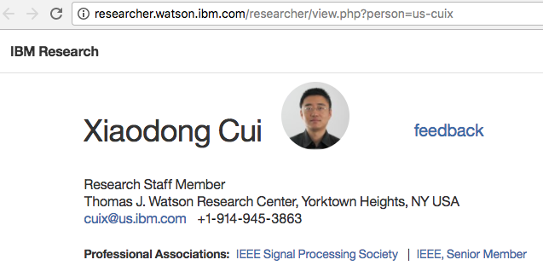
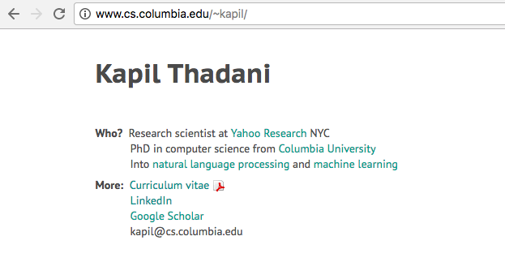
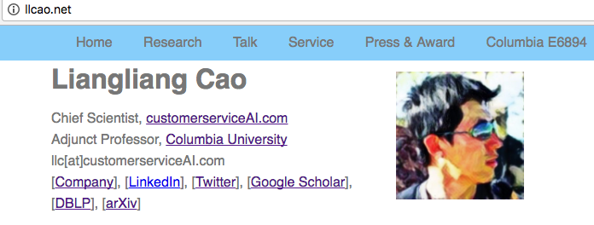
Lectures
Guest lectures to be announced

Slide 4
Teaching assistants (To be confirmed)
???
???@columbia.edu
???
???@columbia.edu

Slide 5
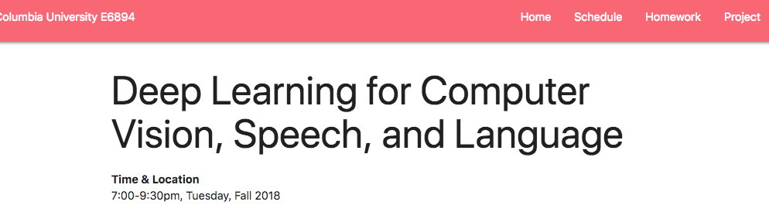
Website
Slides and materials will be available on the website https://columbia6894.github.io/

Slide 6
How to register this class?
Please talk to your department.
Currently none of the lecturers has access to the Columbia course system so we have no control of it.
Current policy:
First come first serve
Please drop out early if you realize this course is not a good fit
Especially if you cannot finish homework#1, you should drop the class!

Slide 7
Grading
40% project
In previous class the best team published paper in top/premium conferences
40% homework and paper presentation
HW1 is important
Present one paper on the important research breakthough
20% paper presentation and course attendence

Slide 8
Course requirements
Knowledgeable about NLP and/or speech and/or vision and/or machine learning
Fluent in Python.
Know Tensorflow (or pyTorch) or you can learn it quickly
Willing to work with GPUs.

Slide 9
Why Python?
Free (not like Matlab!)
Much easier to use than CUDA C/C++
THE choice for scientific computing and cloud service
If you do not know python, please consider to drop coz it will be too hard to follow the class.

Slide 10
How to access GPU?
Build one
If you have a (relative new) desktop, you should add a GPU card with $1000 (eg. NVidia GTX1080Ti or Titan XP)
Rent cloud
Google cloud helps free access may come soon

Slide 11
Course schedule
Overview (class 1-4)
Course overview and Tensorflow basic
Review of NN and Optimization
Review of NLP basic
Review of CNN
Deep learning for Speech, Language, and Vision Each class focuses one topic with
Lectures by the instructor/guest speaker
One homework per topic

Slide 12
Student presentation
Procedure:
Form a team with two students
Select one paper (from the list suggested on the webpage)
Prepare a 20 mins presentation, at least 15 pages slides
Slides should be sent to the instructor one day before the presentation.
Demos/source code analysis are welcome

Slide 13
Final project
Team work: 2-3 students per group
Goal:
Develop the state-of-the-art deep learning techniques.
Try to solve real problems with the knowledge you learned
Format:
4 pages double column (e.g., in ICASSP format)
or 8 pages single column (e.g., in NIPS format)
Evaluation
Students’ vote: Idol Award
Instructor’s pick: AI conference quality
( I only write recommendation letters for students with conference-quality projects)

Slide 14
Which toolkit shall I use for project
Tensorflow (huge society, by Google)
Keras (high level interface)
Good for development and deployment
PyTorch (popular in speech. By Facebook FAIR)
Good for research
Potential support from Caffe2: object detection

Slide 15
Mastering the tools
Use Python Notebook (Jupyter)
http://jupyter.org/try
colab.research.google.com
Submit homework with results in python notebook!
Use Git for team project
- Create a personal account on github.com
- Understand git commands

Slide 16
Power of Deep Networks
AlphaGo Zero by David Silver
Google Cloud Vision API
Visual Memory QA
Super SloMo
Watson Text to Speech and Watson Speech to Text

Slide 17
Short Break
https://columbia6894.github.io/

Slide 18
Programming: Tensorflow, Keras and Homework
Liangliang Cao
https://columbia6894.github.io/
Notes:
how to help the computer to understand challenging questions;
how to benchmark the AI;
how to scale up the computational power for AI.

Slide 19
Install Tensorflow
Documentation
https://www.tensorflow.org/
We suggest to use virtual env
Straightforward installation
On cloud, you need setup a project
On your local machine, type “pip install tensorflow” and install other related libraries
In this class, we’ll use Codelab to demonstrate some basic concept
https://colab.research.google.com/

Slide 20
Which is True Statement for Tensorflow?
A python framework of computing math expression
Designed for large scale data
Designed for the specific purpose of deep learning

Slide 21
Which is True Statement for Tensorflow?
A python framework of computing math expression
Similar with Theano
Designed for large scale data
Excellent engineering
Designed for the specific purpose of deep learning
Tensorflow’s low level APIs are for general purpose.

Slide 22
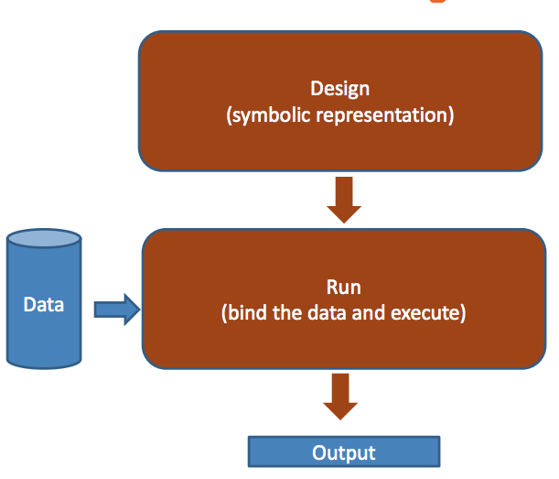
Tensorflow’s Design

Slide 23
Simpler Interface for Machine Learning
Keras is a wrapper of Tensorflow
from tensorflow.python import keras
Keras.Model
Model.fit()
Model.predict()
Model.evaluate()
Reference: https://keras.io/

Slide 24
A Simple Tensorflow Code
import tensorflow as tf a = tf.add(3, 5) print(a)
What is the output?

Slide 25
A Simple Tensorflow Code
import tensorflow as tf a = tf.add([1,2], [2,1]) print(a)
What is the output?
[3, 3]
Tensor("Add:0", shape=(2, 1), dtype=int32)
None of above

Slide 26
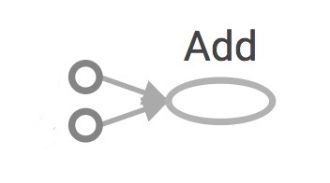
A Simple Tensorflow Code
import tensorflow as tf a = tf.add([1,2], [2,1]) print(a)
What is the output?
[1, 2]
A tf graph includes symbolic objects
A tf session allocates memory to evaluate symbolic objects
a
[2, 1]

Slide 27
A Simple Tensorflow Code
import tensorflow as tf a = tf.add([1,2], [2,1]) print(a)
with tf.Session() as sess:
print sess.run(a)
What is the new output?

Slide 28
Why Graph and Session?
Optimize computation. The graph model will be optimized before evaluating
Facilitate distributed computation, spread the work across multiple CPUs, GPUs, or TPUs.

Slide 29
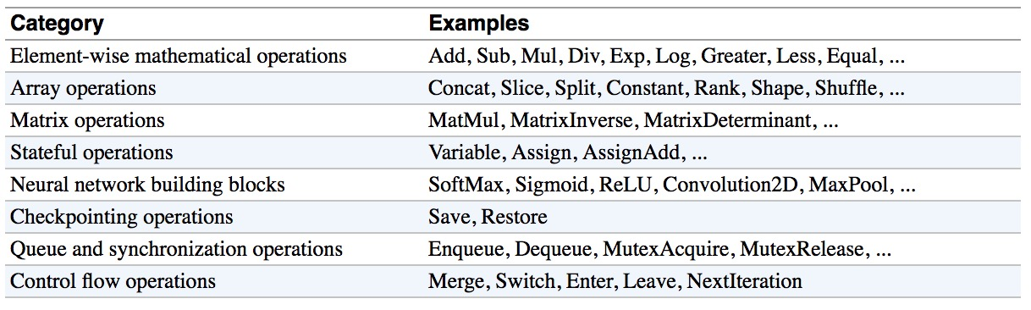
Tensorflow Low-level APIs
Refer to Chip Huyen’s course on Tensorflow

Slide 30
A Magic Function
import tensorflow as tf x = tf.placeholder(tf.float32) y = 2*x + x*x g = tf.gradients(x + y, [x, y])
with tf.Session() as sess:
print sess.run(g, feed_dict={x:1.0})
Tf.gradient allows automat gradient calculation.
Super useful for optimization (next class)

Slide 31
Another Example
import tensorflow as tf X = tf.placeholder(tf.float32, name='X')
Y = tf.placeholder(tf.float32, name='Y')
w = tf.get_variable('weights', initializer=tf.constant(0.0))
b = tf.get_variable('bias', initializer=tf.constant(0.0))
Y_predicted = w * X + b
loss = tf.square(Y - Y_predicted, name='loss')
optimizer = tf.train.GradientDescentOptimizer(learning_rate=0.001).minimize(loss)
with tf.Session() as sess:
sess.run(tf.global_variables_initializer())
for i in range(100): # run 100 epochs
for x, y in data:
sess.run(optimizer, feed_dict={X: x, Y:y})
w_out, b_out = sess.run([w, b])

Slide 32
From Tensorflow to Keras
import tensorflow as tf
from tensorflow.python.keras.models import Sequential from tensorflow.python.keras.layers import Dense, Activation
model = Sequential() model.add(Dense(10, input_dim=100, activation='softmax')) model.compile(optimizer='sgd', loss='categorical_crossentropy', metrics=['accuracy']) history = model.fit(X_train, Y_train, 128, nb_epoch=5, validation_data=(X_test, Y_test)) score = model.evaluate(X_test, Y_test)

Slide 33
From Tensorflow to Keras
import tensorflow as tf
from tensorflow.python.keras.models import Sequential from tensorflow.python.keras.layers import Dense, Activation
model = Sequential() model.add(Dense(10, input_dim=100, activation='softmax')) model.compile(optimizer='sgd', loss='categorical_crossentropy', metrics=['accuracy']) history = model.fit(X_train, Y_train, 128, nb_epoch=5, validation_data=(X_test, Y_test)) score = model.evaluate(X_test, Y_test)
Keras is simpler to use for classification/regression problems.
Keras has a lot of wrapper functions for network building
Keras does not provide many low level APIs for large scale data

Slide 34
Take-home Work
Required:
Install Jupiter Notebook
Install Tensorflow and Keras
Work for homework #1
Suggested:
Create a github account
Read Tensorflow and Keras tutorials
https://columbia6894.github.io/homework.html

