Slide 1
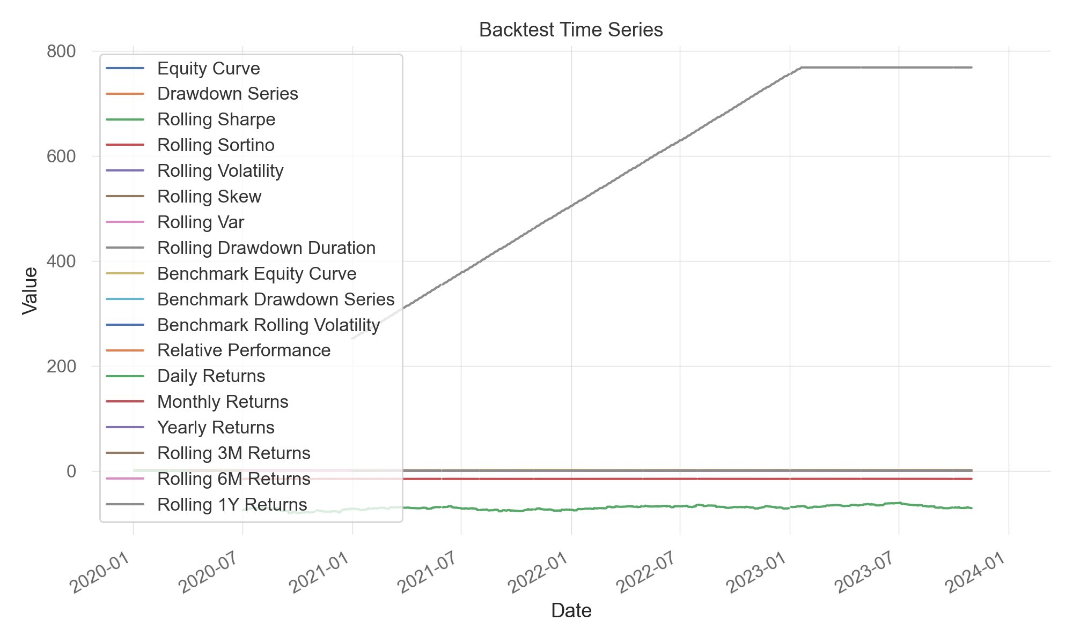
Backtest Time Series

Slide 2
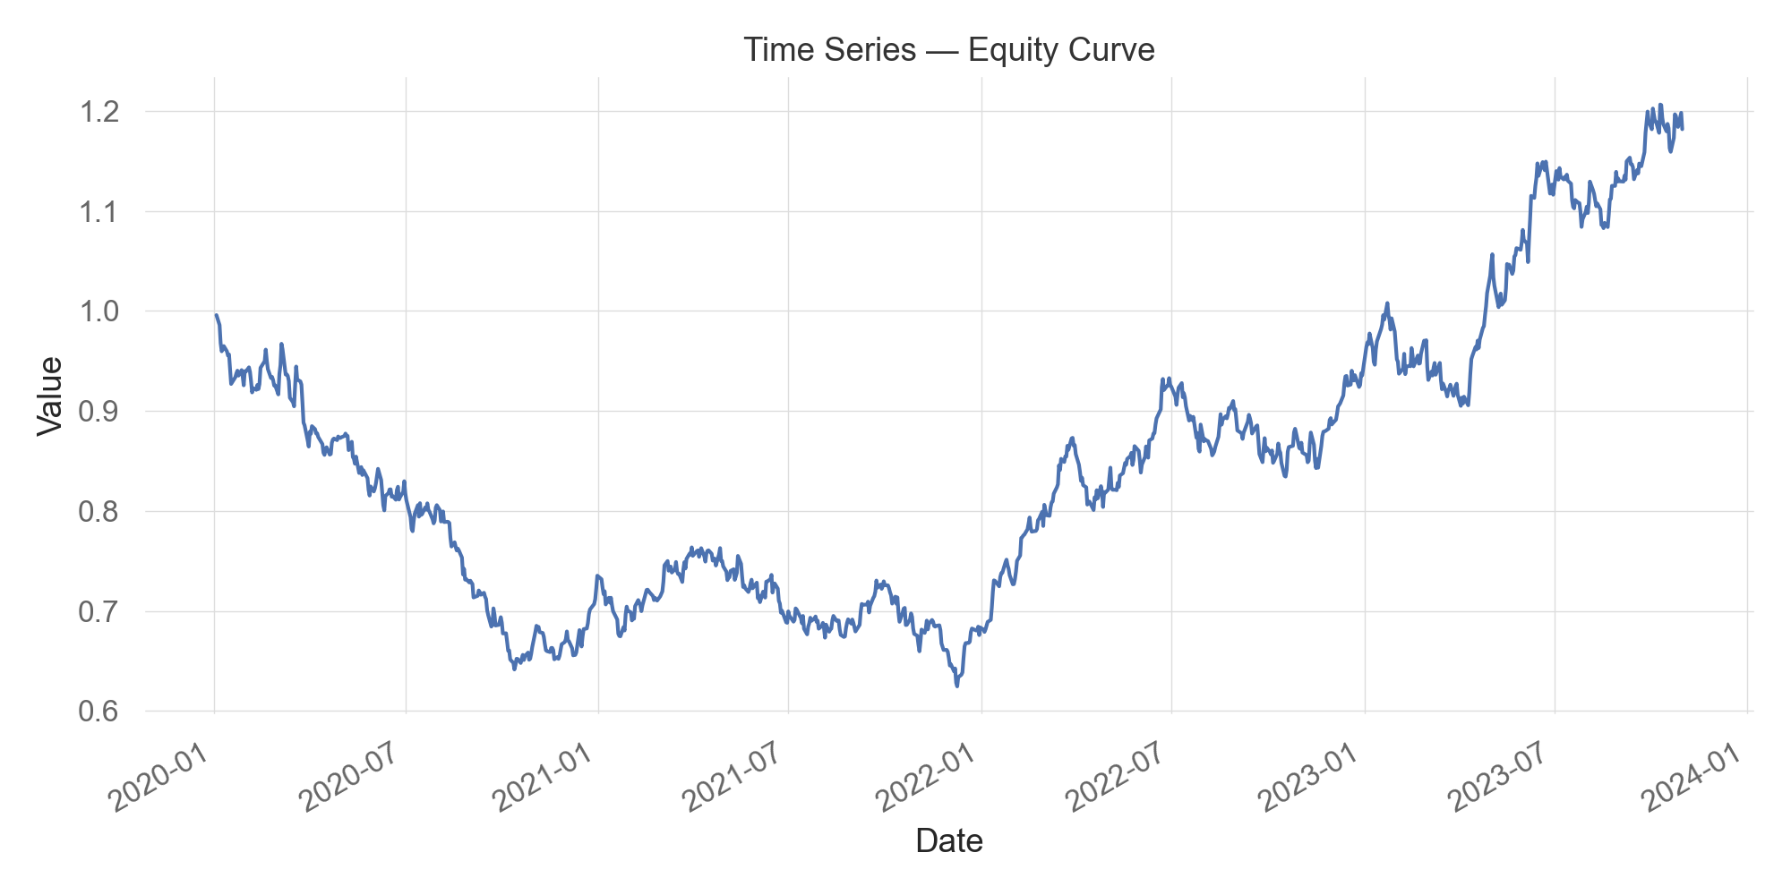
Time Series — Equity Curve

Slide 3
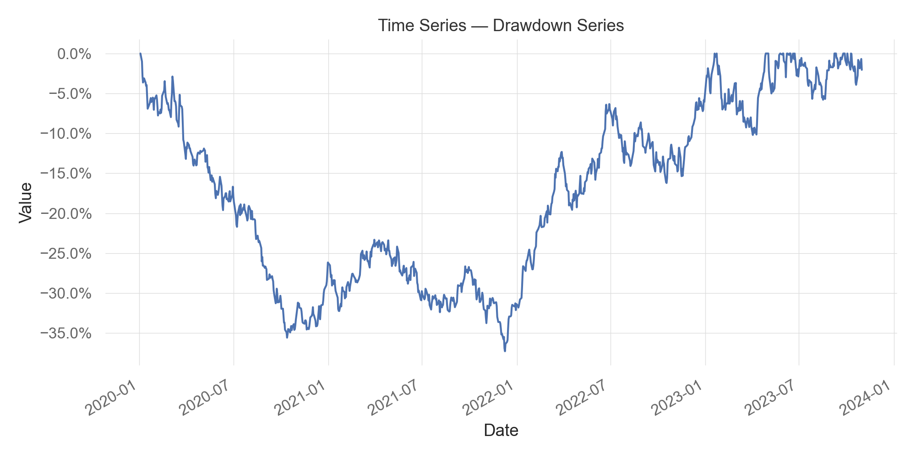
Time Series — Drawdown Series

Slide 4
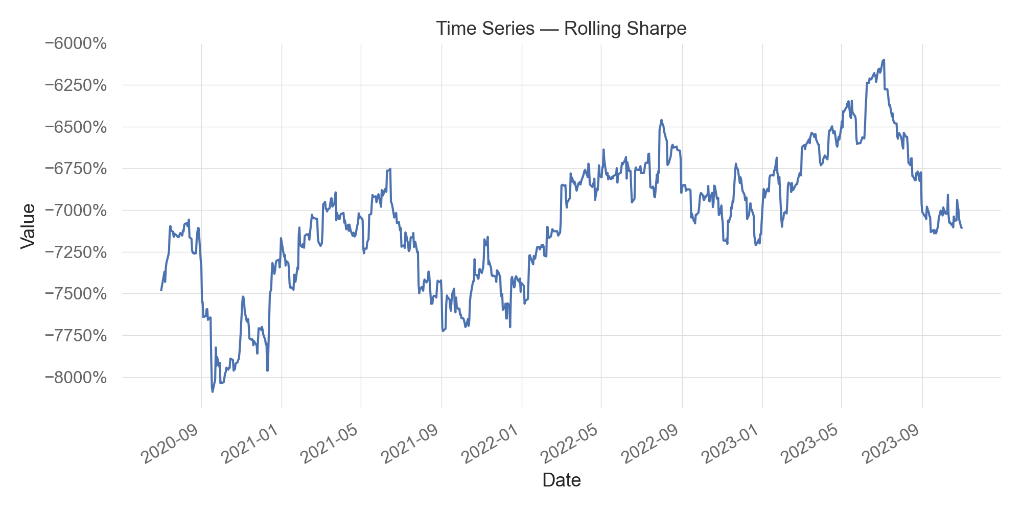
Time Series — Rolling Sharpe

Slide 5
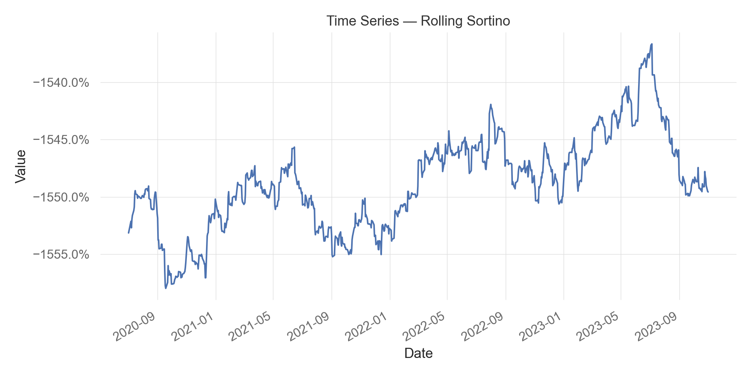
Time Series — Rolling Sortino

Slide 6
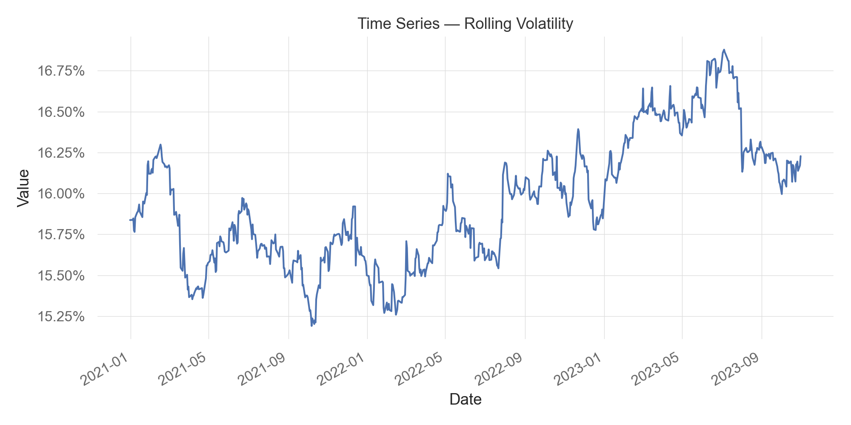
Time Series — Rolling Volatility

Slide 7
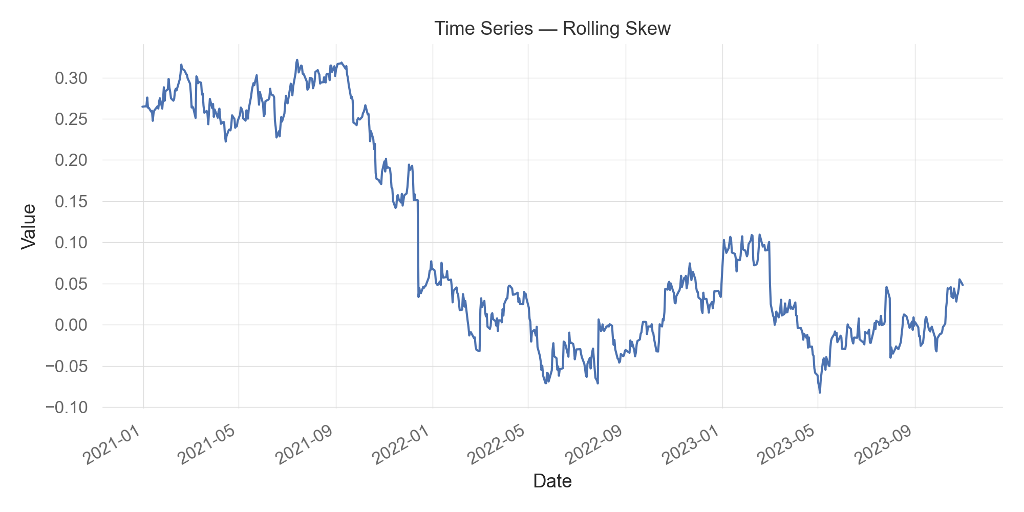
Time Series — Rolling Skew

Slide 8
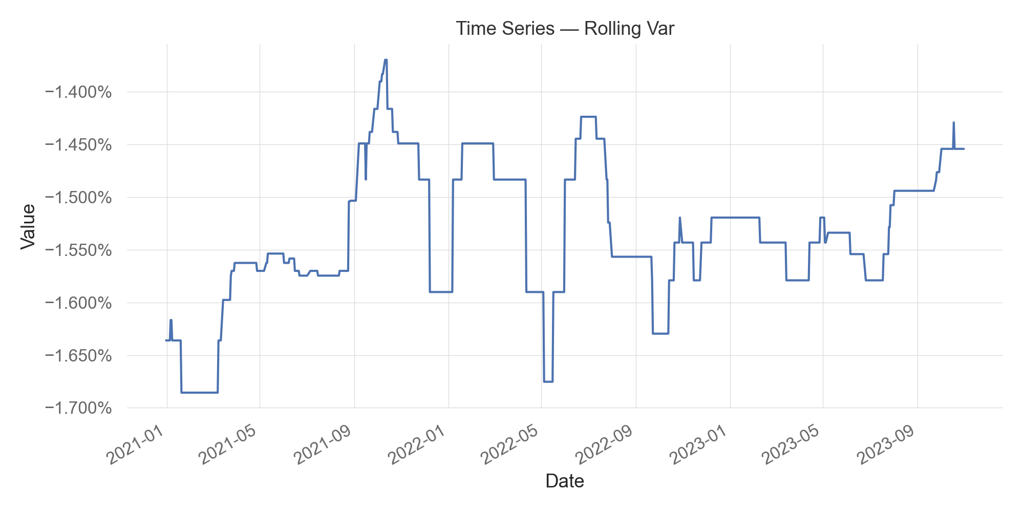
Time Series — Rolling Var

Slide 9
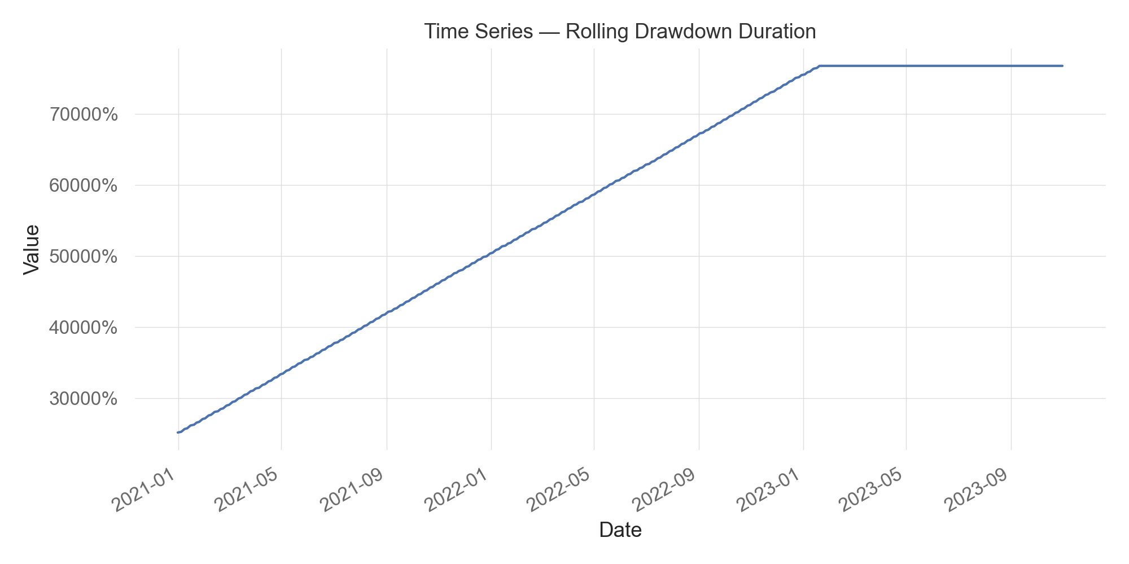
Time Series — Rolling Drawdown Duration

Slide 10
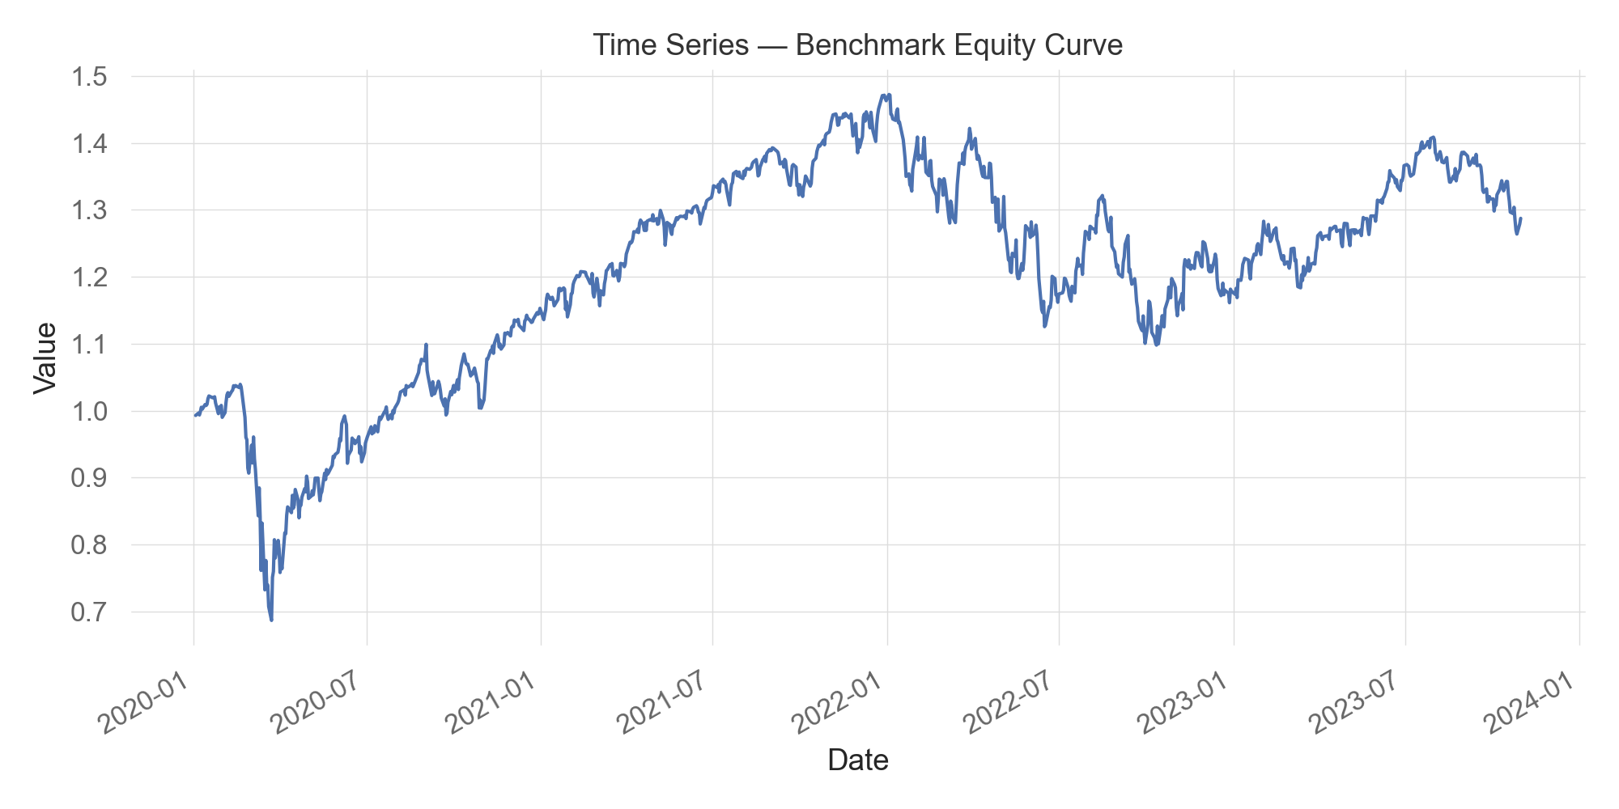
Time Series — Benchmark Equity Curve

Slide 11
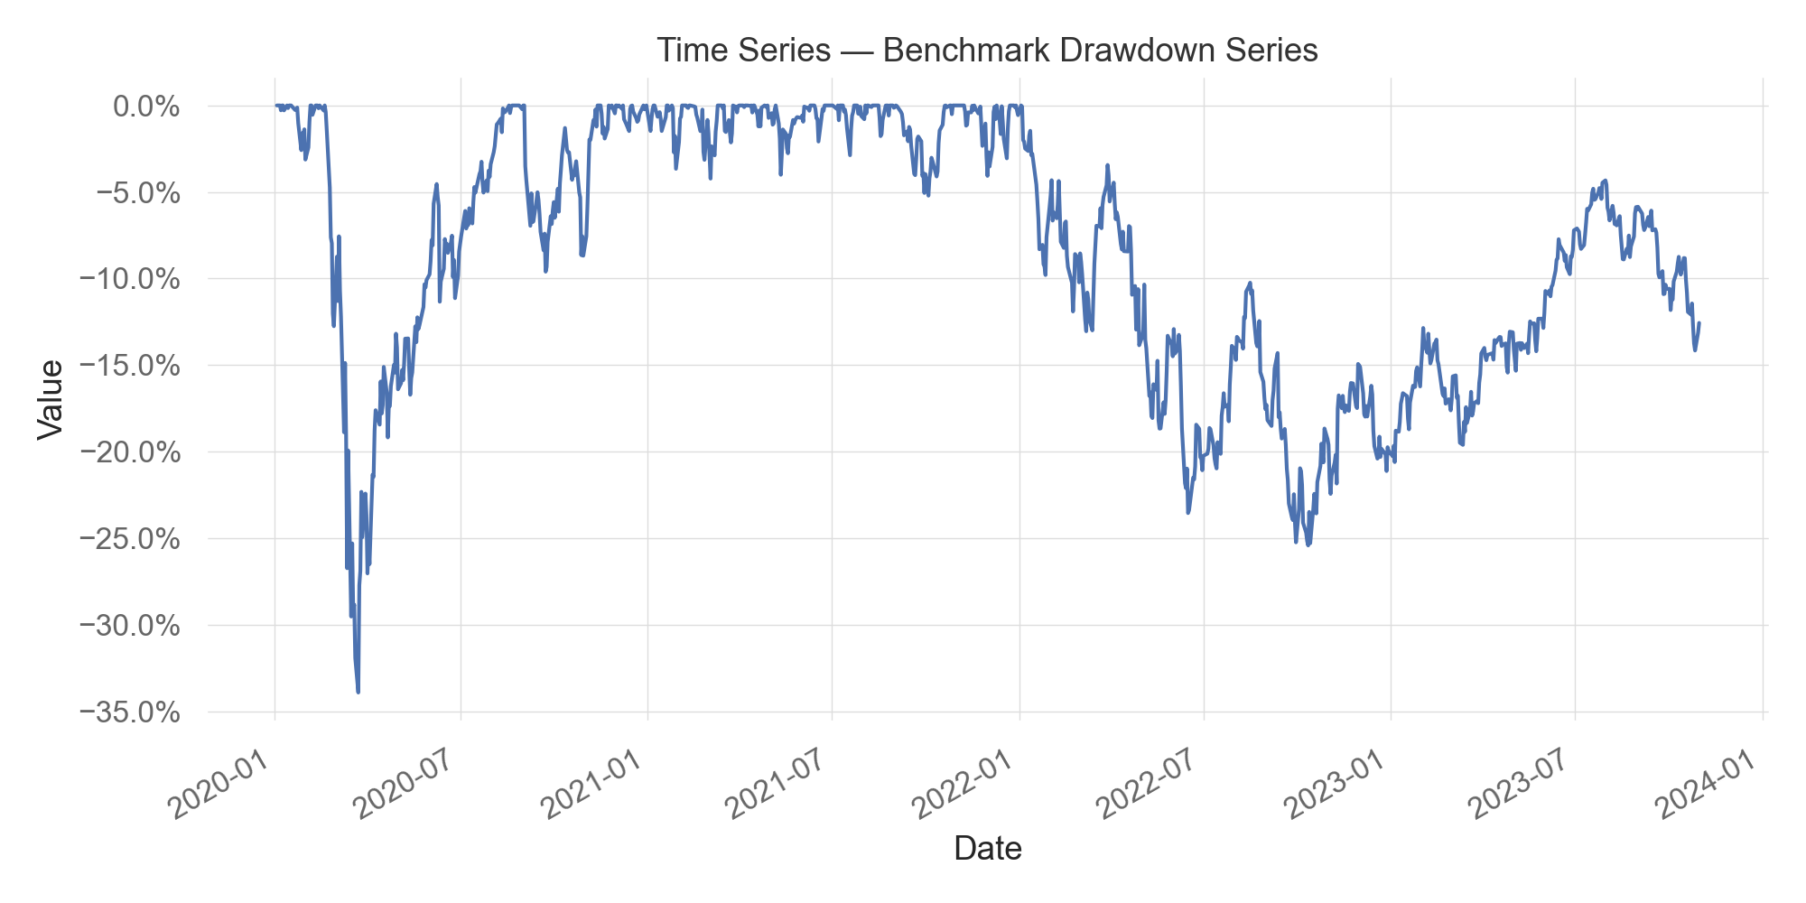
Time Series — Benchmark Drawdown Series

Slide 12
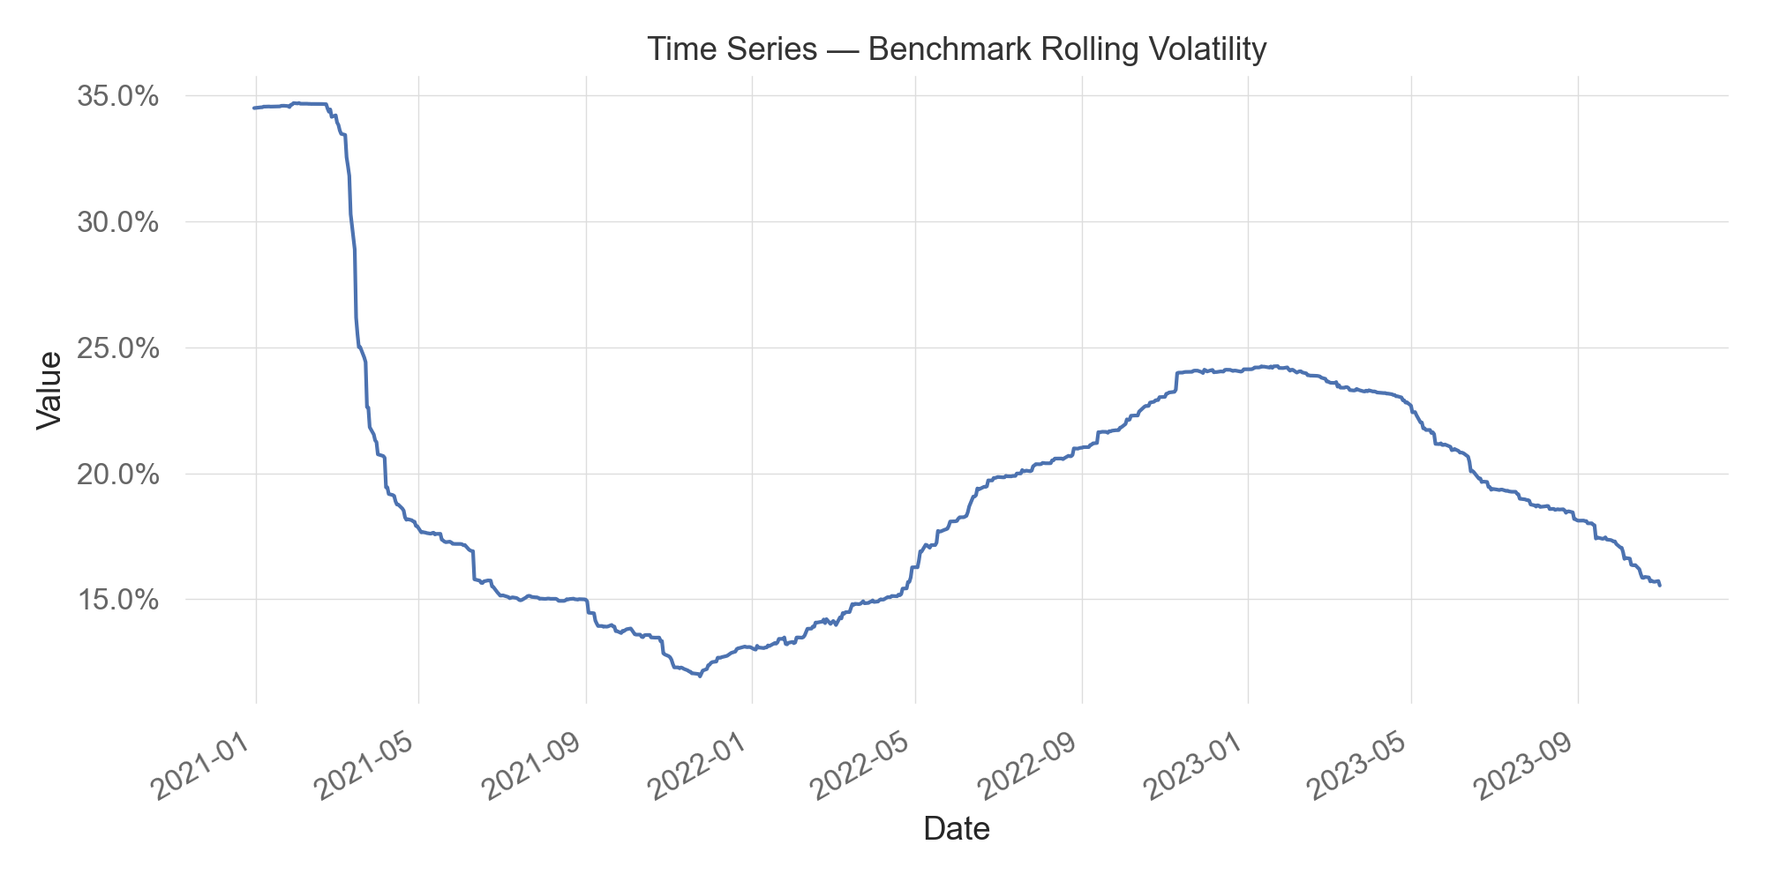
Time Series — Benchmark Rolling Volatility

Slide 13
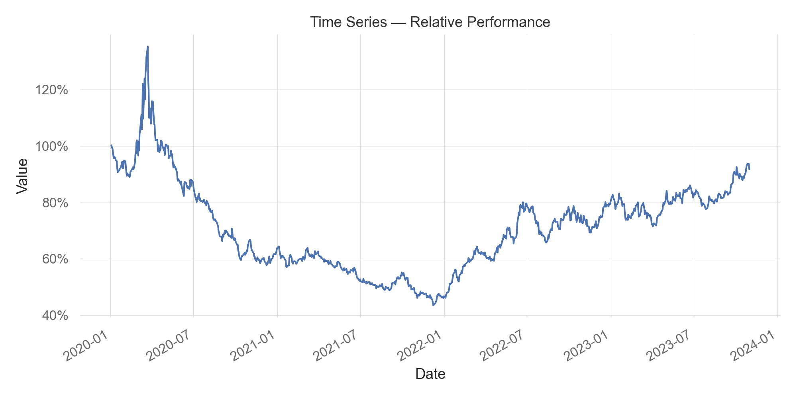
Time Series — Relative Performance

Slide 14
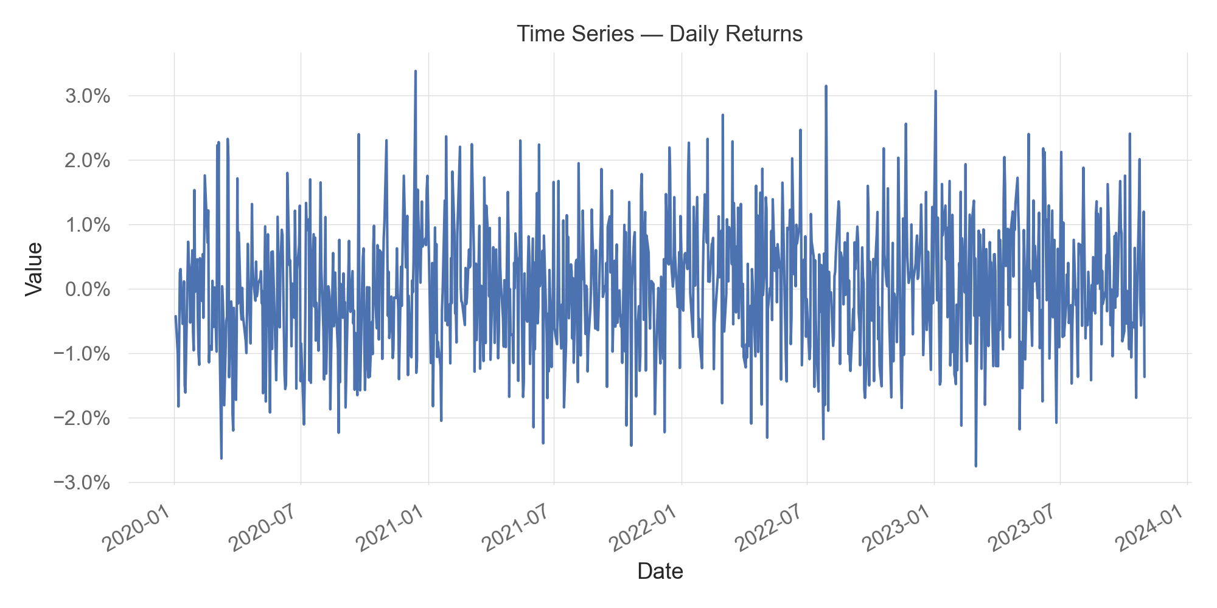
Time Series — Daily Returns

Slide 15
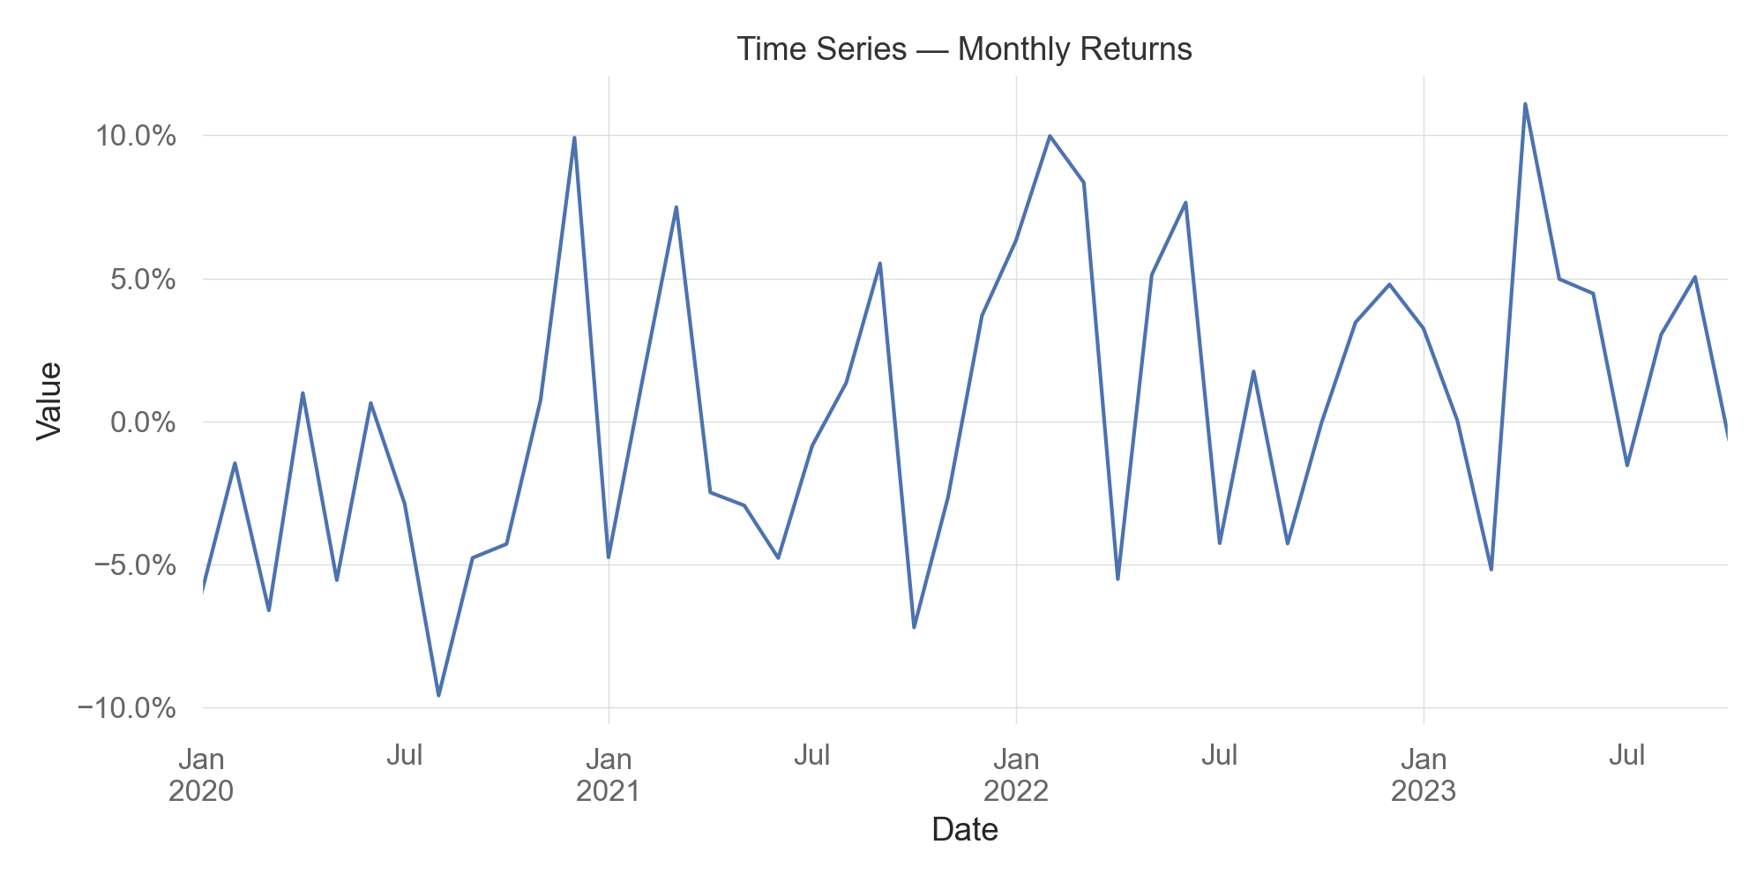
Time Series — Monthly Returns

Slide 16
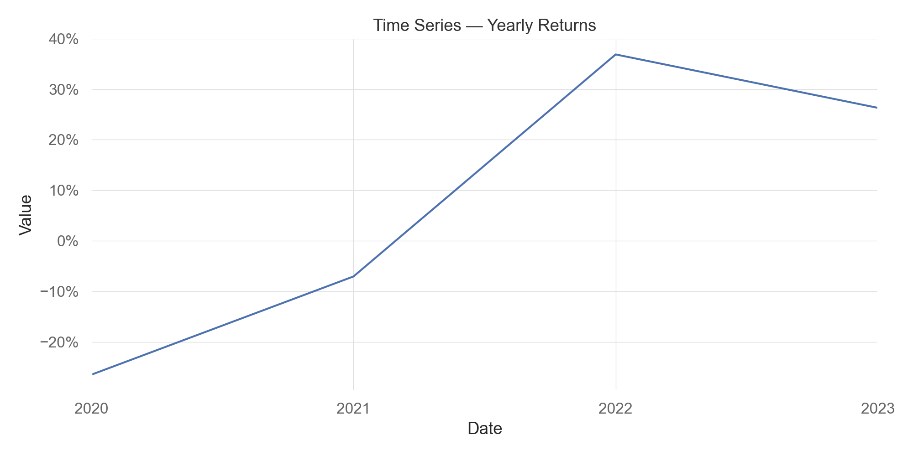
Time Series — Yearly Returns

Slide 17
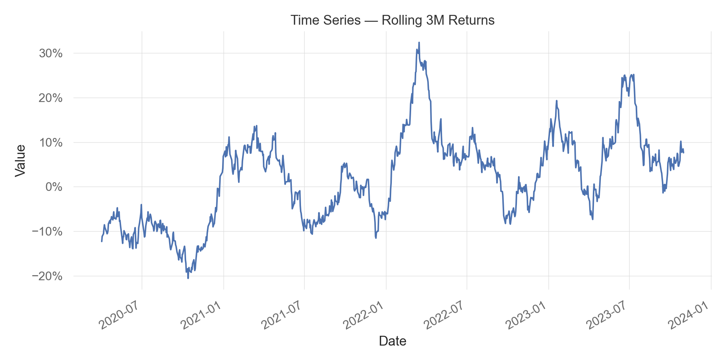
Time Series — Rolling 3M Returns

Slide 18
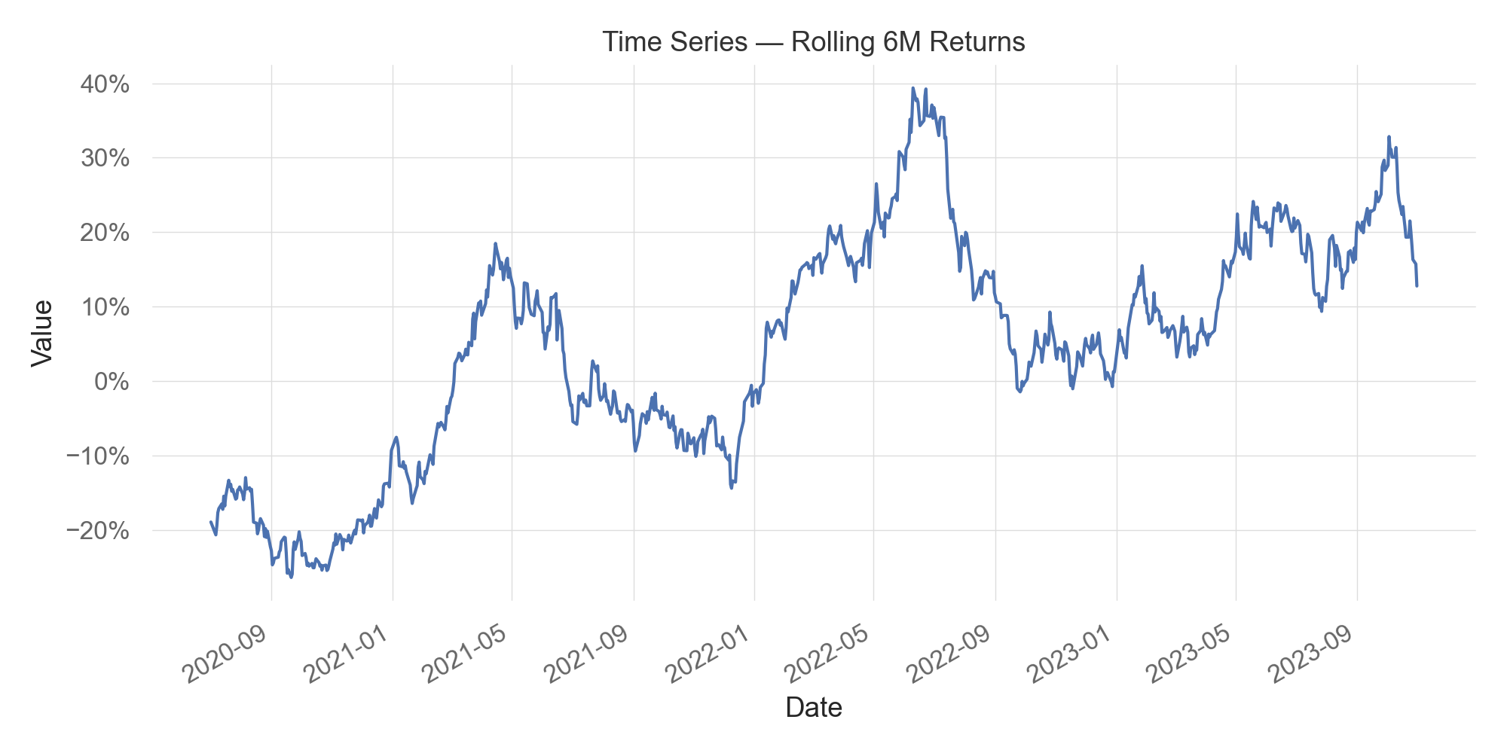
Time Series — Rolling 6M Returns

Slide 19
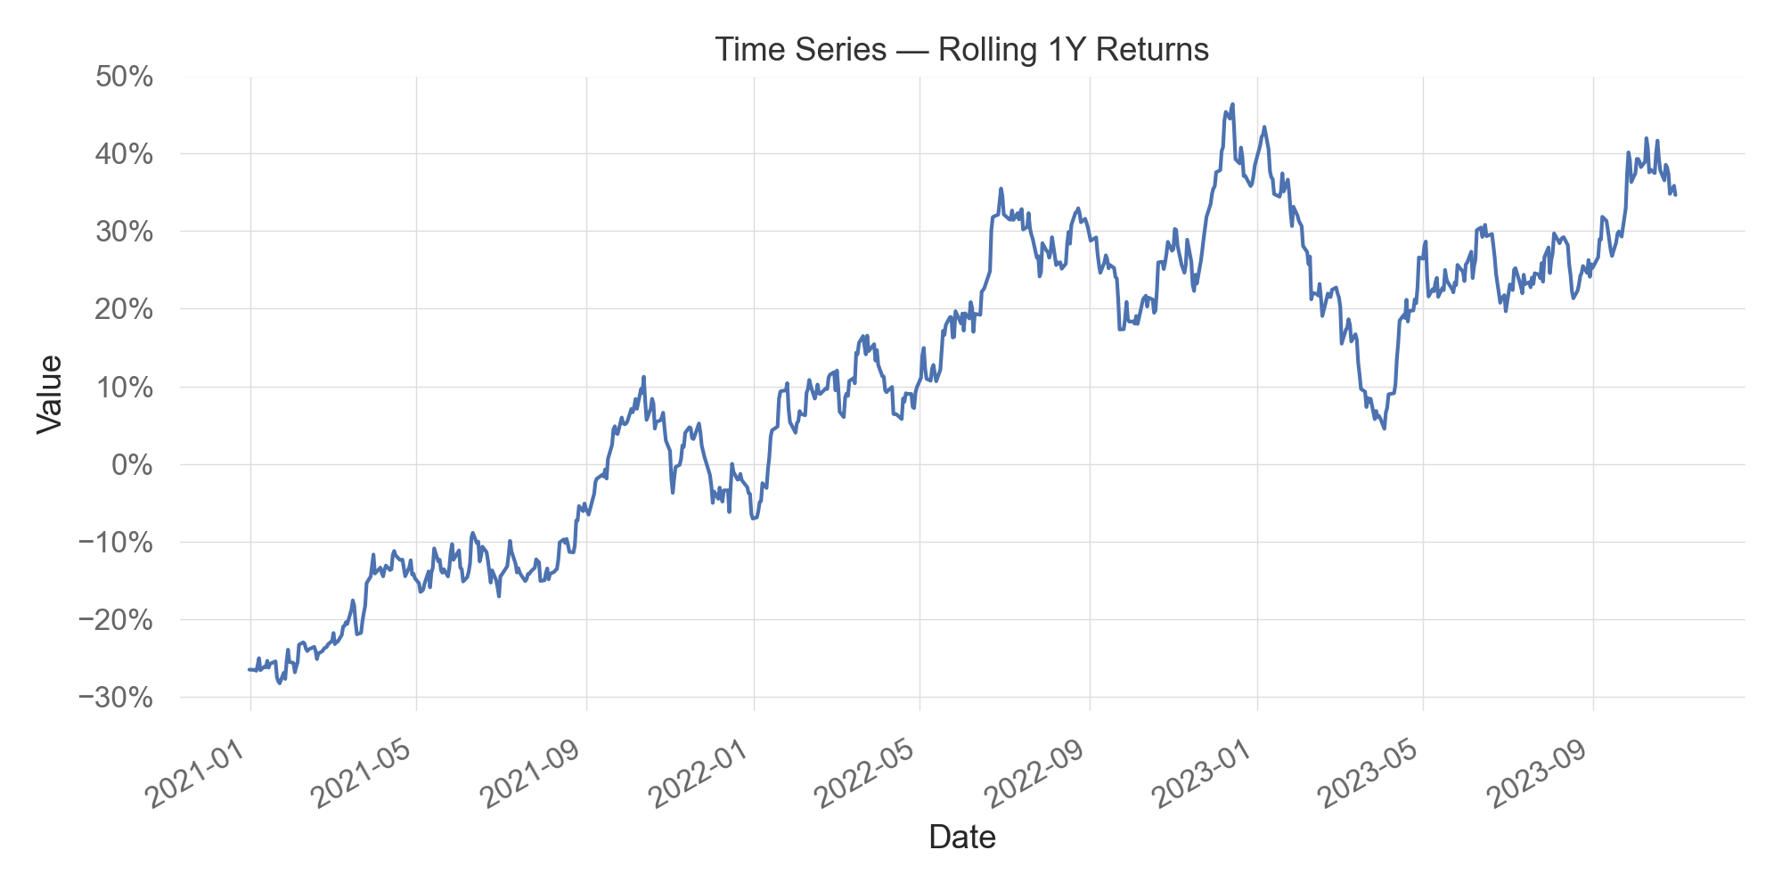
Time Series — Rolling 1Y Returns

Slide 20
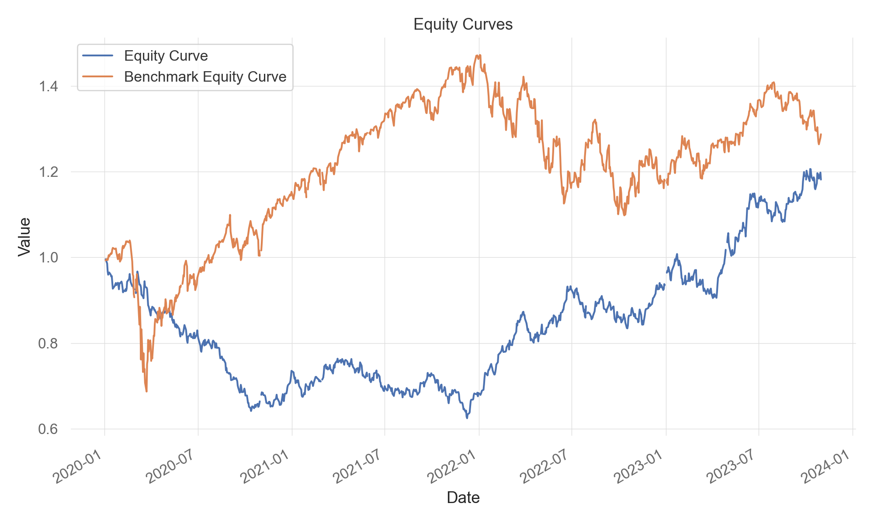
Equity Curves

Slide 21
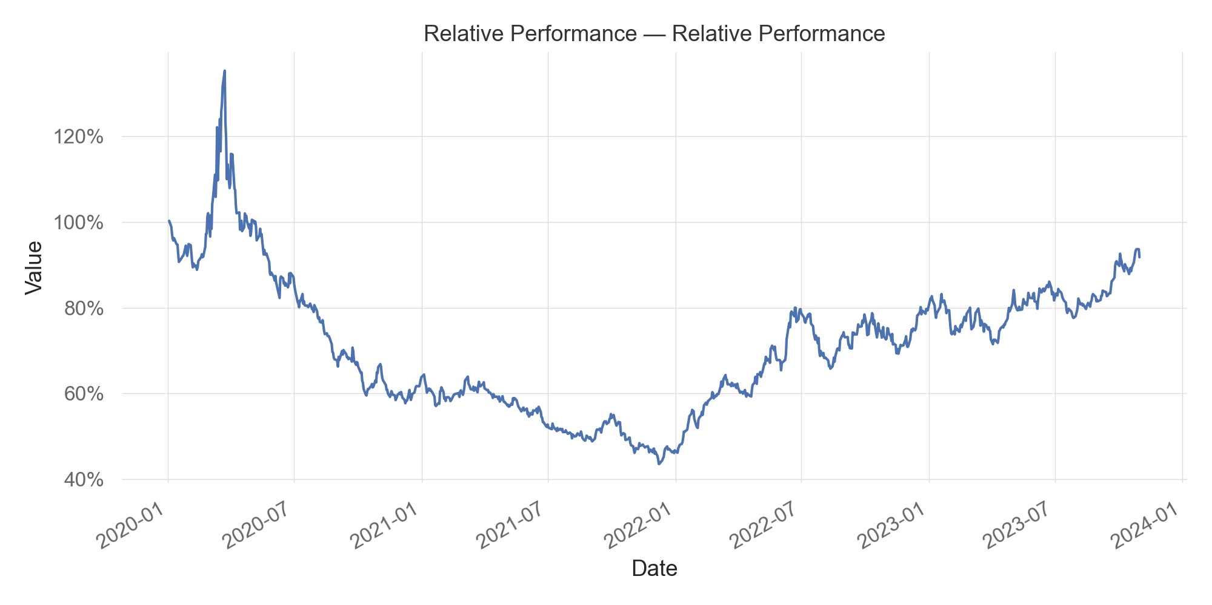
Relative Performance — Relative Performance

Slide 22

Drawdown — Drawdown Series

Slide 23

Drawdown — Benchmark Drawdown Series

Slide 24

Drawdown — Rolling Drawdown Duration

Slide 25
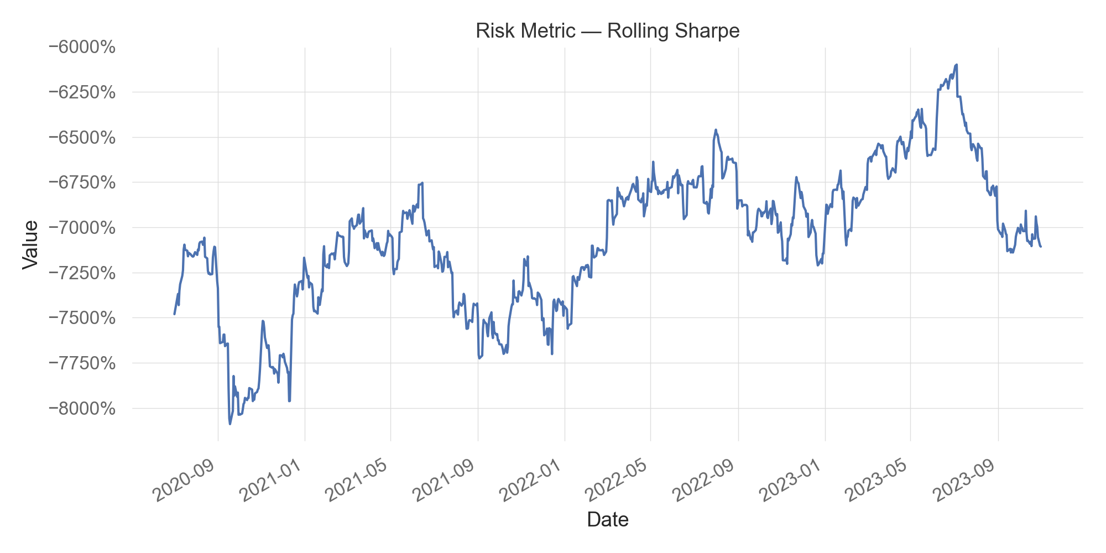
Risk Metric — Rolling Sharpe

Slide 26
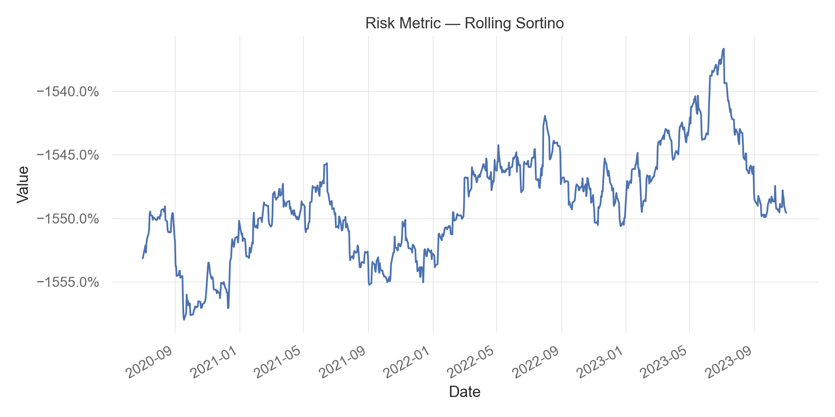
Risk Metric — Rolling Sortino

Slide 27
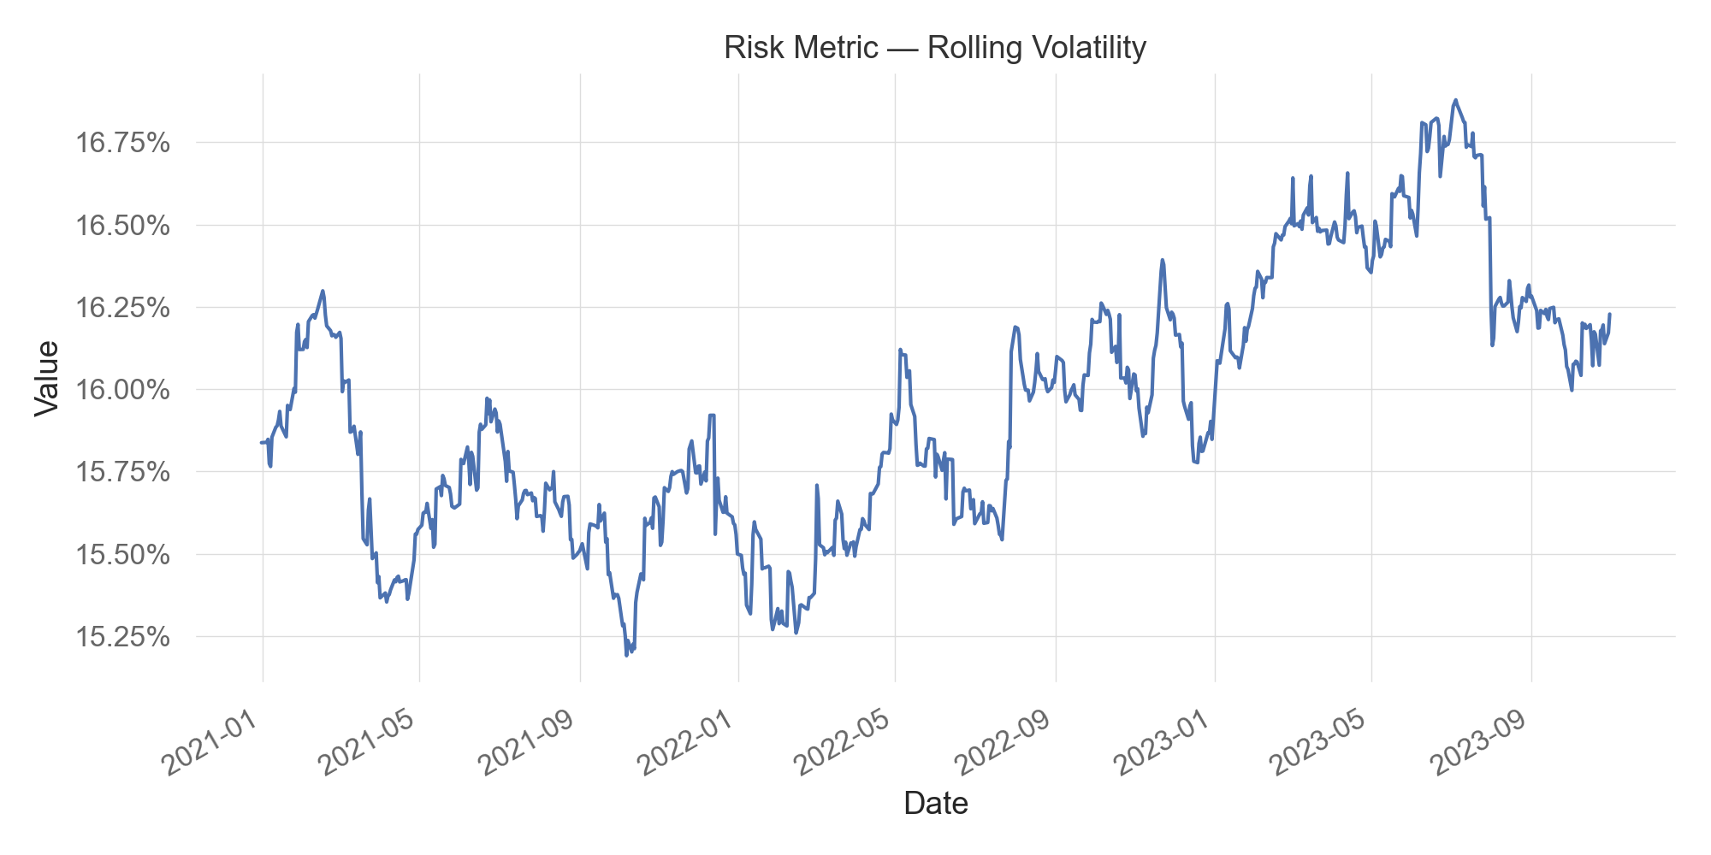
Risk Metric — Rolling Volatility

Slide 28

Risk Metric — Rolling Skew

Slide 29

Risk Metric — Rolling Var

Slide 30
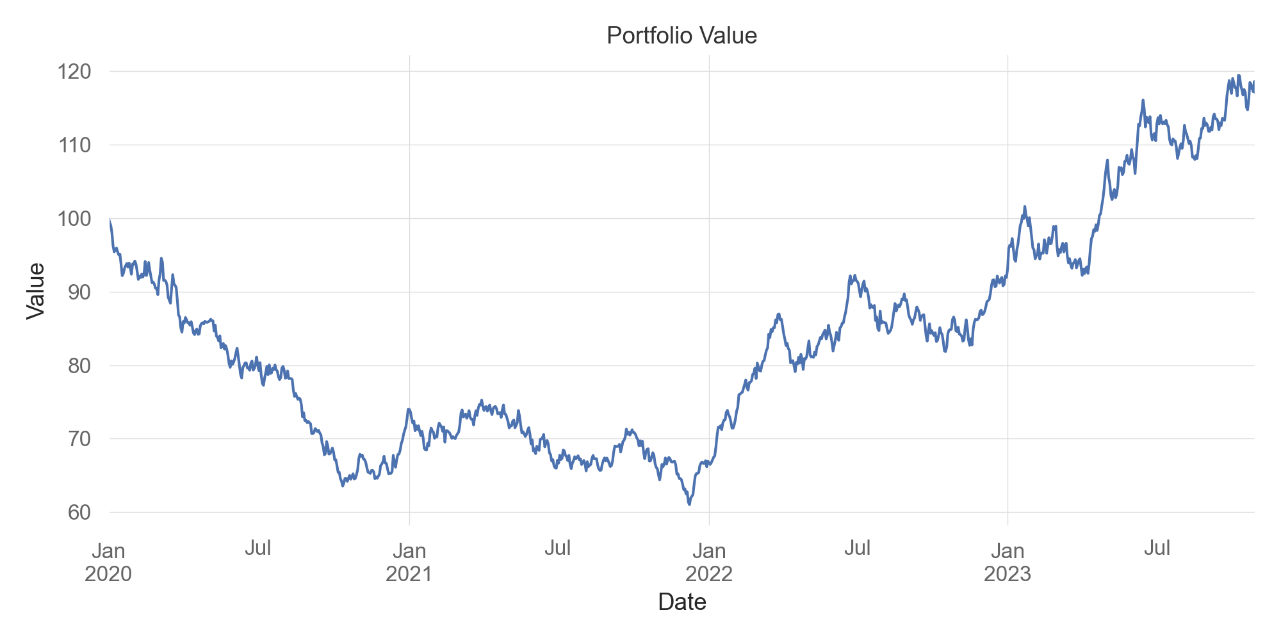
Portfolio Value

