Slide 1
Backtesting Summary Statistics
Metric | Value
Total Return | 176.69%
Annualized Return | 29.34%
Max Drawdown | -0.0273
Volatility | 0.0547
Sharpe Ratio | 4.73
Sortino Ratio | 8.81
Calmar Ratio | 7.10
Var 95 | 0.0045
Positive Days | 411
Metric | Value
Negative Days | 275
Best Month | 0.0784
Worst Month | -0.0147
Alpha | 0.0000
Beta | 1.0000
Correlation | -0.0252
Start Date | 2022-01-01 00:00:00
End Date | 2024-09-26 00:00:00
Generated by AlgoSystem

Slide 2
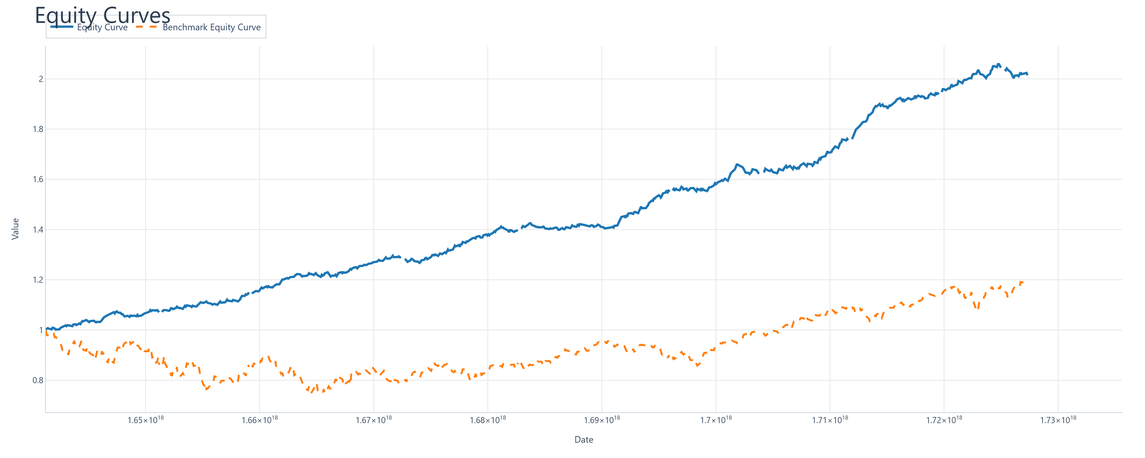
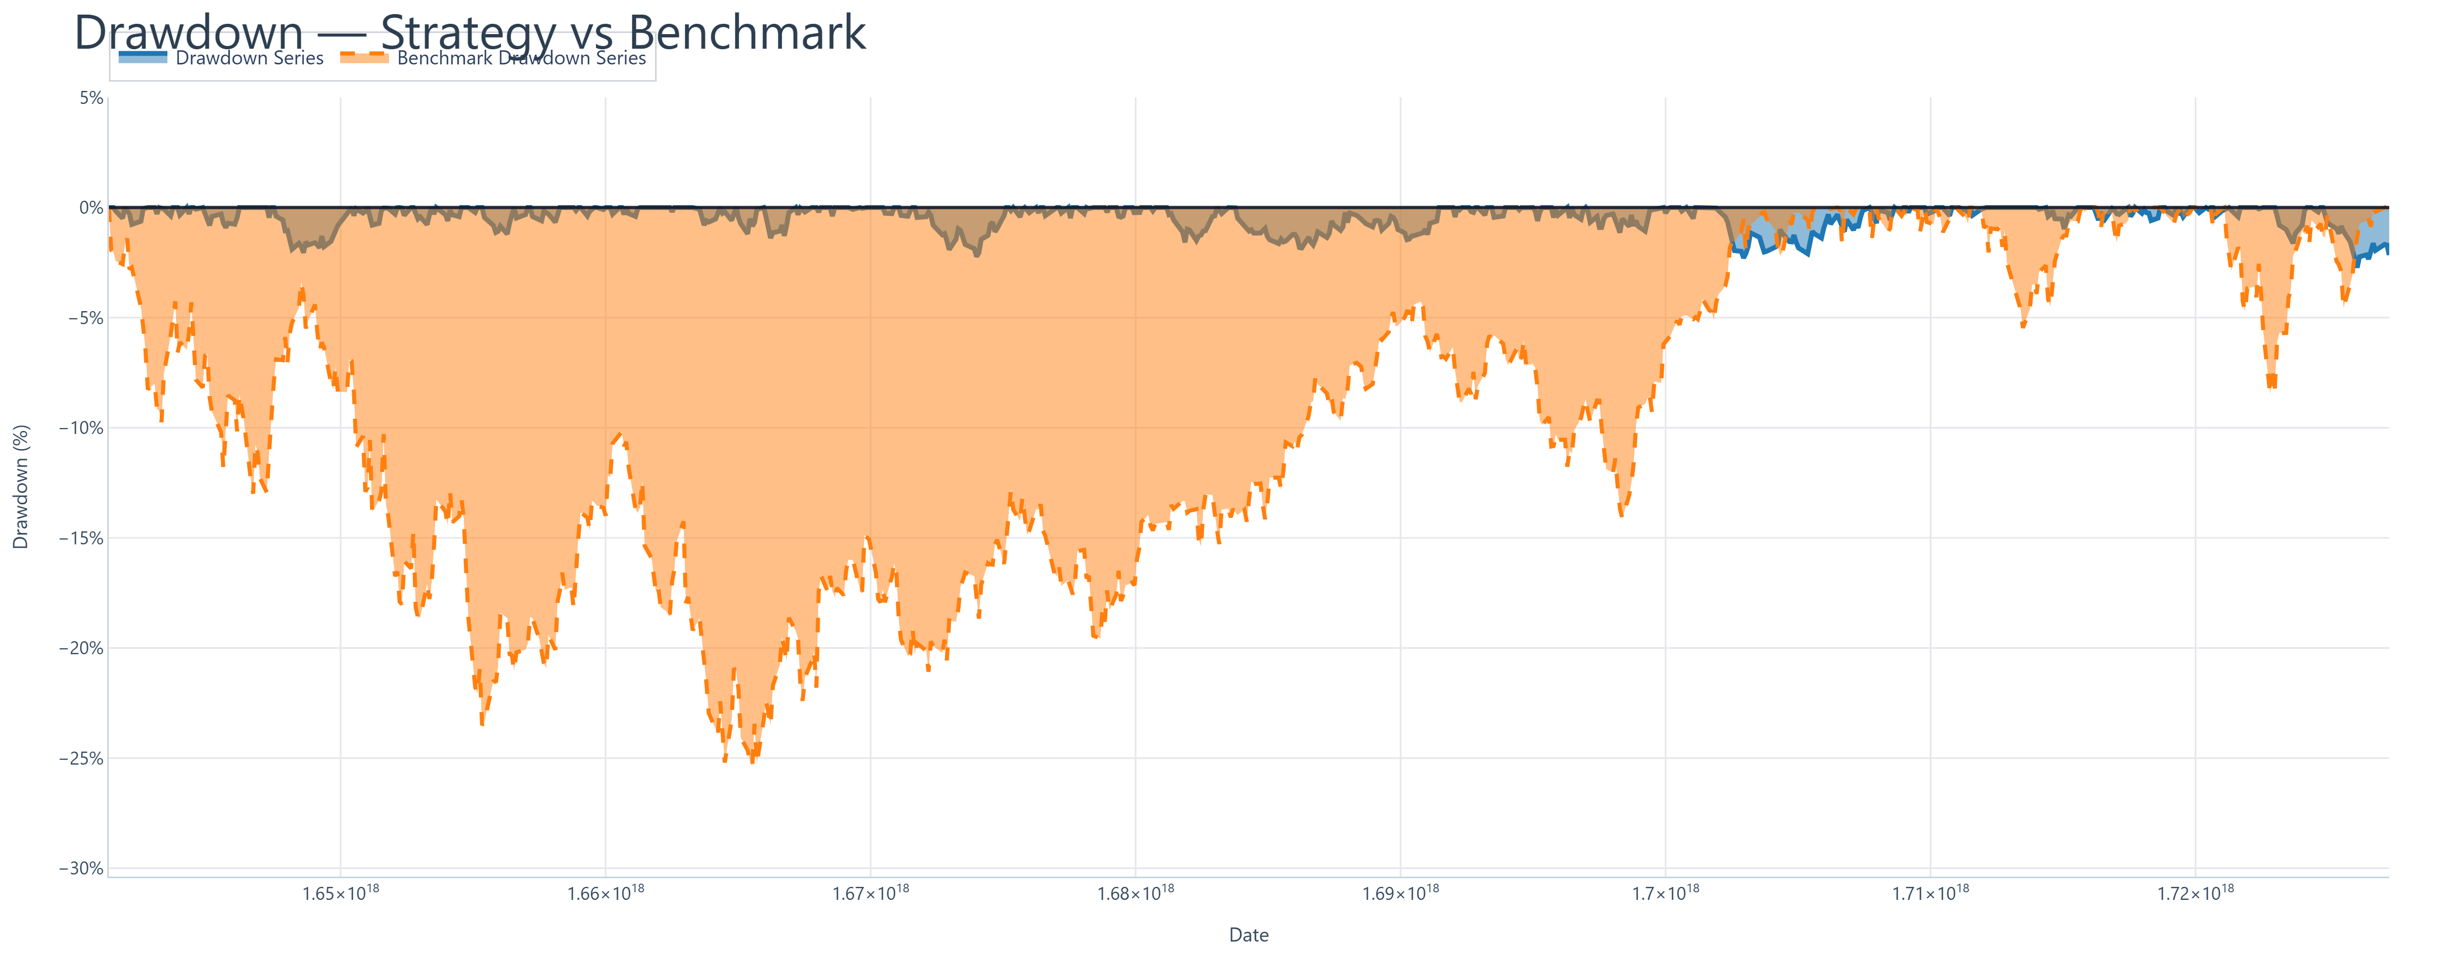
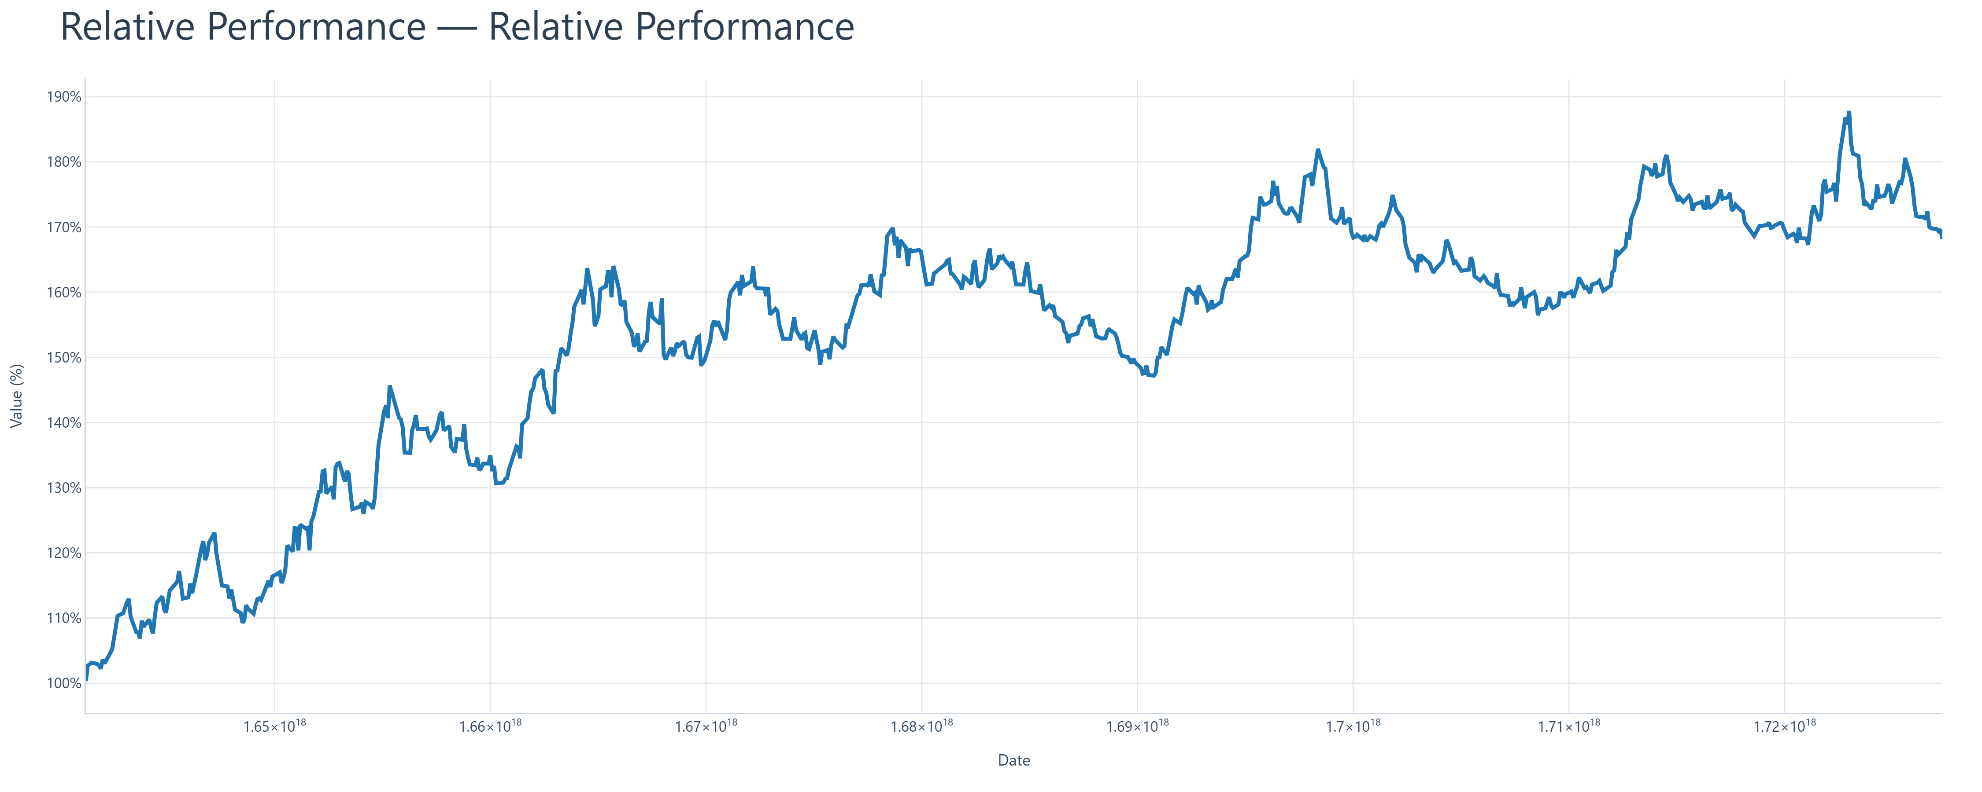
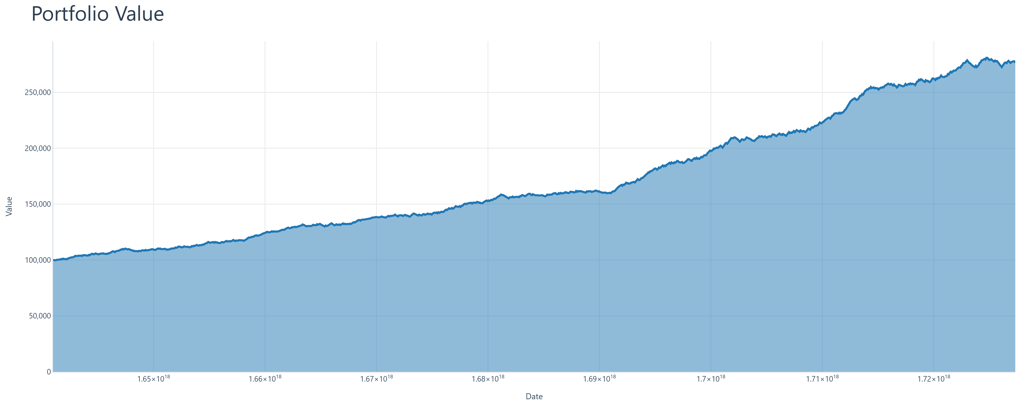
Performance Comparison: Strategy vs Benchmark
Generated by AlgoSystem

Slide 3
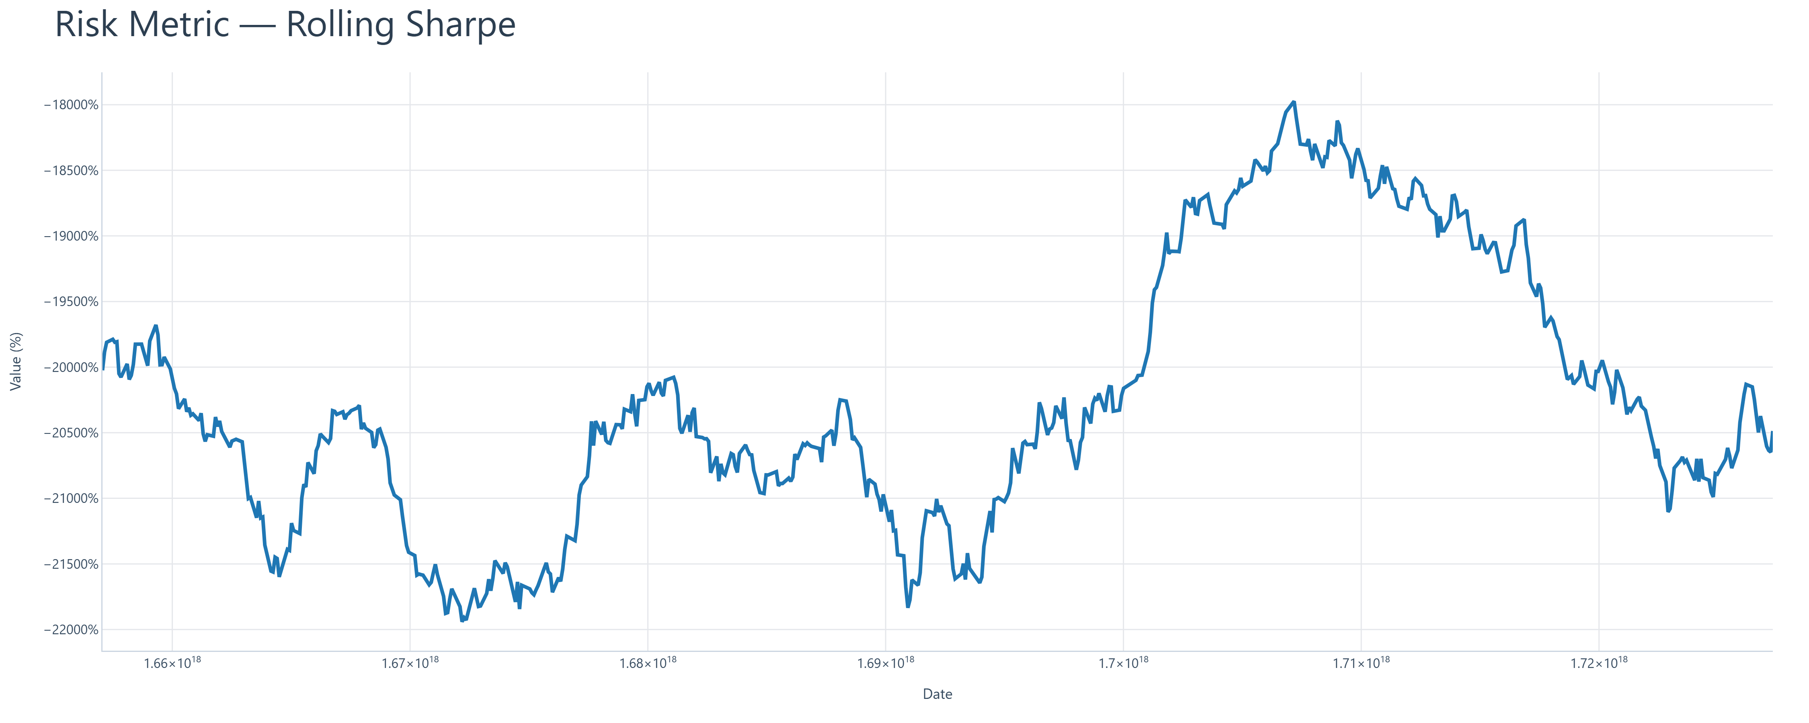
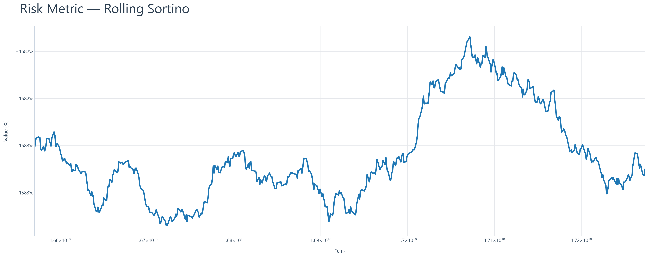
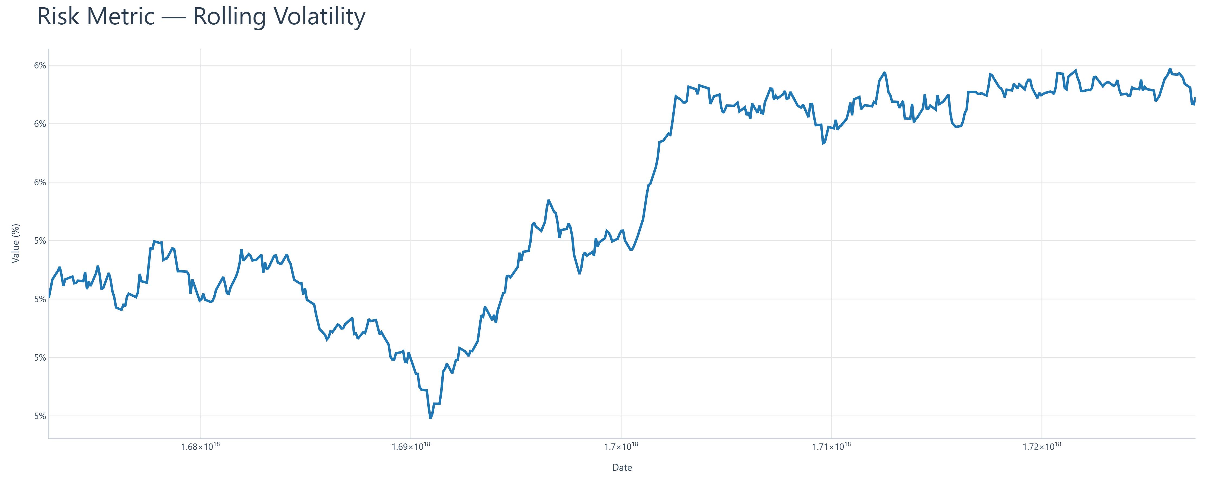
Rolling Risk Metrics I
Generated by AlgoSystem

Slide 4
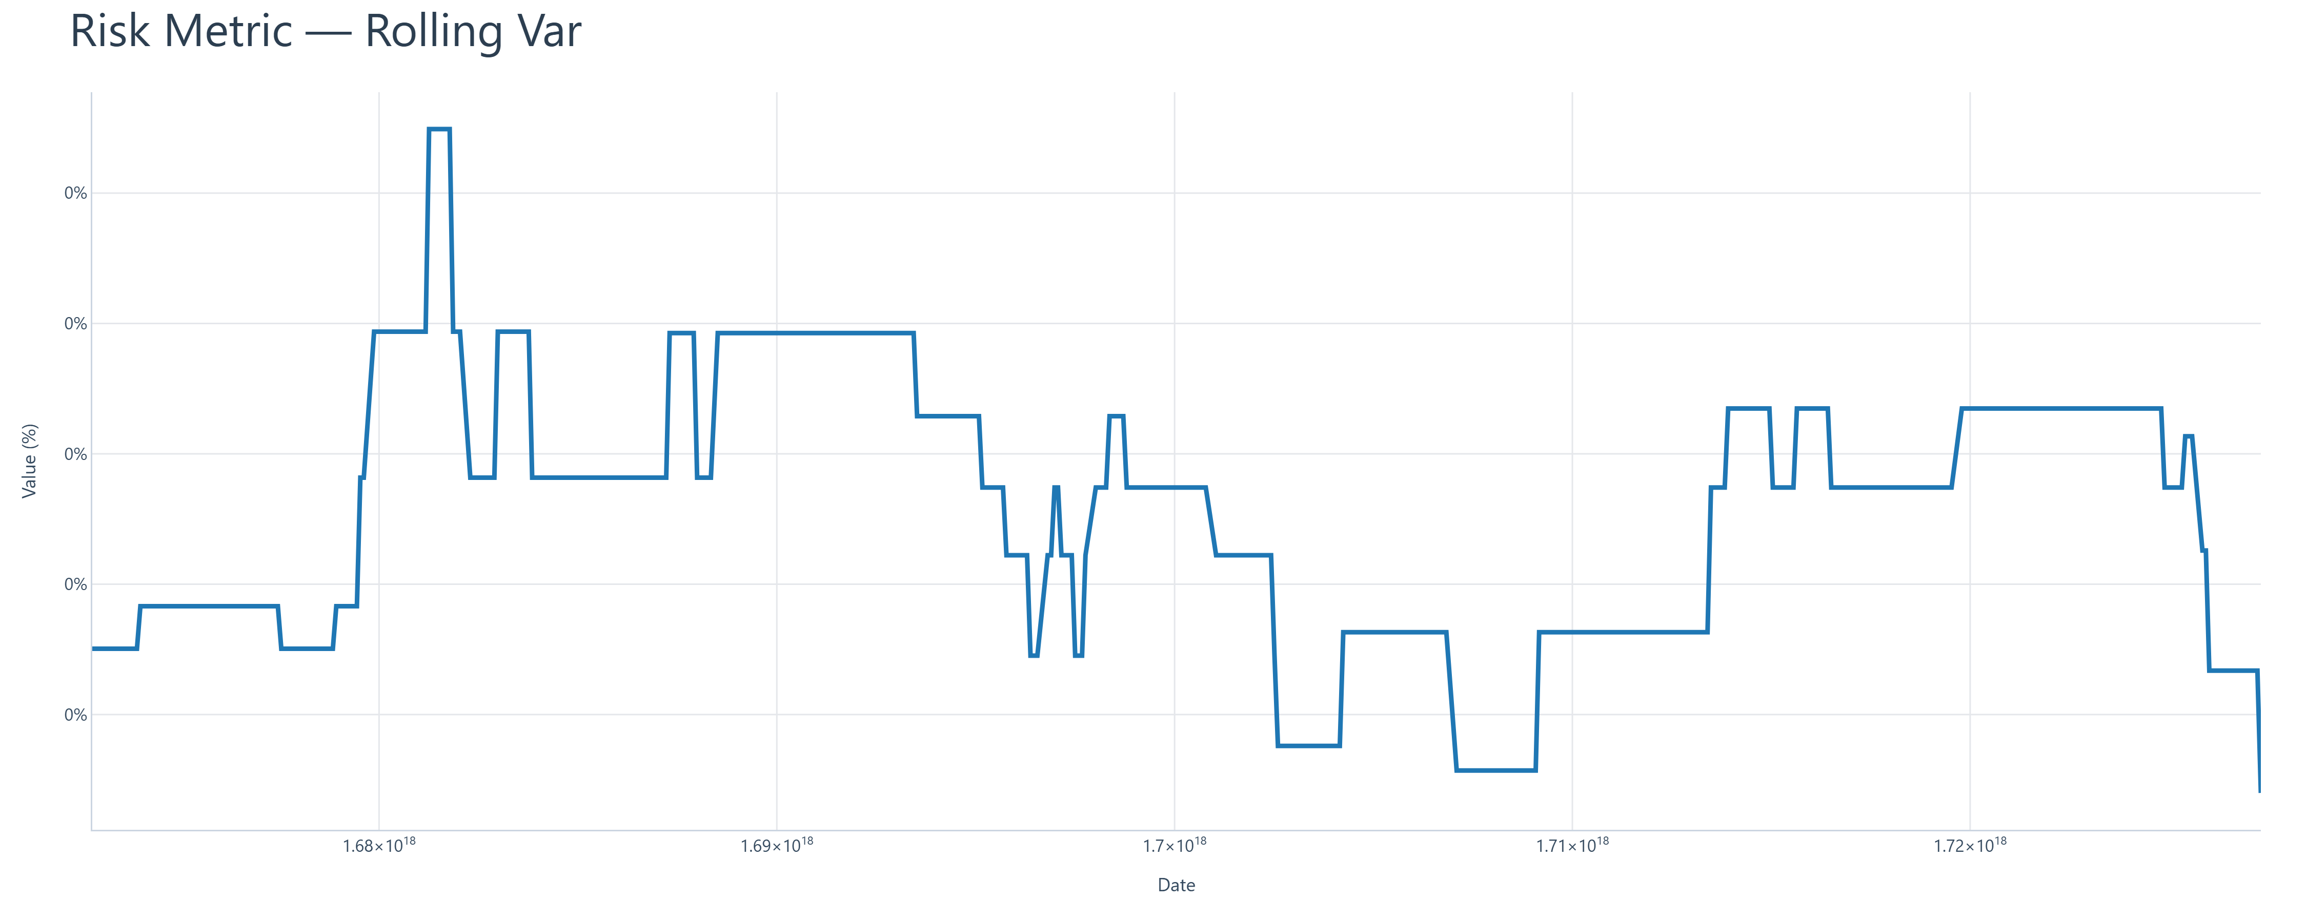
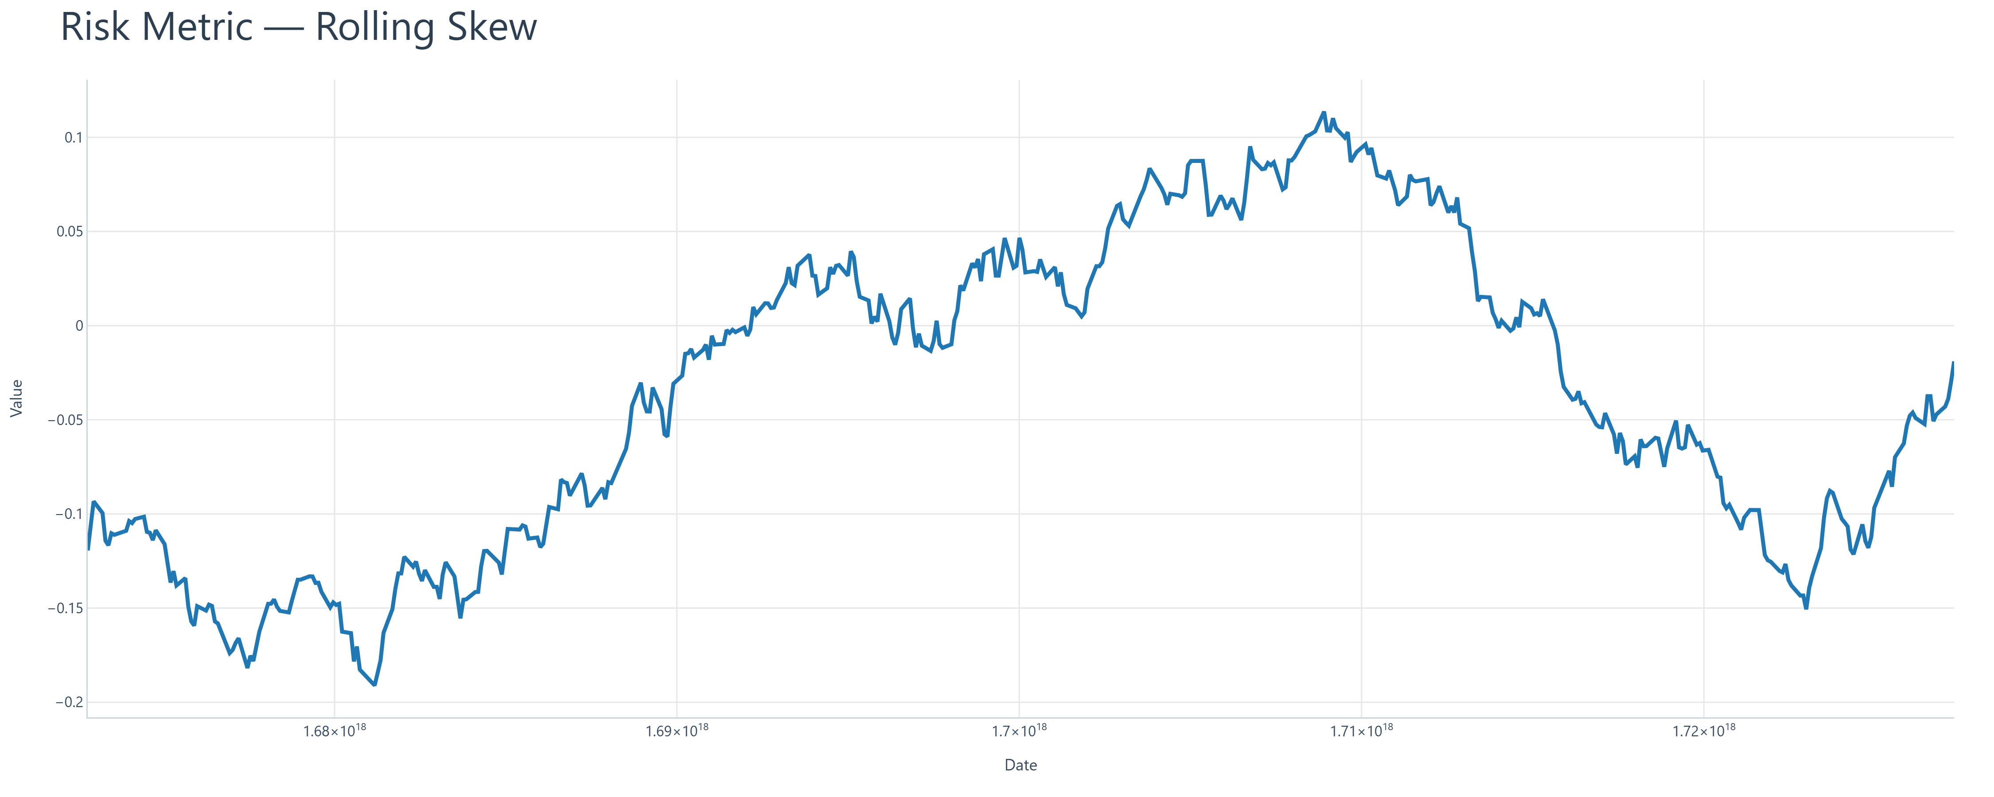
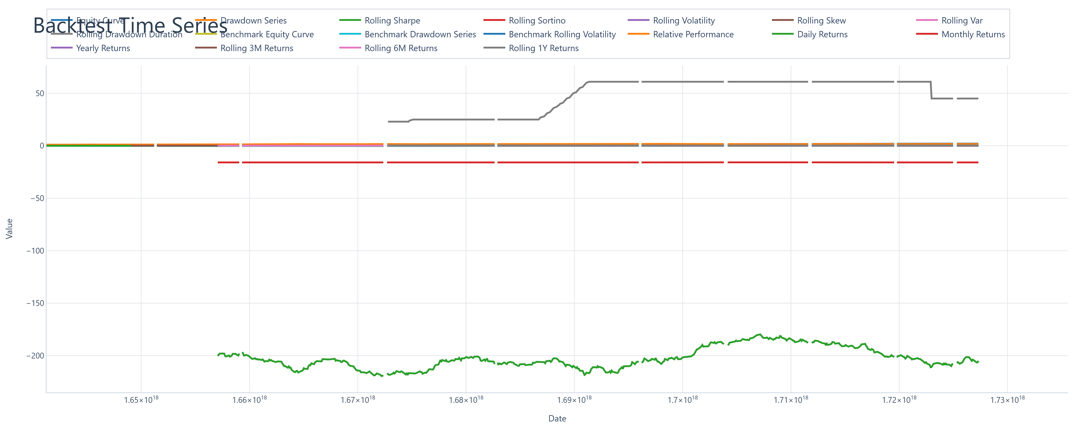
Rolling Risk Metrics II
Generated by AlgoSystem

