Slide 1
Instruction Set Principles
Introduction
Classifying Instruction Set Architectures
Addressing Modes
Type and Size of Operands
Operations in the Instruction Set
Instructions for Control Flow
Instruction Format
The Role of Compilers
The MIPS Architecture
Conclusion
CDA 5155 – Spring 2012 Copyright © 2012 Prabhat Mishra

Slide 2
Introduction
An instruction set architecture is a specification of a standardized programmer-visible interface to hardware.
  A set of instructions
    With associated argument fields, assembly syntax, and machine encoding.
  A set of named storage locations
    Registers, memory.
  A set of addressing modes
    Ways to name locations

Slide 3
Classifying Architectures
Classification is based on addressing modes.
  Stack architecture
    Operands implicitly on top of a stack.
  Accumulator architecture
    One operand is implicitly an accumulator
  General-purpose register architecture
    Register-memory architectures
      One operand can be memory.
    Load-store architectures
      All operands are registers (except for load/store)

Slide 4
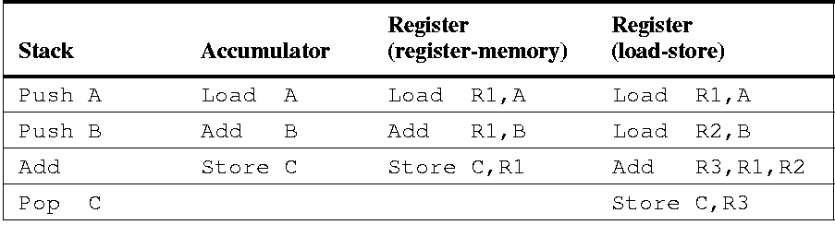
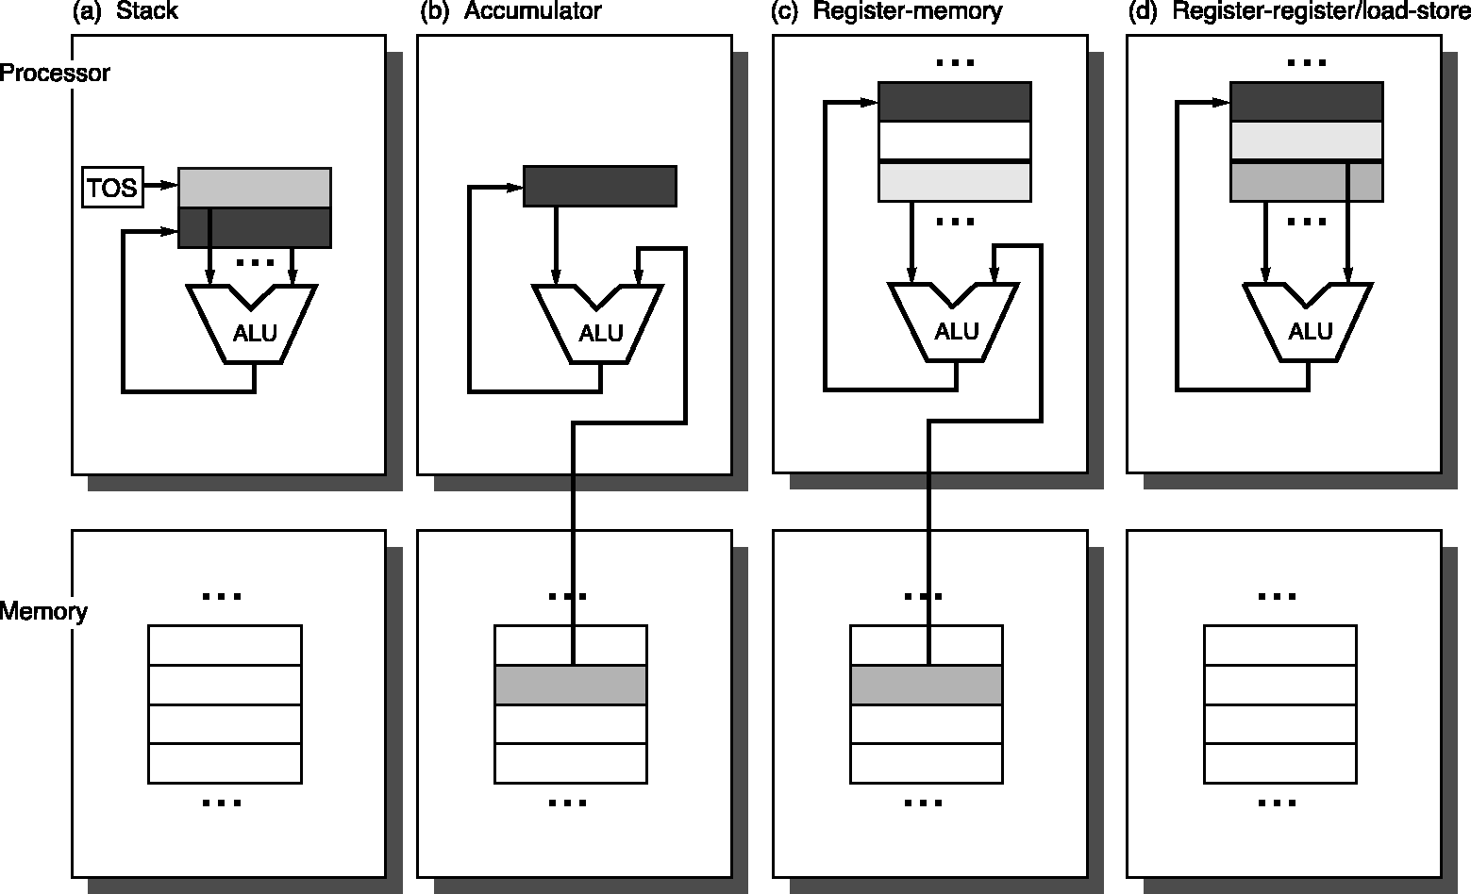
Four Architecture Classes
Assembly for C:=A+B

Slide 5
Classification based on Operands
Instruction-set architecture can also be classified based on the number of operands
  2-operand and 3-operand
Further classification can be done based on the type of operands
# of Memory Operands | # of Operands | Type of Architecture | Examples
0 | 3 | Register-register | Alpha, ARM, MIPS, PowerPC, Sparc
1 | 2 | Register-memory | Intel 80x86, Motorola 68000, TI C54x
2 | 2 | Memory-memory | VAX
3 | 3 | Memory-memory | VAX

Slide 6
Comparison of Architecture Types
Type | Instruction Encoding | Code Generation | # of Clock Cycles/Inst. | Code Size
Register-register | Fixed-length | Simple | Similar | Large
Register-memory | Easy | Moderate | Different | Medium
Memory-memory | Variable-length | Complex | Large variation | Compact
Advantages
Disadvantages

Slide 7
Endians & Alignment
Increasing byte
address
7
6
5
4
3
2
1
0
Aligned
Not-aligned
word
Little-endian byte order
(least-significant byte “first”).
3 (MSB)
2
1
0 (LSB)
word
0 (LSB)
1
2
3 (MSB)
Big-endian byte order
(most-significant byte “first”).

Slide 8
Addressing Modes
Mode | Example | Meaning
Register | add r4, r3 | R[4]←R[4]+R[3]
Immediate | add r4, #3 | R[4]←R[4]+3
Displacement | add r4, 100(r1) | R[4]←R[4]+M[100+R[1]]
Register indirect | add r4, (r1) | R[4]←R[4]+M[R[1]]
Indexed | add r3, (r1+r2) | R[3]←R[3]+M[R[1]+R[2]]
Direct/Absolute | add r1, (1001) | R[1]←R[1]+M[1001]
Memory indirect | add r1, @(r3) | R[1]←R[1]+M[M[R[3]]]
Autoincrement | add r1, (r2)+ | R[1]←R[1]+M[R[2]] R[2]←R[2]+d
Autodecrement | add r1, – (r2) | R[2]←R[2] – d R[1]←R[1]+M[R[2]]
Scaled | add r1, 100(r2)[r3] | R[1]←R[1]+M[100+R[2]+R[3]*d]
Register Values
Constants
Local Variables
Pointer Access
Array Access
Static Data
*p (Ptr Address)
Array in a Loop
( ) ➔ memory access
[ ] ➔ accessing a Register or Memory location

Slide 9
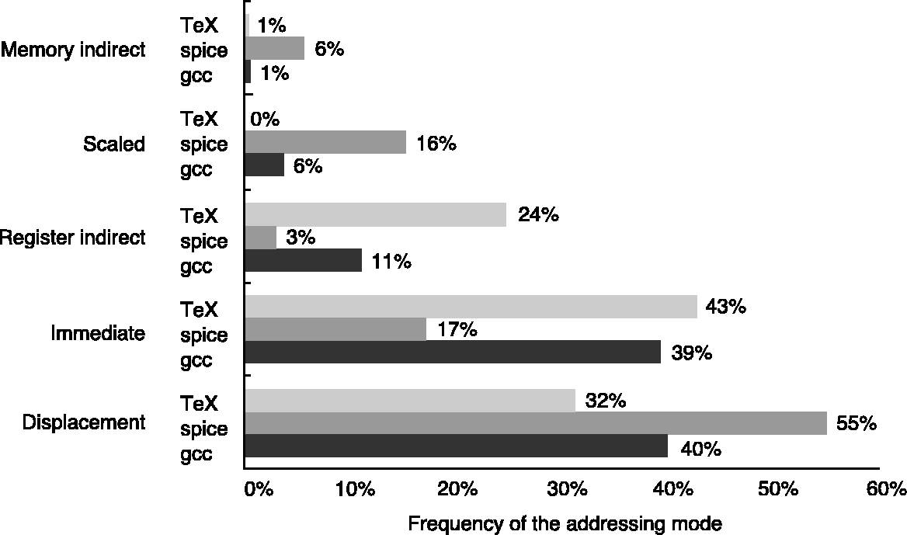
Addressing Mode Usage
3 SPEC89 programs on VAX
Register mode accounts for almost half of the operand access.
Compiler affects what addressing modes are used.
© 2003 Elsevier Science (USA). All rights reserved.

Slide 10
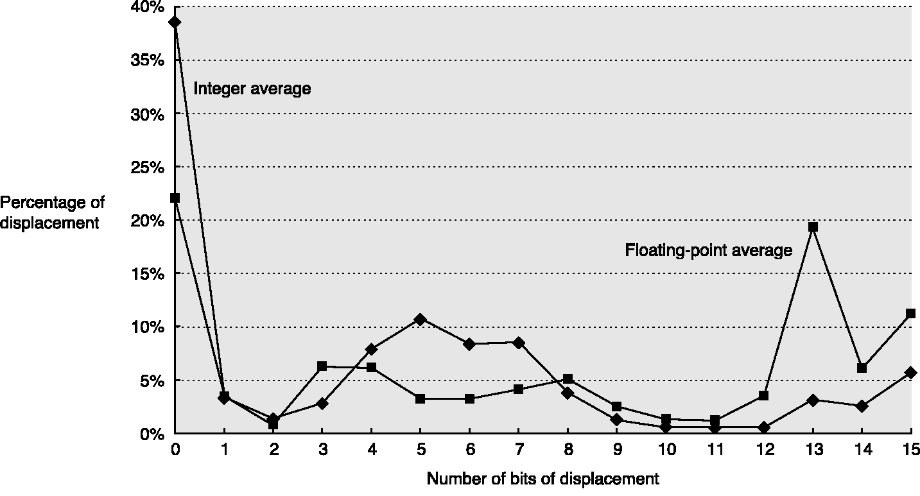
Displacement Distribution
SPEC CPU2000 on Alpha
Sign bit is not counted
© 2003 Elsevier Science (USA). All rights reserved.

Slide 11
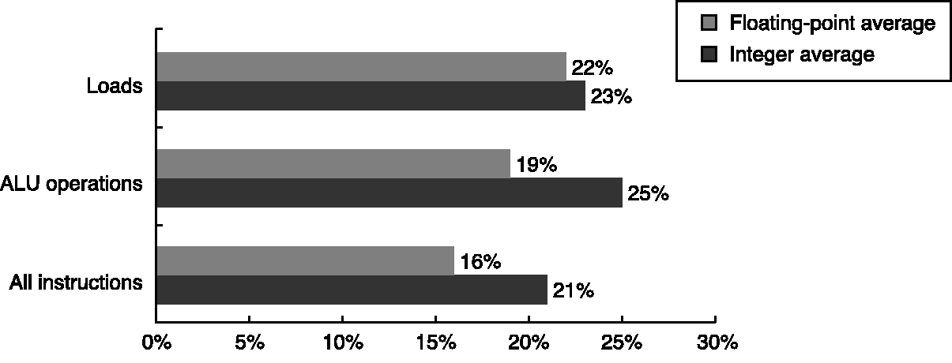
Use of Immediate Operand
© 2003 Elsevier Science (USA). All rights reserved.

Slide 12
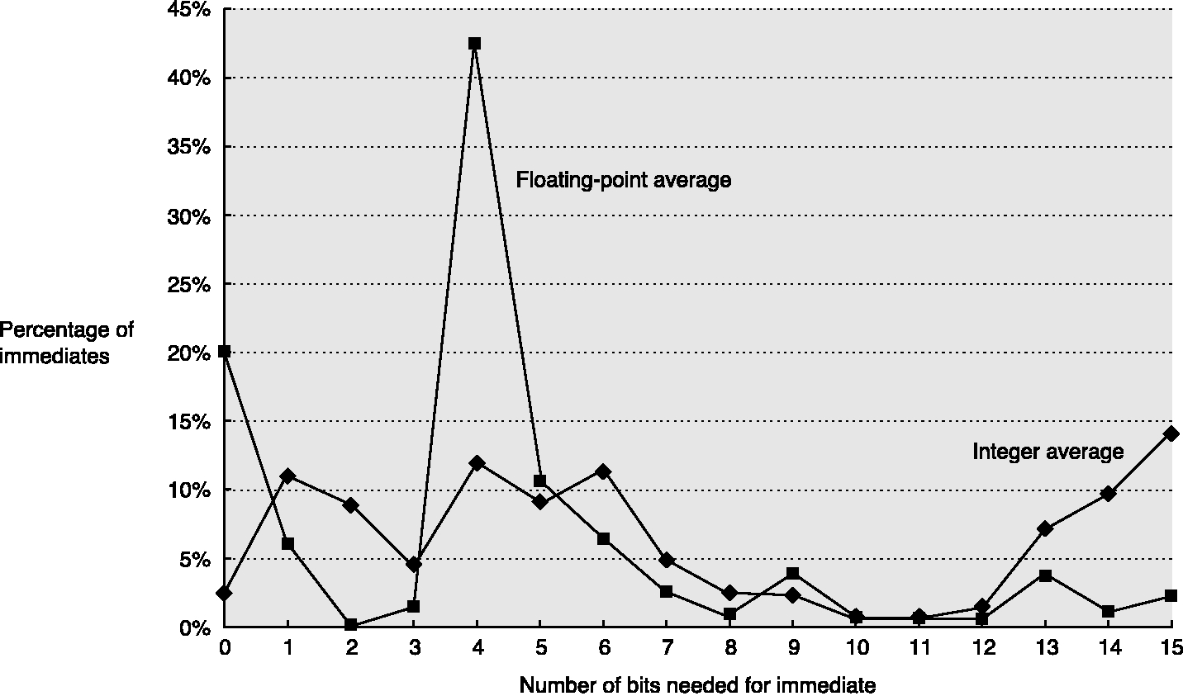
Distribution of Immediate
SPEC CPU2000 on Alpha
Sign bit is not counted
© 2003 Elsevier Science (USA). All rights reserved.

Slide 13
Addressing Mode for FFT
FFTs start or end their processing with data shuffled in a particular order.
  Eight data items in a radix-2 FFT.
    000 ➔ 000
    001 ➔ 100
    010 ➔ 010
    011 ➔ 110
    100 ➔ 001
    101 ➔ 101
    110 ➔ 011
    111 ➔ 111

Slide 14
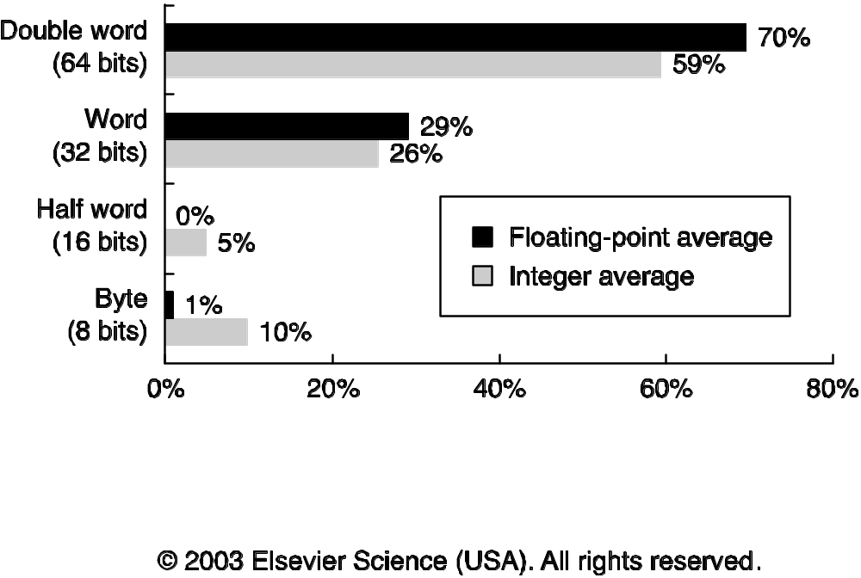
Type and Size of Operands

Slide 15
Why use Decimal?
Some architectures support a decimal format
  Packed decimal or binary-coded decimal (BCD)
Why?
  (0.10)₁₀ = (?)₂
  Answers
    0.10
    0.0001
    0.1010
    0.000110011
Some decimal fractions does not have exact representation in binary.

Slide 16
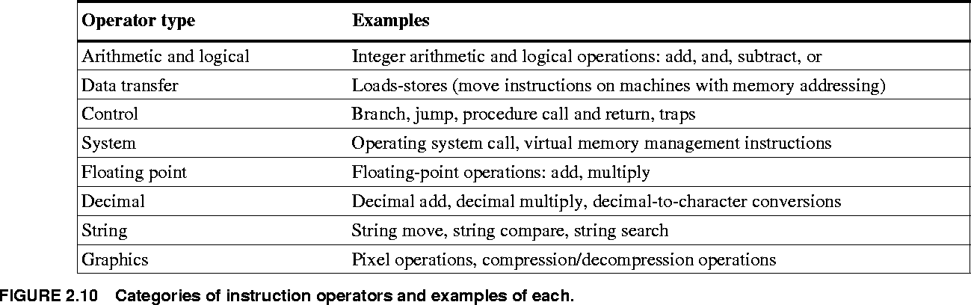
Instruction Type

Slide 17
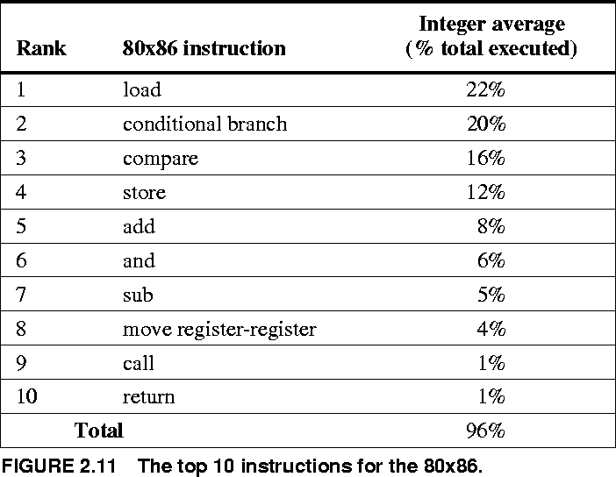
Top 10 Instructions for the 80x86
Average of 5 SPECint92 programs

Slide 18
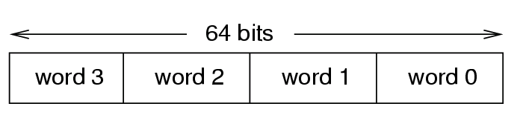
Multimedia Instructions
Multimedia instructions exploit the fact that
  Many registers, adders etc. are wide (32/64 bit)
  Most multimedia data types are narrow
    e.g., 8 bit per color, 16 bit per audio sample per channel
2-8 values can be stored/register and added.
+
4 additions per instruction; carry disabled at word boundaries.
SIMD: Single Instruction Multiple Data

Slide 19
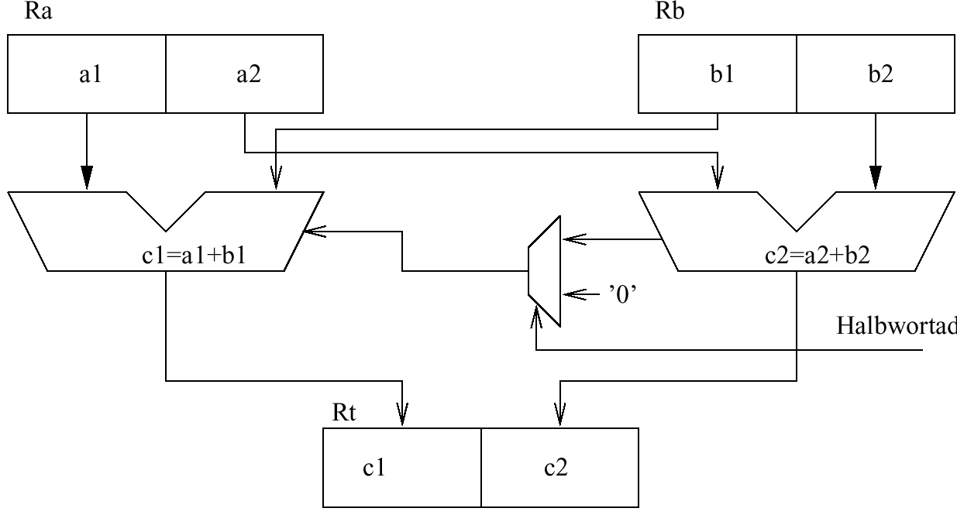
HP precision architecture (hp PA)
Half word add instruction HADD:
Half word add?
Optional saturating arithmetic.
Up to 10 instructions can be replaced by HADD.

Slide 20
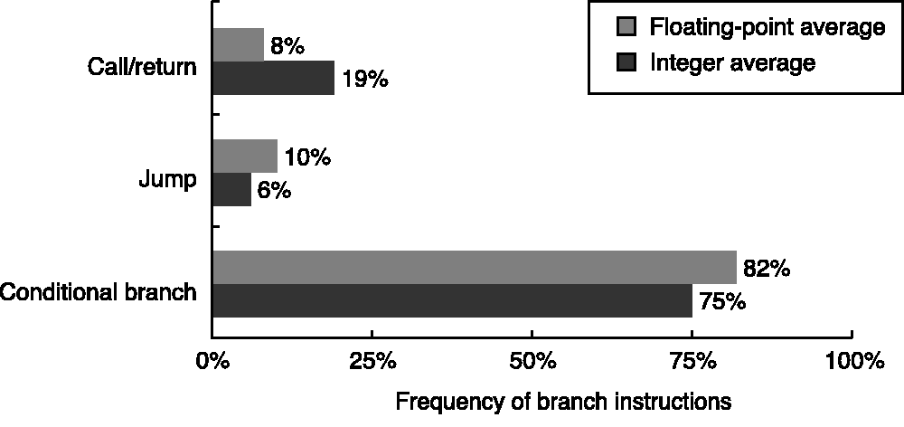
Instructions for Control Flow
Four basic types:
  Conditional branches
  Jumps (unconditional)
  Procedure calls
  Procedure returns
SPEC CPU2000 on Alpha

Slide 21
Addressing Modes for Control Flow
PC-relative (PC + displacement)
  Target is known at compile time.
  Position independence (relocatable)
Register indirect jumps (register has address)
  Procedure returns
  Case / switch statements
  Virtual functions or methods
  High-order functions or function pointers
  Dynamically shared libraries

Slide 22
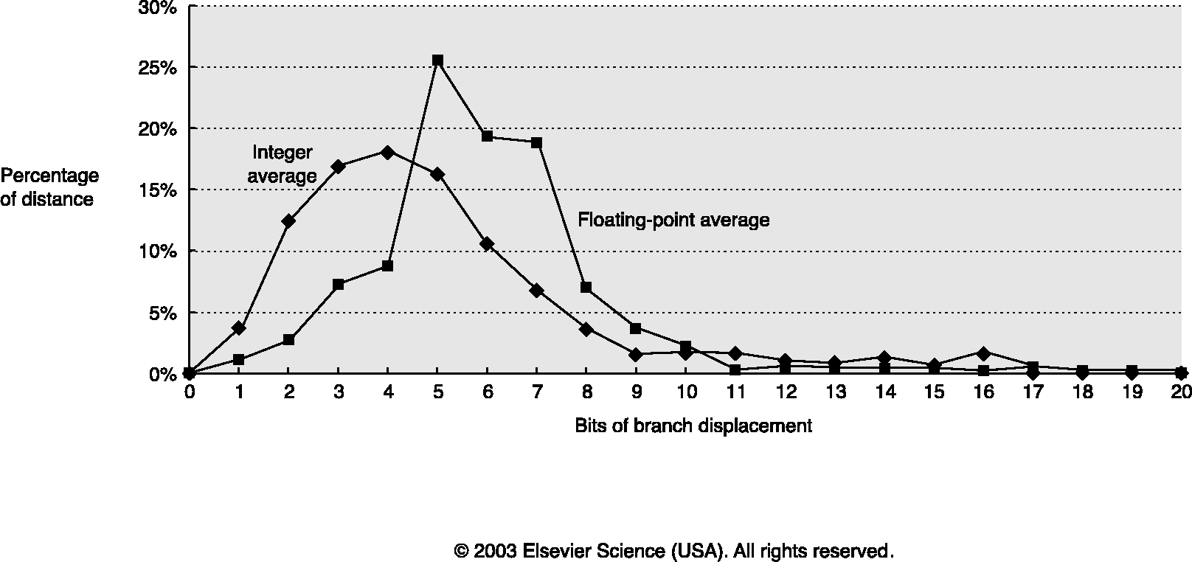
Branch Distance Distribution
SPEC CPU2000 on Alpha
© 2003 Elsevier Science (USA). All rights reserved.

Slide 23
Conditional Branch Options
Condition Code (CC) Register
  For example: X86, ARM, PowerPC, SPARC, …
  ALU operations set condition code flags in the CCR
  Branch just checks the flag
Condition register
  For example: Alpha, MIPS
  Comparison instruction puts result in a GPR
  Branch instruction checks the register
Compare & Branch
  For example: PA-RISC, VAX
  Compare & branch in 1 instruction.

Slide 24
Procedure Calling Conventions
Two major calling conventions:
  Caller saves:
    Before the call, procedure caller saves registers that will be needed later, even if callee did not use them
  Callee saves:
    Inside the call, called procedure saves registers that it will overwrite
    Can be more efficient if many small procedures
Many architectures use a combination of both
  For example, MIPS: Some registers caller-saves, some callee-saves for optimal performance.

Slide 25
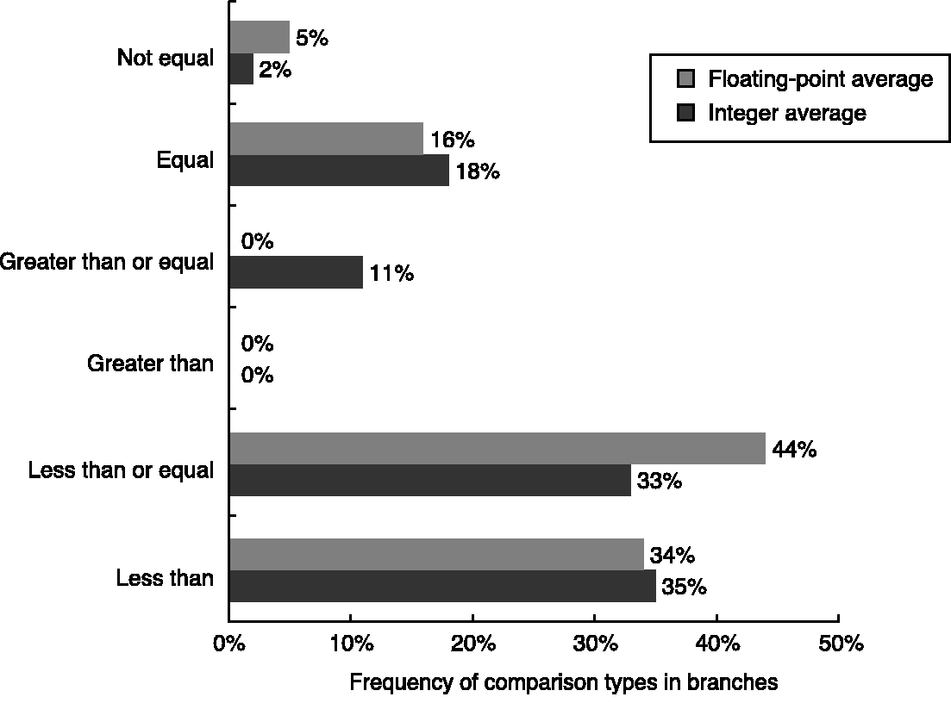
Branch Comparison Types
SPEC CPU2000 on Alpha

Slide 26
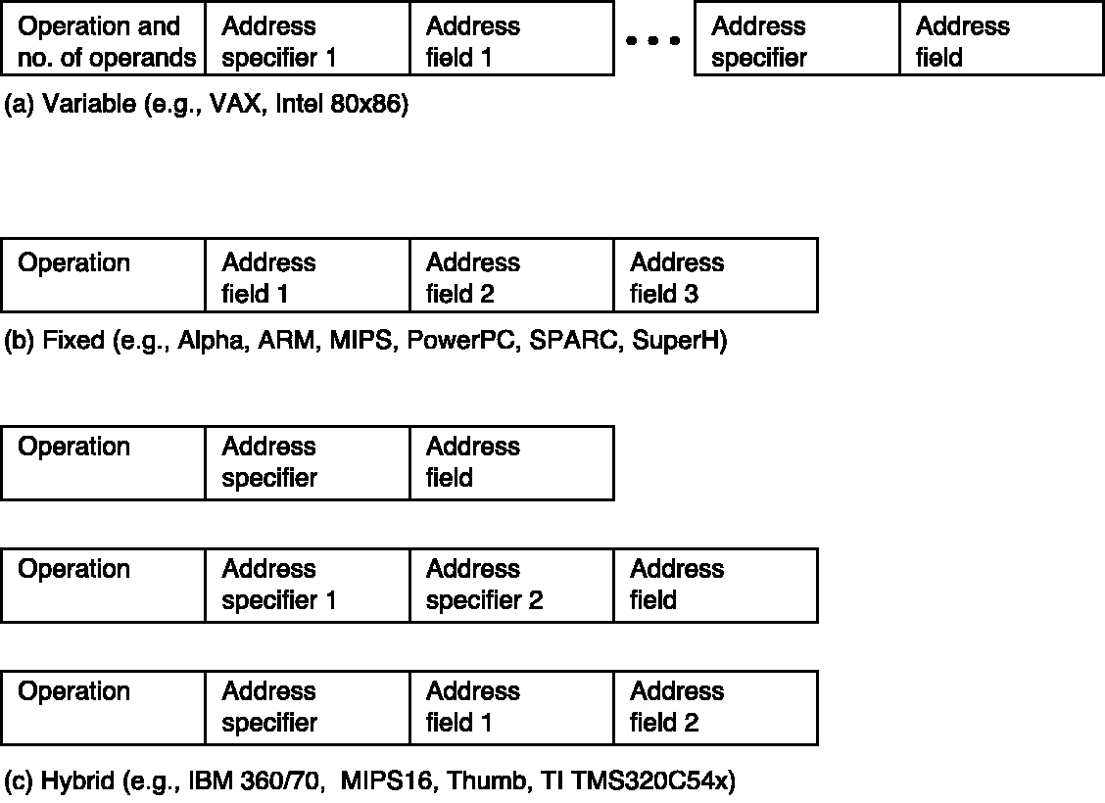
Encoding An Instruction Set
Reduced code size in RISCs
© 2003 Elsevier Science (USA). All rights reserved.

Slide 27
Role of Compiler
High-level language program (in C)
  swap (int v[], int k)
  (int temp;
  temp = v[k];
  v[k] = v[k+1];
  v[k+1] = temp;)
Assembly language program (for MIPS)
  swap: sll $2, $5, 2
  add $2, $4,$2
  lw $15, 0($2)
  lw $16, 4($2)
  sw $16, 0($2)
  sw $15, 4($2)
  jr $31
Machine (object) code (for MIPS)
  000000 00000 00101 0001000010000000
  000000 00100 00010 0001000000100000
    . . .
C compiler
assembler
Notes:
For lecture:
Computer only understands zeros and ones – instructions of 0’s and 1’s.
Early programmers found representing machine instructions in a symbolic notation – assembly language
And developed programs that translate from assembler to machine code
Eventually, programmers found working even in assembler too tedious so migrated to higher-level languages and developed compilers that would translate from the higher-level languages to assembler
Higher-level languages
Allow the programmer to think in a more natural language
Improve programmer productivity – more understandable code that is easier to debug and validate
Improve program maintainability
Allow programmers to be independent of the computer on which they are developed (compilers and assemblers can translate high-level language programs to the binary instructions of any machine)
Emergence of optimizing compilers that produce very efficient assembly code optimized for the target machine

Slide 28
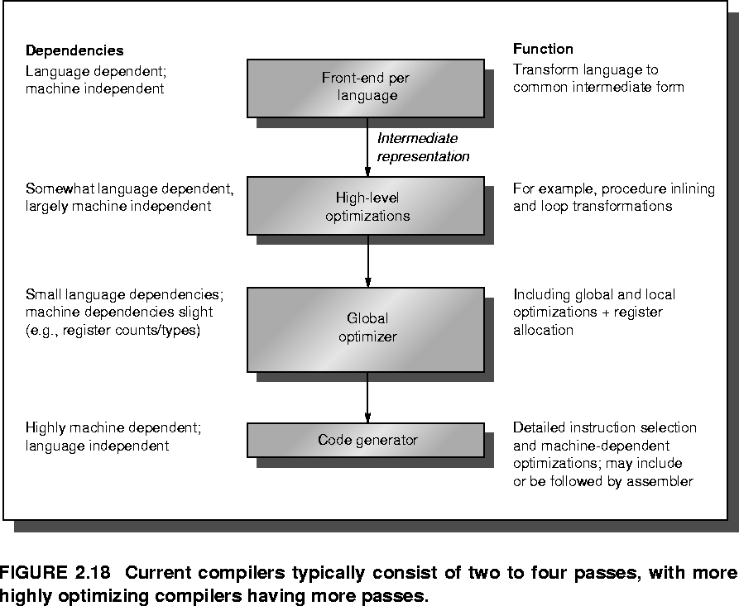
Compiler Structure

Slide 29
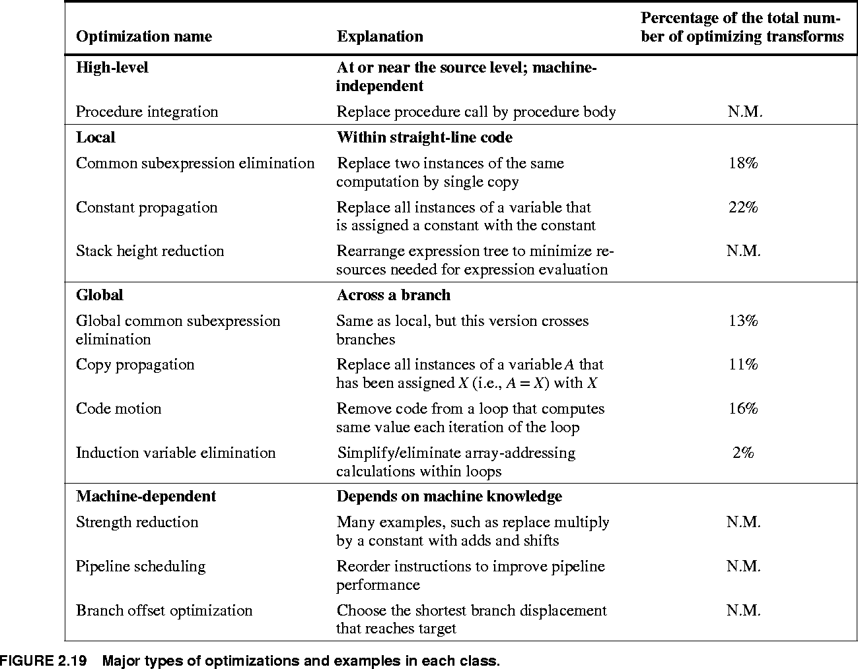
Compiler Optimizations
N.M. – Not Measured

Slide 30
Compiler Optimizations
N.M. – Not Measured

Slide 31
Phase Ordering Problem
It is difficult to decide the sequence of compiler steps to generate optimal code
Example: Consider interaction between two steps
  Common sub-expression elimination
    R = a + b – c + d x (g + b – c)
    Needs temporary to store the value
  Register allocation
    Assigning registers to variables and temporaries
    It is typically done towards the end.
  Depending on register pressure, it is profitable to recompute certain expressions than holding a register for long (generates memory spills).

Slide 32
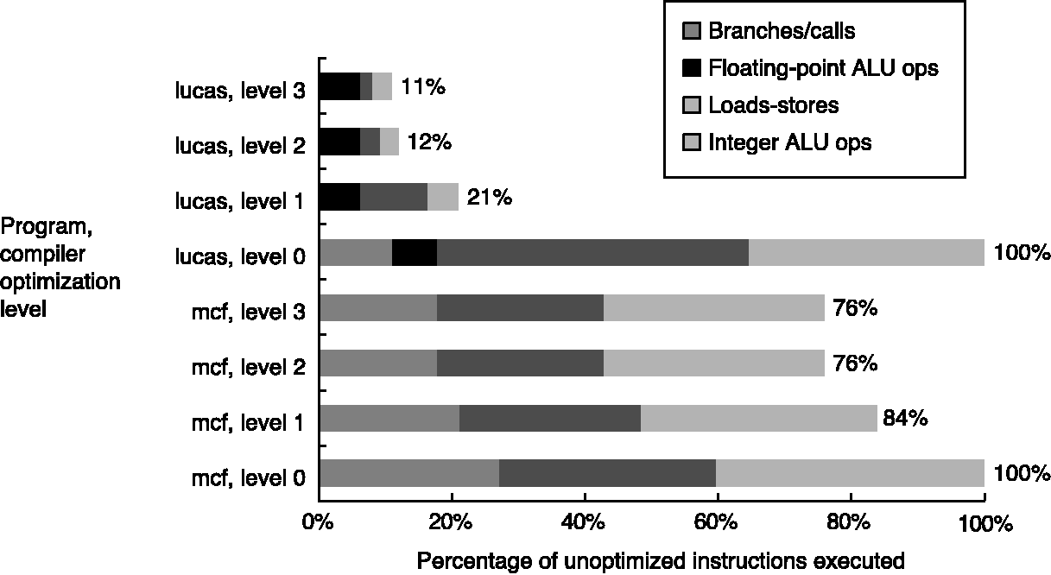
Effect of Compiler Optimization
© 2003 Elsevier Science (USA). All rights reserved.

Slide 33
Architectural Support for Compiler
Provide regularity
  Orthogonality (independence) of:
    Registers used
    Addressing modes
    Operations used
Provide primitives, not solutions
  Don’t directly support specific kernels or languages
Simplify trade-offs among alternatives
  Generate efficient code sequence at compile time
Don’t interpret values known at compile time

Slide 34
Putting It All Together
Use GPRs with load-store architecture
Support simple addressing modes
  Displacement (12-16), immediate (8-16), register indirect
Support basic types
  8-, 16-, 32-, 64-bit integers and 64-bit floats
Support most executed operations
  Load, store, add, subtract, move, and shift
  Compare equal/not equal/less, branch (PC-relative) with at least 8 bits, jump, call, and return
Instruction encoding based on goal
  Fixed encoding for performance and variable for code size.
Provide at least 16 GPRs, orthogonal instruction-set

Slide 35
The MIPS Architecture
RISC, load-store architecture
32-bit instructions, fixed format
32 64-bit GPRs, R0-R31.
  R0 is just a constant 0.
32 64-bit FPRs, F0-F31
  Can hold 32-bit floats also (with other ½ unused).
  “SIMD” extensions operate on more floats
A few special registers – e.g., FP status register
Load/store 8-, 16-, 32-, 64-bit integers
  All sign-extended to fill 64-bit GPR
  Also 32- bit floats/doubles

Slide 36
MIPS Addressing Modes
Supports four (using two) addressing modes
  Displacement (offset 16 bits for load/store)
    Register indirect: use 0 as displacement offset
    Direct (absolute): use R0 as displacement base
  Immediate (16 bits for arithmetic/logical ops)
Byte-addressed memory, 64-bit address
Software-settable big-endian/little-endian flag
Alignment required

Slide 37
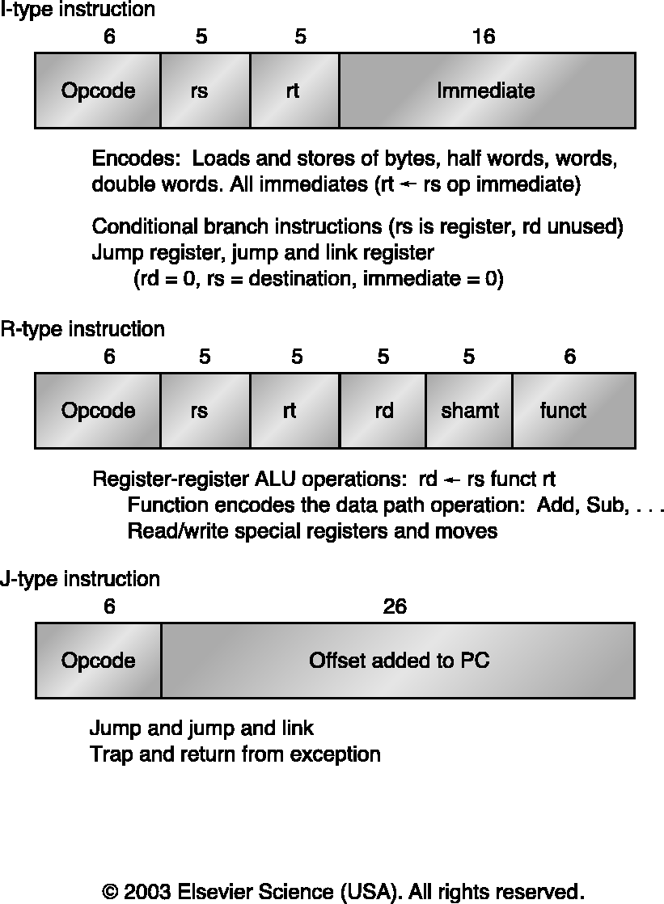
Instruction Format: I-type

Slide 38
Instruction Format: R-type

Slide 39
Instruction Format: J-type

Slide 40
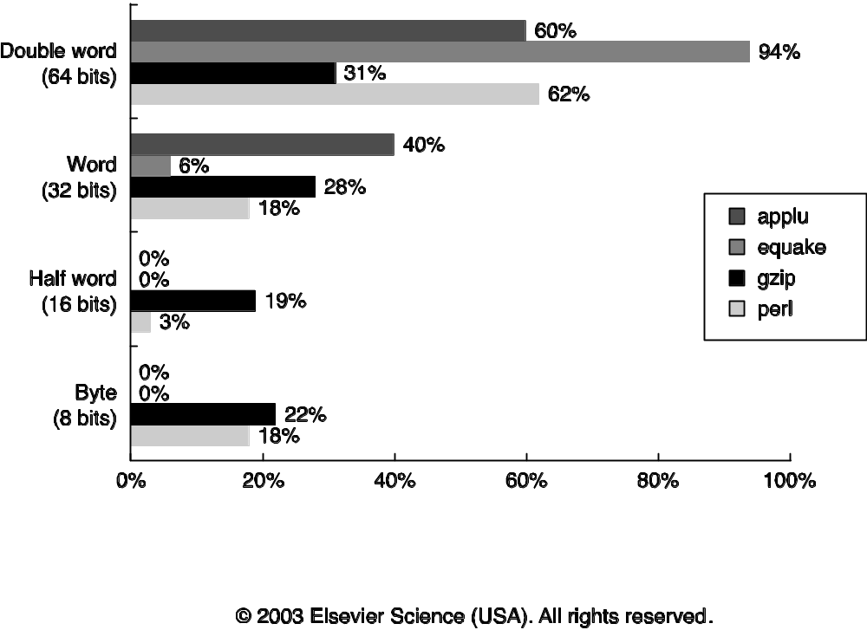
Fallacies and Pitfalls
Designing a “high-level” instruction set feature specifically oriented to supporting a high-level language structure.
  Too general for the most frequent case ➔ slow
There is such a thing as a typical program.

Slide 41
Fallacies and Pitfalls
Innovating at the instruction set architecture to reduce code size without accounting for the compiler.
  Architect struggles for 30-40%, compiler gets 2x
An architecture with flaws cannot be successful
  80x86: segmentation, extended accumulators for integers, and stack for floats, …
You can design a flawless architecture
  Avoiding flaws in the long run ➔ compromising efficiency in the short run

