Slide 1
Pipelining: Basic and Intermediate Concepts
Introduction
The Major Hurdle of Pipelining
  Pipeline Hazards
Implementation
Multi-cycle Operations
The MIPS R4000 Pipeline
Crosscutting Issues
  Scoreboarding
Conclusion
CDA 5155 – Spring 2012 Copyright © 2012 Prabhat Mishra

Slide 2
Introduction
In early CPUs, deep combinational logic networks were used between state updates.
  Signal delays may vary widely across paths.
  New input cannot be provided to the network until the slowest paths have finished.
  Slow clock speed, slow processing rates.
Logic Gate

Slide 3
Introduction
In pipelined design, logic networks are divided into shallow slices (pipeline stages).
  Delays through the network are made uniform.
  A new input can be provided to each slice as soon as its quick, shallow network has finished.
  Clock cycle is only as long as the slowest stage.

Slide 4
Pipelining
Pipelining is an implementation technique whereby multiple instructions are overlapped in execution
  Takes advantage of parallelism that exists among the actions needed to execute an instruction
    fetch instruction from memory
    decode to figure out what to do
    read source operands
    execute
    write results

Slide 5
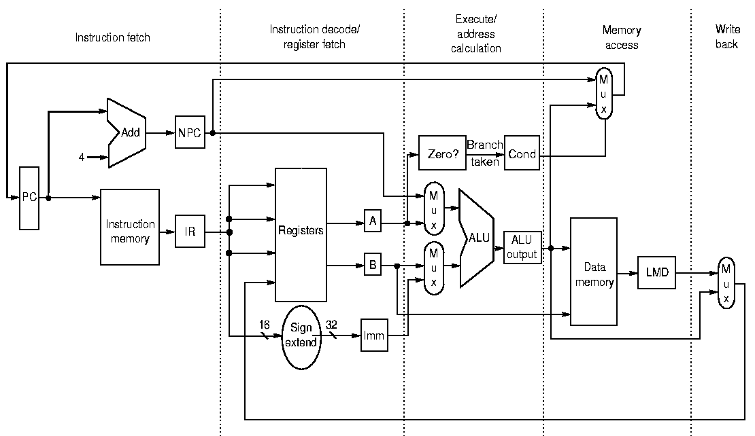
Simple RISC Datapath
IF
ID
EX
MEM
WB
Next PC
Load
fr. Mem.
Data
Program
Counter
Inst.
Reg.

Slide 6
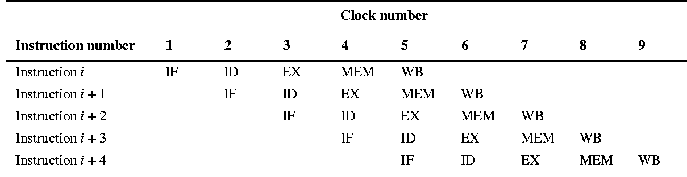
Basic RISC Pipelining
Basic idea:
  Each instruction spends 1 clock cycle in each of the 5 execution stages.
  During 1 clock cycle, the pipeline can process (in different stages) 5 different instructions.

Slide 7
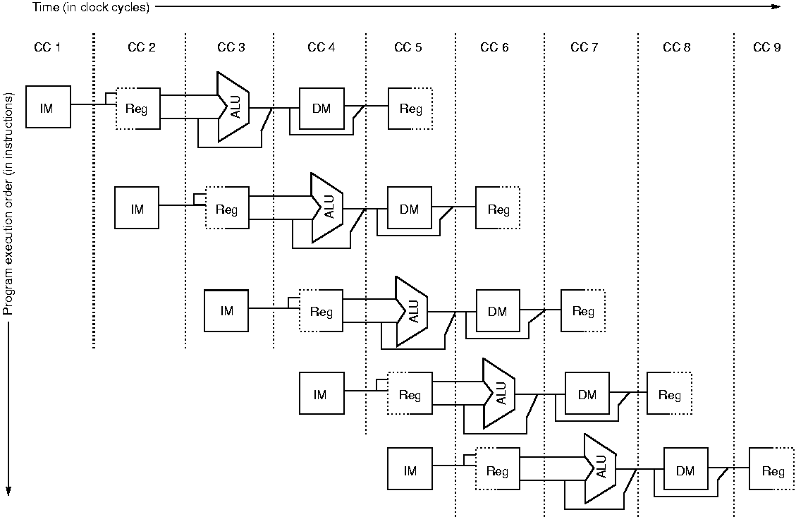
Alternative Visualization

Slide 8
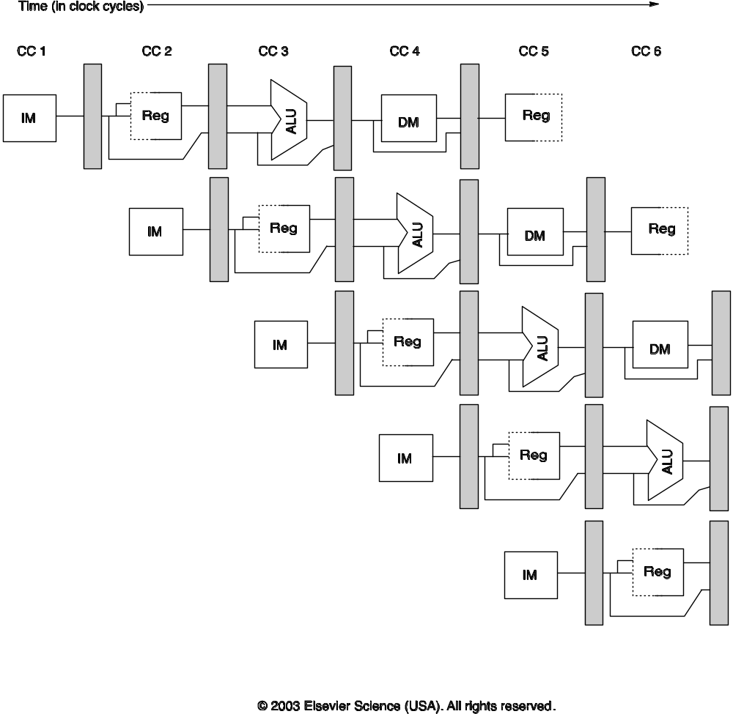
Visualization with Pipeline Registers

Slide 9
Limits of Pipelining
Increasing the number of pipeline stages in a given logic block by a factor of n
  Generally allows increasing clock speed and throughput by a factor of almost n.
  Usually less than n because of overheads such as latches and balance of delay in each stage.
But, pipelining has a natural limit:
  At least 1 layer of logic gates per pipeline stage.
  Practical minimum is usually several gates (2-10).
  Commercial designs are rapidly nearing this point.

Slide 10

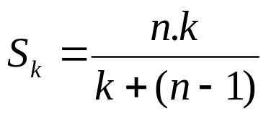


Few Related Terms
Clock Period
  τ = Max { time delay of a stage }₁^{k} + other delay (e.g., skew, latch delay)
Frequency
  Reciprocal of the clock period
Speedup
  k stage pipeline, n instructions
  ➔ k when n >> k.
Efficiency
  Ratio of its actual speedup to the ideal speedup
Throughput
  Number of instructions that can be completed per unit time.

Slide 11
Beyond Pipelining
There are some problems with clocked logic
  High power dissipation for clock signal distribution throughout chip
    up to 40% or more of total power
  Clock signal timing differences (clock skew) between different portions of chip
    Can be significant, interfere with proper execution
  Each clock cycle can only be as fast as the worst-case delay over all pipeline stages in the entire design.
    Many results end up waiting when they don’t need to.
An alternative
  Self-timed logic, Asynchronous logic, Dataflow circuits
  Each logic block uses explicit “handshaking” signals
  Globally asynchronous locally synchronous (GALS)

Slide 12
Outline
Introduction
The Major Hurdle of Pipelining
Implementation
Multi-cycle Operations
The MIPS R4000 Pipeline
Crosscutting Issues
Conclusion

Slide 13
Pipeline Hazards
Hazards are circumstances which may lead to stalls (delays, “bubbles”) in the pipeline if not addressed.
Three major types:
  Structural hazards:
    Not enough HW resources to keep all instrs. moving.
  Data hazards
    Data results of earlier instructions not available yet.
  Control hazards
    Control decisions resulting from earlier instr. (branches) not yet made; don’t know which new instr. to execute.

Slide 14
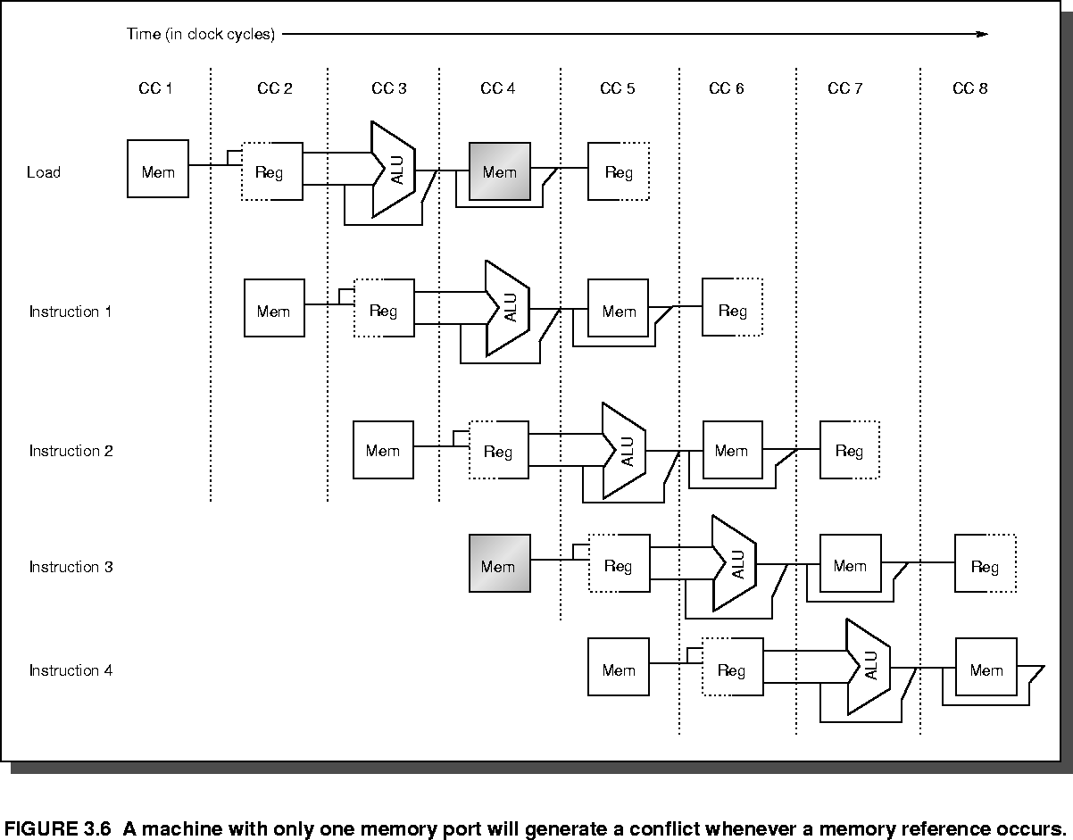
Structural Hazard Example
The processor has a combined instruction+data memory with only 1 read port

Slide 15
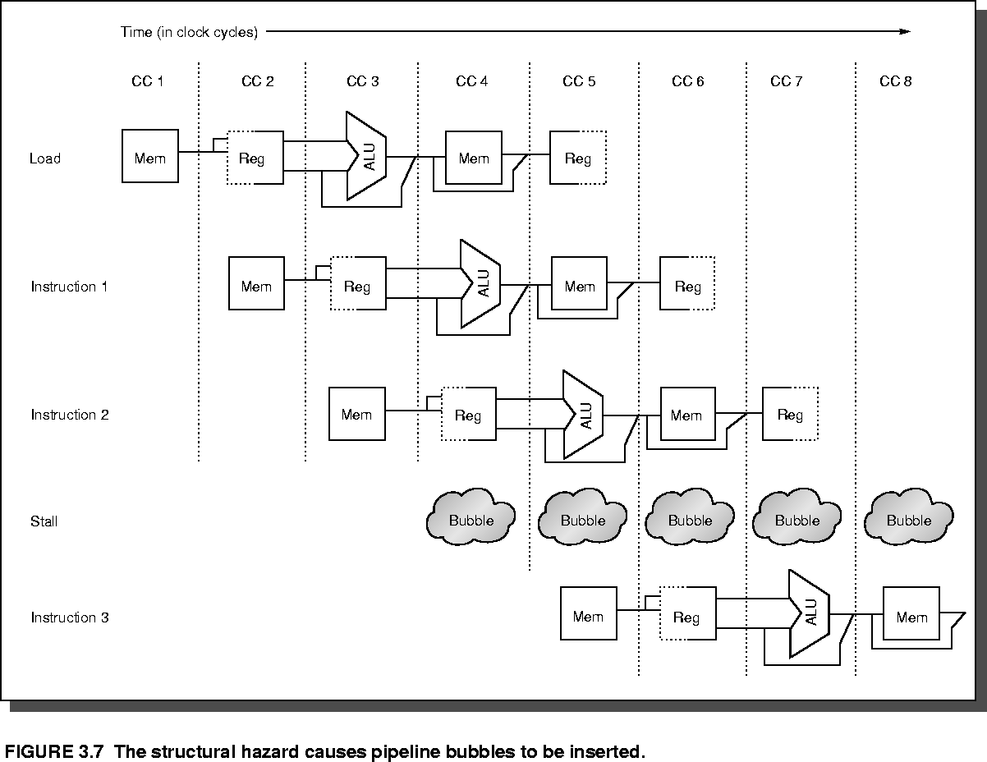
Hazards Produce “Bubbles”

Slide 16
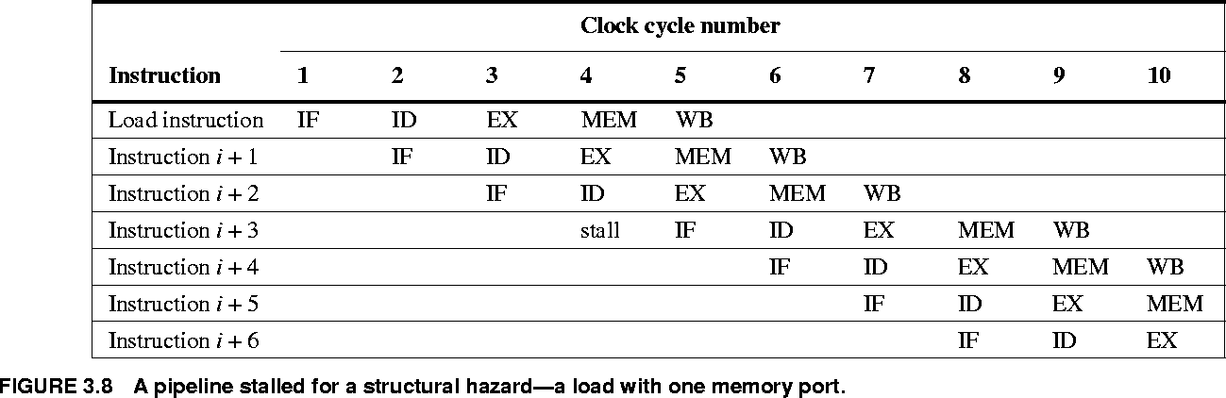
Textual View
A pipeline stalled for a structural hazard – a load with only one memory port

Slide 17
Three Types of Data Hazards
Let i be an earlier instruction, j a later one.
RAW (read after write)
  j tries to read a value before i writes it
WAW (write after write)
  i and j write to same place, but in the wrong order.
  Only occurs if more than 1 pipeline stage can write
WAR (write after read)
  j writes a new value to a location before i has read the old one.
  Only occurs if writes can happen before reads in pipeline (in-order).

Slide 18
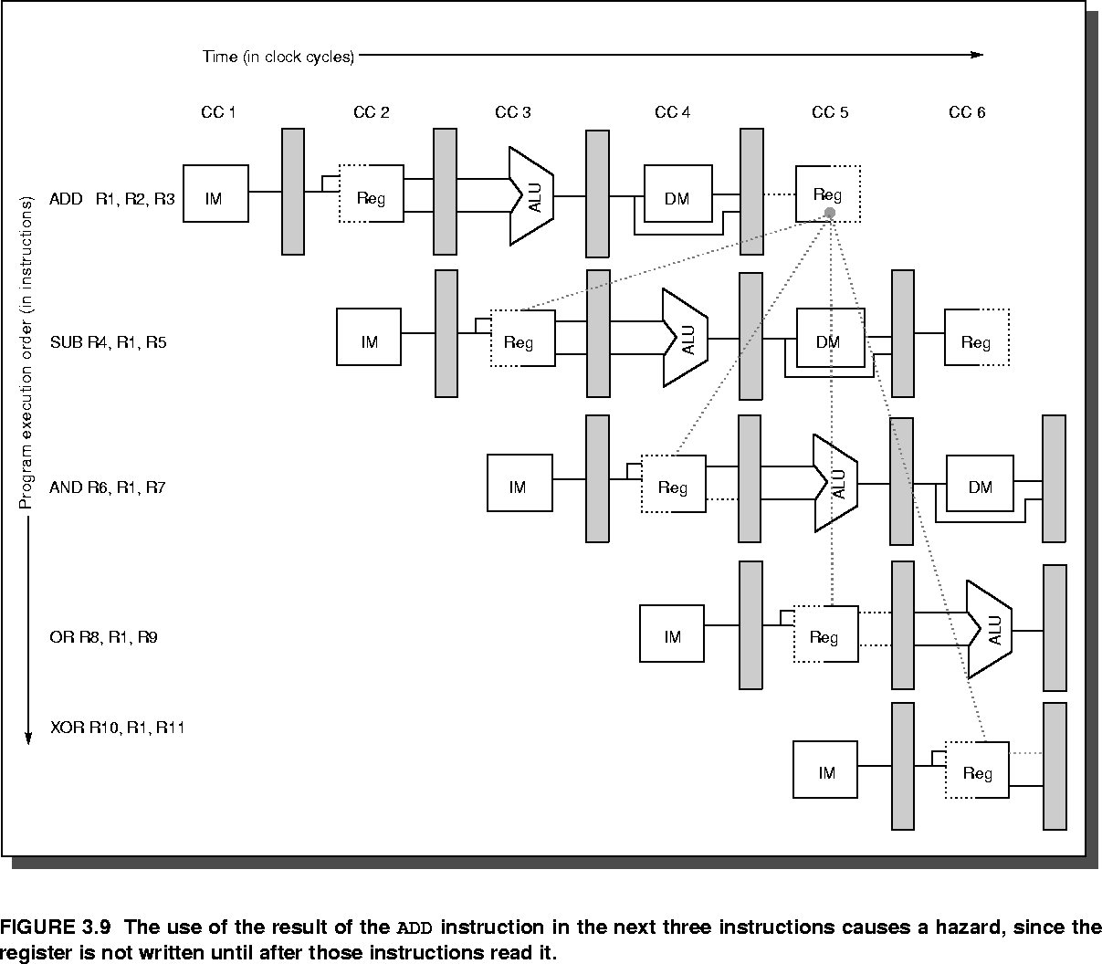
Data Hazard Example

Slide 19
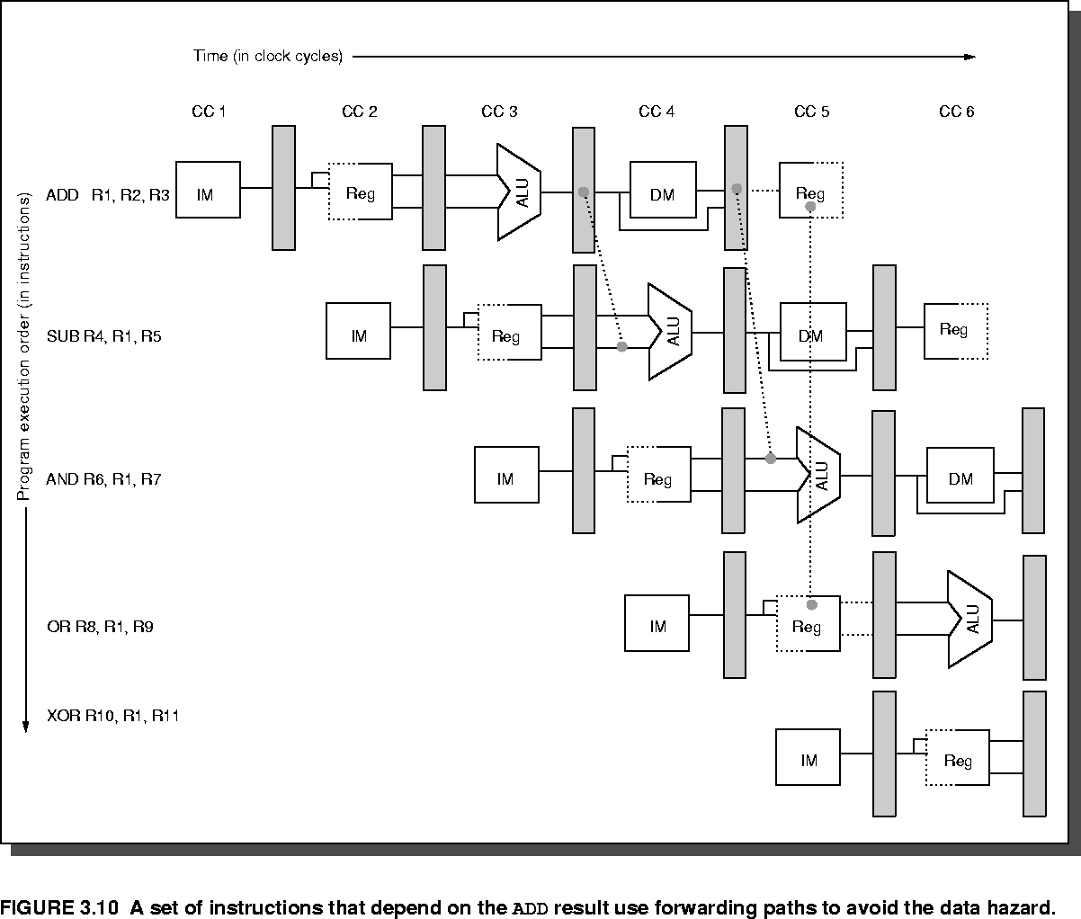
Forwarding for Data Hazards

Slide 20
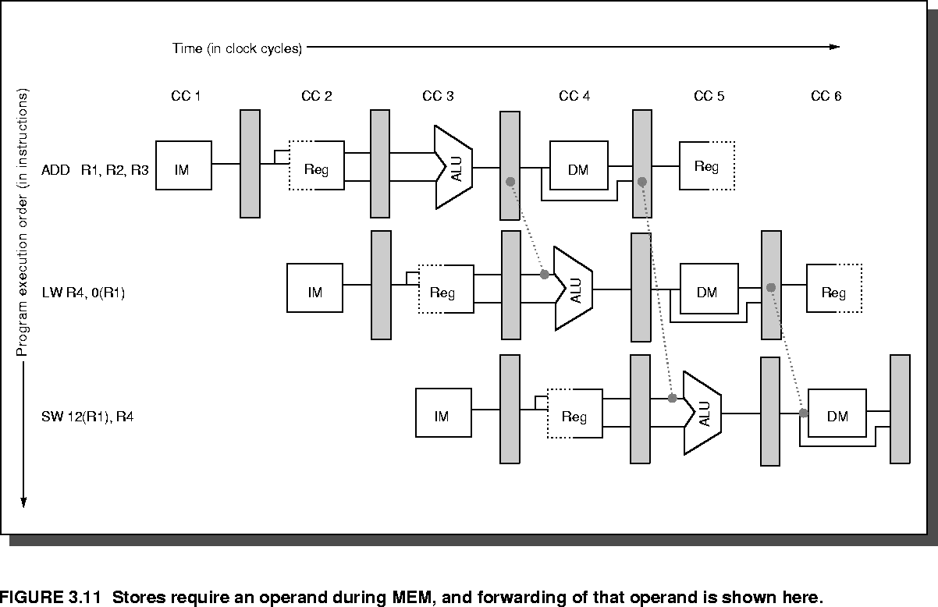
Another Forwarding Example

Slide 21
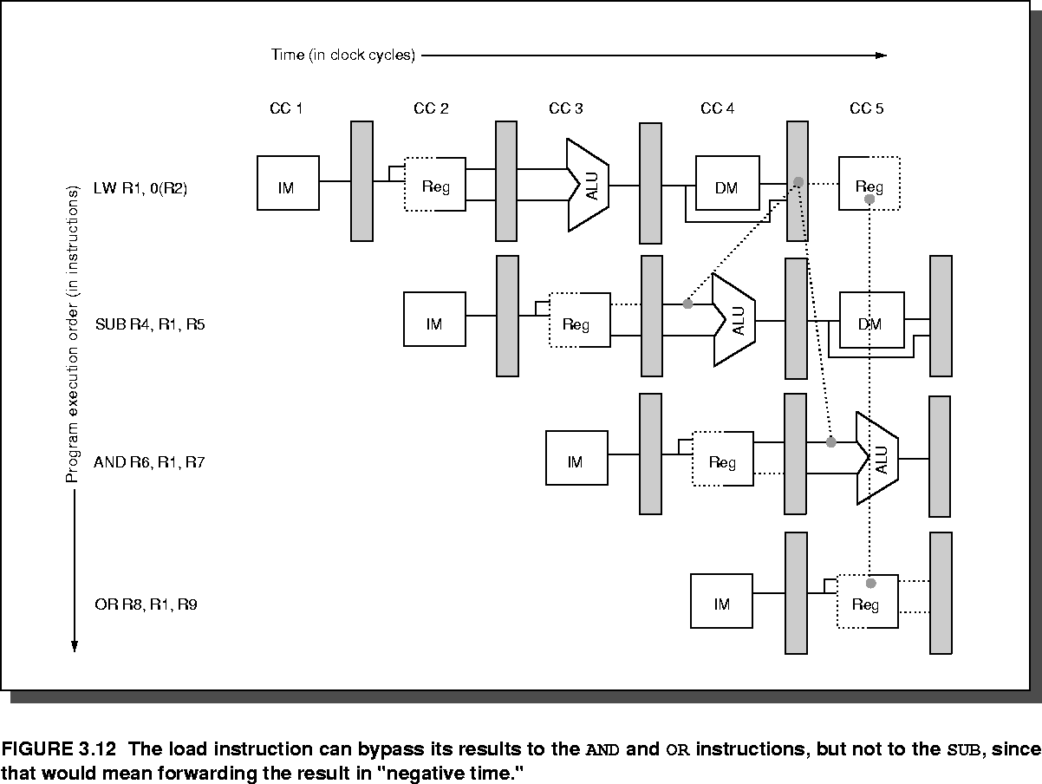
An Unavoidable Stall

Slide 22
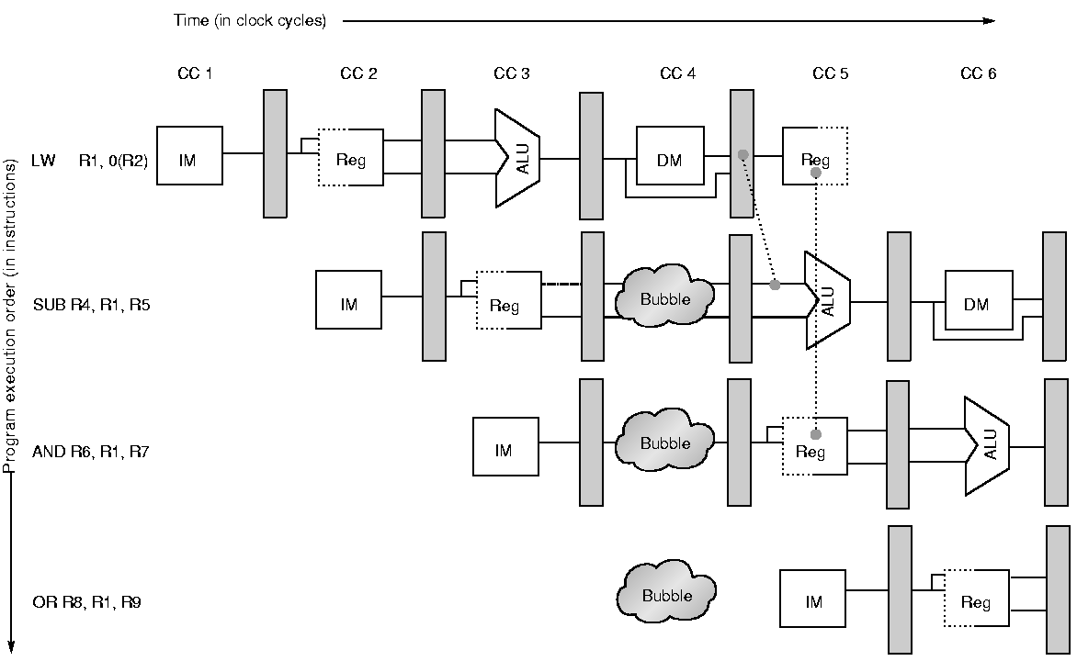
Stalling in midst of instruction

Slide 23
Data Hazard Prevention
A clever compiler can often reschedule instructions to avoid a stall.
  A simple example:
    Original code:
    lw r2, 0(r4)
    add r1, r2, r3 ← Stall happens here.
    lw r5, 4(r4)
    Transformed code:
    lw r2, 0(r4)
    lw r5, 4(r4)
    add r1, r2, r3 ← No stall needed.

Slide 24
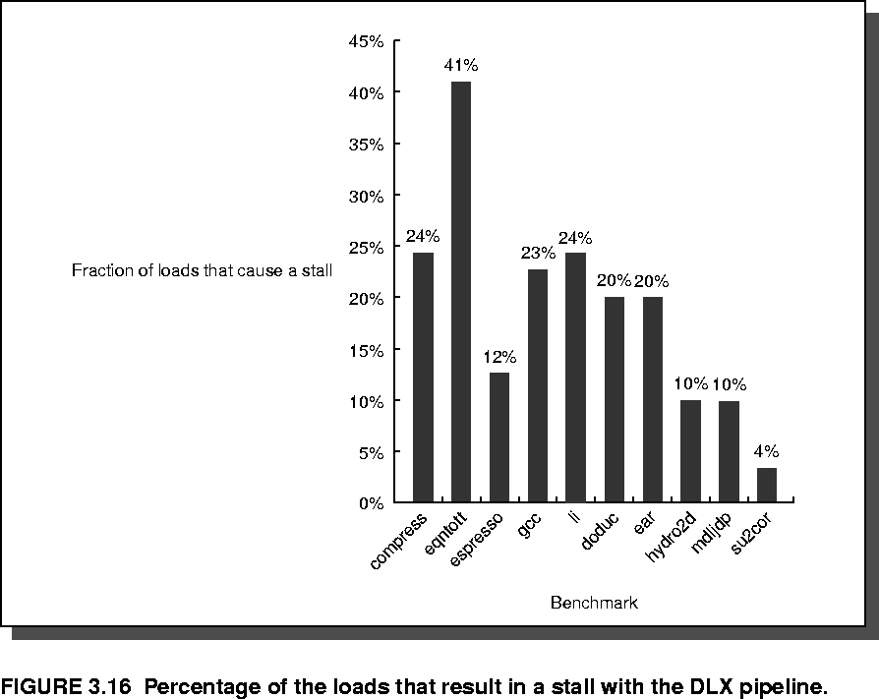
Simple RISC Pipeline Stall Statistics
% of loads that cause a stall

Slide 25
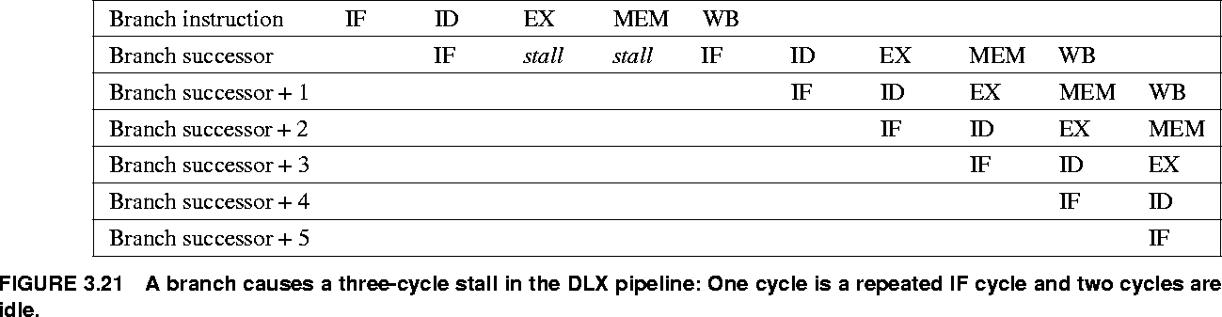
Control (Branch) Hazards
Suppose the new PC value is not computed until the MEM stage.
Then we must stall 3 clocks after every branch!

Slide 26
Performance of Pipelines with Stalls
Speedup
  Avg. inst. time (unpipelined) / Avg. inst. time (pipelined)
  …
  CPI unpipelined / CPI pipelined
  …
  Pipeline Depth / (1 + Pipeline stall cycles per instruction)
  Pipeline Depth / (1 + Branch frequency x Branch penalty)

Slide 27
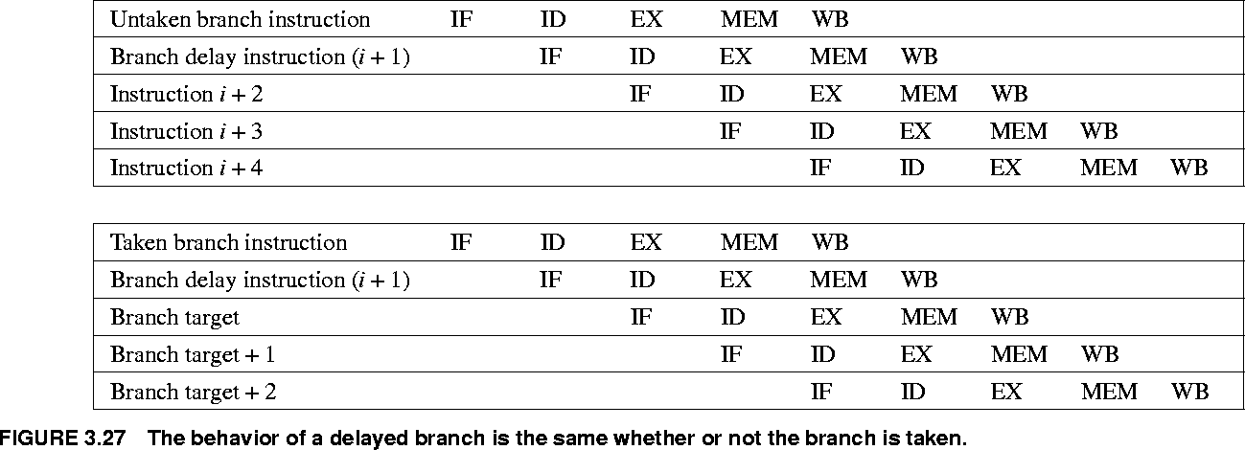
Delayed Branches
Machine code sequence:
Branch instruction
Delay slot instruction(s)
Post-branch instructions
Branch is taken
(if taken) at this point

Slide 28
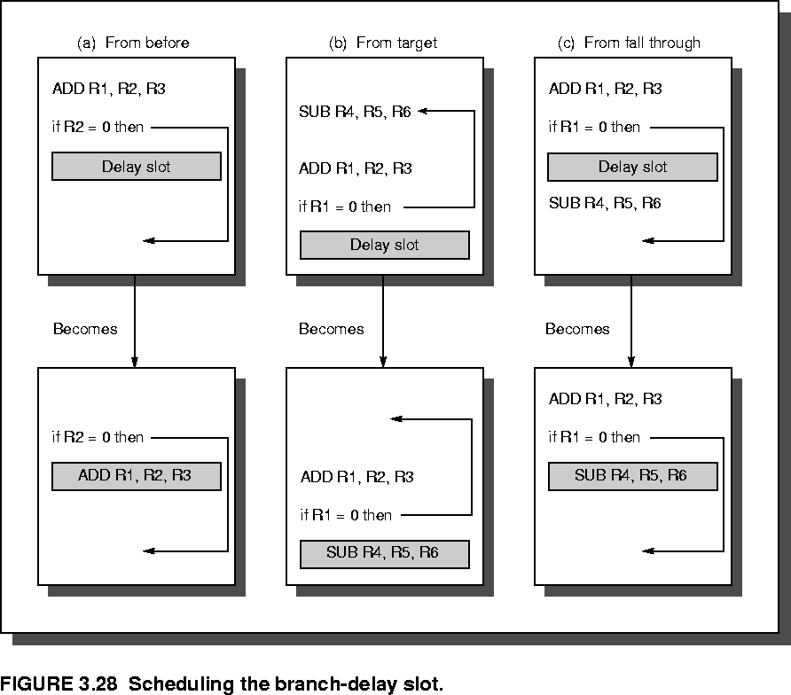
Scheduling the Branch-Delay Slot

Slide 29
Outline
Introduction
The Major Hurdle of Pipelining
Implementation
Multi-cycle Operations
The MIPS R4000 Pipeline
Crosscutting Issues
Conclusion

Slide 30
Simple RISC Datapath
IF
ID
EX
MEM
WB
Next PC
Load
fr. Mem.
Data
Program
Counter
Inst.
Reg.

Slide 31
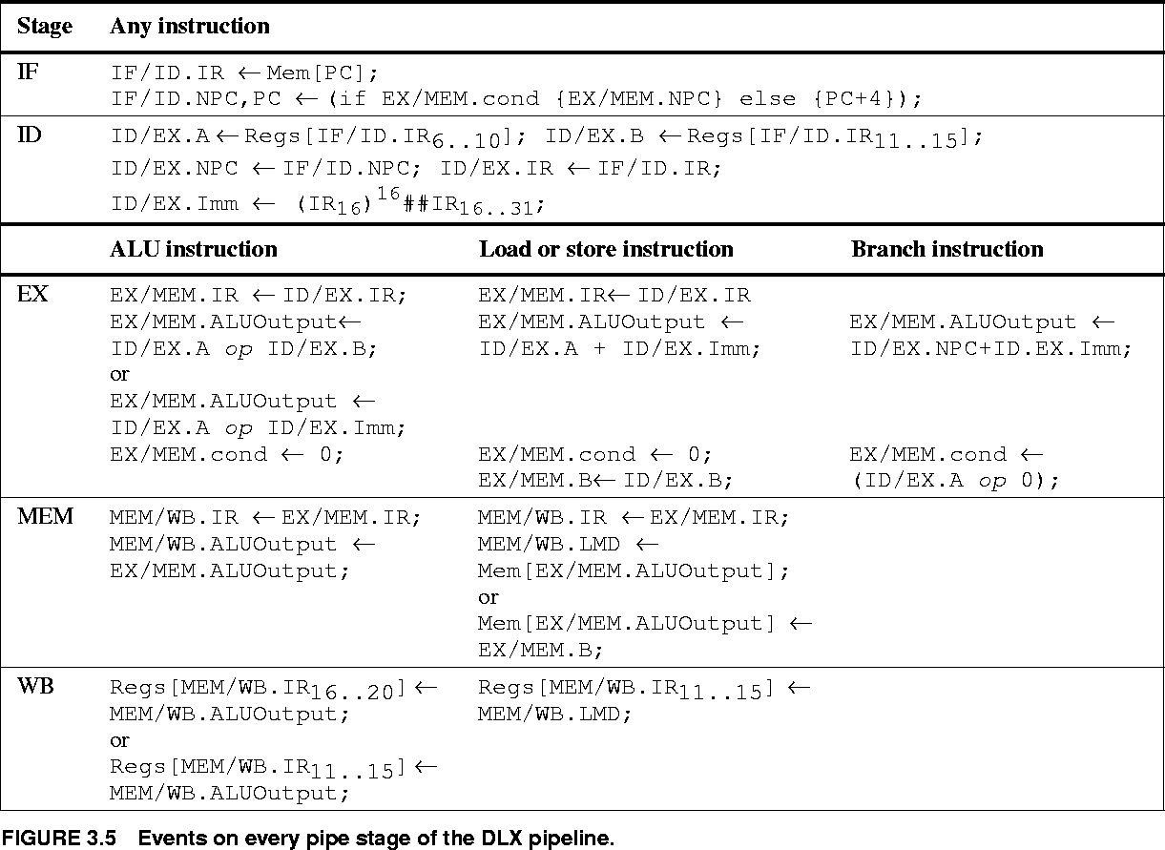
Description of Pipe Stages

Slide 32
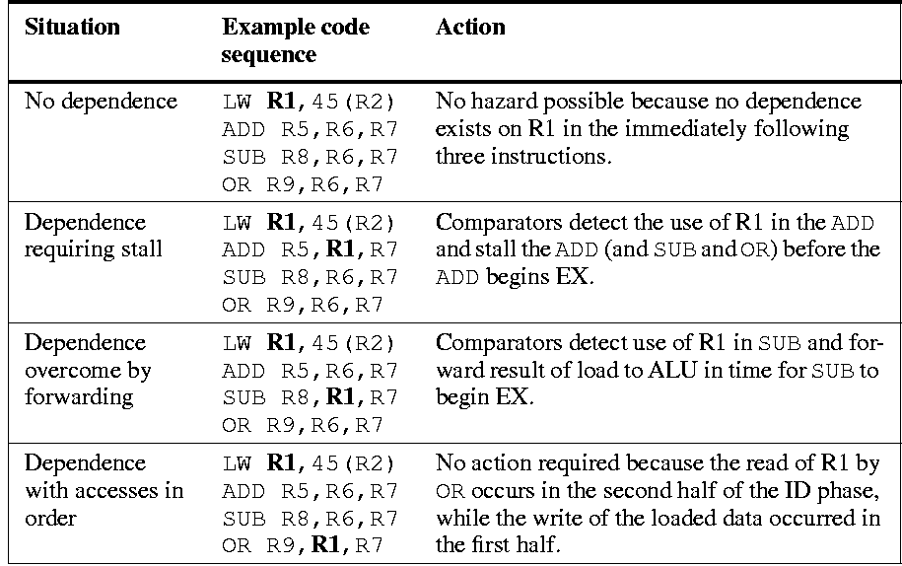
Data Hazard Detection

Slide 33
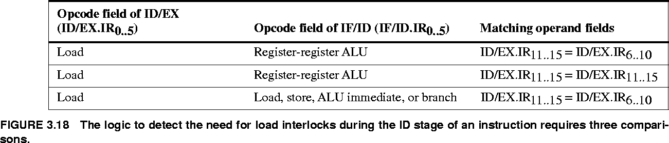
Hazard Detection Logic
Example: Detecting whether an instruction that has just been fetched needs to be stalled because of a preceding load.
ID/EX.IR[rt] == IF/ID.IR[rs]
ID/EX.IR[rt] == IF/ID.IR[rt]
ID/EX.IR[rt] == IF/ID.IR[rs]

Slide 34
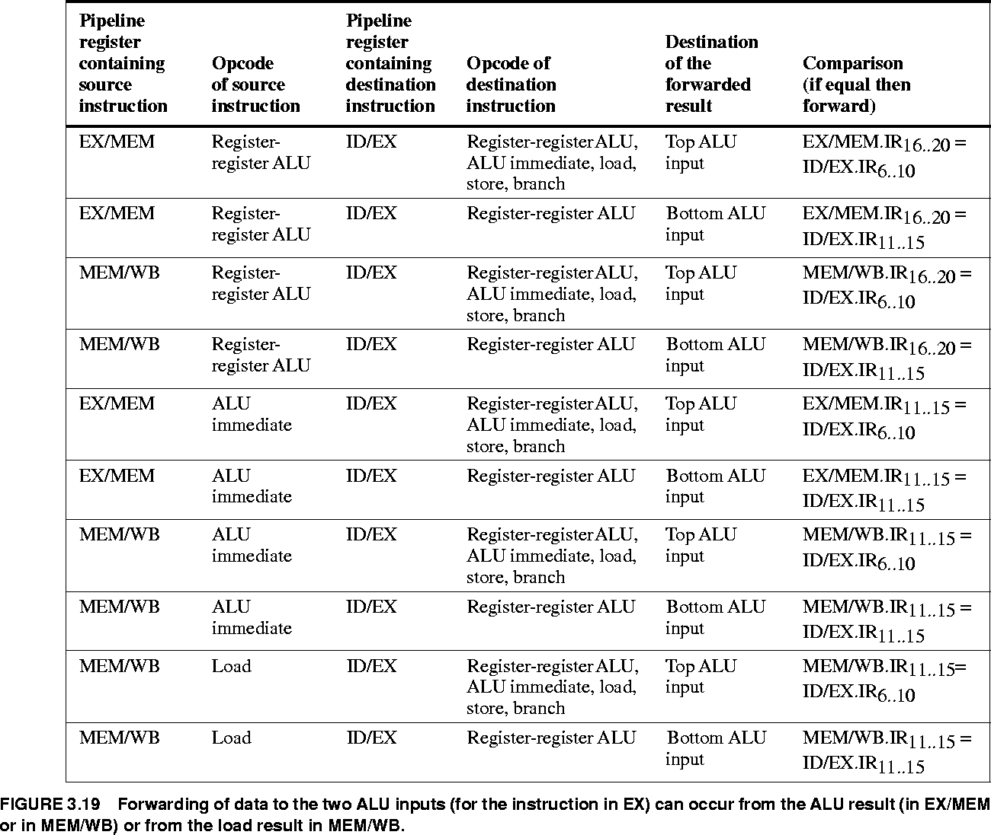
Forwarding Situations in DLX

Slide 35
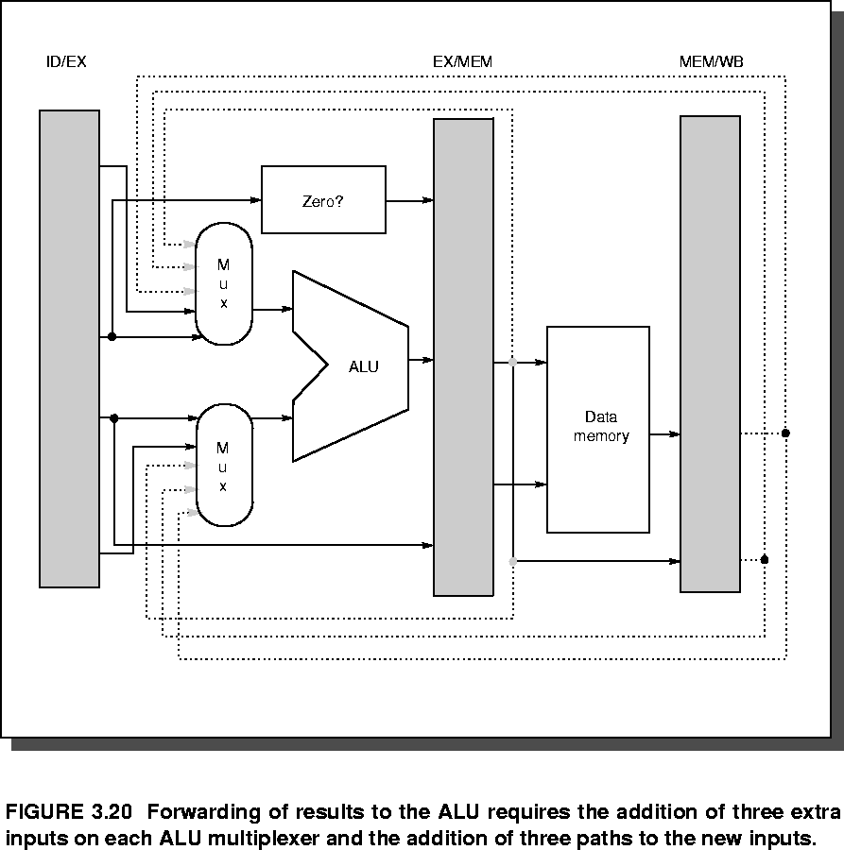
Implementing Forwarding in HW

Slide 36
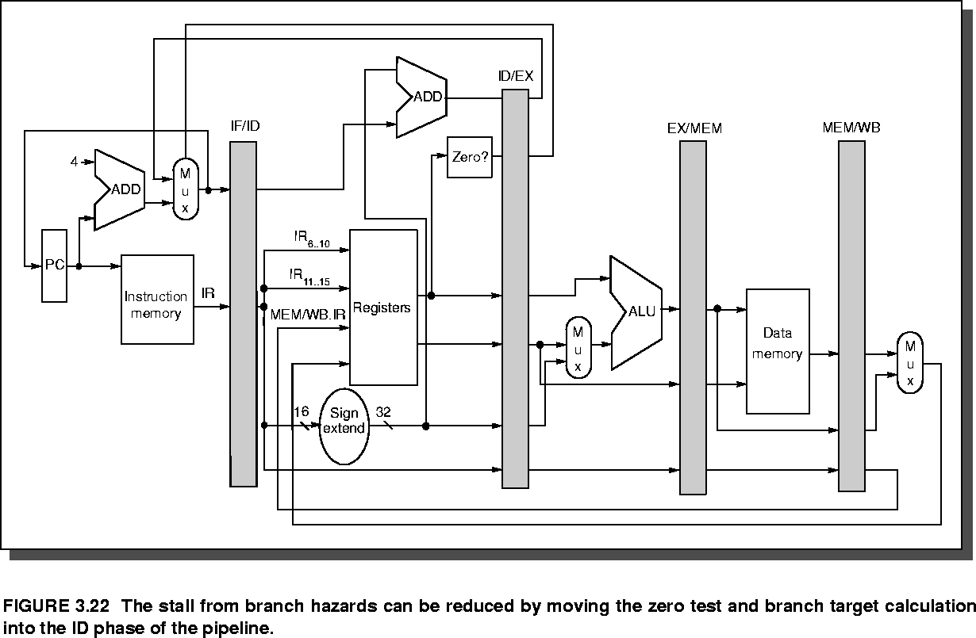
Early Branch Resolution

Slide 37
Original RISC Datapath
IF
ID
EX
MEM
WB
Next PC
Load
fr. Mem.
Data
Program
Counter
Inst.
Reg.

Slide 38
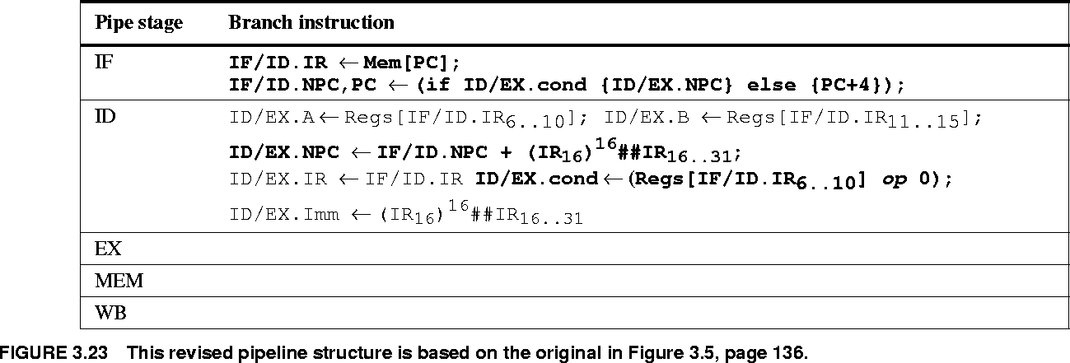
New Pipeline Logic

Slide 39
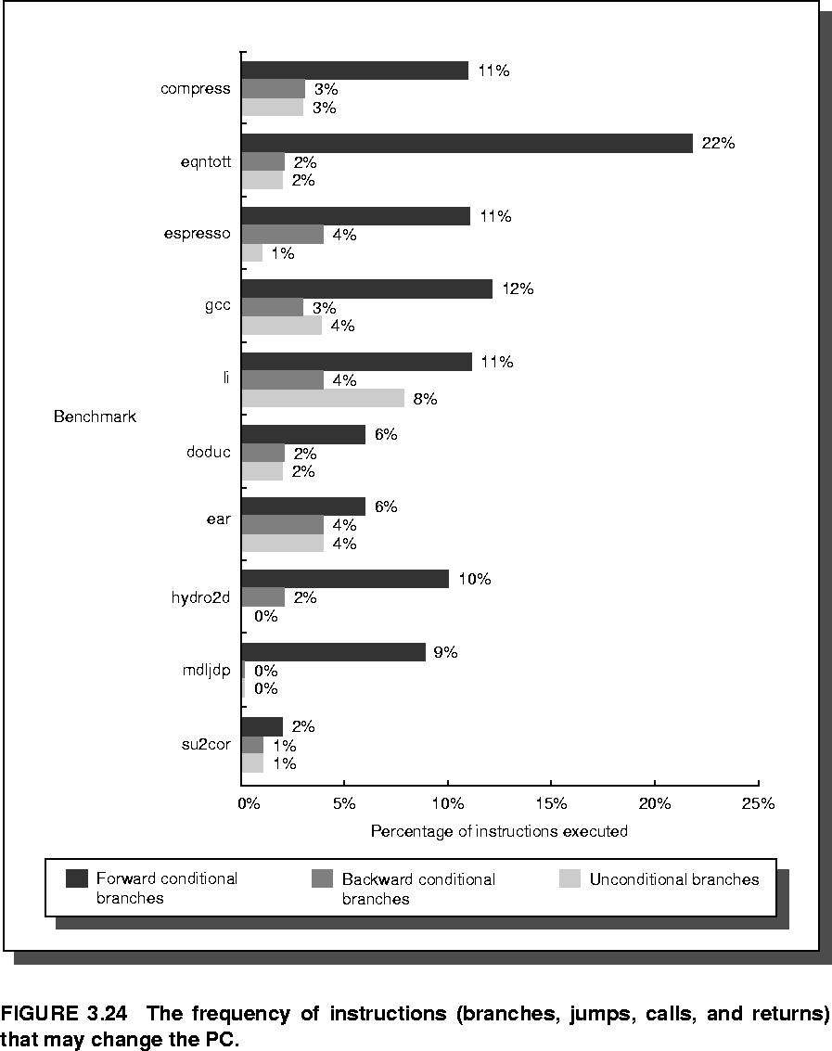
Control Instruction Statistics

Slide 40
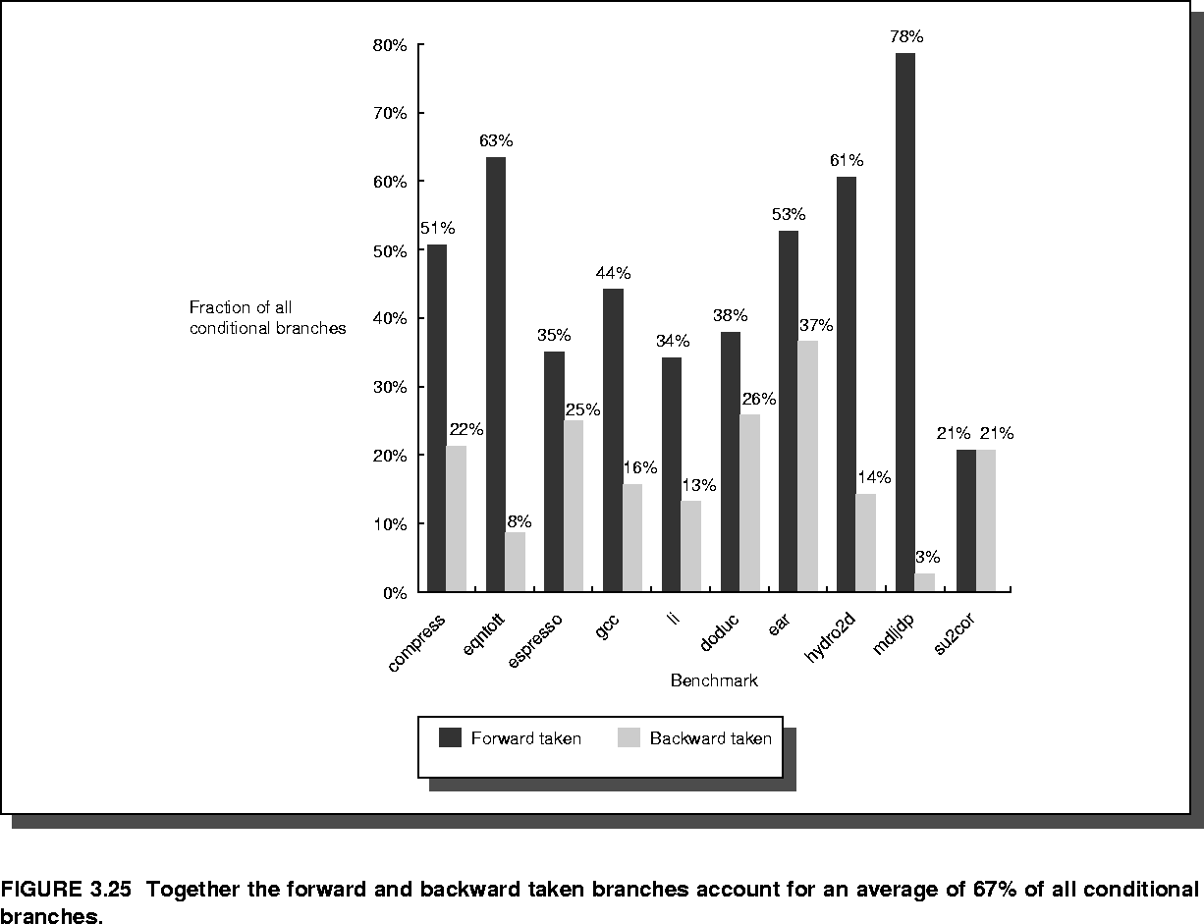
Statistics on Taken Branches

Slide 41
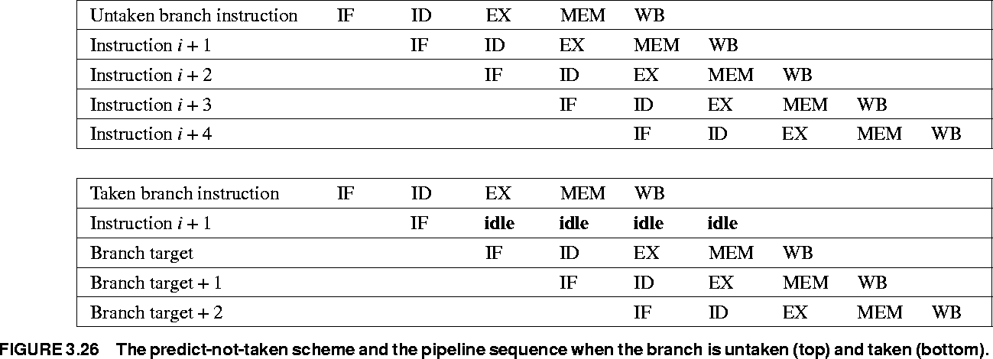
Predict-Not-Taken

Slide 42
Static Branch Prediction
Earlier we discussed predict-taken, predict-not-taken static prediction strategies
  Applied uniformly across all branches in program
Static analysis in compiler may be able to do better, if it can non-uniformly predict whether each specific branch is likely to be taken
  One way: backwards taken, forwards not taken.
If we can do better, it can help with static code scheduling to reduce data hazard stalls…
  Also may assist later dynamic prediction

Slide 43
Prediction Helps Static Scheduling
Some data dependences
LD R1,0(R2)
DSUBU R1,R1,R3
BEQZ R1,else
OR R4,R5,R6
DADDU R10,R4,E3
J after
else: DADDU R7,R8,R9
…
after:
Code
movements
to consider:
Potential load delay to fill
Which way will this
branch go?
If
case
If-then-else
control flow
Else
case

Slide 44
Some Static Prediction Schemes
Always predict taken
  34% mispredict rate on SPEC (range 9%-54%)
Backwards predict taken, forwards not taken
  In SPEC, more than ½ of forwards are taken!
    This does worse than “always predict taken” strategy
  Usu. not better than 30-40% misprediction rate
Better than either: Use profile information
  Collect statistics on earlier program runs.
  Works well because individual branches tend to be strongly biased (taken or not) given average data
    Bias remains stable across multiple runs

Slide 45
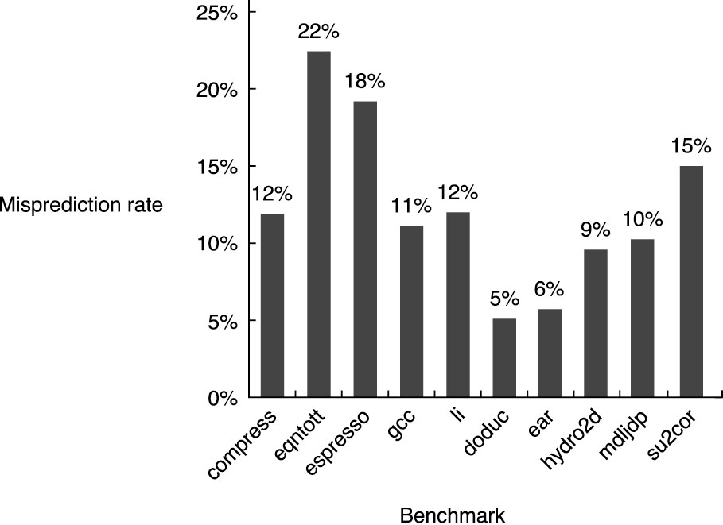
Profile-Based Predictor Statistics
Floating-Point

Slide 46
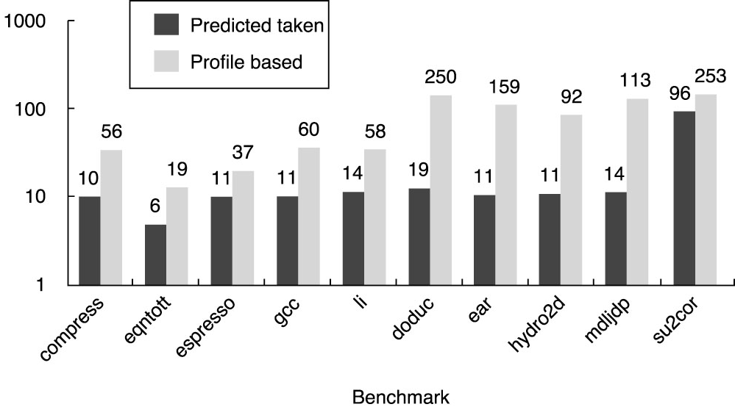
Predict-Taken vs. Profile-Based
Instructions between mis-predictions
Floating-point

Slide 47
Types of Exceptions (Interrupts, Faults)
I/O device request, timer event
Invoking OS services from a user program
Tracing (single-stepping) through program
Breakpoints
Integer arithmetic overflow, divide by zero
FP arithmetic anomaly (overflow, underflow, ∞, NaN, etc.)
Page fault (page not in physical memory)
Misaligned memory access
Memory-protection violation (acc. mem. not alloc’ed to proc.)
Illegal (undefined or unimplemented) instruction
Hardware malfunction
Power-related interrupt (e.g. battery low, power failure)

Slide 48
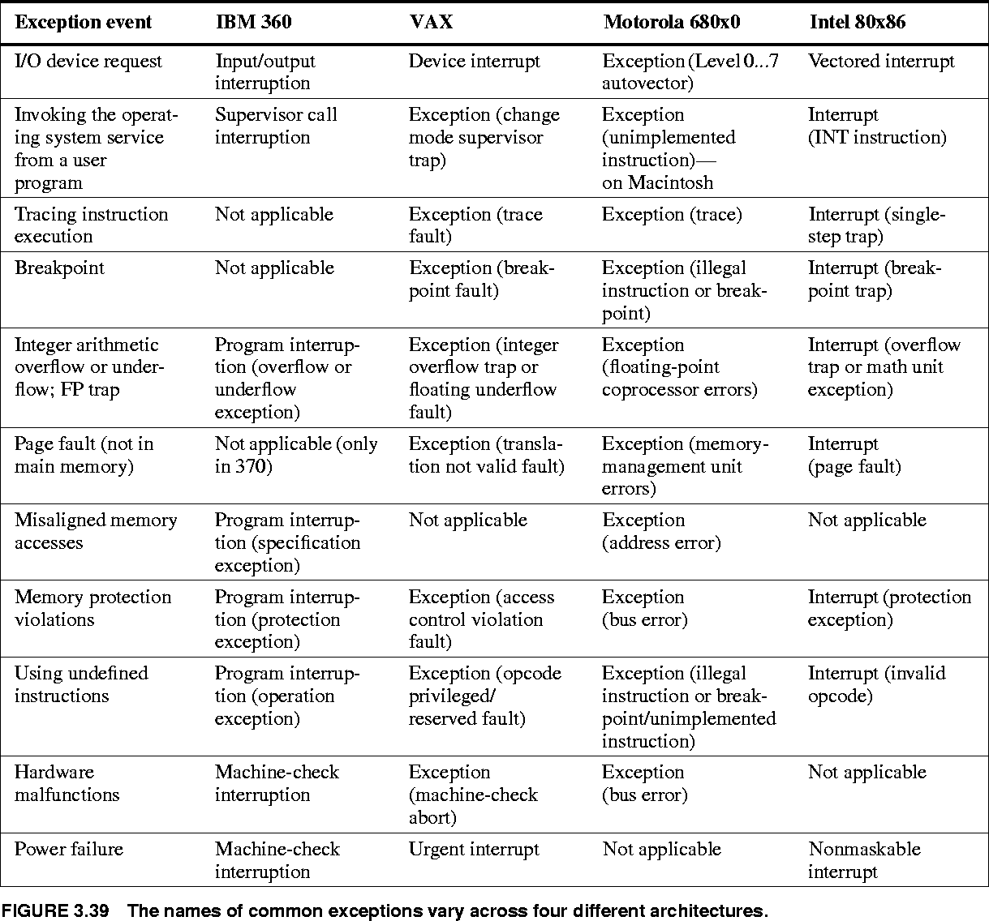
Terminology Across Architectures

Slide 49
Exception Categorizations
Synchronous vs. asynchronous
  Event synchronized with program execution?
User requested vs. coerced
  Event caused intentionally by user program?
User maskable (can be disabled) or not
  Can event be disabled?
Within instructions or between instructions
  Does event prevent instruction from completing?
Resume vs terminate
  Does the program continue from where it left off after exception is handled, or does it stop?

Slide 50
Restartable Exceptions
Requirements:
  Exception may occur within instruction.
  Program must continue after exception is handled.
Examples:
  Virtual memory page fault.
Difficult because:
  Pipeline state must be saved.
One approach, for easy cases:
  1. Force a trap inst. into pipeline on next IF.
  2. Clear pipeline behind faulting instruction.
  3. Exception handler saves PC of faulting instr.

Slide 51
Precise vs. Imprecise Handling
Machines may support either or both modes of exception handling:
  Precise exception handling:
    Correctly implement all possible combinations of exceptions in all circumstances.
    May be a requirement for some systems/applications.
    May be 10x slower!
    Easier for integer than floating-point.
    Useful for debugging code.
  Imprecise exception handling:
    Only correctly implement the most common cases.
    Software may avoid some exceptions.
    Only statistical guarantee of correctness, through testing.

Slide 52
Exceptions in MIPS pipeline
Instruction Fetch, & Memory stages
  Page fault on instruction/data fetch
  Misaligned memory access
  Memory-protection violation
Instruction Decode stage
  Undefined/illegal opcode
Execution stage
  Arithmetic exception
Write-Back stage
  None!

Slide 53
Out-of-Order Exceptions
Consider the following code sequence:
  LW IF ID EX MEM WB
  ADD IF ID EX MEM WB
The ADD may cause an exception during IF, before LW causes an exception during MEM!
  Can’t restart PC on the ADD!
Solution:
  Note the exception in a status vector, carried along.
  Disable writes for that instruction.
  Resolve all exceptions at a late stage (e.g. WB).

Slide 54
Outline
Introduction
The Major Hurdle of Pipelining
Implementation
Multi-cycle Operations
The MIPS R4000 Pipeline
Crosscutting Issues
Conclusion

Slide 55
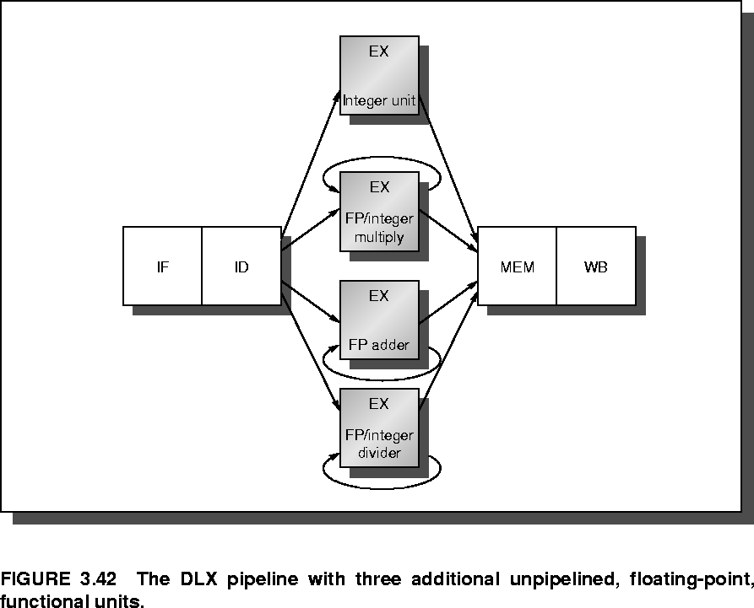
Multi-cycle Operations for FP

Slide 56
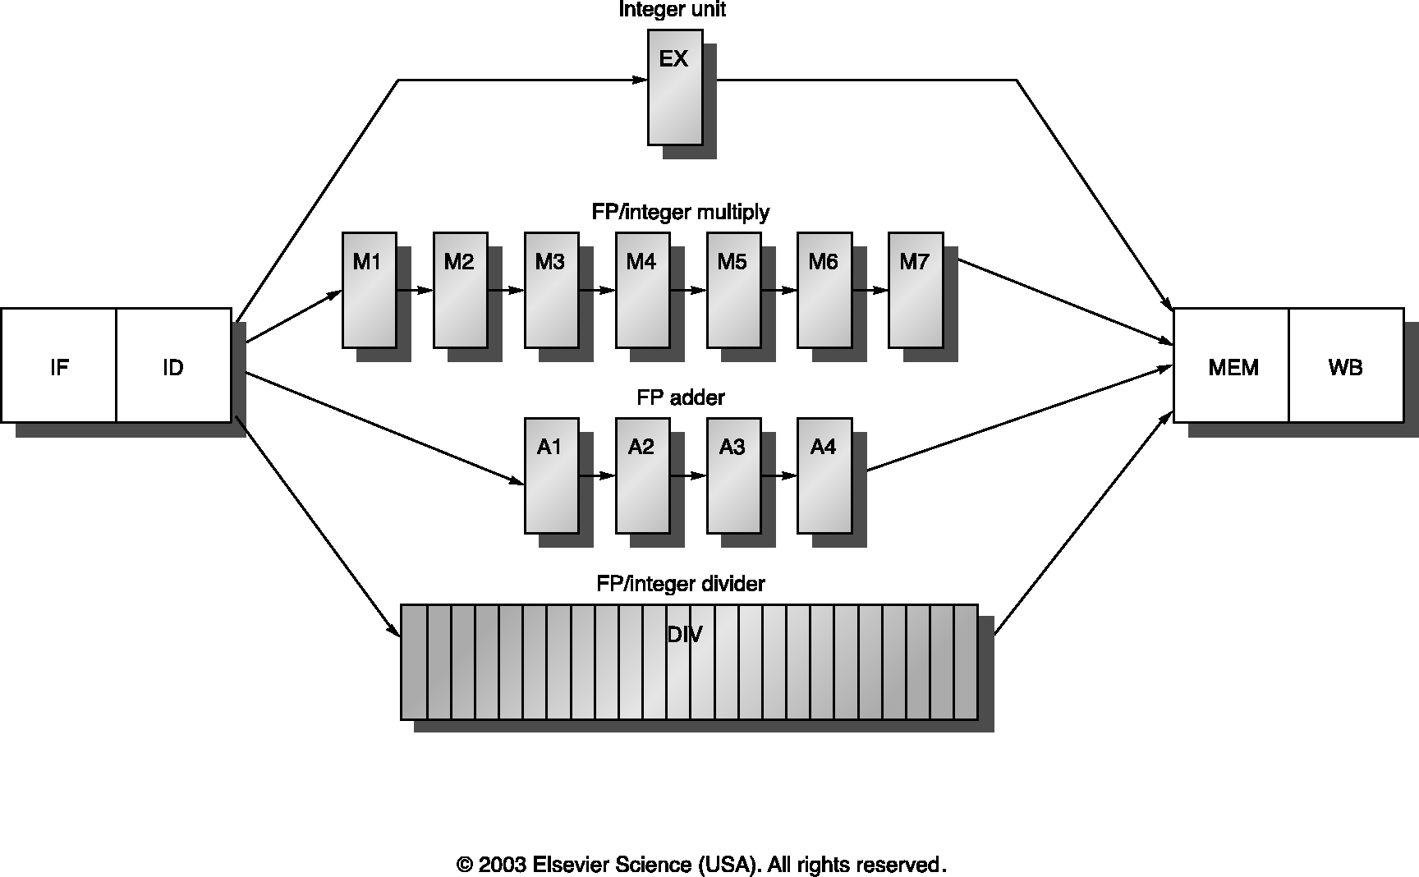
Pipelined Multiple-Issue FPU

Slide 57
FPU Pipelining Issues in DLX
Notice instructions may complete out-of-order:
  MULTD IF ID M1 M2 M3 M4 M5 M6 M7 ME WB
  ADDD IF ID A1 A2 A3 A4 ME WB
  LD IF ID EX ME WB
  SD IF ID EX ME WB
Raises the possibility of WAW hazards, and structural hazards in MEM & WB stages.
Structural hazards may occur especially often with non-pipelined DIV unit.
Out-of-order completion impacts exception handling.

Slide 58
Typical FP Code Seq. with Stalls
MUL.D stalls
  in ID 1 cycle waiting for new value of F4 from MEM stage of L.D
ADD.D stalls
  1 cycle in IF waiting for MUL.D to leave ID,
  then 6 cycles in ID waiting for new F0 to be returned by MUL.D stage M7.
S.D stalls
  6 cycles in IF waiting for ADD.D to leave ID,
  then 2 cycles in EX waiting for new F2 to be returned by ADD.D stage A4, then 1 more cycle in EX waiting for ADD.D to clear MEM stage.
 | Clock Cycle Number
Instruction | 1 | 2 | 3 | 4 | 5 | 6 | 7 | 8 | 9 | 10 | 11 | 12 | 13 | 14 | 15 | 16 | 17
L.D F4,0(R2) | IF | ID | EX | ME | WB
MUL.D F0,F4,F6 |  | IF | ID | stall | M1 | M2 | M3 | M4 | M5 | M6 | M7 | ME | WB
ADD.D F2,F0,F8 |  |  | IF | stall | ID | stall | stall | stall | stall | stall | stall | A1 | A2 | A3 | A4 | ME | WB
S.D F2,0(R2) |  |  |  |  | IF | stall | stall | stall | stall | stall | stall | ID | EX | stall | stall | stall | ME

Slide 59
Issues in Multi-Cycle Operations
Stall for RAW is longer and more frequent (Fig. A33)
WAW is possible; WAR is not (why?)
Structural Hazard possible for non-pipelined unit
Multiple WBs are likely (Fig. A.34)
Handling hazards at Issue (ID) stage:
    Check structural hazards: functional unit, WB port
    Check RAW hazards: Issue with forwarding
    Check WAW hazards: Not issue to make sure write in order
  Detect and stall instruction before MEM and WB stages

Slide 60
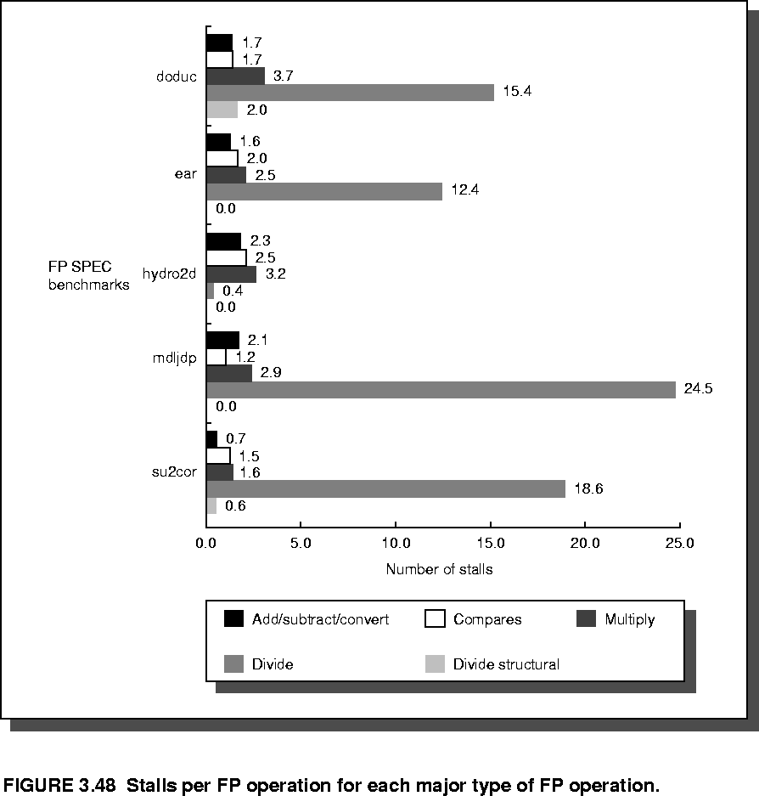
FP Stall Statistics
per FP operation

Slide 61
ISA Design Impacts Pipelining
Variable instruction lengths & run times:
  Introduces delays due to pipeline inequities.
  Complicates hazard-detection & precise exceptions
Sophisticated addressing modes:
  Post-autoincrement complicates hazard detection, restarting, introduces WAR & WAW hazards.
  Multiple-indirect modes complicate pipeline control & timing.
Self-modifying code:
  What if you overwrite an instruction in the pipe?
Implicit condition codes: WAR hazards, restarts

Slide 62
Outline
Introduction
The Major Hurdle of Pipelining
Implementation
Multi-cycle Operations
The MIPS R4000 Pipeline
Crosscutting Issues
Conclusion

Slide 63
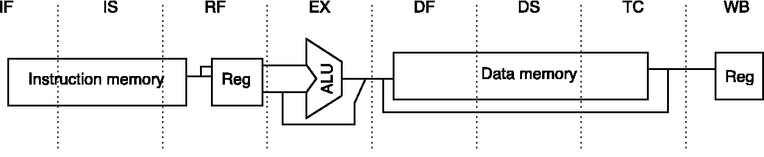
Real MIPS R4000 “SuperPipeline”
IF,IS - Instruction cache fetch, First & Second halves.
RF - Inst. decode, Register Fetch, hazard check…
EX - Execution (EA calc, ALU op, target calc…)
DF,DS - Data cache access, First & Second halves.
TC - Tag Check, did cache access hit?
WB - Write-Back for loads & register-register ops.

Slide 64
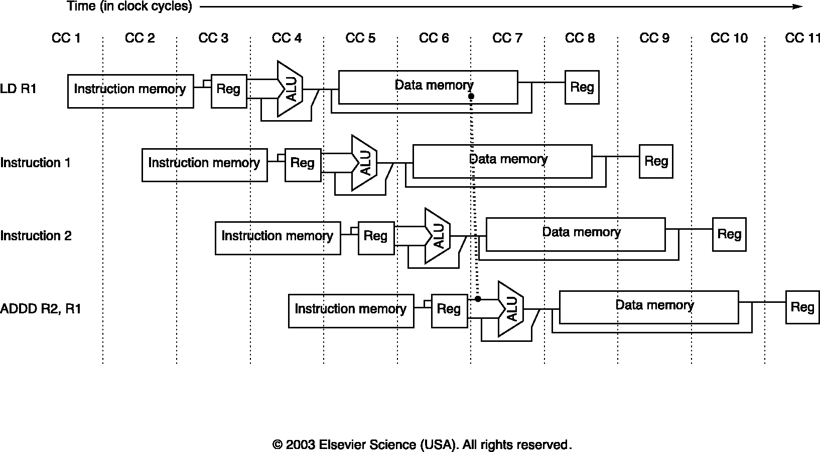
R4000: Two-Cycle Load Delay

Slide 65
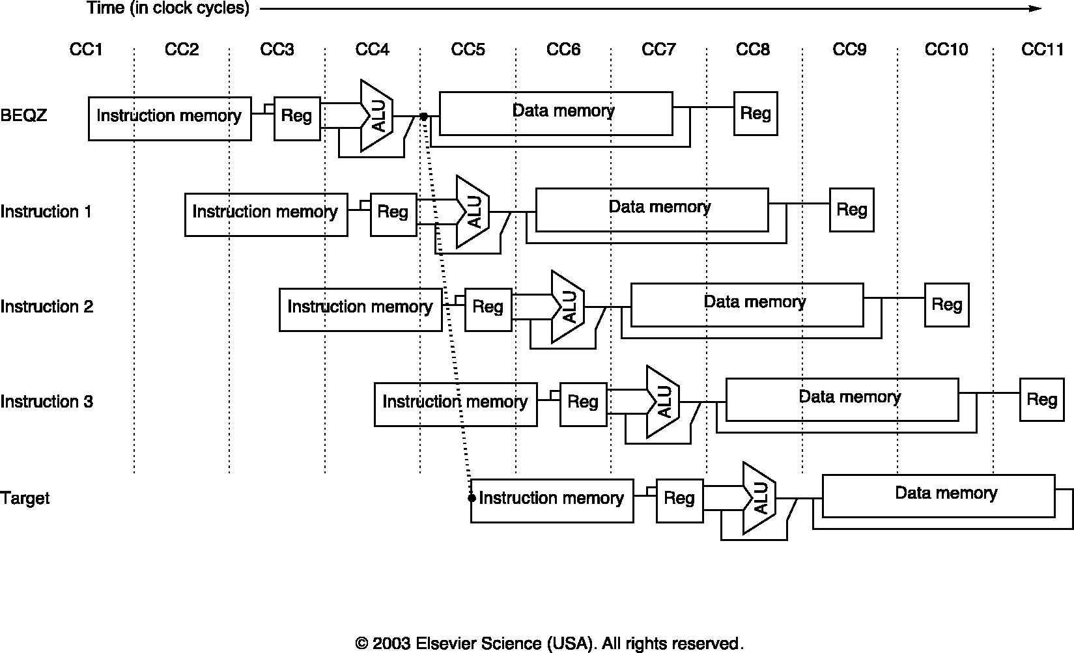
R4000: Three-Cycle Branch Delay

Slide 66
R4000 FP Functional Unit Stages
U – Unpack floating-point numbers
FP adder functional unit stages:
  A – Mantissa ADD stage
  R – Rounding stage
  S – Operand shift stage
FP multiplier functional unit stages:
  E – Exception test stage
  M – First stage of multiplier
  N – Second stage of multiplier
FP divider function unit stages:
  D – Divide pipeline stage

Slide 67
Latency and Initiation Interval
Both units used in same clock cycle
FP Instruction | Latency | Initiation interval | MIPS R4000 Pipe stages
Add, subtract | 4 | 3 | U, S+A, A+R, R+S
Multiply | 8 | 4 | U, E+M, M, M, M, N, N+A, R
Divide | 36 | 35 | U, A, R, D²⁷, D+A, D+R, D+A, D+R, A, R
Square root | 112 | 111 | U, E, (A+R)¹⁰⁸, A, R
Negate | 2 | 1 | U, S
Absolute value | 2 | 1 | U, S
FP compare | 3 | 2 | U, A, R
Pair of units used on
108 consecutive cycles
U – unpack
A – mantissa add
R – round
S – shift
E – exception test
M – multiply 1st stage
N – multiply 2nd stage
D – divide

Slide 68
FP Multiply followed by Add
 |  | Clock cycle
Op | Issue/ Stall | 0 | 1 | 2 | 3 | 4 | 5 | 6 | 7 | 8 | 9 | 10 | 11 | 12
mul | Issue | U | EM | M | M | M | N | NA | R
add | Issue |  | U | SA | AR | RS
 | Issue |  |  | U | SA | AR | RS
 | Issue |  |  |  | U | SA | AR | RS
 | Stall |  |  |  |  | U | SA | AR | RS
 | Stall |  |  |  |  |  | U | SA | AR | RS
 | Issue |  |  |  |  |  |  | U | SA | AR | RS
 | Issue |  |  |  |  |  |  |  | U | SA | AR | RS

Slide 69
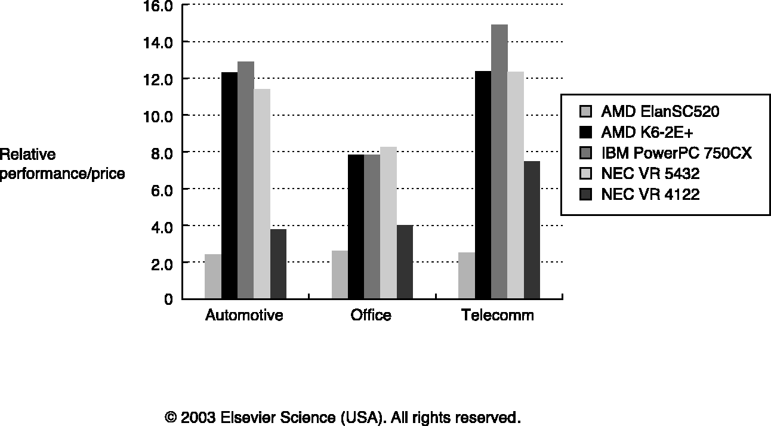
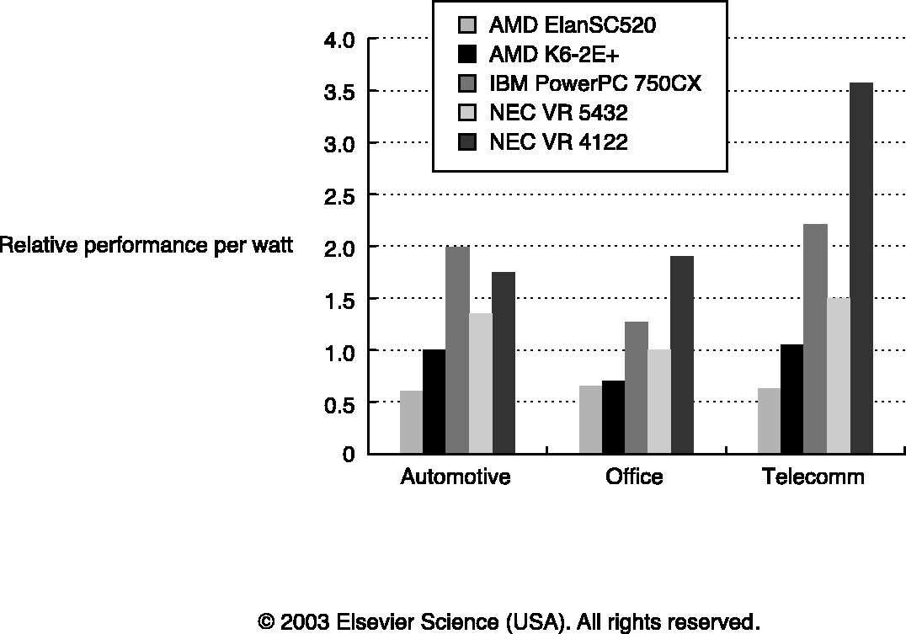
The MIPS R4300 Pipeline
Manufactured by NEC
64-bit processor implements MIPS64 ISA
Used in embedded applications
  Nintendo-64 game processor, network router, …
Multiple EX stages for floating-point pipeline
  Out-of-order completion, precise exceptions
  NEC VR 4122: Integer datapath, software for FP operations

Slide 70
Outline
Introduction
The Major Hurdle of Pipelining
Implementation
Multi-cycle Operations
The MIPS R4000 Pipeline
Crosscutting Issues
Conclusion

Slide 71
RISC ISA and Efficiency of Pipelines
Simple instruction set
  Easier to schedule code to improve performance
Static scheduling by compiler
Dynamic scheduling by hardware
  Leads to out-of-order execution (completion)
  Requires mechanism to ensure correct execution
    Scoreboarding

Slide 72
Scoreboarding
Technique for implementing an instruction queue that supports dynamic reordering.
Developed on CDC 6600 (decades ago).
Reordering must check WAR/WAW hazards:
DIVD F0,F2,F4 ← Long-running
ADDD F10,F0,F8 ← Depends on DIV
SUBD F8,F8,F14 ← Anti-depends on ADD
Goal: Begin execution of instructions as early as possible

Slide 73
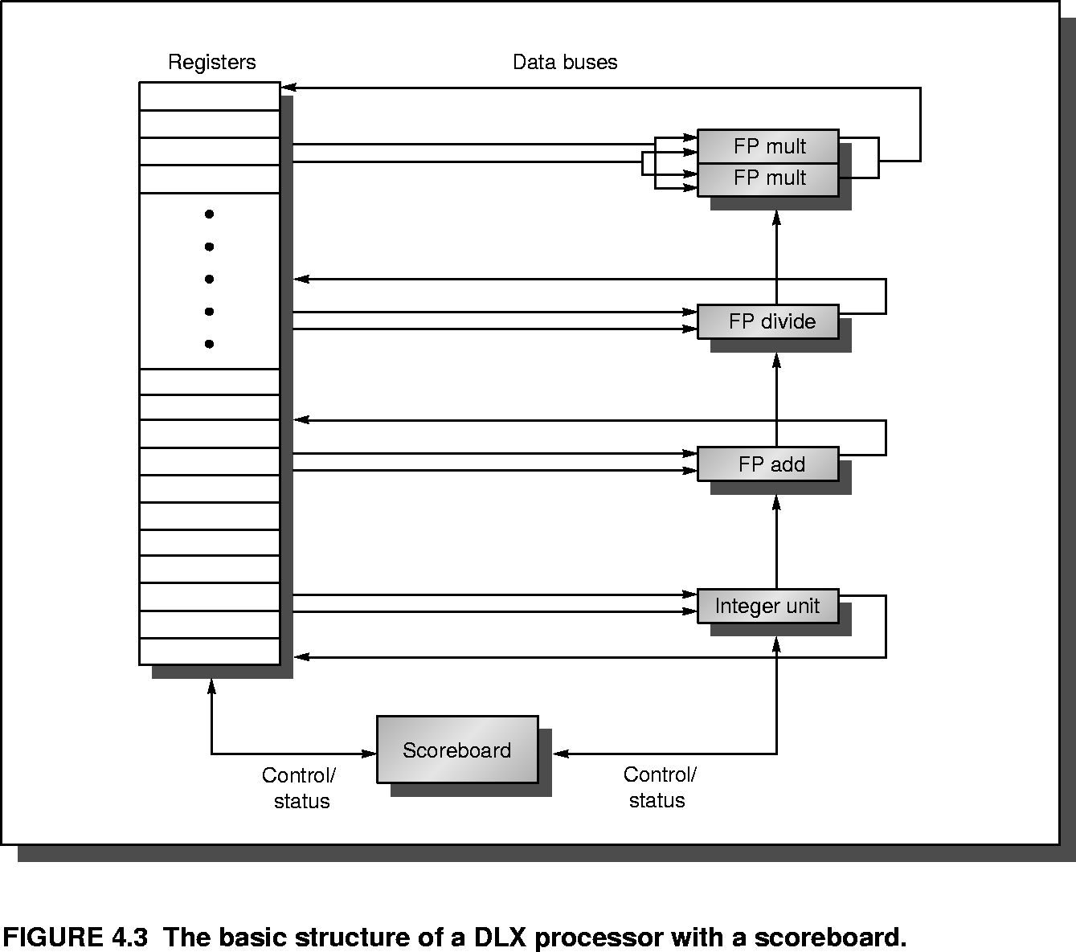
Simple scoreboarded datapath

Slide 74
Pipeline with Scoreboarding
0. (F) Fetch instruction from cache or prefetch buffer
(I) Issue inst. to an execution path (when no structural/WAW hazards)
(R) Read operands (when no RAW hazards remain)
(E) Execute instruction (possibly multi-cycle)
(W) Write results (when no WAR hazards remain)
Scoreboard /
Control Unit
Pre-execution
buffers
Post-execution
buffers
Read
operands
Execution unit 1
Instruction Fetch
Instruction Issue
Write results
Read
operands
Execution unit 2
Pre-issue
buffer
…
Instruction Decode

Slide 75
1. Instruction Issue (IS) Stage
Receive newly-fetched instruction
Decode binary instruction format
Check for structural hazards:
  Instruction needs execution unit currently in use, whose initiation interval hasn’t passed?
Check for WAW hazards:
  Instruction wants to write to a register that an active instruction (issued, but not yet finished) wants to write to?
    Bad if they finish out-of-order!
Stall all current (& future) instruction issuing, until none of these hazards remain.
Issue instructions (in-order) to the appropriate execution units & track status on scoreboard.
Replaces first half
of ID stage

Slide 76
2. Read Operands (RO) Stage
Receive instruction issued to functional unit.
Check for RAW hazards: Are all source operands available yet?
  If no: Hold instruction in a pre-execution buffer.
    If buffer has only 1 entry, this and all not-yet-issued instructions using this functional unit must wait.
  If yes: Read operands from register file, & start instruction down the execution unit’s pipeline.
Replaces second half
of ID stage

Slide 77
3. Execution (EX) Stage
Once operands are received, begin execution of the instruction in the execution unit.
Execution may take multiple cycles.
When result is ready, notify scoreboard of instruction completion.
Replaces old EX stage

Slide 78
4. Write Result (WR) stage
Receive completed instruction & its result from execution unit.
Check for WAR hazards:
  Does any previously-issued instruction that has not yet read its operands depend on the old value we are about to overwrite? (Does it anti-depend on us?)
While yes:
Stall instruction in a post-execution buffer.
When no:
Write instruction result to register file.
Replaces WB stage

Slide 79
Scoreboard Implementation
One typical implementation uses three tables:
  Instruction status, for each instruction on the scoreboard
    Which stage of execution is the instruction currently in?
  Functional Unit (FU) status, for each FU:
    What instruction (if any) is being processed?
    If inst. is in RO stage, then for each operand:
      What register is the operand coming from?
      Is the operand ready?
      If not, which FU will produce the operand?
  Register result status, for each reg. in the ISA:
    Which currently-running FU (if any) is scheduled to overwrite the given register?

Slide 80
Functional Unit Status Table
For each functional unit, the following fields:
  Busy – Is the unit busy (Yes/No)?
  Op – Which exact opcode to perform in the FU?
  F_{i} – Destination register of instruction in the FU
  F_{j},F_{k} – Source registers of instruction
  These fields are only needed during RO stage:
    Q_{j},Q_{k} – FUs to write new values of source registers, or 0
    R_{j},R_{k} – Are operands Fj,Fk ready? (Yes/No)
Register result status table has only 1 field:
  Result – Which currently-executing FU will write its result to this register?

Slide 81
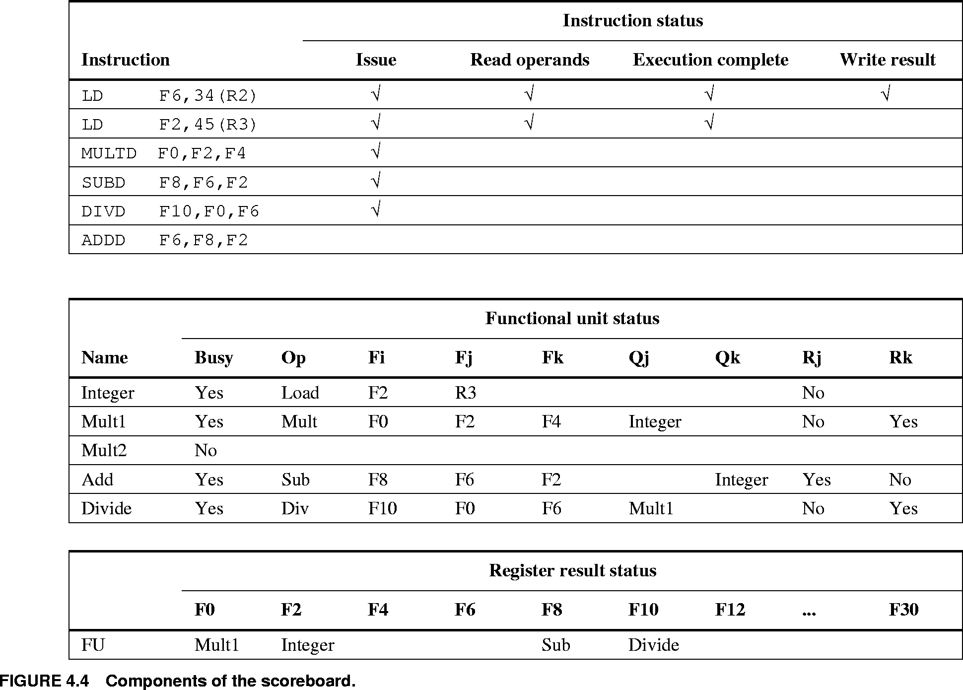
#1: Scoreboard After 2nd LD’s EX

Slide 82
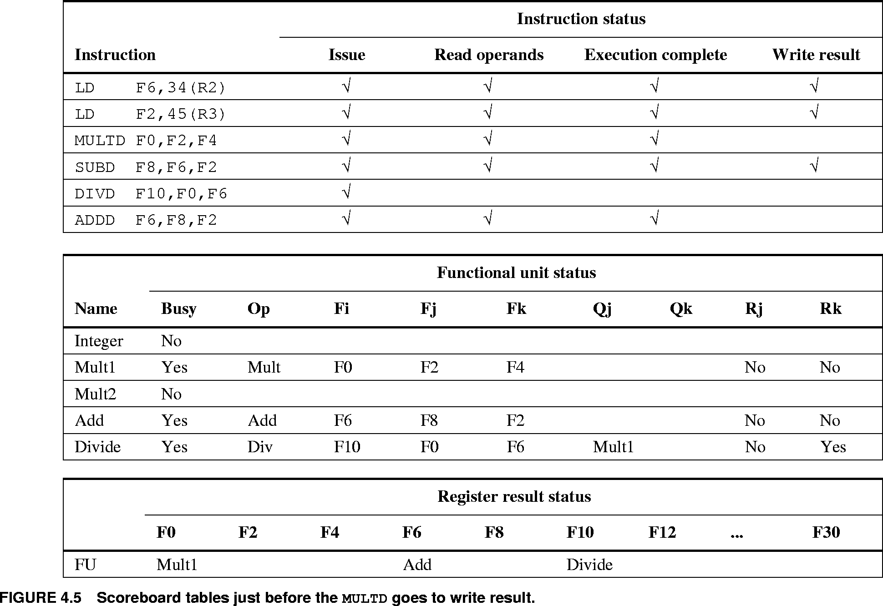
#2: Just before MULTD’s WR stage

Slide 83
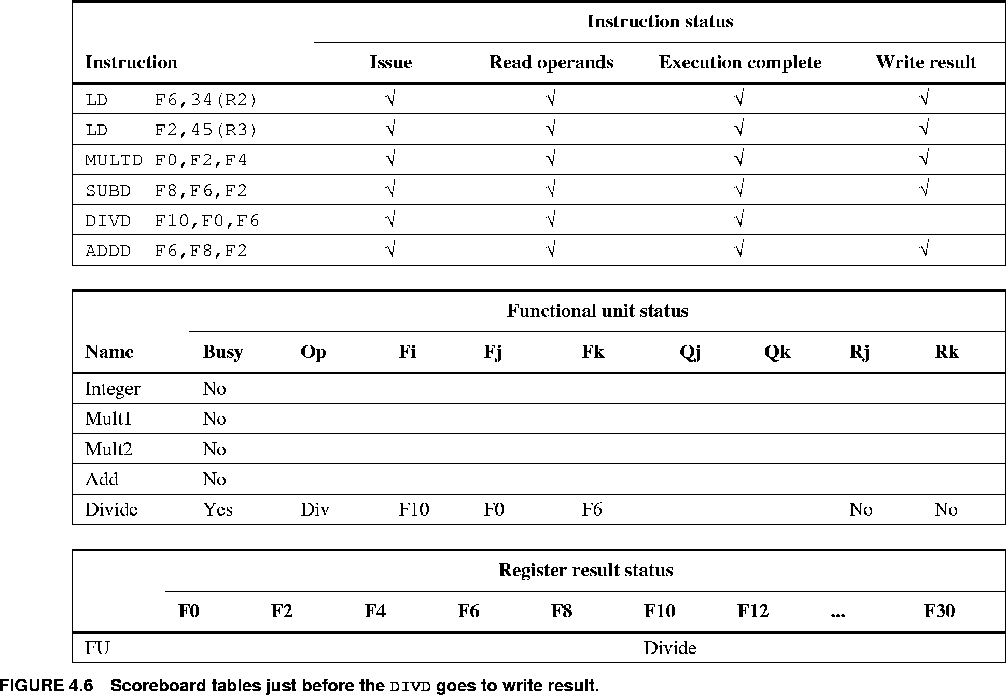
#3: Just before DIVD’s WR stage

Slide 84
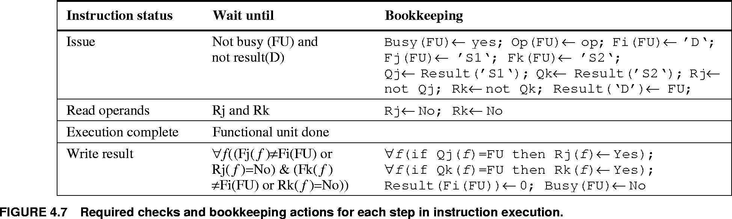
Scoreboarding Logic
In the table below:
  FU = functional unit used by given instruction
  D,S1,S2 = given instr’s destination & source regs
  op = operation to be performed
  Result[reg] = Register result status table entry
  for register identified by reg
(true @ start
of cycle)
(completed by end of cycle)
(Avoids WAW)
(Avoids RAW)
(Release other writers of operand regs.)
(Lock into
operands)
(Avoids WAR)

Slide 85
A Problem with that Implementation
Note: The following artifact is introduced:
  Only one instruction per execution unit at a time!
    Even if it is a pipelined, multi-cycle unit!
Think: What would you need to change in order to fix this problem?
  Change the register result & FU status tables:
    Specify which recently-issued instruction (not just FU) is responsible for producing a given register value.
    Instructions can be assigned unique ids when issued
  Add structural hazard detection logic, if needed:
    To determine exactly when it is safe for a new instruction to actually enter the pipe for each FU.

Slide 86
Another problem w. Scoreboarding
Since WAW hazards are avoided by stalling on instruction issue, we lose time during which we could go ahead and begin executing.
  But note: If we just went ahead and issued the instruction, then we haven’t ensured that results will get written in the right order!
Think: How might you fix this deficiency?

Slide 87
Limitations on Scoreboarding
The following factors limit the number of stalls that can be eliminated by scoreboarding:
Available parallelism among instructions
  Cross-basic-block rescheduling helps with this
Number of scoreboard instruction table entries
Number and types of functional units
Presence of name dependences (lead to WAR/WAW hazards)
  Can fix with register renaming
    Static, or dynamic (we’ll see how later)

Slide 88
Fallacies and Pitfalls
Why compiler generates two writes w/o read → WAW
  instruction in the delay slot from fall through
    assuming branch is not taken.
Extensive pipelining can impact other aspects of a design leading to overall worse cost-performance
  8600 – 80 ns cycle time; 8650 – 55 ns
  8700 operates at micro-instruction level - 45 ns
    simpler pipeline, smaller CPU, faster clock – 45 ns
    8650 has CPI adv. of 20%; 8700 has clock adv. 20%
    8700 achieves same performance with less hardware
Evaluating a compile time scheduler on the basis of un-optimized code
  Idle cycles increases 18% in gcc/R3000 from unopt. to optimized
    Optimized version is faster since it has less instructions.
  To fairly evaluate a scheduler use optimized code.

