Slide 1
PRIVACY PRESERVATION IN DEEP LEARNING
Under the Supervision of: Prof. Sayak Ray Chowdhury
Presented By –
Sarthak Paswan
B.Tech CSE
IIT Kanpur

Slide 2
Privacy in Machine Learning
Privacy preservation in machine learning refers to the set of techniques and strategies aimed at ensuring that sensitive information within training data is not exposed or leaked during the development or deployment of machine learning models.
As models learn from vast amounts of data often containing personal, medical, financial, or other confidential information, there is a growing need to protect individual privacy. Without proper safeguards, models may inadvertently memorize and reveal details about specific training examples.
The Risks
Data leaks from trained models
Membership inference attacks
Model inversion revealing private inputs
Why It’s Critical
Used in healthcare, finance, education, defence, etc.
Need to protect users' private data.
Legal Obligations
Training Must comply with regulations like GDPR, HIPAA, etc.

Slide 3
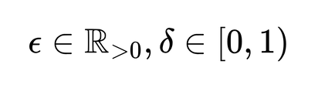



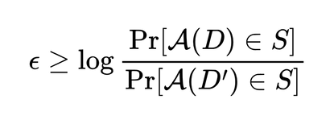
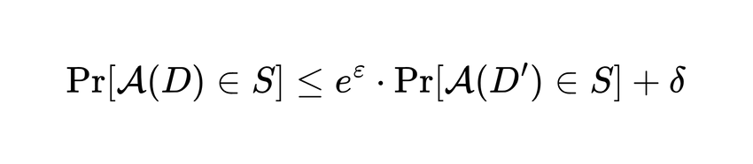


What is Differential Privacy
Definition (Differential Privacy):
Let . A randomized algorithm is said to be - differentially private, if for any two input datasets which differ by at most one datapoint D and D’, and any subset S of outputs of , it holds that:
Differential Privacy is a metric designed to ensure the privacy of individual inputs in a dataset. It guarantees that the output of an algorithm remains statistically similar, whether or not any single individual's data is included.
The privacy level is controlled using two parameters: epsilon (ε), which measures the privacy loss, and delta (δ), which indicates the probability of a privacy breach or failure probability.
Differential Privacy allows us to extract useful insights from data while protecting sensitive personal information, making it a powerful tool for privacy-preserving machine learning.
Our goal is to design deep learning models that achieve strong privacy guarntees by ensuring low values of
in -DP

Slide 4

Differentially Private SGD Algorithm
Motivation behind DP-SGD
What is DP-SGD
A simple way to protect training data privacy is to treat the training process as a black box and only privatize the final model parameters.
Difficult to precisely understand how those parameters depend on the training data.
To be safe, one might add conservative (i.e., large) amounts of noise based on worst-case scenarios.
Unfortunately, this can severely harm the model's accuracy and utility.
Instead, a better approach is to control the influence of data during the training process itself.
By modifying the standard Stochastic Gradient Descent (SGD) this control over data is achieved.
DP-SGD is a private version of the Stochastic Gradient Descent (SGD) algorithm used in deep learning.
It ensures privacy by:
Clipping each individual gradient to a fixed norm.
Adding Gaussian noise to the averaged gradients.
Clipping protects individual data points from being entirely memorized by the model. It bounds the amount of information in a given update.
The noise is added to the model gradients themselves to introduce privacy so that individual data points can’t be identified.
More noise better privacy, but possibly lower accuracy.
Less noise Higher accuracy, but weaker privacy guarantees.

Slide 5
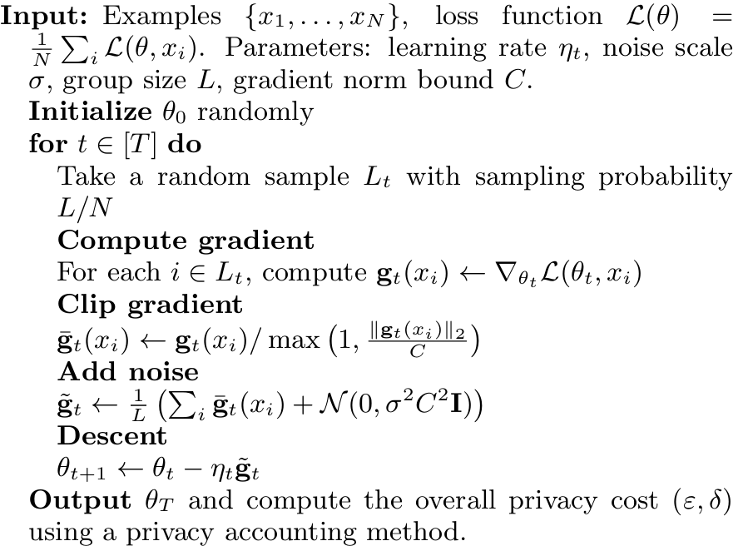
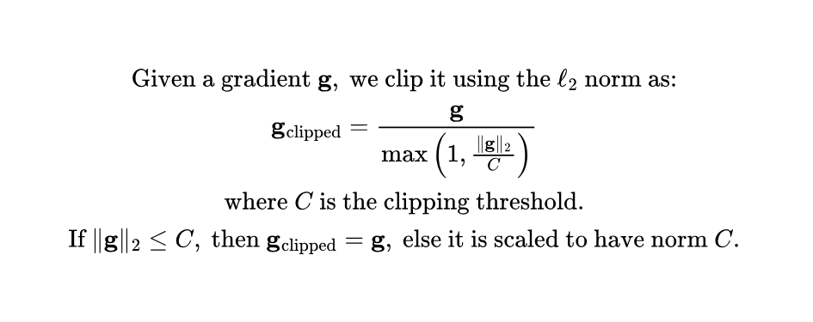


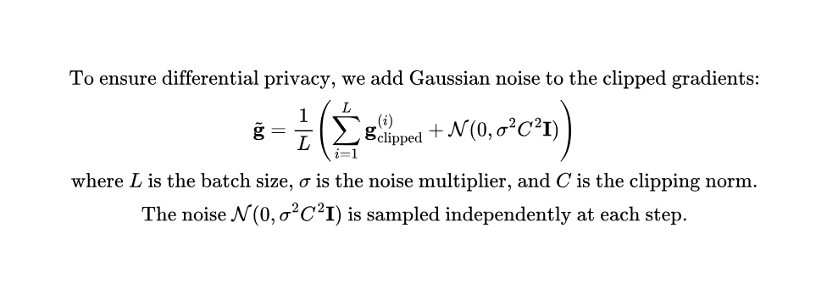

Differentially Private SGD Algorithm
Clipping Gradient
Adding noise
Here, each epoch is a 100 iteration of the main loop, i.e. 100 T.

Slide 6

Label Differential Privacy
What is Label-DP
Need for Label-DP
A specialized form of differential privacy that only privatizes the labels in a dataset.
Assumes that input features (X) may already be public or less sensitive than labels (Y).
During training, noise is added only to the label-related computations, not the features.
Helps reduce the overall privacy cost while preserving model utility.
Maintains formal (ε, δ)-DP guarantees with respect to the labels.
Ex algorithms: Randomized Response, Label-DP Pro, etc.
In many tasks, labels contain the most sensitive information (e.g., medical conditions, personal preferences).
Traditional DP methods like DP-SGD protect both features and labels, which is sometimes unnecessary.
Protecting everything equally can reduce model performance due to excess noise.
Label DP focuses privacy only on the labels, assuming features are less sensitive or public.
This allows for better accuracy while still maintaining strong privacy guarantees.

Slide 7
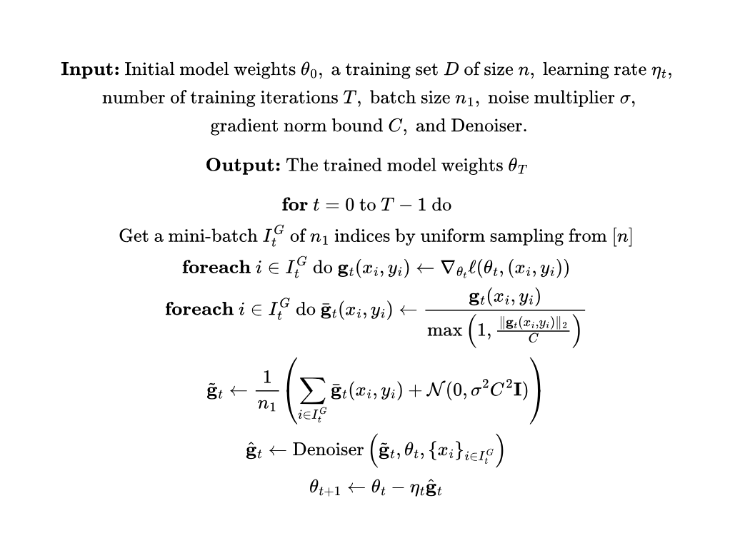

Label DP Pro Algorithm
Algorithm
Label DP Pro DP-SGD
The algorithm follows the same steps as DP-SGD up to the point where noise is added to the clipped gradients.
After noise addition to the clipped gradients, the noisy gradient is not used directly for optimization.
A denoiser module then attempts to remove the noise corresponding to the input features and reconstructs a more accurate version of the gradient.
The denoiser is designed such that it does not access the private labels, which thereby ensures label differential privacy.
The denoised gradients are then used to update the model parameters.

Slide 8
Label DP Pro Denoisers
SELFConv Denoiser
ALTConv Denoiser
Projects the noisy gradients onto the convex hull defined by the per example per class gradients.
Constructs a projection-based denoiser using only gradients from public data, i.e. the input features of the batch.
Leverages the geometric priors of the convex hull to improve denoising, especially in scenarios with many classes (better dependency on K).
Called “SELFConv” because it uses the same (public) batch for projection, avoiding label usage.
Uses a separate, independently sampled alternative public batch of an alternative size​.
Projects noisy gradients onto per example per class gradients from this alternative batch.
Also uses only public information, preserving label differential privacy.
Performs better than SELFCONV as it has the added benefit of amplification by subsampling, leading to lower privacy cost.

Slide 9
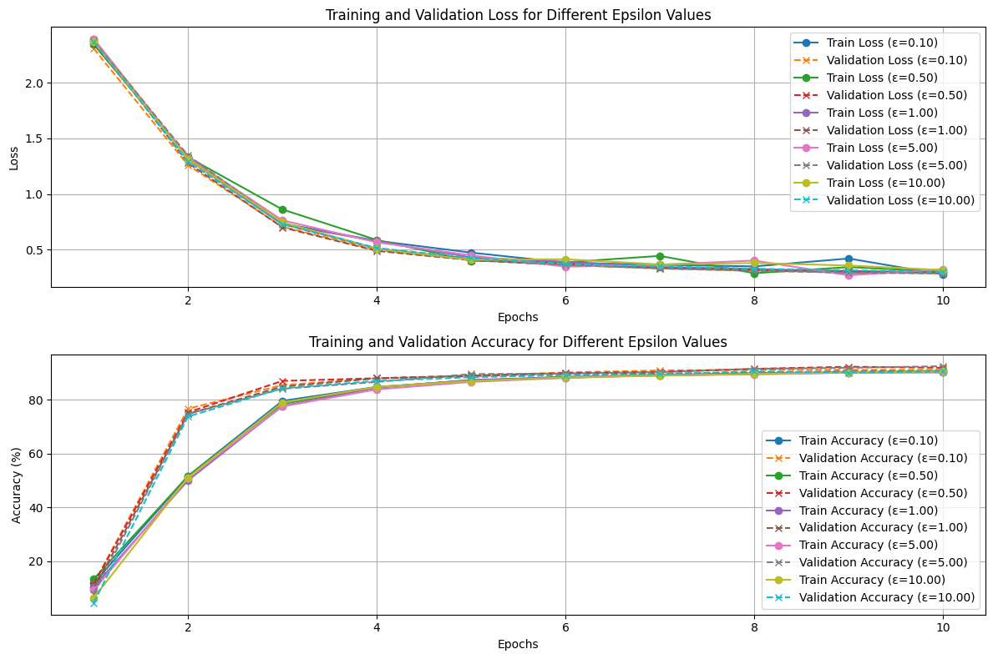

Implementation Results
DP-SGD
Test Accuracy
Epsilon
91.59%
0.1
91.65%
0.5
91.68%
1
91.73%
5
91.82%
10
Clipping Norm C = 0.1, learning rate = 0.05,
epochs = 10,

Slide 10
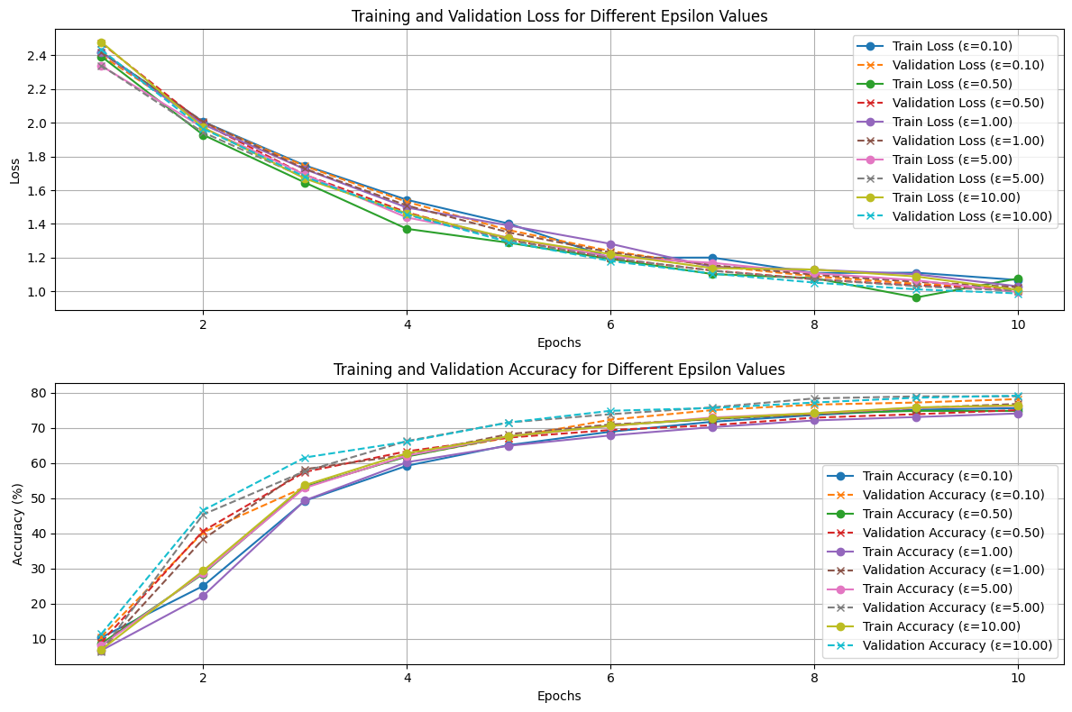

Implementation Results
Label DP Pro - ALTConv
Test Accuracy
Epsilon
76.08%
0.1
77.71%
0.5
77.82%
1
78.58%
5
78.69%
10
Clipping Norm C = 0.1, learning rate = 0.05,
epochs = 10, PGD epochs = 20, PGD learning rate = 0.05,

Slide 11

Privacy Accounting in Differential Privacy
Why Privacy Accouting
Google’s DP Accounting
Formally tracks cumulative privacy loss i.e., total (ε,δ) across multiple training steps.
Ensures that the overall privacy loss remains within a specified budget.
Essential for DP algorithms, where noise is added at every step and each step consumes a bit of privacy.
AmortizedAccountant is a simple method that accumulates privacy loss over time, assuming uniform random sampling.
More advanced techniques like Moments Accountant or PLD Accountant provide tighter bounds and better utility.
Implemented in libraries such as TensorFlow Privacy and Google's DP Accounting.
A Python library for tracking cumulative privacy loss in DP algorithms.
Supports multiple accounting methods:
Privacy Loss Distributions (PLD)
Rényi Differential Privacy (RDP)
Amortized Accountant
Moments Accountant
Allows for precise computation of (ε,δ)-DP guarantees.
It computes:
ε for a given number of steps, noise, and sampling size.
Determine the required noise for a desired (ε,δ)-DP.

Slide 12
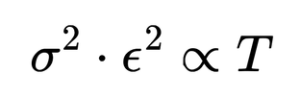
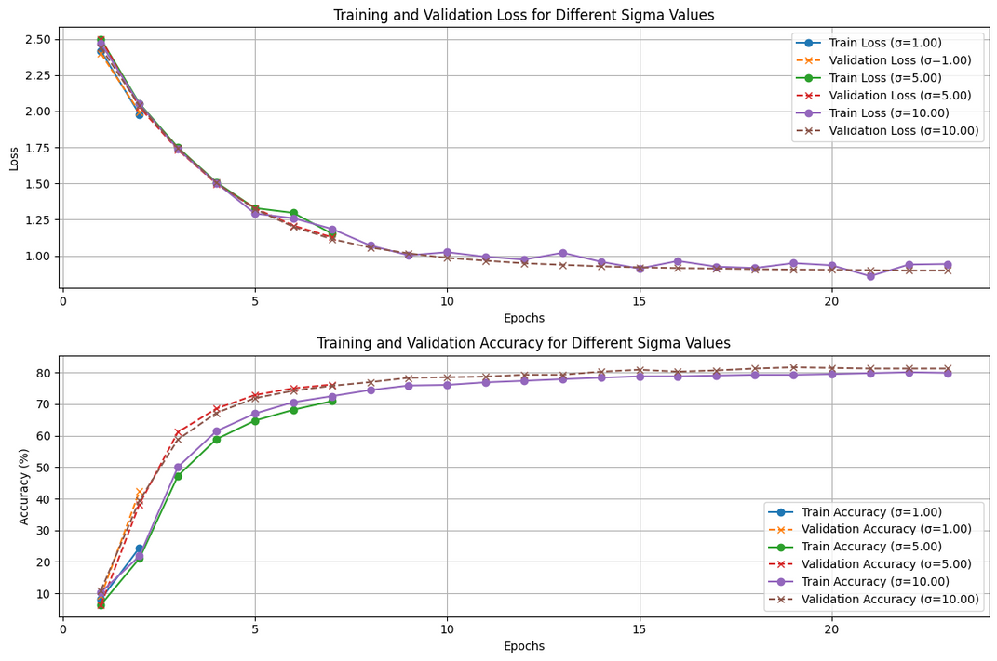


Privacy Accounting Implementation
Epochs
Test Accuracy
1
1
42.80%
5
6
73.49%
10
22
81.01%
Clipping Norm C = 0.1, learning rate = 0.05,
epochs = 10, PGD epochs = 20, PGD learning rate = 0.05,
ε = 30,

Slide 13
References
DP-SGD Paper - https://arxiv.org/pdf/1607.00133
Label DP Pro Paper - https://openreview.net/pdf?id=JnYaF3vv3G
Google’s DP Accounting Library - https://github.com/google/differential-privacy/tree/main/python/dp_accounting
Github Repository Link - https://github.com/AlgoSarthak/Privacy-Preservation-in-Deep-Learning-UGP-

Slide 14
Thank you very much!
PRESENTED BY SARTHAK PASWAN

