Slide 1
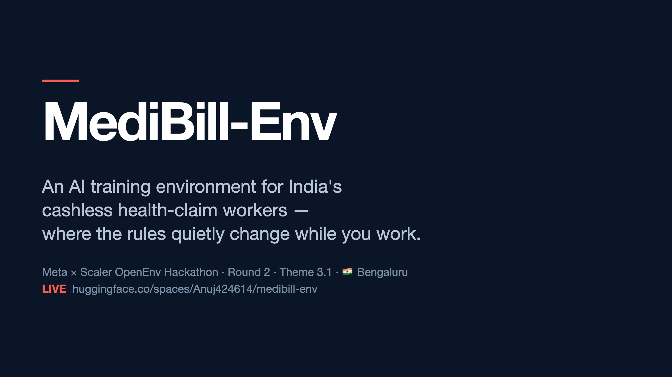
Notes:
This is MediBill-Env. A training environment for AI agents that work on Indian health insurance claims. The hard part: the insurer's rules can change while the agent is working, and nobody tells the agent. Three minutes. Theme 3.1, DataOps Copilot.

Slide 2
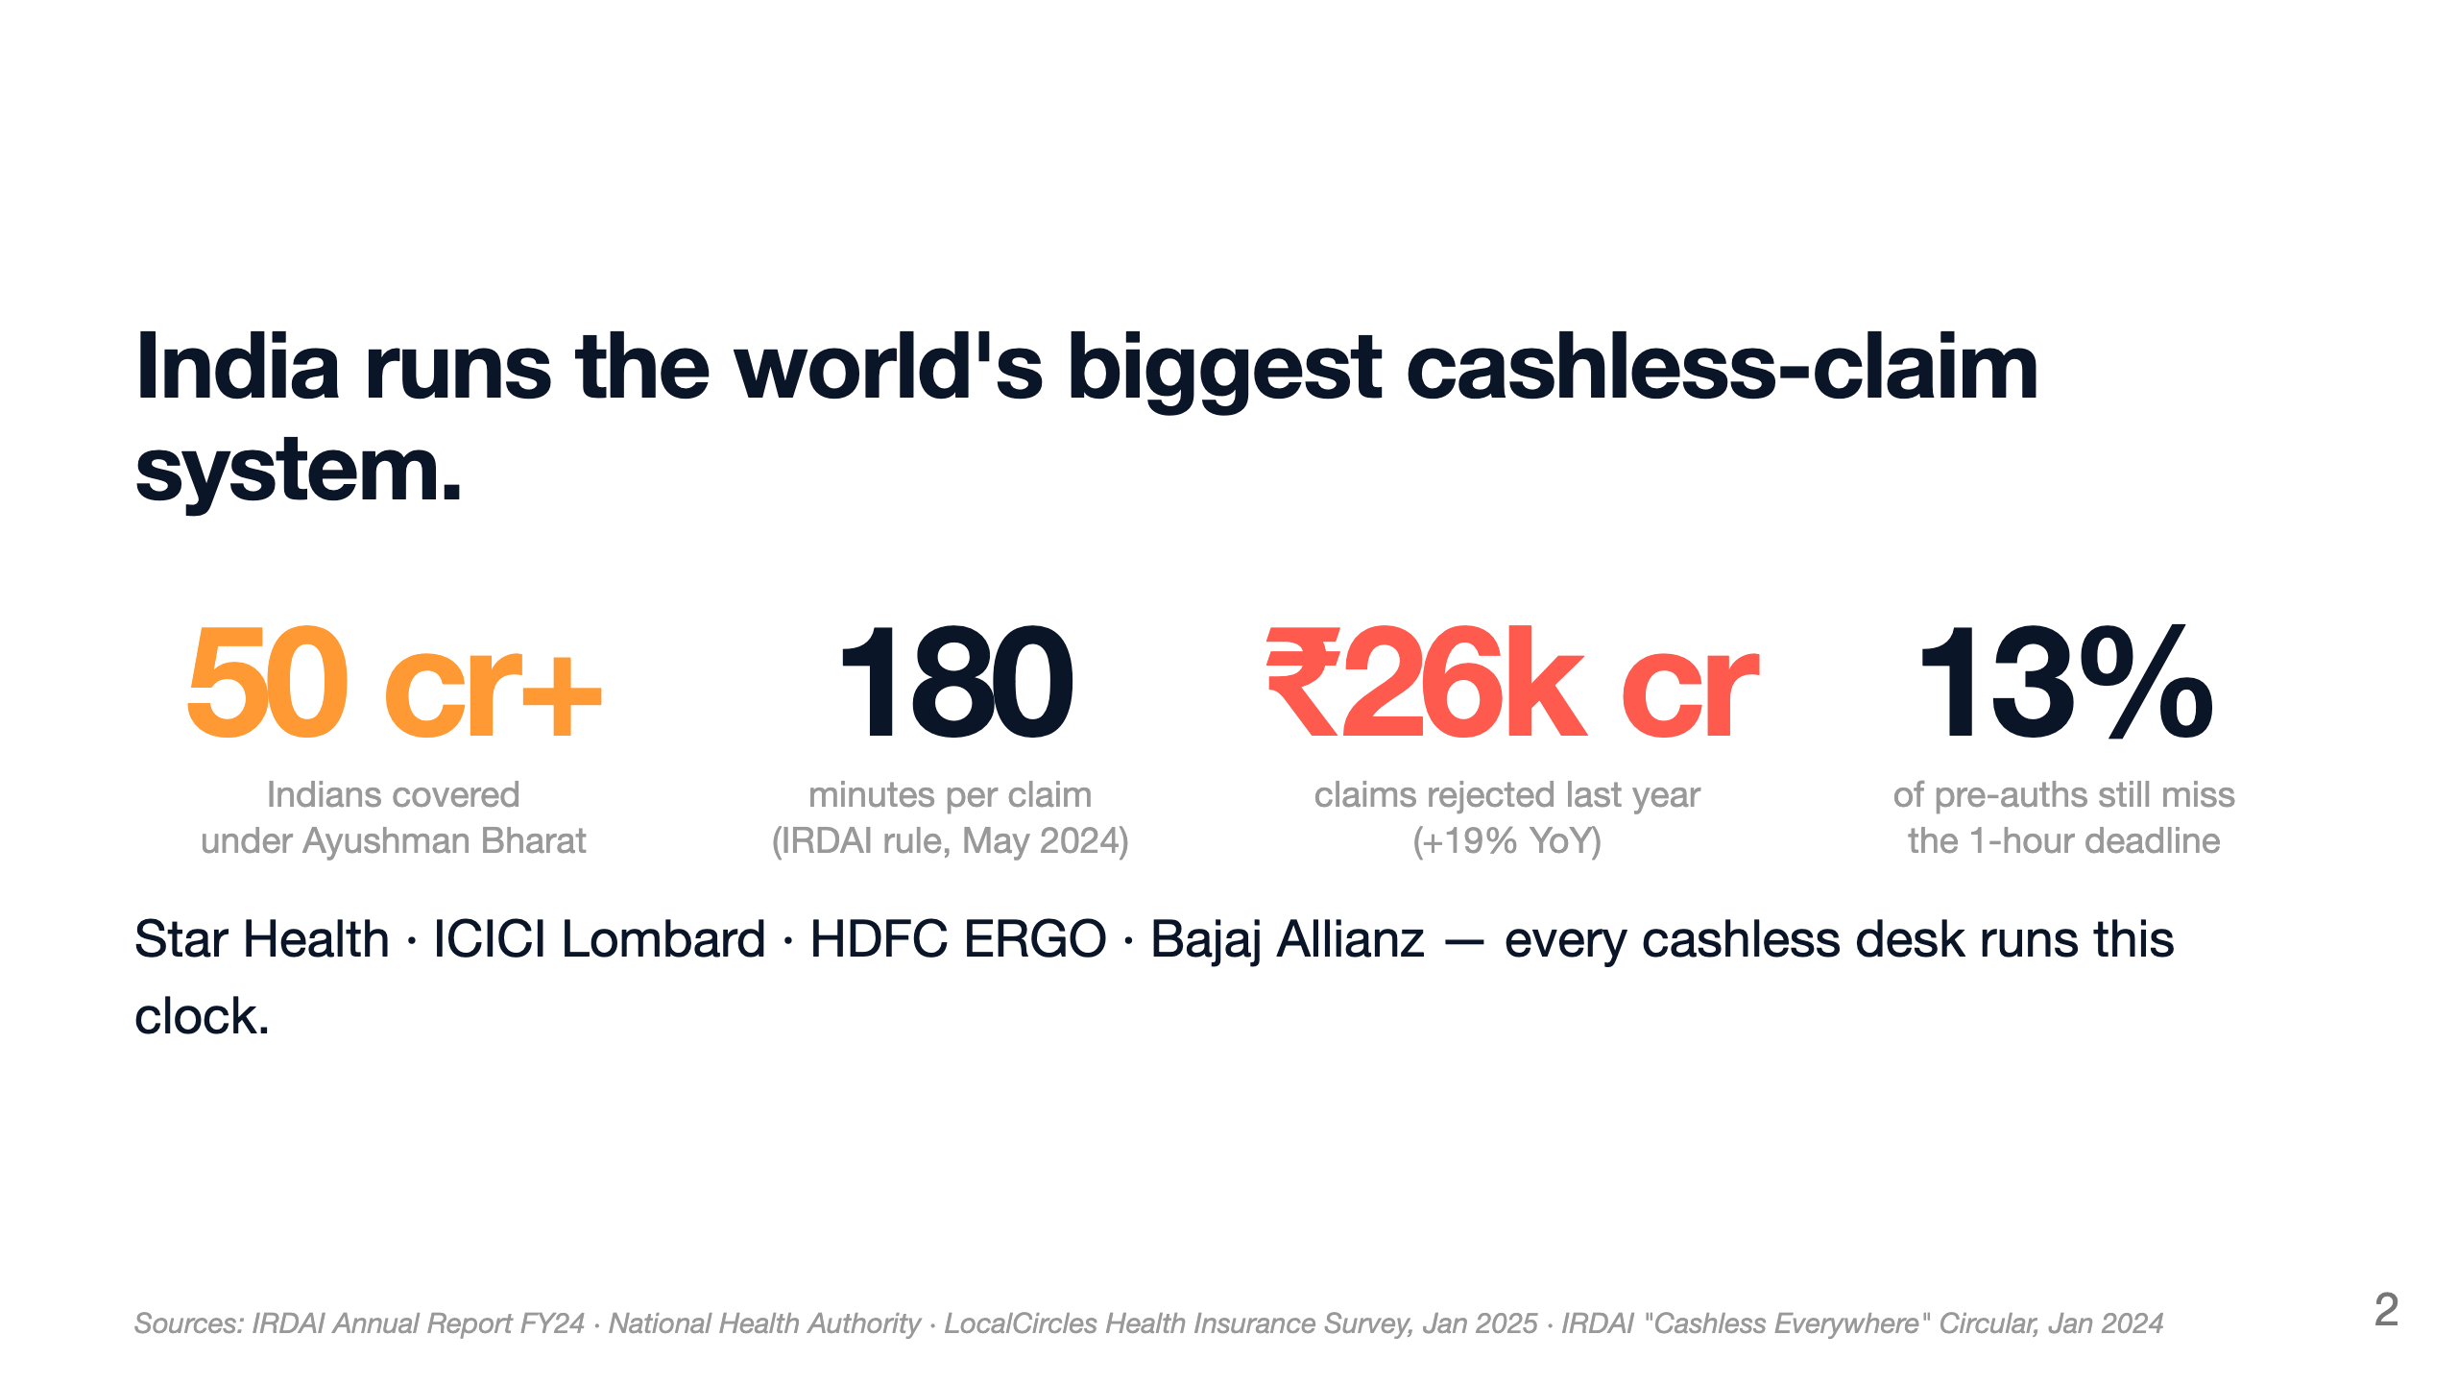
Notes:
Fifty crore Indians are now covered under Ayushman Bharat. Every cashless claim — Star Health, ICICI Lombard, HDFC ERGO, Bajaj Allianz — has a strict deadline. IRDAI rule from May 2024: one hour for pre-auth, three hours for final discharge. Miss the clock and the insurer takes the cost from their own funds. Last year alone, twenty-six thousand crore rupees of claims were rejected, up nineteen percent. Thirteen percent of pre-auths still miss the one-hour window.

Slide 3
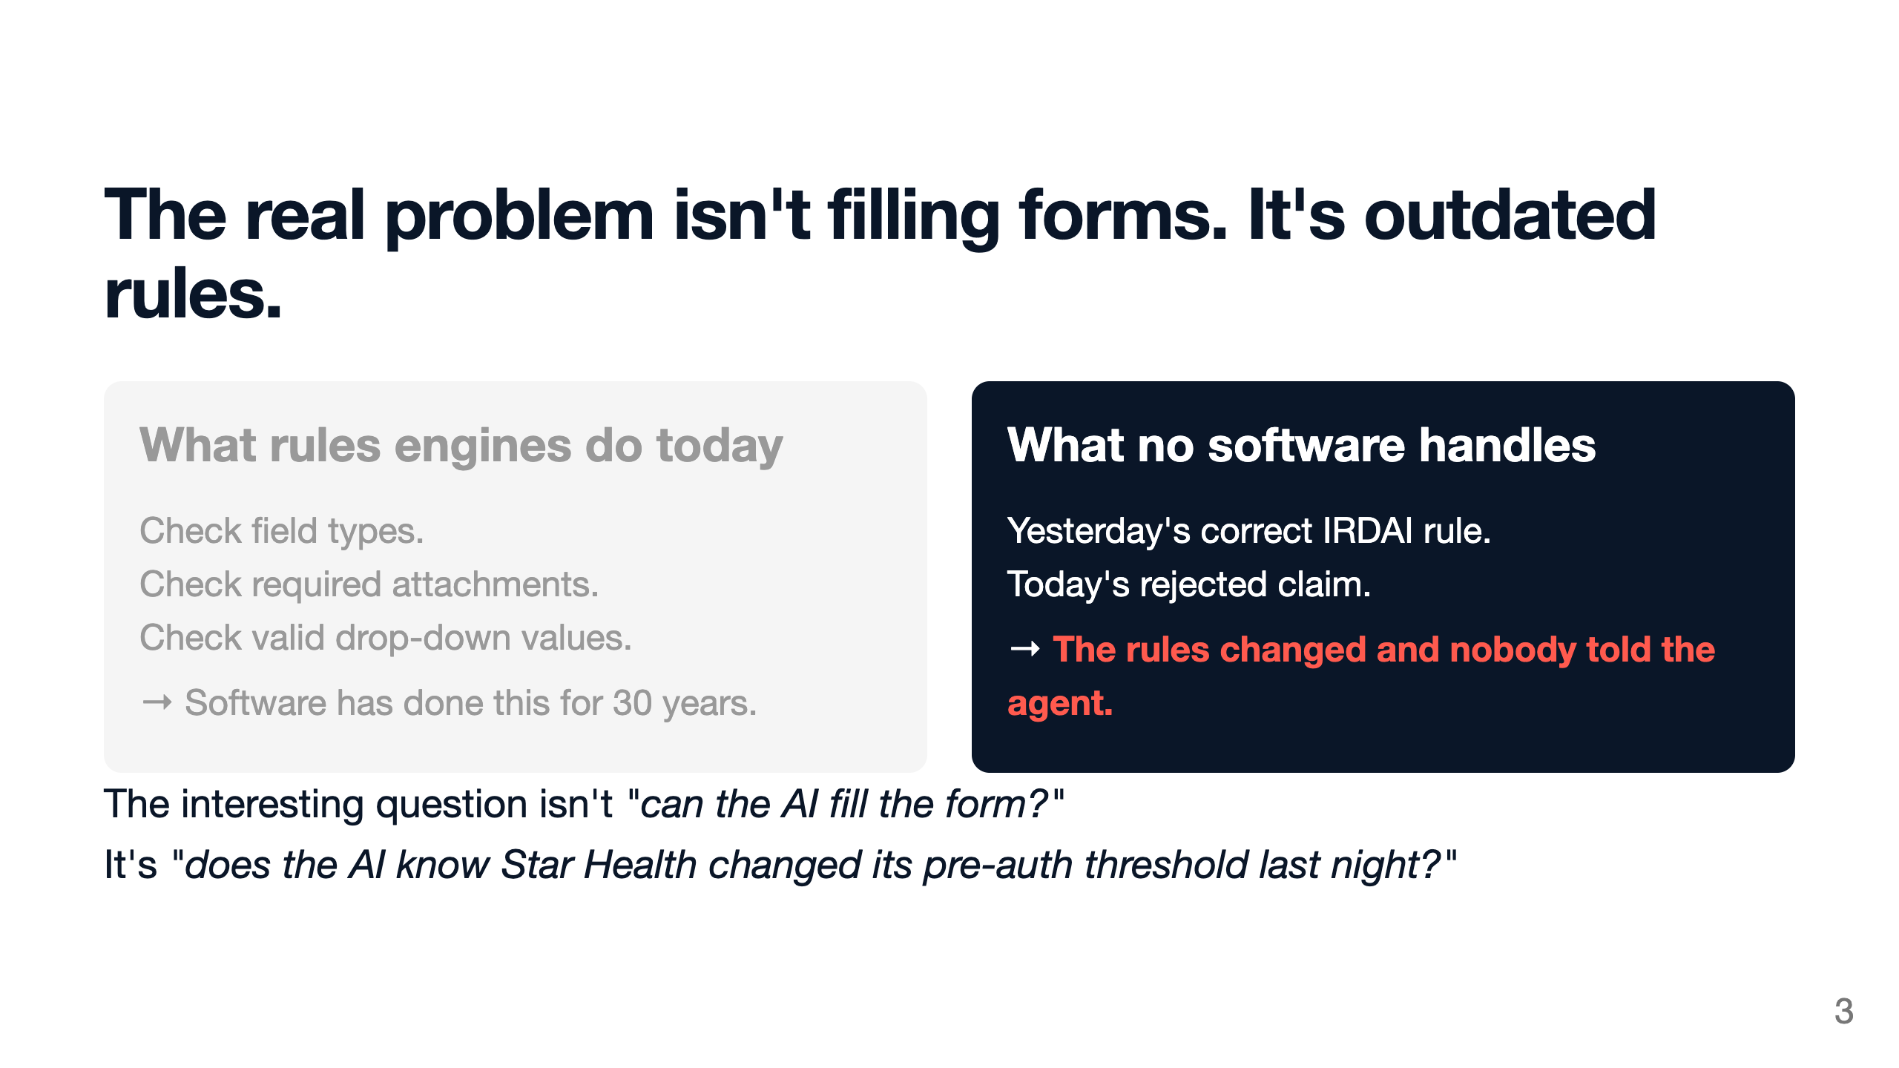
Notes:
Every rules engine on the market handles forms. None handles outdated rules. When Star Health, ICICI Lombard, or HDFC ERGO updates a rule mid-shift, an AI that learned from last month's claims will reproduce last month's rules. Our environment tests whether the AI knows to re-check the insurer's policy before submitting. That is the real-world failure mode.

Slide 4
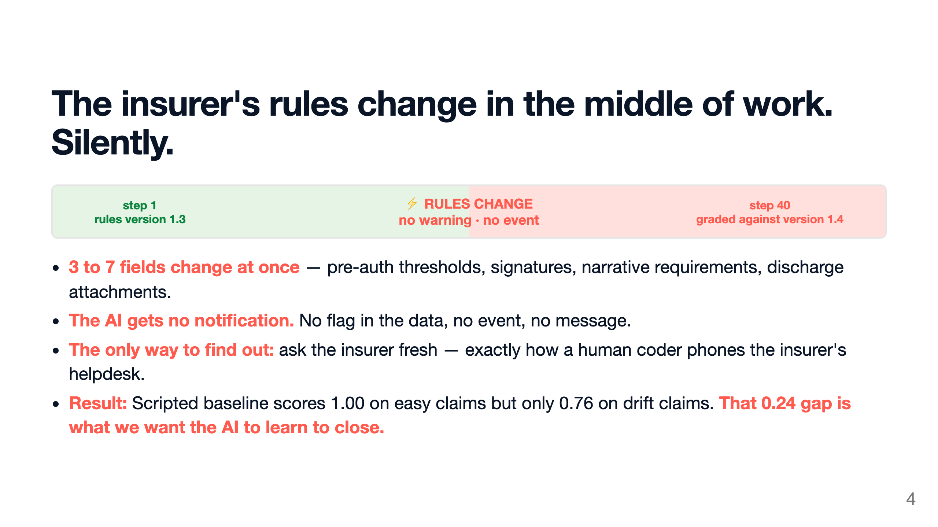
Notes:
On the hard task, the insurer silently changes three to seven rules at a random step in the middle of the episode. The AI gets no notification at all. No flag, no event, no message. The only way for the AI to know is to call the insurer's policy lookup tool again, just like a human would phone the helpdesk. Twelve thousand unique scenarios. The scripted baseline drops from one-zero on easy to zero-seven-six when rules change. That gap is the trainable signal.

Slide 5
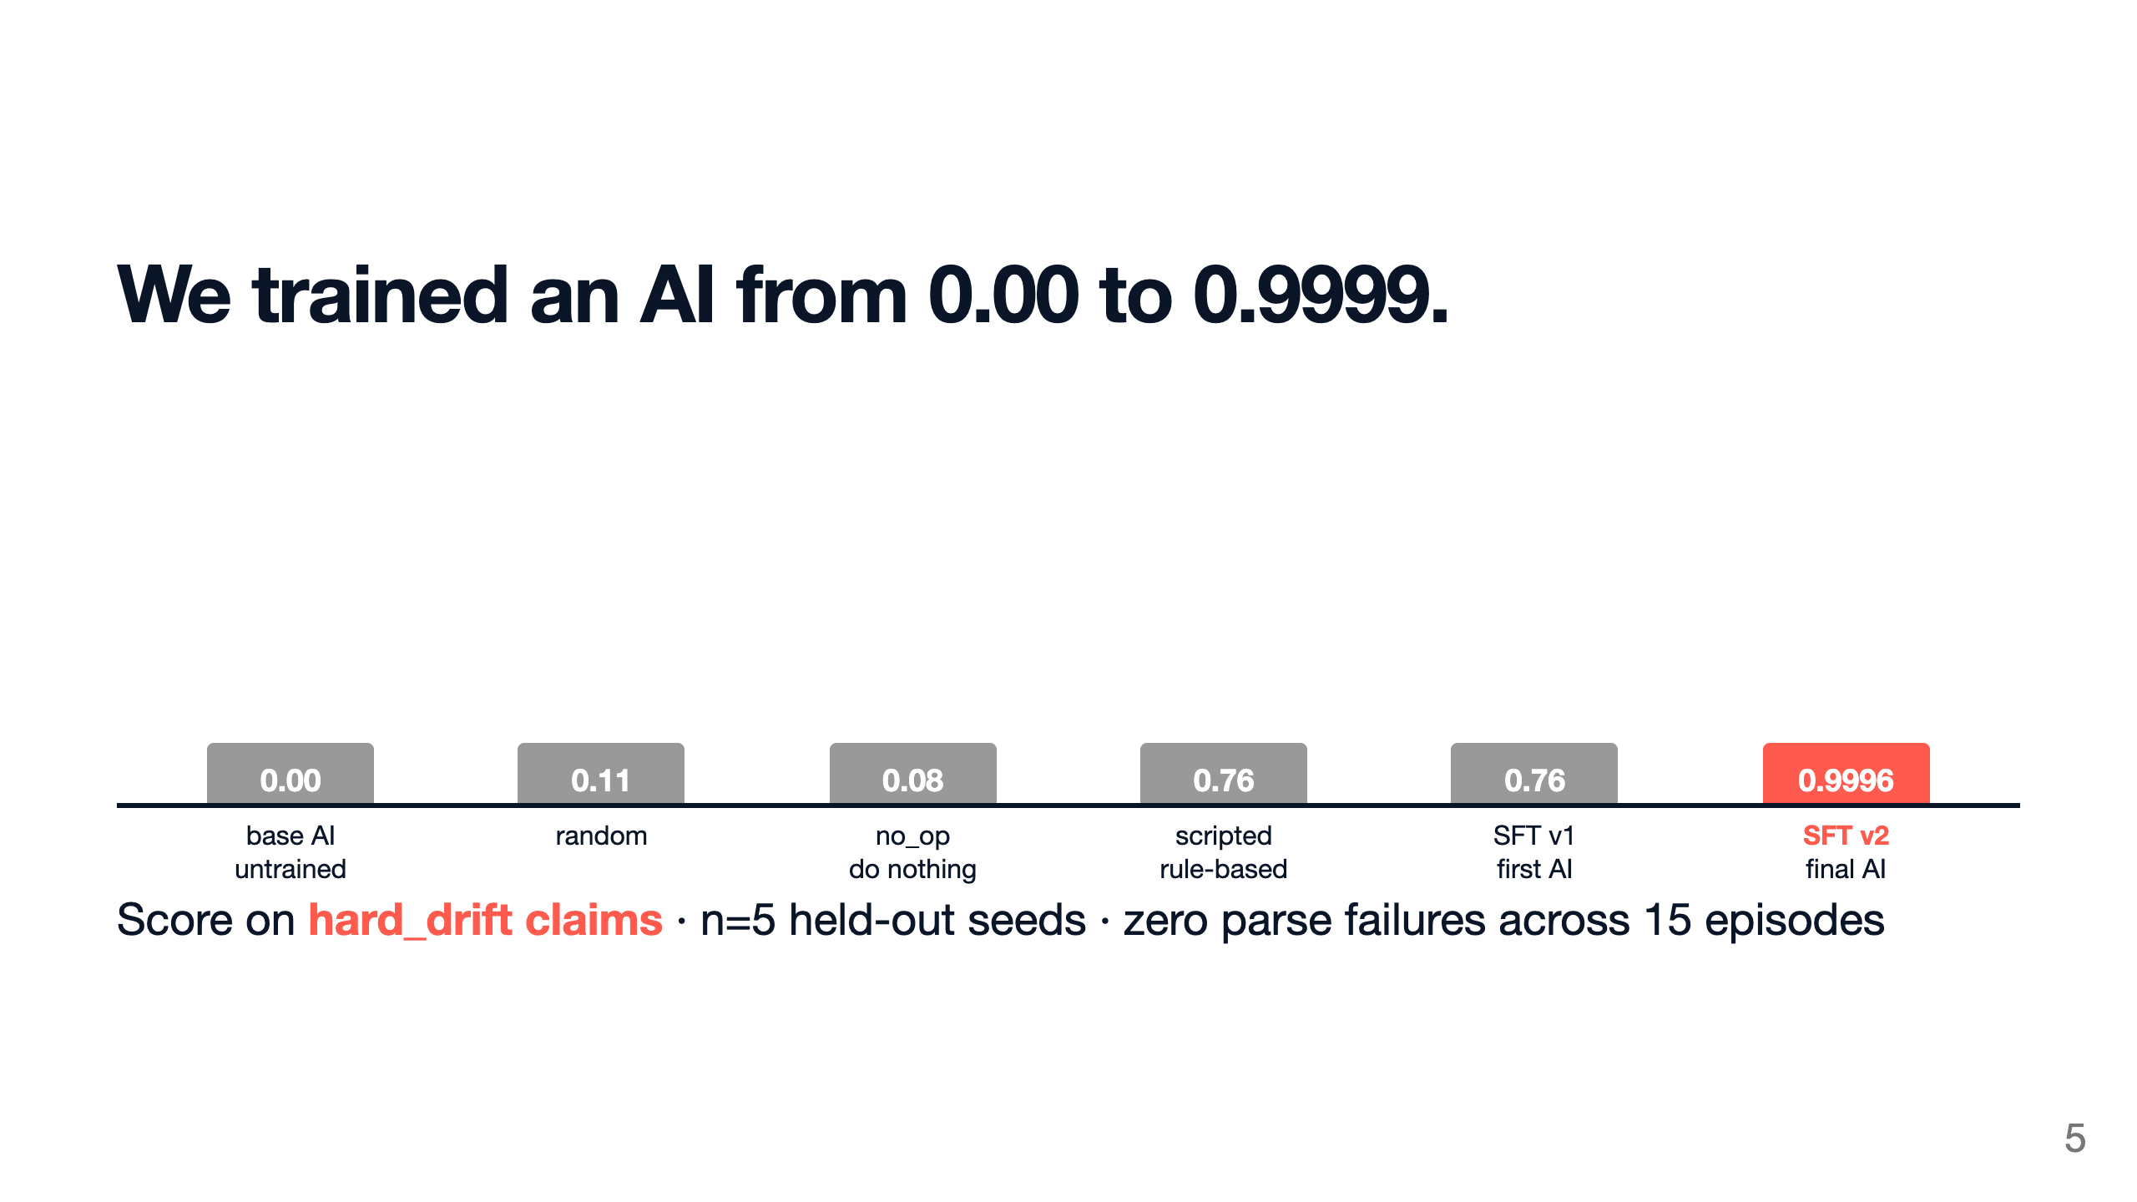
Notes:
Look at the bars. The untrained AI scores zero. Random guessing scores zero-point-eleven. Doing nothing scores zero-point-zero-eight. The rule-based scripted approach scores zero-point-seven-six. Our first trained AI, SFT v1, copied that scripted approach and matched it. We then tried reinforcement learning — GRPO — to push higher. Zero improvement. So we built a smarter scripted teacher that escalates ambiguous cases and re-checks the insurer before submitting. We retrained the AI from this smarter teacher. Result: zero-point-nine-nine-nine-six on hard claims. The next slide explains how.

Slide 6
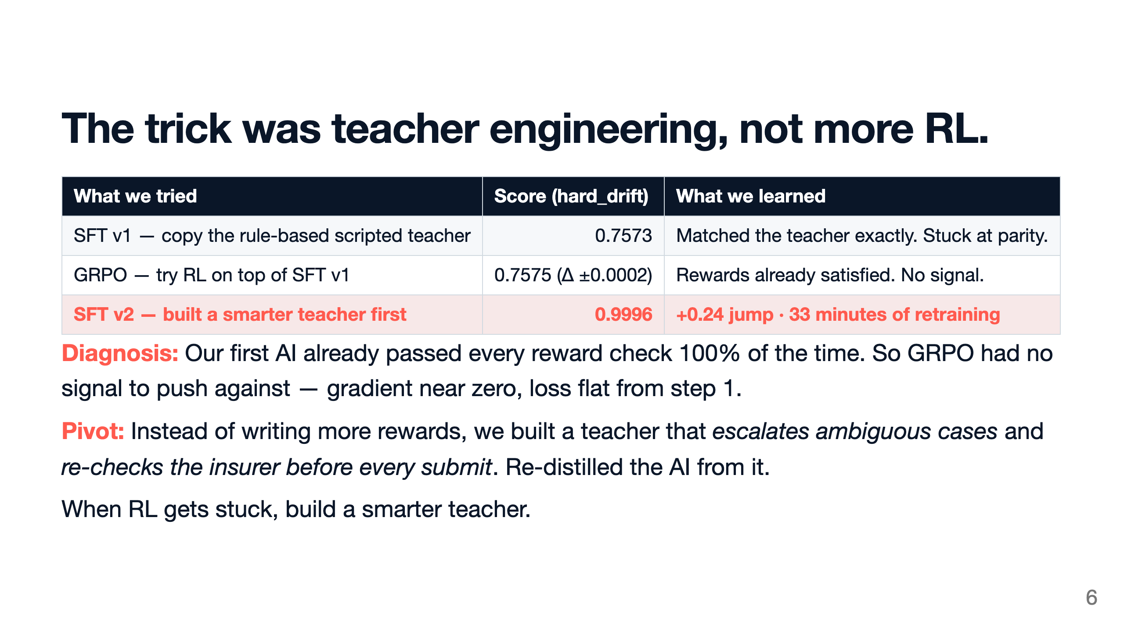
Notes:
Three rows. Row one: SFT v1 copied the rule-based scripted teacher and matched it at 0.7573. Row two: we ran GRPO with five reward functions, hoping to push higher — score change was plus or minus two ten-thousandths. Diagnosis: SFT had already extracted everything the rewards could measure, so the gradient was zero. Row three: we built a smarter teacher — escalates ambiguous cases, re-checks the insurer before every submit — and retrained the AI from it. 0.9996 on hard claims, in 33 minutes. The lesson: when RL gets stuck, the answer is sometimes a smarter teacher, not more reward shaping.

Slide 7
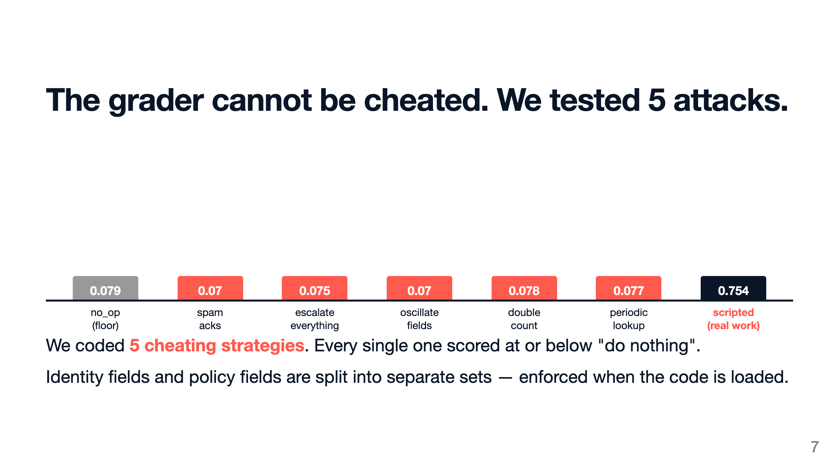
Notes:
Five different cheating strategies — spam acknowledgments, escalate every case, oscillate field values, double-count, periodic lookup. Every one of them scored at or below "do nothing". The only way to get a high score is to actually do the work. The grader splits identity fields and policy fields completely apart, and this split is enforced in the code itself when the module loads.

Slide 8
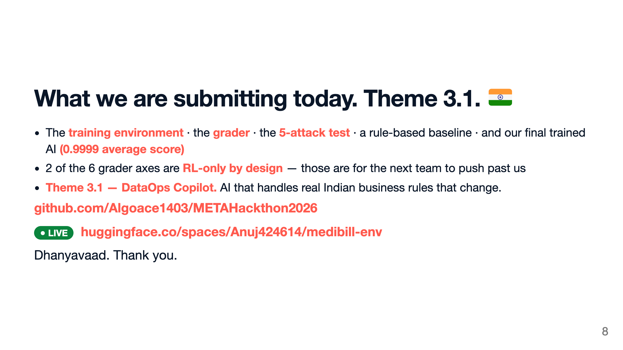
Notes:
What we are submitting under Theme 3.1, DataOps Copilot. The training environment, the six-axis grader, the five-attack test suite, a rule-based baseline, and our final trained AI at zero-point-nine-nine-nine-nine average. Two of six axes are RL-only by design, for the next team. Theme 3.1, DataOps Copilot — AI that handles real Indian business rules that change. Repo and live HuggingFace Space on screen. Dhanyavaad. Thank you.

Slide 9
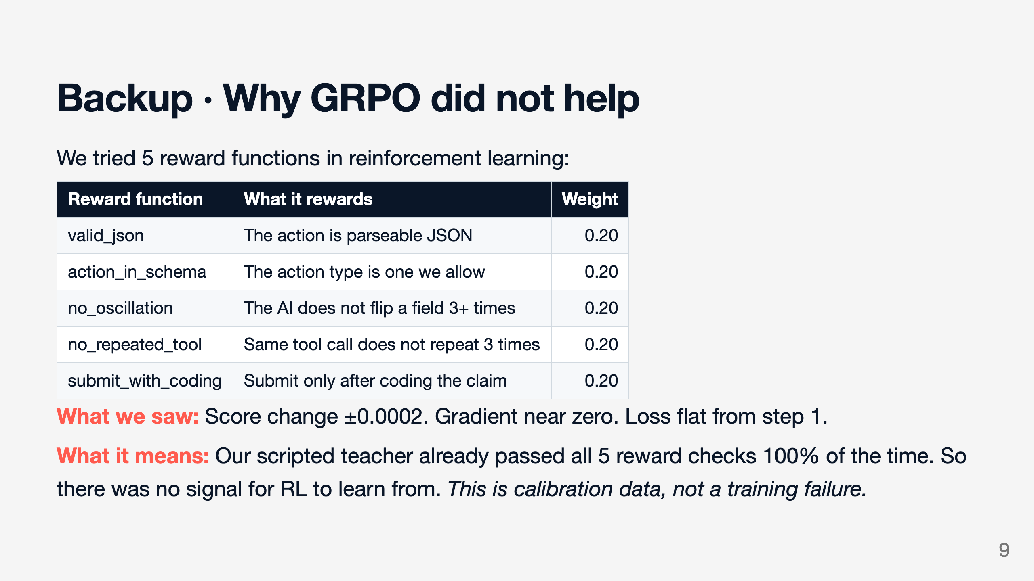

Slide 10
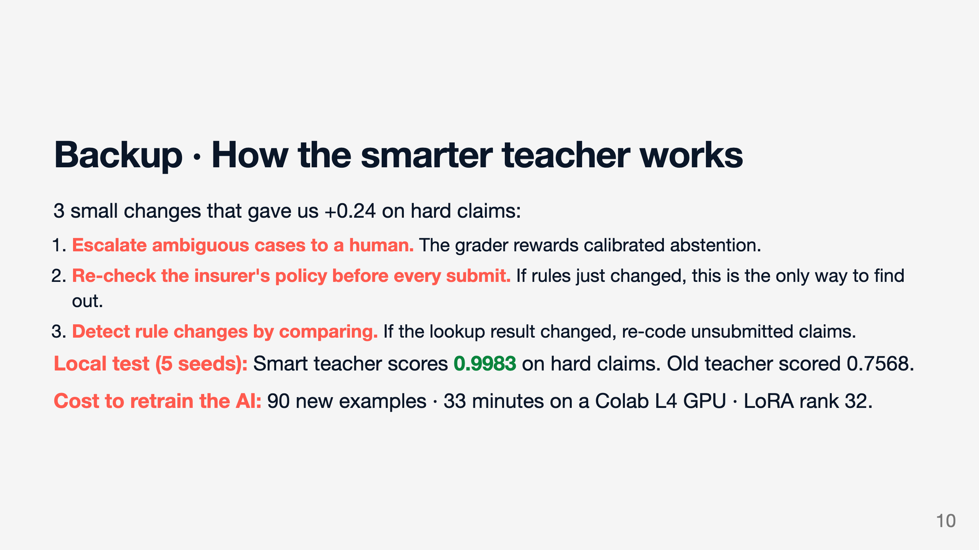

Slide 11
