Slide 1
CONTIGUOUS MEMORY
ALLOCATION SIMULATOR
Operating Systems Mini Project
Python + Streamlit | First Fit | Best Fit | Worst Fit

Slide 2
1. Problem Statement
• Processes require memory space before execution.
• Available memory is divided into blocks of different sizes.
• An allocation strategy must decide where each process should be placed.
• Different strategies can produce different allocation and remaining-memory patterns.
• This project simulates and compares First Fit, Best Fit, and Worst Fit.
Contiguous Memory Allocation Simulator | 2

Slide 3
2. Objectives
• Understand contiguous memory allocation.
• Implement First Fit, Best Fit, and Worst Fit.
• Accept custom memory block and process sizes.
• Display allocated and unallocated processes.
• Calculate used memory, remaining memory, and utilization.
• Visualize memory blocks and compare algorithms.
Contiguous Memory Allocation Simulator | 3

Slide 4
3. Inputs and Outputs
INPUTS
• Memory block sizes (KB): 100, 500, 200, 300, 600
• Process sizes (KB): 212, 417, 112, 426
• Selected allocation strategy
OUTPUTS
• Process-to-block allocation
• Unallocated processes and remaining memory
• Memory utilization and algorithm comparison
Contiguous Memory Allocation Simulator | 4

Slide 5
4. Allocation Algorithms
FIRST FIT — Allocates a process to the first suitable block found.
BEST FIT — Allocates a process to the smallest suitable block.
WORST FIT — Allocates a process to the largest suitable block.
Each algorithm updates the remaining size of the selected block after allocation.
Contiguous Memory Allocation Simulator | 5

Slide 6
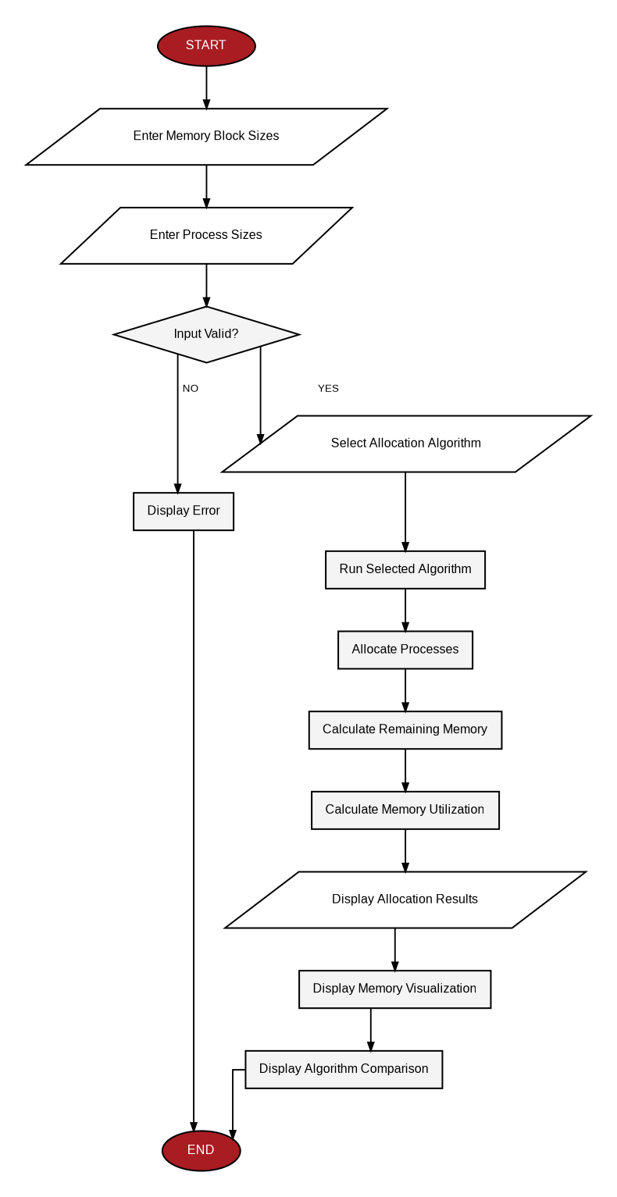
5. System Flowchart
Contiguous Memory Allocation Simulator | 6

Slide 7
6. System Design
app.py
• Streamlit user interface
• Input validation and algorithm selection
• Results, metrics, visualization, and comparison
algorithms.py
• first_fit()
• best_fit()
• worst_fit()
requirements.txt → Streamlit dependency
Contiguous Memory Allocation Simulator | 7

Slide 8
7. Project Structure
OsProject/
├── app.py
├── algorithms.py
├── requirements.txt
├── README.md
├── PROJECT.md
└── contiguous_memory_allocation_flowchart.png
Contiguous Memory Allocation Simulator | 8

Slide 9
8. Test Case Results
Test input:
Memory = [100, 500, 200, 300, 600] KB
Processes = [212, 417, 112, 426] KB
First Fit: 3 allocated, 1 unallocated
Best Fit: 4 allocated, 0 unallocated
Worst Fit: 3 allocated, 1 unallocated
Contiguous Memory Allocation Simulator | 9

Slide 10
9. Algorithm Comparison
Algorithm | Allocated | Unallocated
First Fit | 3 | 1
Best Fit | 4 | 0
Worst Fit | 3 | 1
The simulator presents these results without assuming one strategy gives the same outcome for every input.
Contiguous Memory Allocation Simulator | 10

Slide 11
10. Memory Utilization
Formula:
Memory Utilization = (Used Memory / Total Memory) × 100
Total Memory = 1700 KB
Best Fit: 1167 KB used → approximately 68.65%
First Fit: 741 KB used → approximately 43.59%
Worst Fit: 741 KB used → approximately 43.59%
Contiguous Memory Allocation Simulator | 11

Slide 12
11. User Interface
Streamlit GUI provides:
• Memory block and process input fields
• Allocation strategy selection
• Run Simulation button
• Process allocation table
• Memory utilization metrics
• Memory block visualization
• Compare All Algorithms charts
• Input validation and error messages
Contiguous Memory Allocation Simulator | 12

Slide 13
12. Future Enhancements
• Fragmentation analysis
• Memory deallocation
• Process arrival and termination
• Allocation history
• Animated memory visualization
• Export results to CSV/PDF
• Additional memory allocation strategies
Contiguous Memory Allocation Simulator | 13

Slide 14
13. Conclusion
• Demonstrates contiguous memory allocation using three classical strategies.
• Connects operating-system concepts with a working interactive application.
• Allows experiments with different block and process sizes.
• Makes allocation, remaining memory, utilization, and algorithm differences easy to observe.
Contiguous Memory Allocation Simulator | 14

Slide 15
14. Viva / Demo Flow
1. Explain contiguous memory allocation.
2. Explain First Fit, Best Fit, and Worst Fit.
3. Show the input fields.
4. Run each algorithm.
5. Explain the allocation table and remaining memory.
6. Use Compare All Algorithms.
7. Explain memory utilization.
8. Show the project structure and code modules.
Contiguous Memory Allocation Simulator | 15

