Slide 1
Algorithm
Shahriyar Mahmud
Golam Ibrahim
Apurba Sarkar
Arian khan Rifat
Nahid Reza

Slide 2
To know the basic of the question???
To know or understand the question???

Slide 3
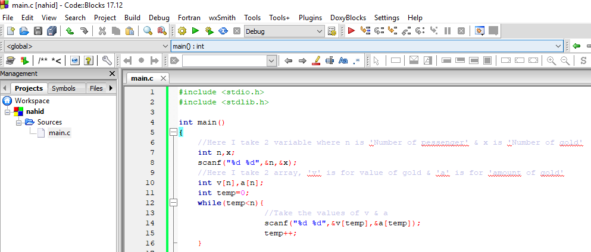
Code with documentation:

Slide 4
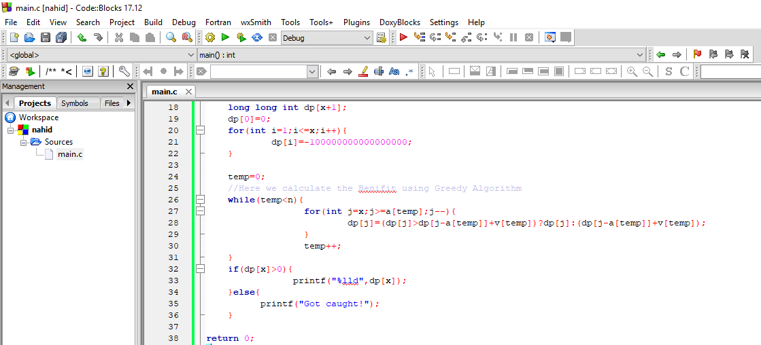

Slide 5
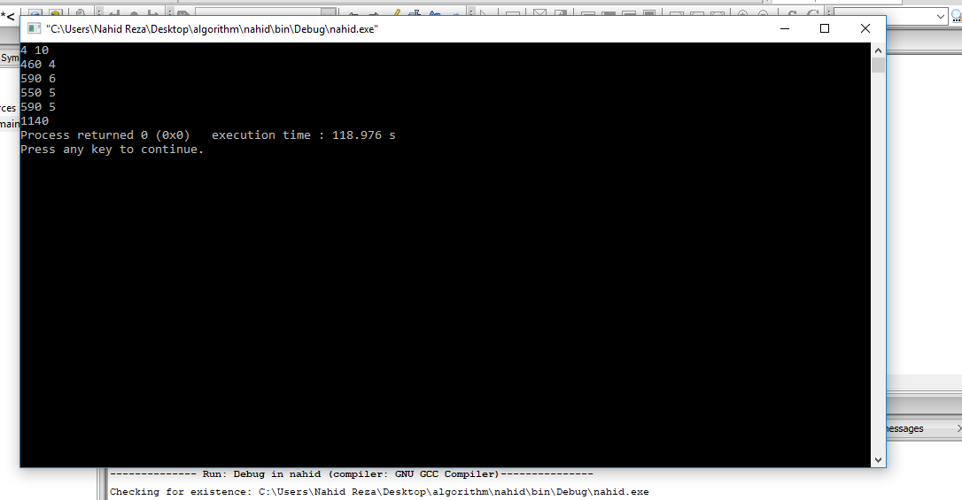
Screenshot of the Output:

Slide 6
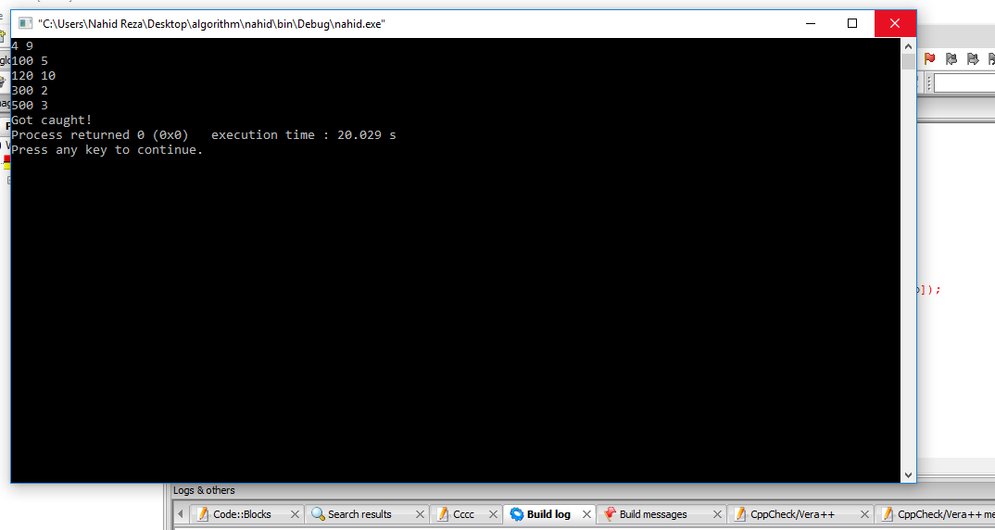

Slide 7
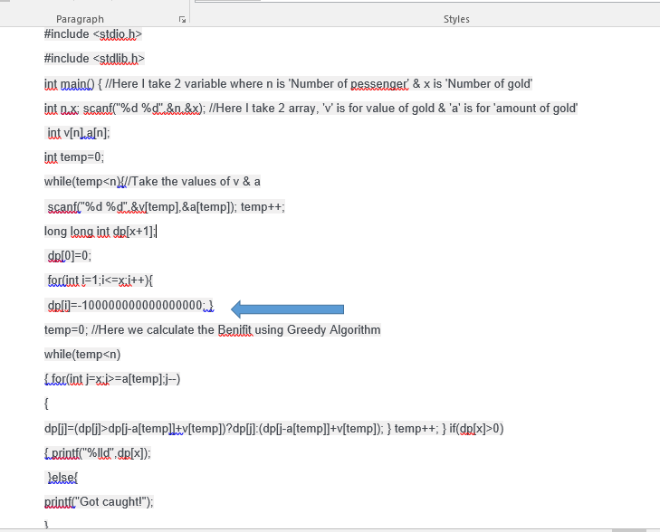
What kind of algorithm is used?
Greedy algorithm is used.
Reason:
Example: Huffman code

Slide 8
Referrences:
Github Link - https://github.com/AlgorithmG2/G2-of-algorithm
https://www.google.com/search?q=how+many+types+of+greedy+algorithm&rlz=1C1CHBF_enBD805BD805&oq=how+many+types+of+greedy+algorithm&aqs=chrome..69i57.13418j0j1&sourceid=chrome&ie=UTF-8
https://www.google.com/search?q=greedy+algorithm&rlz=1C1CHBF_enBD805BD805&source=lnms&tbm=isch&sa=X&ved=0ahUKEwiAtsDc1KffAhVKrY8KHfr6AEAQ_AUIDigB&biw=1366&bih=608
https://www.google.com/search?q=why+maximum+profit+in+greedy+algorithm&rlz=1C1CHBF_enBD805BD805&oq=why+maximum+profit+in+greedy+algorithm&aqs=chrome..69i57.19267j0j1&sourceid=chrome&ie=UTF-8

