Slide 1

Overtourism & Hospitality Real Estate Inflation: A Symbiotic Surge
Salem Alhabshi | Ben Kearney | Laice Rollins
HMG 6257: Hospitality Industry Research Analysis

Slide 2
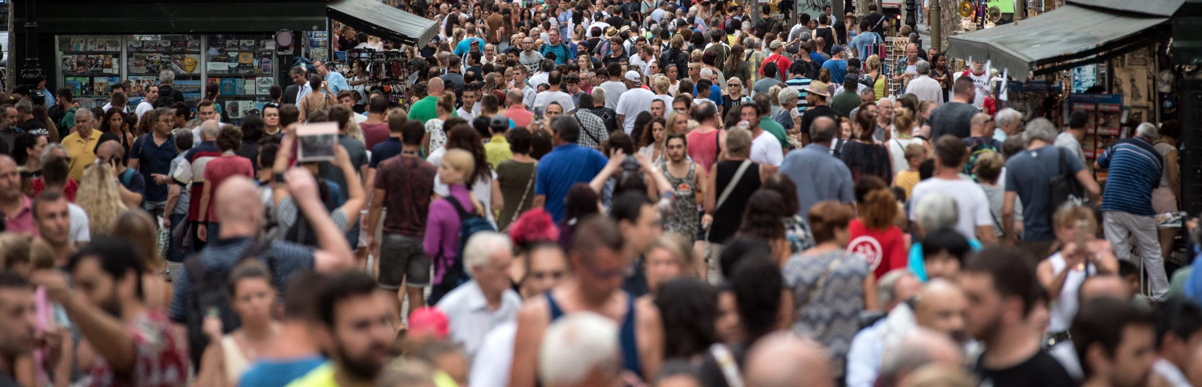
What Is Overtourism & Why It Matters
Define overtourism: excessive tourist volume overwhelming local infrastructure, culture, and environment
Show global tourism rebound post-COVID (revenge travel, Instagram-driven destinations)
Hospitality relevance: spike in demand for short-term rentals, hotel stays, and branded residences

Slide 3
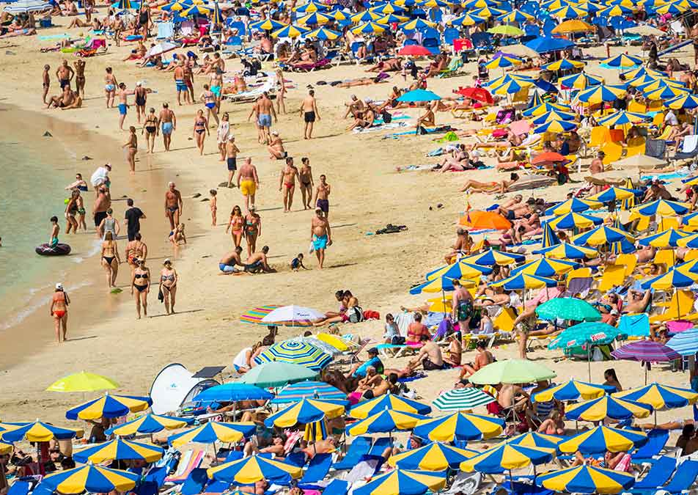
What’s Driving the Surge?
Social media & influencer culture (Instagrammable spots)
Rise of flexible work and global mobility (digital nomads, pied-à-terre buyers)
Hospitality platforms (Airbnb, Vrbo) expanding inventory during peak seasons
Government incentives for tourism development

Slide 4
Where is Overtourism being felt?
According to Fodor's No List 2025
Bali, Indonesia: "Post-pandemic travel rebound has only intensified the strain on the island. While this influx has boosted the economy, it has also placed overwhelming pressure on Bali’s infrastructure."
Europe: "According to the European Travel Commission, the number of visitors in the first quarter of 2024 alone was 7.2% higher than before the pandemic. This influx isn’t just clogging neighborhoods with excessive foot traffic, it’s altering the very fabric of society: raising the cost of living, straining infrastructure and natural resources, and homogenizing the culture of Europe’s most popular places. "
Koh Samui, Thailand: Season 3 of HBO's 'The White Lotus' filmed in Thailand, and experts are concerned how the popularity of the show will influx a place that has long struggled with overtourism.
Places Fodor warns of "Beginning to Suffer"
Sicily, Italy (Severe water issue)
British Virgin Islands (Cruise market taking away from local businesses)
Kerala, India (Rise in tourism has exasperated the devastation from natural disasters)
Tokyo and Kyoto, Japan (Overflow of international tourists)
Oaxaca, Mexico (Locals are complaining their culture and customs are being commercialized, leading to large wealth gaps and environmental degradation.)

Slide 5
What’s Driving the Surge?
Visuals:
- Airbnb listings growth
- Remote work lifestyle infographic
- Quote: “Flexibility is now the ultimate luxury.”

Slide 6
The Ripple Effect on Real Estate
- Hospitality real estate prices surge in tourist hotspots (e.g., NYC, Miami, Barcelona)
- Developers prioritize luxury hotel-branded residences
- Local housing affordability declines
- Future: more gated hospitality zones, investor-led urban reshaping
Visuals:
- Price per square foot comparison (pre/post overtourism)
- Branded residence examples (Ritz-Carlton, etc.)
- Graph: tourism vs. real estate value correlation

Slide 7
Possible solutions
Adaptive Co-Management Move from top-down governance to participatory management that includes local communities, NGOs, and private stakeholders in decision-making.
Carrying Capacity & Visitor Limits Apply tools like Limits of Acceptable Change (LAC) and reservation systems to regulate overcrowding and protect fragile ecosystems.
Policy & Regulation Introduce tourism taxes, limit short-term rentals (e.g., Airbnb), restrict cruise ships, or temporarily close sites for ecological recovery.
Sustainable Tourism Development
Encourage eco-lodges, locally sourced materials, and diversification of the economy to reduce over-dependence on mass tourism.

Slide 8
Possible AI solutions
Smart Monitoring & Data Analytics
Use sensors, GPS tracking, and AI to monitor real-time visitor flows, detect congestion points, and predict peak periods.
Digital Twin for Destinations
A digital twin is a virtual replica of a physical destination (e.g., a national park, heritage site, or even a city center).
It simulates tourist movements, infrastructure stress, and environmental impacts under different scenarios.
Managers can test “what if” strategies before implementing them — for example:
What happens if daily visitors increase by 20%?
How would restricting access to one trail affect biodiversity?
Which areas will suffer most from overcrowding?
Already used in mega-events (e.g., Paris 2024 Olympics) and urban planning, and it can be applied to hospitality real estate hotspots to optimize traffic, safety, and sustainability.
Smart Reservation & Pricing Systems Integrate apps that allow timed-entry tickets, dynamic pricing based on demand, and distribution of visitors to less crowded areas.

Slide 9
How Hospitality Can Respond
Several destinations have already begun protocols to combat overtourism
Miami Beach: Marketing campaign aimed at informing potential spring breakers that disorderly behavior will no longer be tolerated, emphasizing the strict enforcement of existing laws and regulations (Spezzano 2024).
Spain: Spain's Consumer Rights Ministry ordered the removal of over 65,000 Airbnb listings, aiming to curb overtourism and protect housing for residents. (Ledsom 2025).
Italy: Limiting the amount of cruise ships in Venice.
Copenhagen: Rewarding guests with free food for cleaning up around the city.

Slide 10
Rethinking Hospitality Expansion: Sustainable Investment in Emerging Markets
Shift from saturated markets to emerging destinations
Investors are increasingly exploring countries like Colombia, Vietnam, and Rwanda — rich in culture but not yet overwhelmed by mass tourism.
Build with sustainability at the core
Emphasize eco-lodges, locally sourced materials, and community-integrated designs to avoid extractive development.

Slide 11
Reference List (APA style)
Fodor's Editors. (2024, November 13). Fodor’s No List 2025 - 15 Destinations to Reconsider in 2025. Fodors Travel Guide. https://www.fodors.com/news/news/fodors-no-list-2025
Ledsom, A. (2025, June). Spain Overtourism: Housing Crisis Sparks Bold Reforms. Forbes. https://www.forbes.com/sites/alexledsom/2025/06/01/spain-overtourism--housing-crisis-sparks-bold-reforms/
Spezzano, W., & Lusby, C. (2024). Mitigating Overtourism in Miami Beach Through Sustainable Destination Branding: A Tourism Discourse Analysis of the Anti-Spring Break Marketing Campaign. 21st SIM Conference: Brands and Purpose in a Changing Era.
https://www.researchgate.net/publication/385776477_Mitigating_Overtourism_in_Miami_Beach_Through_Sustainable_Destination_Branding_A_Tourism_Discourse_Analysis_of_the_Anti-Spring_Break_Marketing_Campaign
‌
‌
Gretzel, U. (2021). Technological solutions to overtourism: Potential and limits. In Mediterranean protected areas in the era of overtourism: Challenges and solutions (pp. 337-349). Cham: Springer International Publishing.

