Slide 1

Seminar: Advanced Topics in Animation
Presenter: Alhajras Algdairy
Instructor: Dr.-Ing. Matthias Teschner
University: University of Freiburg

Slide 2
Bounding Volume Hierarchies
Alhajras Algdairy

Slide 3
Introduction
BVH is simply a tree structure that represents geometric models with specific bounding volumes.
Computer graphics focus: Data structure.
Tree structure.
Alternative to space subdivision

Slide 4
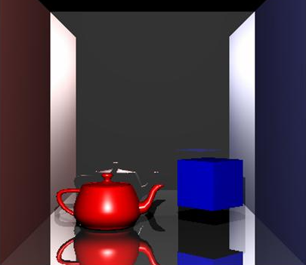
Motivation
Applications:
Collision detection
Ray tracing
Performance improvements
Focus of the presentation:
Comprehensible understanding of BVH
Scratching the surface of OBB and AAC
Fig. 2. Raytracing
Fig. 1.Collision detection

Slide 5
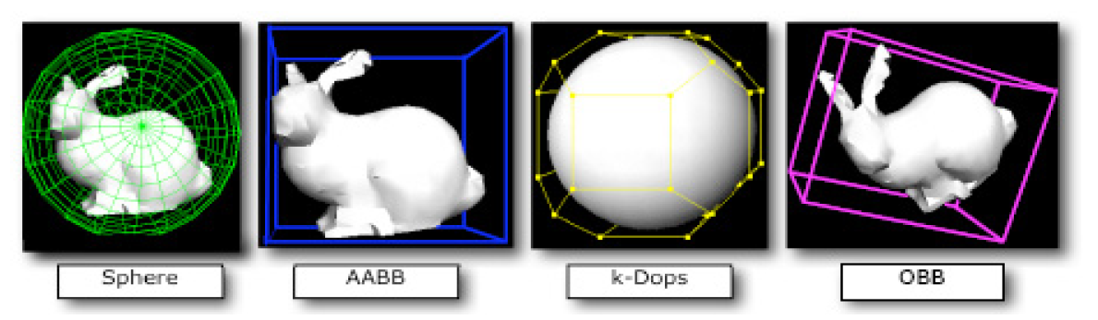
Bounding-volume
The purpose of using BV is to reduce the computational cost to detect object interference.
Types:
Spheres
Axis Aligned Bounding Box (AABB)
Discrete Oriented Polytope (k-DOP)
Oriented Bounding Box (OBB)
Fig. 3. Common Bounding Volume in previous researches (Suaib et al., 2008, Bade et al.,2006).

Slide 6
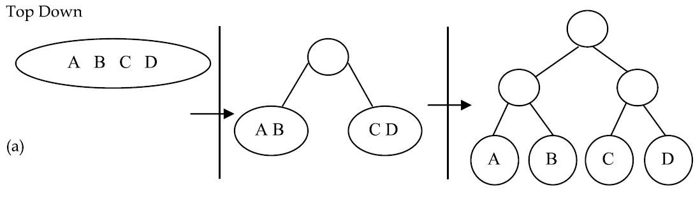
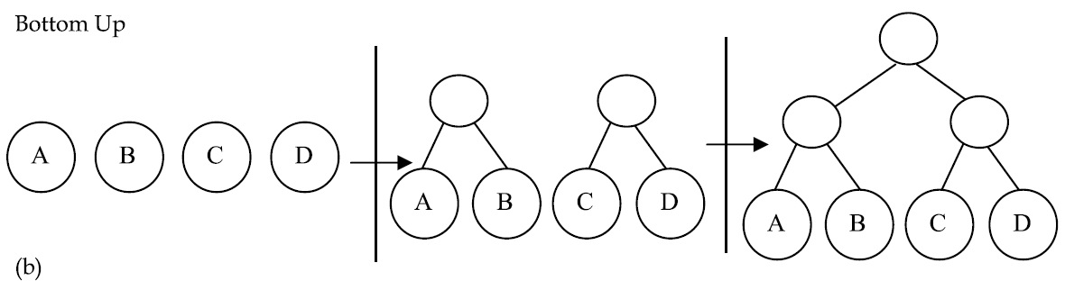
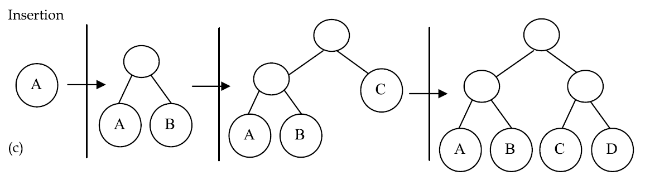
Building up the tree
Top Down: Most popular technique to be used to construct
hierarchy tree, uses ‘fit and split’, O(lgn) depth for balanced partition, in average building time nlogn
Bottom Up: More complicated to put into as it has slower construction time but it is efficient in producing the best tree, fit each BV and merge them, n-1 merges for n polygons.
Insertion: The problem of this method is that it can become worst as it depends on the insertion order of the nodes, propagate upward to the root.
Note: Depending on the application type, they might not always produce the best result.
Fig. 5. Hierarchy (Ericson, 2004).

Slide 7
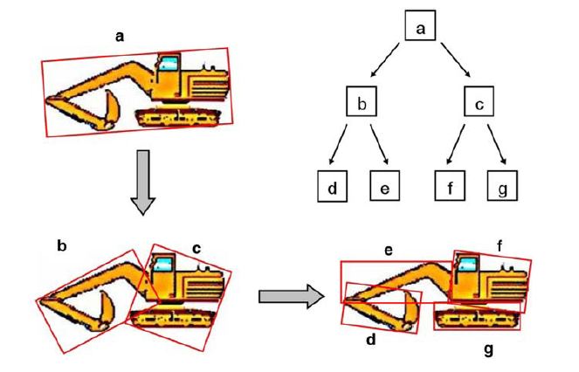
TREE CONSTRUCTION
Meanwhile, (Gottschalk et al., 1996) constructed OBB trees using top-down approach. The first procedure is to enclose all primitives by an oriented bounding box, and the recursive partition is made possible by using certain rules. Their subdivision rule proposed as applied to the object is to find the longest axes and the splitting point is determined through an orthogonal plane on one of its axes. Objects are partitioned according to the side of the splitting point but this does not involve the primitive. Figure 8 and 9 depicts the splitting example (Gottschalk et al., 1996).
(a) Object median splitting (b) Object mean splitting (c) Spatial median
splitting based on (Ericson, 2004)
Fig. 5. OBB tree recursively divides the object into two parts using binary tree and top-down
approach (Kamat and Martinez, 2007).

Slide 8
Partitioning strategies and splitting algorithm
The simplest way to partition an object is to split the object equally with respect to local coordination axes of the object. The split can be done according to the median-cut algorithm style or several other strategies as follows(Ericson, 2004):-
• Minimize the sum of the volumes (or surface areas) of the child volumes. Minimizing the sum of value can effectively minimize the probability of intersection - tightness bounding volume must be used.
• Minimize the maximum volume (surface area) of the child volumes. Divides the child volume into equal size by making larger volume as small as possible.
• Minimize the volume (surface area) of the intersection of the child volumes. Complex to be implemented as it depends on the tightness of bounding volume.
• Minimize the separation of the child volumes. Where each child will be separated, it helps to decrease the probability of both children being traversed at the same time.
• Divide primitives equally between the child volumes. Divide the object into two equal parts as mentioned earlier.
• Hybrid combination of multiple bounding-volumes

Slide 9

Fitting an obb
Orientation, centre, minimal edge length.
Calculating the covariance matrix.

Slide 10
For a binary BVH that stores a single primitive in each leaf, the total number of nodes is 2n -1
where is the number of n primitives. There will be leaf nodes and n-1 interior nodes
four algorithms to use when partitioning primitives to build the tree, Split Methods : SAH, HLBVH, Middle, EqualCounts

Slide 11
Final result and goal
−Collision detection is an essential part of physically realistic dynamic simulations
In each time step
Detect collisions
Resolve collisions
Compute dynamics

Slide 12
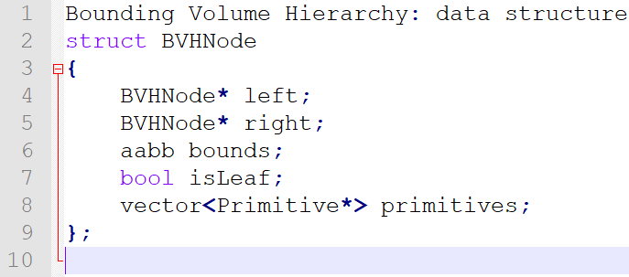
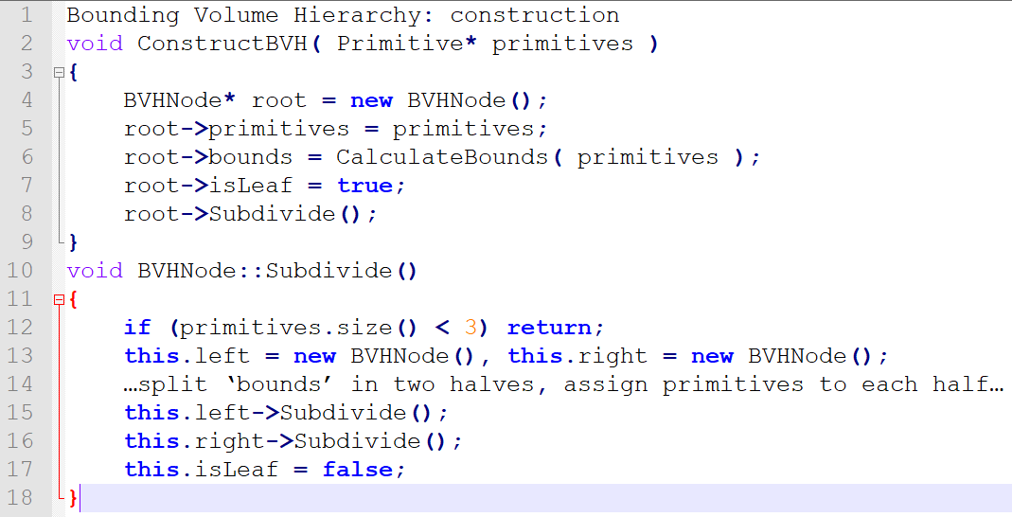
CODE

Slide 13
Main part
Main part
Should consist of distinguished sections
Separate different sections of the presentation explicitly
Each section should be introduced and summarized
−Introduction
Bounding volumes BV
Hierarchies of bounding volumes BVH
Generation and update of BVs
Design issues of BVHs
Performance

Slide 14
Benchmark and anlysis
Which method is better?

Slide 15
Summary
Summary
Selection sort is  Collision detection for polygonal models is in o(n^2)
Tell the audience what you have told them
Ask for questions
Alternative: Regular space subdivision

