Slide 1





Access Layer
IT
HR
Management
Sales
Finance
Support
straight through

Slide 2

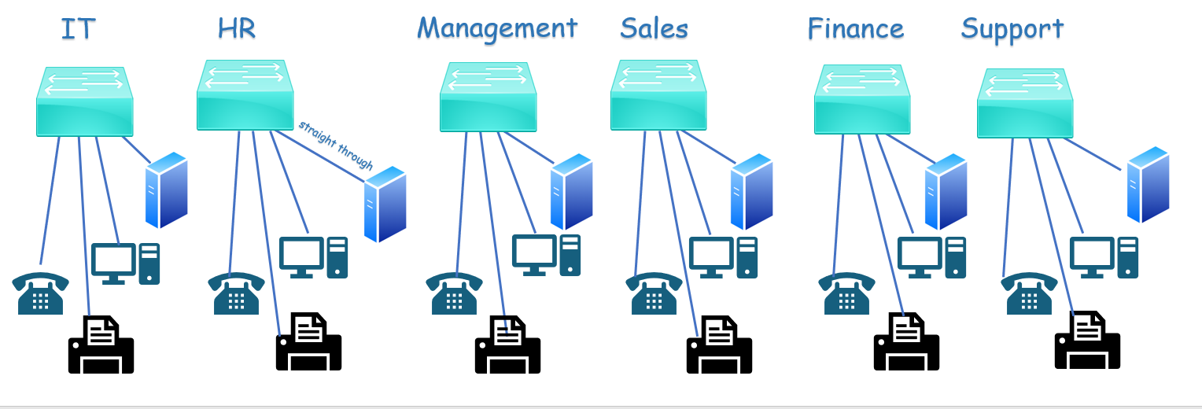
Distribution layer
Cross Over
Distribution layer
G1/0/1-6
F0/1-3
Access layer

Slide 3

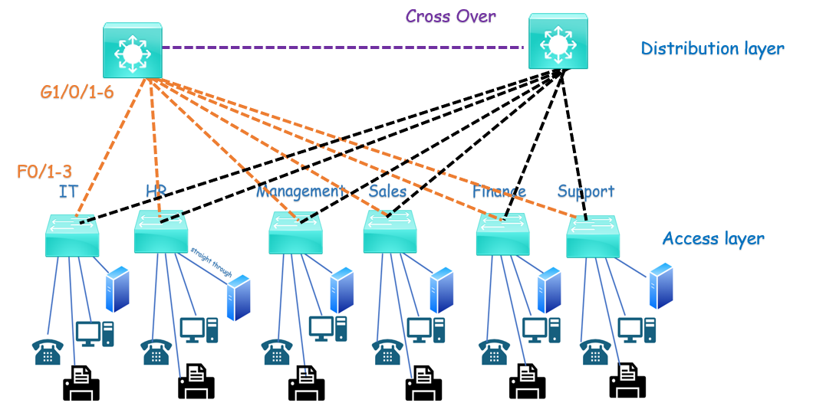
Core Layer
ISP
ISP
S0/0/0
S0/0/0
Core Layer
Fiber Optic

