Slide 1
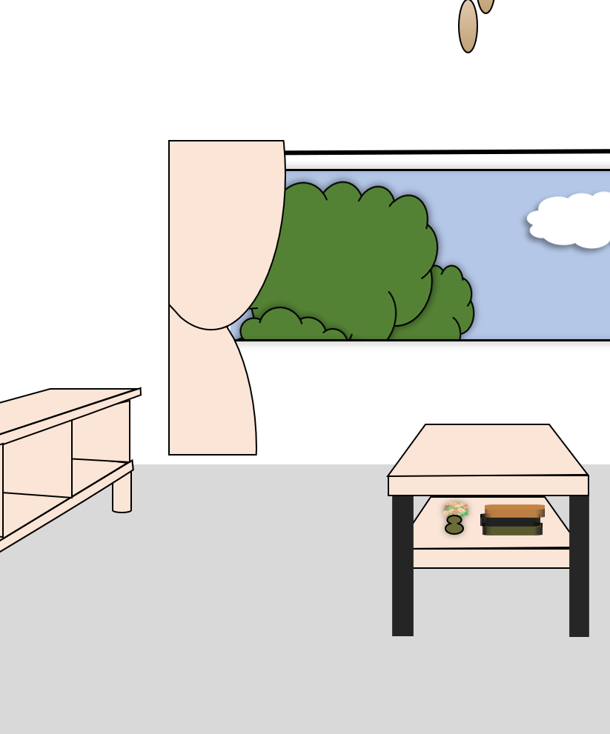


A Clueless Detective

