Slide 1
Max

Slide 2
Leo

Slide 3
Tina

Slide 4

Sasha

Slide 8
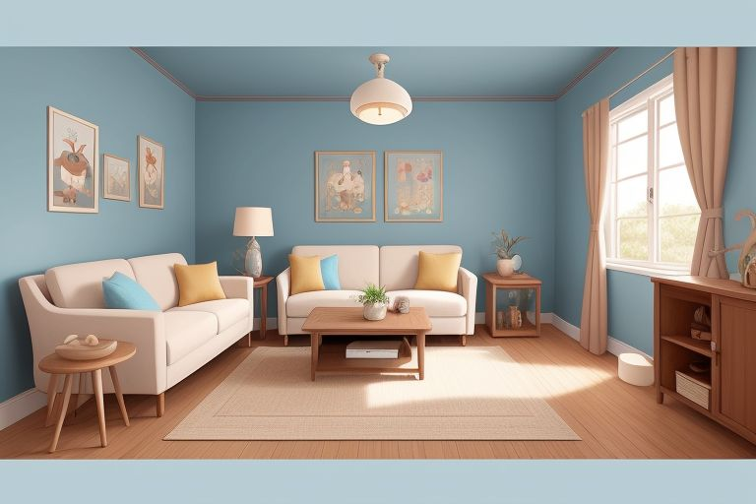

Slide 9
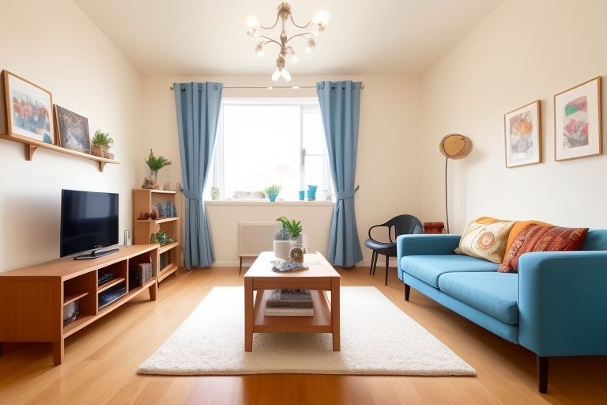

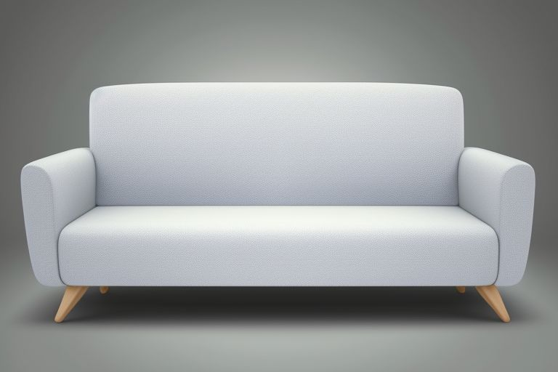

Tina

Slide 10


Slide 13
Tina

Slide 14
Laugh Lane - 1

