Slide 1

G is for Giraffe!

Slide 2
Gg
Hh
Ii
Jj
Kk
Ll
Mm
Nn
Oo
Pp
Qq
Rr
Ss
Tt
Uu
Vv
Ww
Xx
Yy
Zz

Slide 3
G g

Slide 4
Giraffe

Slide 5
Goat

Slide 6
Gift

Slide 7
Frog
Giraffe

Slide 8
G g
Giraffe

Slide 9
Giraffe
Goat
Gift

Slide 10
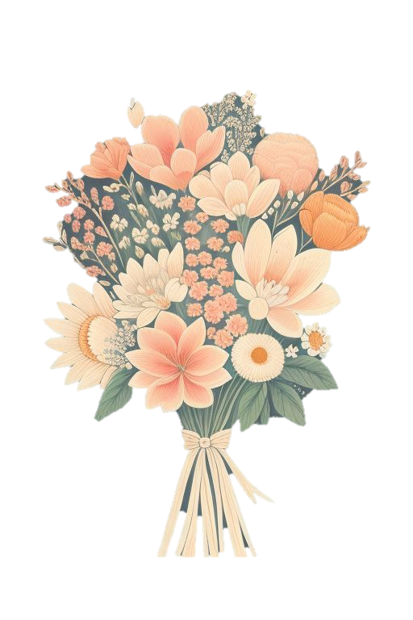
Gabby the Goat Goes to the Garden

Slide 11
Gabby the Goat Goes to the Garden

Slide 12
Gabby the Goat is looking for something to eat.

Slide 13
She finds a green garden full of vegetables.

Slide 14
Gabby eats grass and crunchy carrots.

Slide 15
“Yum!” says Gabby. “I love the garden!”

Slide 16
G is for Goat
G is for Giraffe

Slide 17
Giraffe
Goat
Gift

