Slide 2
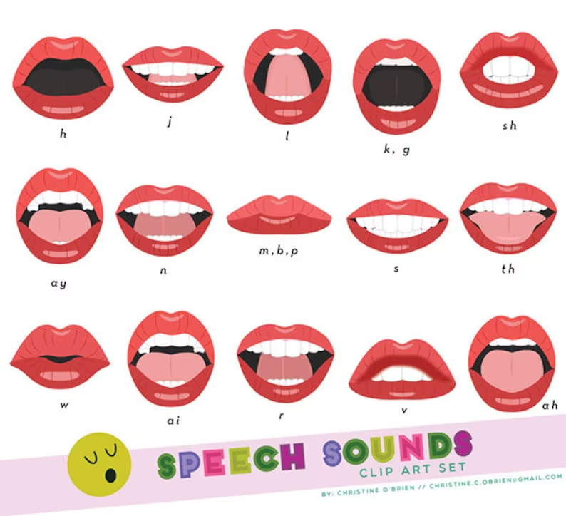


Slide 3
m, b, p
ah
sh
s
K, g
l
h
th
j
n
ay
v
f
w

