Slide 1

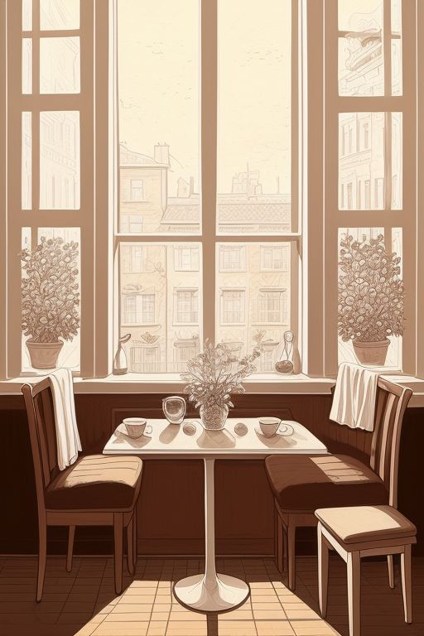





Slide 2


Slide 11
Gsjgdgdgeiehd jndkjnhvhikv lejnvlkinrlvinkjv;kjv ]wlec’lwv,’e’vrd’, v
Ljcnkncknlk;EWLVLEwlvj”Pwke’vpkw;kvk;/lrdvp;,l /
Ms,mc ,MDNKWM;VLN/’LMV’Q
M,CM L.KM;VLWWLMV ‘
JLNCKNKKJIJIJijijJZAOJX;SO PDOJODOKK OKOKKKKKKKKKKKKKKKKKKKKKKKKKKKKKKKKKKKKKKKKKKKKKKKKKKKKKKKKKKKKKKKKKKKKKKKKKKKKKKKKKKKKKKKKKKKKKKKKKKKKKKKKKKKKKKKKKK
MN ,SK,KDNLSKNDKLSKDNKNDK;M;SKMD;SLDL,MND,CJNSLKDLOWIEHIKEKWJLIJ

Slide 12
Gsjgdgdgeiehd jndkjnhvhikv lejnvlkinrlvinkjv;kjv ]wlec’lwv,’e’vrd’, v
Ljcnkncknlk;EWLVLEwlvj”Pwke’vpkw;kvk;/lrdvp;,l /
Ms,mc ,MDNKWM;VLN/’LMV’Q
M,CM L.KM;VLWWLMV ‘
JLNCKNKKJIJIJijijJZAOJX;SO PDOJODOKK OKOKKKKKKKKKKKKKKKKKKKKKKKKKKKKKKKKKKKKKKKKKKKKKKKKKKKKKKKKKKKKKKKKKKKKKKKKKKKKKKKKKKKKKKKKKKKKKKKKKKKKKKKKKKKKKKKKKK
MN ,SK,KDNLSKNDKLSKDNKNDK;M;SKMD;SLDL,MND,CJNSLKDLOWIEHIKEKWJLIJ

