Slide 1
Ruby the Rabbit Runs in the Rain
Leo the Lion Loves Lollipops

Slide 2
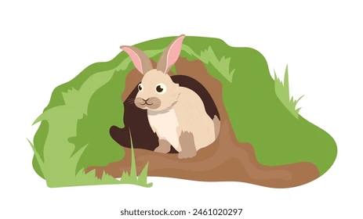

Slide 3
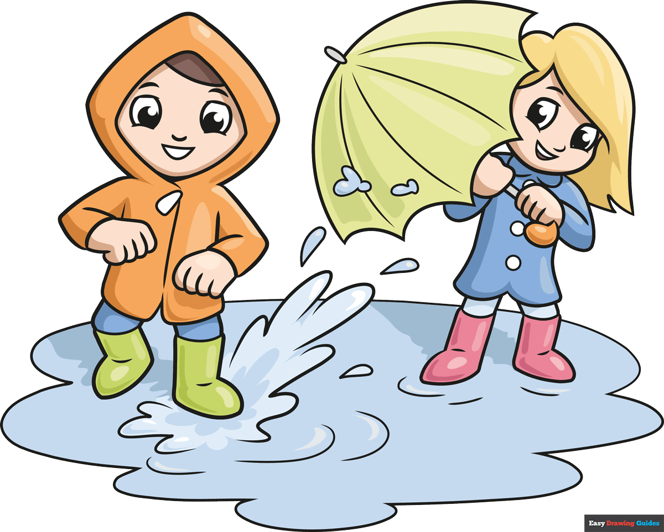

Slide 6


Slide 7
Ruby the Rabbit sees rain falling.

Slide 8
She runs and jumps in a puddle.

Slide 9
“Splash, splash!” Ruby laughs and runs some more.

Slide 10
Ruby loves running in the rain.

Slide 11
R is for Rabbit
R is for Rain

