Slide 1
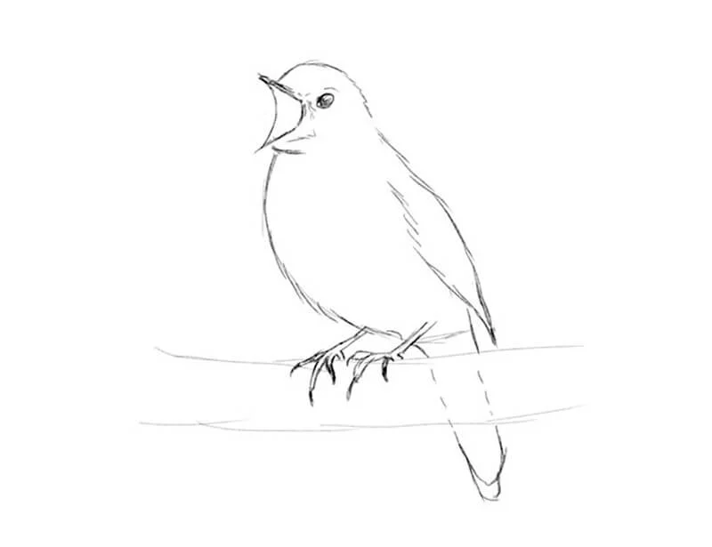
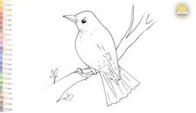
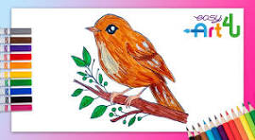

Slide 4
Nina the Nightingale Sings a Song
Leo the Lion Loves Lollipops

Slide 5
Nina the Nightingale loves to sing.

Slide 6
At night, she sings a sweet song.

Slide 7
The stars twinkle as she sings.

Slide 8
“Tweet-tweet!” says Nina. “I love the night.”

Slide 9
N is for Nightingale
N is for Night

