Slide 1
Sammy the Snail Slides in the Sand
Leo the Lion Loves Lollipops

Slide 2
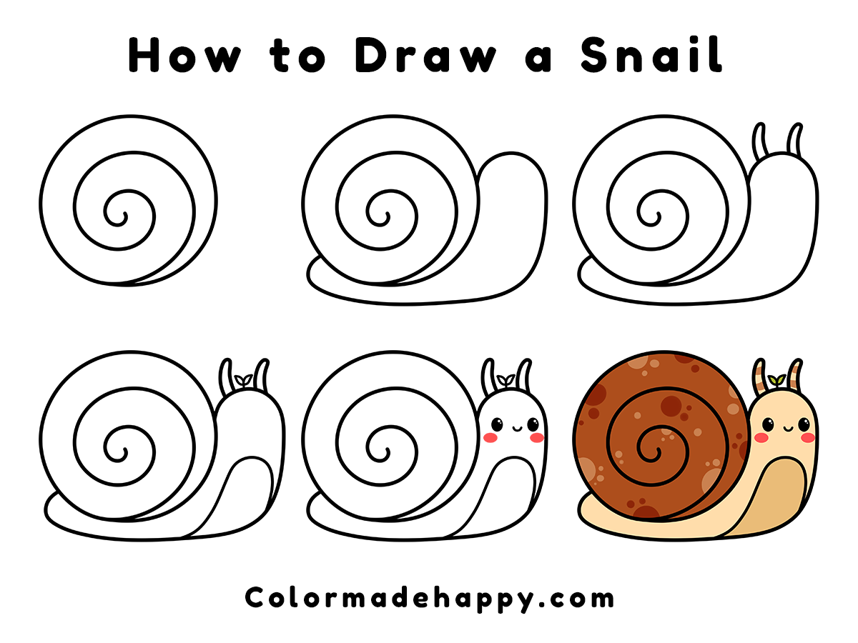

Slide 5
Sammy the Snail lives by the sea.

Slide 6
He slides slowly across the sand.

Slide 7
“Swish, swish!” The sea waves splash nearby.

Slide 8
Sammy sees a starfish and smiles.

Slide 9
S is for Snail
S is for Starfish

