Slide 3
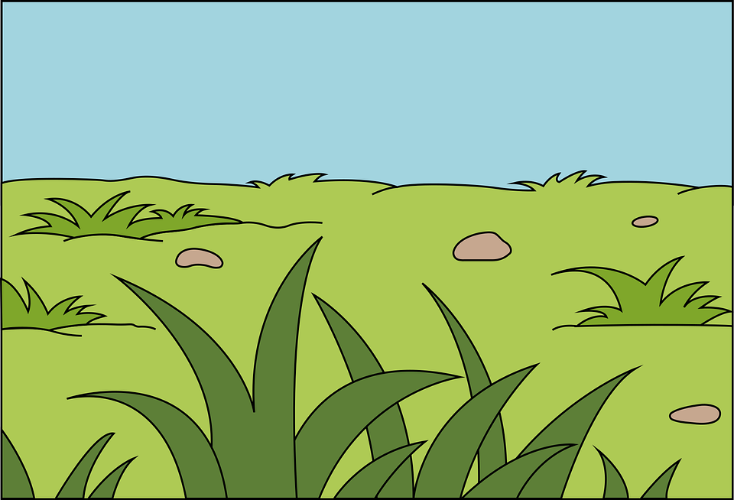

Slide 4
Quincy the Quail Finds a Quilt
Leo the Lion Loves Lollipops

Slide 5
Quincy the Quail walks in the grass.

Slide 6
He finds something soft and colorful.

Slide 7
Quincy picks it up. “It’s a quilt!” he says.

Slide 8
He sits on the quilt. “So cozy!” says Quincy.

Slide 9
Q is for Quail
Q is for Quilt

