Slide 3
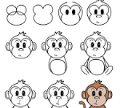

Slide 4
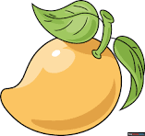

Slide 5
Molly the Monkey Loves Mangoes
Leo the Lion Loves Lollipops

Slide 6
Molly the Monkey climbs a tree.

Slide 7
She finds some yummy mangoes.

Slide 8
Molly picks a mango and takes a big bite.

Slide 9
“Wow!” says Molly. “Mangoes are the best!”

Slide 10
M is for Monkey
M is for Mango

