Slide 1
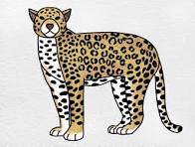

Slide 2
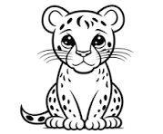

Slide 3
Jack the Jaguar Jumps

Slide 4
Jack the Jaguar loves to jump.

Slide 5
He jumps over a big rock.

Slide 6
Then he jumps into a jungle pond.

Slide 7
“Splash!” says Jack. “Jumping is so much fun!”

Slide 8
J is for Jaguar
J is for Jump

