Slide 7
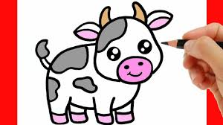

Slide 8
Victor the Vet Visits the Village
Leo the Lion Loves Lollipops

Slide 9
Victor the Vet drives his van to the village.

Slide 10
He helps a sick puppy.

Slide 11
He visits a farm to see the cows and the sheep.

Slide 12
“Thank you, Victor!” says the villagers.

Slide 13
V is for Vet
V is for Van

