Slide 1
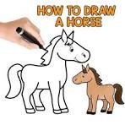

Slide 2
Gabby the Goat Goes to the Garden

Slide 3
Harry the Horse loves to play.

Slide 4
He hops over a hill.

Slide 5
Then he hops over a log.

Slide 6
“Whee!” says Harry. “Hopping is fun!”

Slide 7
H is for Horse
H is for Hop

