Slide 1
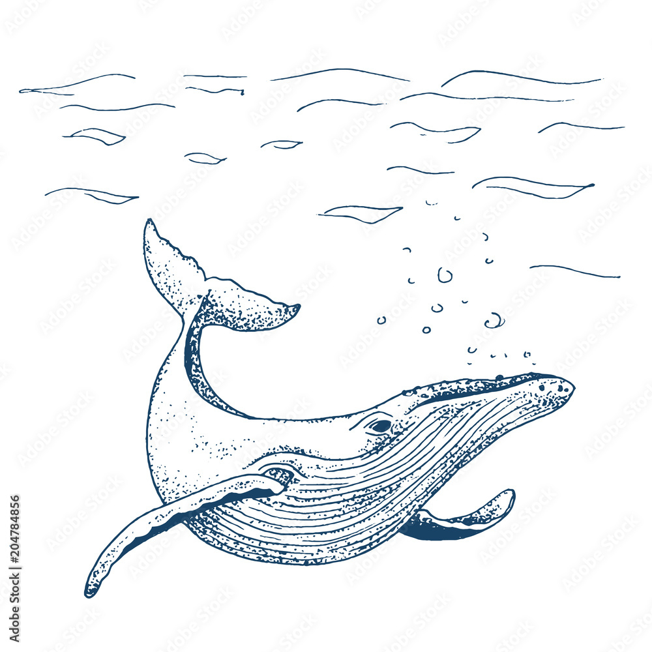

Slide 3
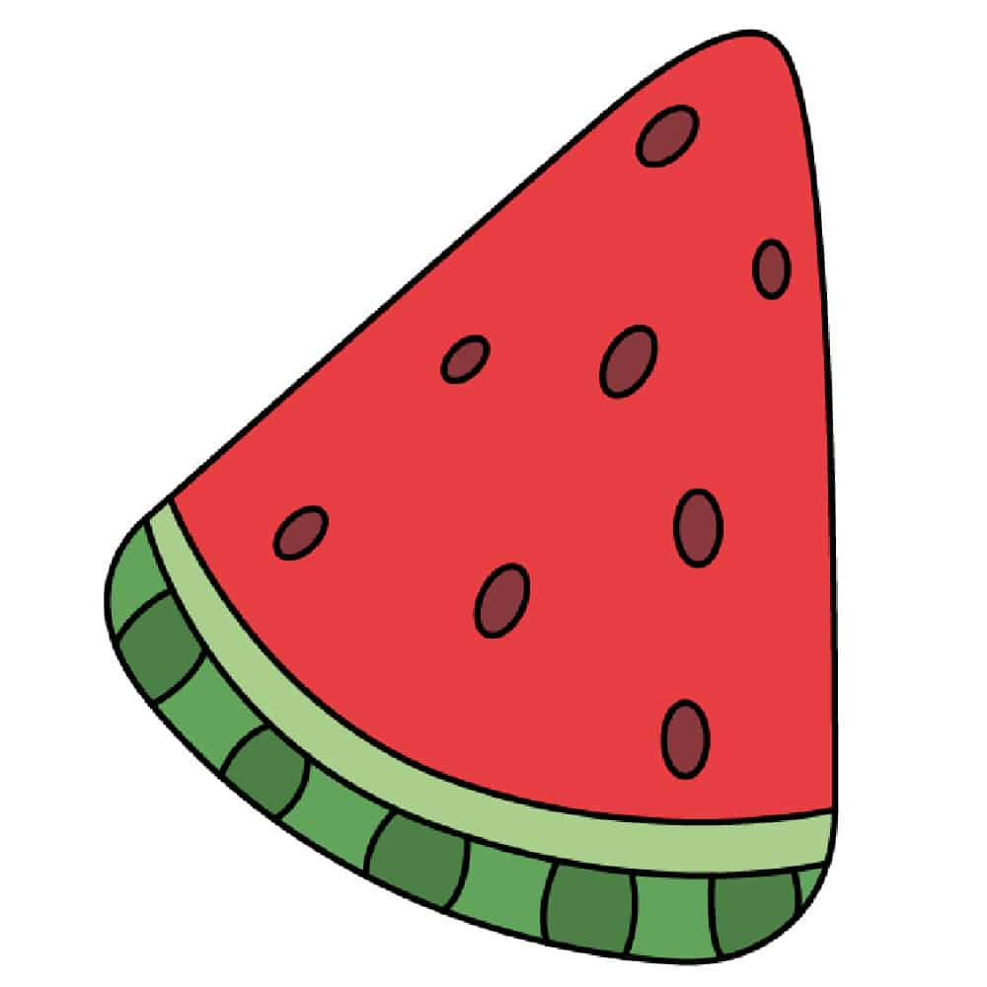

Slide 4
Wendy the Whale Waves Hello
Leo the Lion Loves Lollipops

Slide 5
Wendy the Whale swims in the wide ocean.

Slide 6
She sees a walrus on the warm sand.

Slide 7
Wendy splashes water with her tail.

Slide 8
“Hello, friends!” says Wendy with a big smile.

Slide 9
W is for Whale
W is for Walrus

